Slide 1
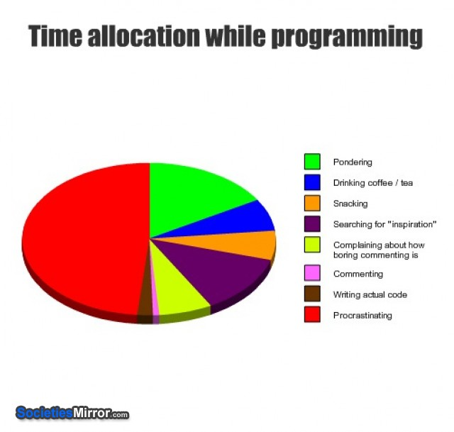

Slide 2
Announcements
APT Set 3 – due tomorrow
Exam review Monday
Come with questions
Exam review 2
Tuesday, 7:30pm, Here!
Run by Jimmy
Exam Wednesday

Slide 3
Today
Write a Linked List from scratch
Intro to next assignment
myHead
myTail
h
e
l
o

Slide 4
Linked List
LinkedList
Nodes
data
pointer to the next node
Pointer to beginning and (sometimes) end
myHead
myTail
h
e
l
o

Slide 5
LinkedLists
Code example
Inner class
public class Node{
int myData;
Node myNext;
public Node(int data, Node next){
myData = data;
myNext = next;
}
}
e

Slide 6
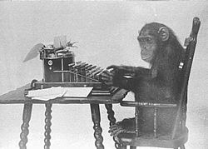
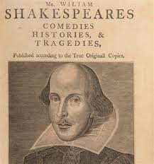
Markov
The infinite monkey theorem

Slide 7
Markov
Training text
ex. Huckleberry Finn
Build a map from text
‘e’ is followed by ‘a’ 30% of the time
‘a’ is followed by ‘t’ 20% of the time
Generate random text

Slide 8
Markov
“bbbabbabbbbaba”
3-gram
bbb

Slide 9
Markov
“bbbabbabbbbaba”
3-gram
bbb | bba

Slide 10
Markov
“bbbabbabbbbaba”
3-gram
bbb | bba
bba | bab

Slide 11
Markov
“bbbabbabbbbaba”
3-gram
bbb | bba
bba | bab
bab | abb

Slide 12
Markov
“bbbabbabbbbaba”
3-gram
bbb | bba
bba | bab
bab | abb
abb | bba

Slide 13
Markov
“bbbabbabbbbaba”
3-gram
bbb | bba
bba | bab | bab
bab | abb
abb | bba

Slide 14
Markov
“bbbabbabbbbaba”
3-gram
bbb | bba
bba | bab | bab
bab | abb | abb
abb | bba

Slide 15
Markov
“bbbabbabbbbaba”
3-gram
bbb | bba
bba | bab | bab
bab | abb | abb
abb | bba | bbb

Slide 16
Markov
“bbbabbabbbbaba”
3-gram
bbb | bba | bbb
bba | bab | bab
bab | abb | abb
abb | bba | bbb

Slide 17
Markov
“bbbabbabbbbaba”
3-gram
bbb | bba | bbb | bba
bba | bab | bab
bab | abb | abb
abb | bba | bbb

Slide 18
Markov
“bbbabbabbbbaba”
3-gram
bbb | bba | bbb | bba
bba | bab | bab | bab
bab | abb | abb
abb | bba | bbb

Slide 19
Markov
“bbbabbabbbbaba”
3-gram
bbb | bba | bbb | bba
bba | bab | bab | bab
bab | abb | abb | aba
abb | bba | bbb

Slide 20
Markov
“bbbabbabbbbaba”
3-gram
bbb | bba | bbb | bba
bba | bab | bab | bab
bab | abb | abb | aba
abb | bba | bbb
aba | bab

Slide 21
Markov
“bbbabbabbbbaba”
“bbb” followed by “bba” 66% and “bbb” 33%
“bba” always followed by “bab”
3-gram
bbb | bba | bbb | bba
bba | bab | bab | bab
bab | abb | abb | aba
abb | bba | bbb
aba | bab

Slide 22
Markov
Training text
ex. Huckleberry Finn
Build a map from text
‘e’ is followed by ‘a’ 30% of the time
‘a’ is followed by ‘t’ 20% of the time
Generate random text

Slide 23
Today
Write a Linked List from scratch
Intro to next assignment
myHead
myTail
h
e
l
o

