Slide 1
CS 356: Computer Network Architectures
Lecture 14: Advanced Internetworking
[PD] Chapter 4.1, 4.2
Xiaowei Yang
xwy@cs.duke.edu

Slide 2
Problems
How do we build a routing system that can handle hundreds of thousands of networks and billions of end nodes?
How to handle address space exhaustion of IPV4?
How to enhance the functionalities of Internet?

Slide 3
Outline
Virtual networks and IP tunnels
IPv6
IP Multicast
  Protocols
  Challenges
    Reliability
    Scalability
    Heterogeneity
Midterm

Slide 4
Virtual private networks
Constrained connectivity is desirable for security reasons
Dedicated leased lines are expensive
➔ Build virtual networks that share physical links and switches

Slide 5
How to build a virtual network?
Virtual circuits
IP tunnels

Slide 6
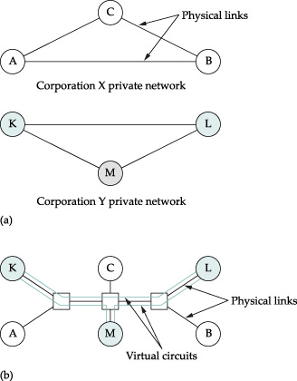
VPN with virtual circuits

Slide 7

IP tunnels
12.3.0.1
18.5.0.1
10/8
20/8
0
R1
1
R2
12.3.0.1
10.0.0.1
18.5.0.1
10.0.0.1
20.0.0.1
10.0.0.1
20.0.0.1
20.0.0.1
A “pseudo wire”, or a virtual point-to-point link
The head router encapsulates a packet in an outer header destined to the tail router

Slide 8
Virtual interface
A router adds a tunnel header for packets sent to a virtual interface
NetworkNum | nextHop
10/8 | ether0
20/8 | tun0
0/0 | ether1

Slide 9
Other tunnel applications
Traversing a region of network with a different addressing format or with insufficient routing knowledge
Mobile IP (later)

Slide 10
IPv4-v6 transition
IPv6
IPv4
IPv6
R1
R2
IPv6
IPv4
IPv6
IPv6

Slide 11
Mbone: multicast backbone
Multicast
enabled
Non
multicast
Multicast
enabled
R1
R2
G
Unicast header
G
G

Slide 12
Outline
Virtual networks and IP tunnels
IPv6
IP Multicast
  Protocols
  Challenges
    Reliability
    Scalability
    Heterogeneity
Midterm

Slide 13
Next Generation IP (IPv6)

Slide 14
Major Features
128-bit addresses
Multicast
Real-time service
Authentication and security
Auto-configuration
End-to-end fragmentation
Enhanced routing functionality, including support for mobile hosts

Slide 15
IPv6 Addresses
Classless addressing/routing (similar to CIDR)
Notation: x:x:x:x:x:x:x:x (x = 16-bit hex number)
  contiguous 0s are compressed: 47CD::A456:0124
  IPv6 compatible IPv4 address:
  ::FFFF:128.42.1.87
Address assignment
  provider-based
  geographic

Slide 16
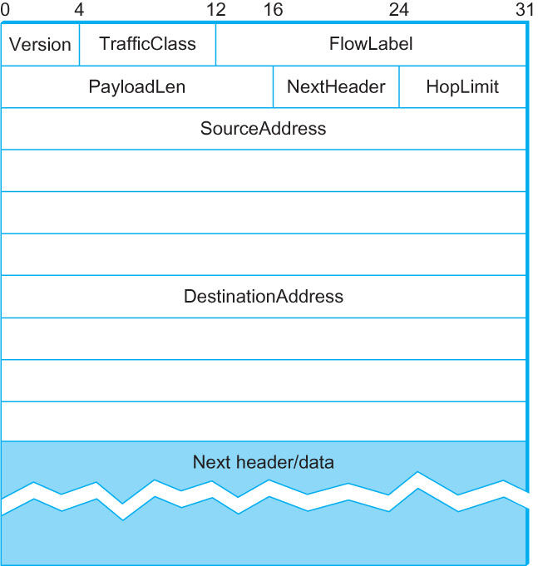
IPv6 Header
40-byte “base” header
Extension headers (fixed order, mostly fixed length)
  fragmentation
  source routing
  authentication and
  security
  other options

Slide 17
IP Multicast

Slide 18
What is Multicast
Many-to-many communications
Applications
  Internet radio
  Video conferencing
  News dissemination

Slide 19
Communication models
Unicast
  One-to-one
  Unicast routing
Multicast
Anycast
Broadcast
Notes:
Internet radio, tv broadcast, pub/sub, news, stock quotes..
Packet duplication, app needs to track all recipients

Slide 20
Design questions
How does a sender know who is interested in the packet?
  Each sender maintains the group membership?
How to send a packet to each receiver?

Slide 21
Multicast Architecture
Nodes interested in many-to-many communications form a multicast group
Each group is assigned a multicast address
Routers establish forwarding state to multicast addresses
Members of a multicast group receives packets sent to the group’s multicast address

Slide 22
Group Management
Routers maintain which outgoing links connect to multicast group members
A host signals to its local router its desire to join or leave a group
  Internet Group Management protocol (IPv4)
  Multicast Listener Discovery (IPv6)

Slide 23
Multicast Addresses
IPv4: 224.0.0.0/4 (28 bits)
IPv6: 1111 1111 / 8
Mapping an IP multicast address to an Ethernet multicast address
  01-00-5E-00-00-00 to 01-00-5E-7F-FF-FF
  Internet Multicast [RFC1112]
  Map the lower-order 23-bit IP address to Ethernet multicast address
IPv6 has a similar mapping scheme
Notes:
http://www.iana.org/assignments/ethernet-numbers
In the normal Internet dotted decimal notation this is 0.0.94 since the bytes are transmitted higher order first and bits within bytes are transmitted lower order first.
33-33-00-00-00-00 to 33-33-FF-FF-FF-FF are used for IPv6 multicast

Slide 24
Receiving a Multicast Packet
Host configures the network adaptor to listen to the multicast group
Examine the IP multicast address, and discard packets from non-interested groups

Slide 25
Types of multicast
Any source multicast
  Many-to-many
  A receiver does not specify a sender
Source specific multicast
  A receiver specifies both the group and the sender
  TV, radio channels

Slide 26
Design questions
How does a sender know who is interested in the packet?
  Sends to a multicast group
  Receivers join the group
  Routers maintain the group membership
How to send a packet to each receiver?
  Unicast?
  Flooding?

Slide 27

Multicast routing
224.16.0.10 | eth0
 | eth1
eth0
eth1
Multicast distribution trees: multiple outgoing interfaces for a multicast destination address

Slide 28
Distance Vector Multicast Routing Protocol
Using existing distance vector routing protocol
Establish multicast forwarding state
  Flood to all destinations (reverse path flooding)
    Key design challenge: loop-avoidance
    Q: how many broadcast loop-avoidance mechanisms have we learned?
  Prone those not in the group

Slide 29
Reverse path flooding
S
Reverse shortest-path flooding
  If packet comes from link L, and next hop to S is L, broadcast to all outgoing links except the incoming one
Packets do not loop back
  Why?
Notes:
Thus, whenever it receives a multicast packet from source S, the router forwards the packet on all outgoing links (except the one on which the packet arrived) if and only if the packet arrived over the link that is on the shortest path to S (i.e., the packet came from the NextHop associated with S in the routing table).

Slide 30
Problems with RPF
S
R2
R1
Problems
  multiple routers on a LAN → receiving multiple copies of packets
  Not all hosts are in the multicast group. Broadcast is a waste

Slide 31
Designated router election
R2
R1
Address the duplicate broadcast packet problem
Routers on the same LAN elect a parent that has shortest distance to S
  Parent is one with shortest path
    Routers can learn this from DV routing messages
  If tie, elect one with smaller router ID

Slide 32
Truncated reverse path flooding
Start with a full broadcast tree to all links (RPB)
Prune unnecessary links
  Hosts interested in G periodically announce membership
  If a leaf network does not have any member, sends a prune message to parent
    Augment distance vector to propagate groups interested to other routers
    Only do so when S starts to multicast
  This prune message can be propagated from router to router to prune non-interested branches

Slide 33
A pruning example
Prune
R2
R1
G

Slide 34
Protocol Independent Multicast (PIM)
Problem with DVMRP
  Broadcast is inefficient if few nodes are interested
  Most routers must explicitly send prune messages
  Dependent on routing protocols
Solution
  Dense mode: flood & prune similar to DVMRP
  Sparse mode: send join messages to rendezvous point (RP)
  Not dependent on any unicast routing protocol, unlike DVMRP

Slide 35
PIM-SM
Routers explicitly join a shared distribution tree
  Unlike DVMRP which starts from a broadcast tree
Source-specific trees are created later for more efficient distribution if there is sufficient traffic

Slide 36
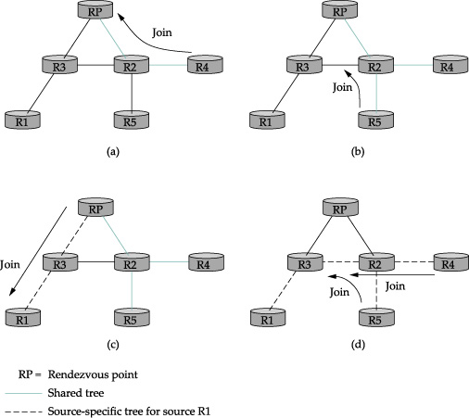
PIM-SM
(*, G), if
(a): R4 joins the multicast group
(b): R5 joins the group
  The Join message travesl to R2
Notes:
To do so, it constructs a packet with the appropriate multicast group address as its destination and sends it to a router on its local network known as the designated router (DR). Suppose the DR is R1 in Figure 4.14. There is no state for this multicast group between R1 and the RP at this point, so instead of simply forwarding the multicast packet, R1 tunnels it to the RP. That is, R1 encapsulates the multicast packet inside a PIM Register message that it sends to the unicast IP address of the RP. Just like a tun- nel endpoint of the sort described in Section 3.2.9, the RP receives the packet addressed to it, looks at the payload of the Register message, and finds inside an IP packet addressed to the multicast address of this group. The RP, of course, does know what to do with such a packet—it sends it out onto the shared tree of which the RP is the root. In the example of Figure 4.14, this means that the RP sends the packet on to R2, which is able to forward it on to R4 and R5. The complete delivery of a packet from R1 to R4 and R5 is shown in Figure 4.15. We see the tunneled packet travel from R1 to the RP with an extra IP header containing the unicast address of RP, and then the multicast packet addressed to G making its way along the shared tree to R4 and R5.

Slide 37
Join
PIM-SM assigns each group a special router known as the rendezvous point (RP)
A router that has hosts interested in G sends a Join message to RP
A router looks at the join message and create a multicast routing entry (*,G) pointing to the incoming interface. This is called an all sender forwarding entry
It propagates join to previous hop closer to RP

Slide 38
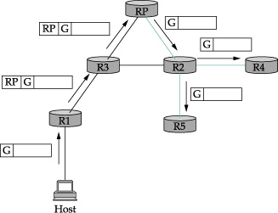
Forwarding along a shared tree
If a source S wishes to send to the group
  S sends a packet to its designated router (R1) with the multicast group as the destination address
  R1 encapsulates the packet into a PIM register message, unicast it to RP
PR decapsulates it and forwards to the shared trees

Slide 39
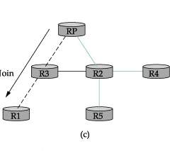
Source specific tree
Problems
  Encapsulation is inefficient
Solution:
  RP sends Join message to source S
  R3 now knows the group (S,G)

Slide 40
Source specific tree
Problem: shared trees are inefficient as paths could be longer than shortest path
Solution
  If s sends at high rates, routers send source-specific Join messages
  Trees may no longer involve RP

Slide 41
PIM-SM
(s,G), if
R1 is the source

Slide 42
PIM: final remarks
Unicast independent
  Assuming a unicast routing protocol has established correct forwarding state
Scalability challenges
  Per (S,G) forwarding state!

Slide 43
Inter-domain multicast
Problem: how can the entire Internet agree on a single RP for a group G?
Multicast Source Discovery Protocol
  Hierarchical
  Intra-domain: PIM-SM
  Inter-domain: a distribution tree among all domain’s RPs

Slide 44
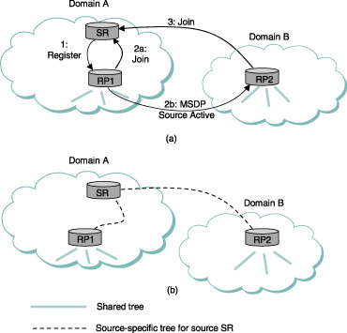
RP uses its shared trees to forward to receivers in its domain
Notes:
A hierarchical design similar to intra- and inter-domain routing protocols
Each domain runs PIM-SM internally
RPs of each domains form an overlay mesh using TCP connection (similar to BGP sessions)
An RP periodically broadcasts active sources to peer RPs: (S,G)
Reverse path forwarding
A peer RP that has active receivers sends join to S on behalf of the receivers
If an MSDP peer RP that receives one of these broadcasts has active receivers for that multicast group, it sends a source-specific Join, on that RP’s own behalf, to the source host, as shown in Figure 4.16(a). The Join message builds a branch of the source-specific tree to this RP, as shown in Figure 4.16(b). The result is that every RP that is part of the MSDP network and has active receivers for a particular multicast group is added to the source-specific tree of the new source. When an RP receives a multicast from the source, the RP uses its shared tree to forward the multicast to the receivers in its domain.

Slide 45
Source-specific multicast (PIM-SSM)
One-to-many
  Considered more common than many-to-many
Channel: (S,G)
Hosts join a channel
Join messages are propagated to S to create a source specific tree
Only S can use the tree
Advantages
  More efficient distribution than shared tree
  More multicast groups
  More secure: only S can send
  No need for MSDR

Slide 46
Remarks on IP multicast
Many design choices
Facing many challenges: used to be a very active resource topic
  Economic model’s not clear: who pays for the service?
  Reliability
  Scalability
  Heterogeneity

Slide 47
Reliable multicast
Problems
  Acknowledgment implosion
  Retransmission exposure

Slide 48
Implosion
Packet 1 is lost
All 4 receivers request a resend
S
Resend request
S
1
2
R1
R1
R2
R2
R3
R4
R3
R4

Slide 49
Retransmission
Re-transmitter
  Options: sender, other receivers
How to retransmit
  Unicast, multicast, scoped multicast, retransmission group, …
Problem: Exposure

Slide 50
Exposure
Packet 1 does not reach R1;
Receiver 1 requests a resend
Packet 1 resent to all 4 receivers
Resend request
S
Resent packet
S
1
2
1
R1
1
R1
R2
R2
R3
R4
R3
R4

Slide 51
Ideal Recovery Model
Packet 1 reaches R1 but is lost before reaching other Receivers
Only one receiver sends NACK to the nearest S or R with packet
S
Resend request
S
Repair sent only to those that need packet
Resent packet
1
2
1
R1
R1
1
R2
R2
R3
R4
R3
R4

Slide 52
Multicast Challenges
Reliability
Scalability
Heterogeneity

Slide 53
Supporting Multicast on the Internet
At which layer should multicast be implemented?
Can routers afford (s,G) state?
Who pays to create a multicast group?
  Botnets
Application
?
IP
?
Network
Internet architecture
Notes:
In the hourglass Internet architecture,
IP is the compatibility layer in the Internet architecture.
All hosts must implement IP
Two choices
multicast at IP
or application: only a subset, customizability
One important architecture question is, at which layer should multicast be implemented.
The convention wisdom has been to support multicast in the IP layer for efficiency and performance reasons. However, more than 10 years since this is proposed, it still has not been widely deployed.
This paper revisits this question with emphasis on Internet evaluation. In particular, we show that multicast at the application layer can be efficient compared to IP Multicast.

Slide 54
End System Multicast
MIT1
MIT
Berkeley
MIT2
UCSD
CMU1
CMU
CMU2
Berkeley
MIT1
Overlay Tree
MIT2
UCSD
CMU1
CMU2
Notes:
Recently, we and others have advocated for an alternative architecture, where all multicast functionality, including pkt replication and group management are pushed to end systems.
- We call this architecture End System Multicast
- In this architecture, end system organize themselves into an overlay tree root at the source
- data is sent along the overlay tree.
- It is an overlay in the sense that each link in the overlay tree corresponds to a physical path in the underlying network

Slide 55
Multicast Challenges
Reliability
Scalability
Heterogeneity

Slide 56
Multicast sending rates
What if receivers have very different bandwidths?
Send at max?
Send at min?
Send at avg?
100Mb/s
100Mb/s
R
S
R
1Mb/s
???Mb/s
1Mb/s
R
56Kb/s
R

Slide 57
Video Adaptation: RLM
Receiver-driven Layered Multicast
Layered video encoding
Each layer uses its own multicast group
On spare capacity, receivers add a layer
On congestion, receivers drop a layer
Join experiments used for shared learning

Slide 58
Layered Media Streams
R1 joins layer 1,
joins layer 2
joins layer 3
R2
R1
10Mbps
10Mbps
R2 join layer 1,
join layer 2
fails at layer 3
S
R
512Kbps
10Mbps
R
128Kbps
R3
R3 joins layer 1,
fails at layer 2

Slide 59
What we’ve learned
Network architectures
  Basic concepts, Internet architecture,
Physical layer
  Delay, bandwidth, and throughput
Link layer
  Coding/encoding, framing, error detection, reliable transmission
  Multi-access links
  Switching, bridges, ATM

Slide 60
What we’ve learned (cont.)
Internetworking
  Challenges, solutions
  Classful vs classless IP addressing
  IP forwarding, longest prefix lookup, ARP
  DHCP
  Dynamic routing protocols
    Distance vector (RIP)
    Link state (OSPF)

