Slide 1
CS 356: Introduction to Computer Networks
Lecture 16: Transmission Control Protocol (TCP)
Xiaowei Yang
xwy@cs.duke.edu

Slide 2
Overview
TCP
  Connection management
  Flow control
  When to transmit a segment
  Adaptive retransmission
  TCP options
  Modern extensions
  Congestion Control

Slide 3
Transmission Control Protocol
Connection-oriented protocol
Provides a reliable unicast end-to-end byte stream over an unreliable internetwork

Slide 4
Flow control

Slide 5
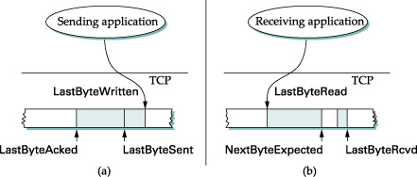
Sliding window revisited
Sender Window Size
Receiver Window Size
Invariants
  LastByteAcked ≤ LastByteSent
  LastByteSent ≤ LastByteWritten
  LastByteRead < NextByteExpected
  NextByteExpected ≤ LastByteRcvd + 1
Limited sending buffer and Receiving buffer

Slide 6
Buffer Sizes vs Window Sizes
Maximum SWS ≤ MaxSndBuf
Maximum RWS ≤ MaxRcvBuf – ((NextByteExpected-1) – LastByteRead)

Slide 7
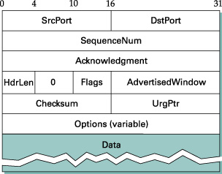
TCP Flow Control
Q: how does a receiver prevent a sender from overrunning its buffer?
A: use AdvertisedWindow
Notes:
A TCP receiver uses the window size field to inform a sender its maximum available receive buffer

Slide 8
Invariants for flow control
Receiver side:
  LastByteRcvd – LastByteRead ≤ MaxRcvBuf
  AdvertisedWindow = MaxRcvBuf – ((NextByteExpected - 1) – LastByteRead)

Slide 9
Invariants for flow control
Sender side:
  MaxSWS = LastByteSent – LastByteAcked ≤ AdvertisedWindow
  LastByteWritten – LastByteAcked ≤ MaxSndBuf
    Sender process would be blocked if send buffer is full

Slide 10
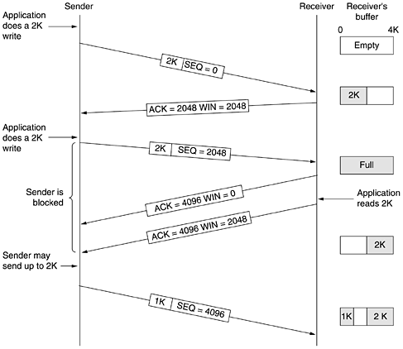

Slide 11
Window probes
What if a receiver advertises a window size of zero?
  Problem: Receiver can’t send more ACKs as sender stops sending more data
Design choices
  Receivers send duplicate ACKs when window opens
  Sender sends periodic 1 byte probes
Why?
  Keeping the receive side simple → Smart sender/dumb receiver

Slide 12
When to send a segment?
App writes bytes to a TCP socket
TCP decides when to send a segment
Design choices when window opens:
  Send whenever data available
  Send when collected Maximum Segment Size data
    Why?

Slide 13
Push flag
What if App is interactive, e.g. ssh?
  App sets the PUSH flag
  Flush the sent buffer

Slide 14
Silly Window Syndrome
Now considers flow control
  Window opens, but does not have MSS bytes
Design choice 1: send all it has
    E.g., sender sends 1 byte, receiver acks 1, acks opens the window by 1 byte, sender sends another 1 byte, and so on

Slide 15
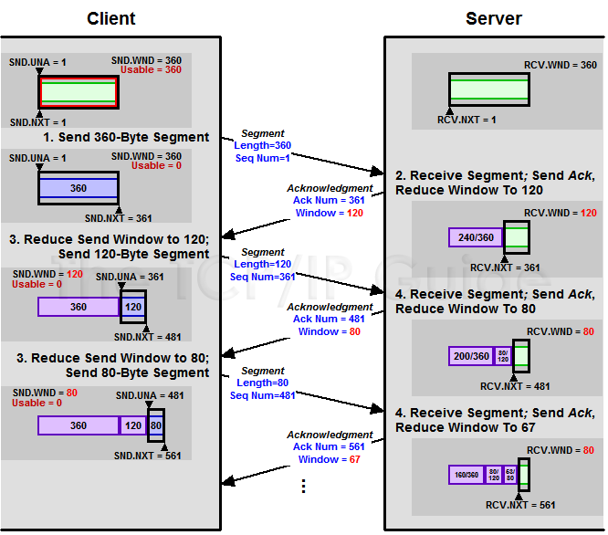
Sending smaller segments

Slide 16
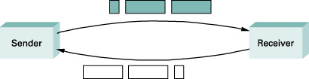
Silly Window Syndrome
Notes:
If you think of a TCP stream as a conveyer belt with “full” containers (data segments) going in one direction and empty containers (ACKs) going in the reverse direction, then MSS-sized segments correspond to large containers and 1-byte segments correspond to very small containers.
If the sender aggressively fills an empty container as soon as it arrives, then any small container introduced into the system remains in the system indefinitely.
That is, it is immediately filled and emptied at each end, and never coalesced with adjacent containers to create larger containers.

Slide 17
How to avoid Silly Window Syndrome
Receiver side
  Do not advertise small window sizes
  Min(MSS, MaxRecBuf/2)
Sender side
  Wait until it has a large segment to send
  Q: How long should a sender wait?

Slide 18
Sender-Side Silly Window Syndrome avoidance
Nagle’s Algorithm
  Self-clocking
Interactive applications may turn off Nagle’s algorithm using the TCP_NODELAY socket option
When app has data to send
if data and window >= MSS
send a full segment
else
if there is unACKed data
buf new data until ACK
else
send all the new data now
Notes:
If not enough data, sender waits for a virtual timer to time out and transmits
Virtual timer is driven by a returning ACK (roughly a RTT time)

Slide 19
TCP window management summary
Receiver uses AdvertisedWindow for flow control
Sender sends probes when AdvertisedWindow reaches zero
Silly Window Syndrome avoidance
  Receiver: do not advertise small windows
  Sender: Nagle’s algorithm

Slide 20
Overview
TCP
  Connection management
  Flow control
  When to transmit a segment
  Adaptive retransmission
  TCP options
  Modern extensions
  Congestion Control

Slide 21
TCP Retransmission
A TCP sender retransmits a segment when it assumes that the segment has been lost
How does a TCP sender detect a segment loss?
  Timeout
  Duplicate ACKs (later)

Slide 22
How to set the timer
Challenge: RTT unknown and variable
Too small
  Results in unnecessary retransmissions
Too large
  Long waiting time

Slide 23
Adaptive retransmission
Estimate a RTO value based on round-trip time (RTT) measurements
Implementation: one timer per connection
Q: Retransmitted segments?
Notes:
Each TCP connection measures the time difference between the transmission of a segment and the receipt of the corresponding ACK
Figure on the right shows three RTT measurements

Slide 24
Karn’s Algorithm
Ambiguity
Solution: Karn’s Algorithm:
  Don’t update RTT on any segments that have been retransmitted
Notes:
If an ACK for a retransmitted segment is received, the sender cannot tell if the ACK belongs to the original or the retransmission.
→ RTT measurements is ambiguous in this case

Slide 25
Setting the RTO value
Uses an exponential moving average (a low-pass filter) to estimate RTT (srtt) and variance of RTT (rttvar)
  The influence of past samples decrease exponentially
The RTT measurements are smoothed by the following estimators srtt and rttvar:
srtt_{n+1} = α RTT + (1- α ) srtt_{n}
rttvar_{n+1} = β ( | RTT – srtt_{n} | ) + (1- β ) rttvar_{n}
RTO_{n+1} = srtt_{n+1} + 4 rttvar_{n+1}
  The gains are set to α =1/4 and β =1/8
  Negative power of 2 makes it efficient for implementation

Slide 26
Setting the RTO value (cont’d)
Initial value for RTO:
  Sender should set the initial value of RTO to
    RTO₀ = 3 seconds
RTO calculation after first RTT measurements arrived
srtt₁ = RTT
rttvar₁ = RTT / 2
RTO₁ = srtt₁ + 4 rttvar_{n+1}
When a timeout occurs , the RTO value is doubled
RTO_{n+1} = max ( 2 RTO_{n} , 64) seconds
  This is called an exponential backoff
Notes:
http://www.ietf.org/rfc/rfc2988.txt

Slide 27
Overview
TCP
  Connection management
  Flow control
  When to transmit a segment
  Adaptive retransmission
  TCP options
  Modern extensions
  Congestion Control

Slide 28
TCP header fields
Options: (type, length, value)
TCP hdrlen field tells how long options are

Slide 29
TCP header fields
Options:
  NOP is used to pad TCP header to multiples of 4 bytes
  Maximum Segment Size
  Window Scale Options
    Increases the TCP window from 16 to 32 bits, i.e., the window size is interpreted differently
    This option can only be used in the SYN segment (first segment) during connection establishment time
  Timestamp Option
    Can be used for roundtrip measurements

Slide 30
Modern TCP extensions
Timestamp
Window scaling factor
Protection Against Wrapped Sequence Numbers (PAWS)
Selective Acknowledgement (SACK)
References
  http://www.ietf.org/rfc/rfc1323.txt
  http://www.ietf.org/rfc/rfc2018.txt

Slide 31
Improving RTT estimate
TCP timestamp option
  Old design
    One sample per RTT
    Using host timer
More samples to estimate
  Timestamp option
    Current TS, echo TS

Slide 32
Increase TCP window size
16-bit window size
Maximum send window <= 65535B
Suppose a RTT is 100ms
Max TCP throughput = 65KB/100ms = 5Mbps
Not good enough for modern high speed links!

Slide 33
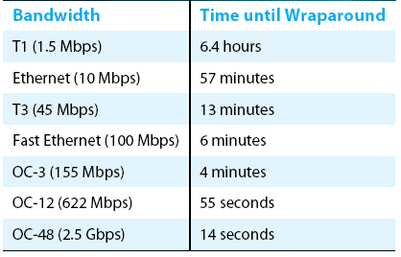
Protecting against Wraparound
Time until 32-bit sequence number space wraps around.

Slide 34
Solution: Window scaling option
Kind = 3
Length = 3
Shift.cnt
Three bytes
All windows are treated as 32-bit
Negotiating shift.cnt in SYN packets
  Ignore if SYN flag not set
Sending TCP
  Real available buffer >> self.shift.cnt → AdvertisedWindow
Receiving TCP: stores other.shift.cnt
  AdvertisedWindow << other.shift.cnt → Maximum Sending Window
Notes:
All windows are treated as 32-bit stored in connection control block
is negotiated during connection setup, carried

Slide 35
Protect Against Wrapped Sequence Number
32-bit sequence number space
Why sequence numbers may wrap around?
  High speed link
  On an OC-45 (2.5Gbps), it takes 14 seconds < 2MSL
Solution: compare timestamps
  Receiver keeps recent timestamp
  Discard old timestamps

Slide 36
Selective Acknowledgement
More when we discuss congestion control
If there are holes, ack the contiguous received blocks to improve performance

Slide 37
Overview
Nitty-gritty details about TCP
  Connection management
  Flow control
  When to transmit a segment
  Adaptive retransmission
  TCP options
  Modern extensions
  Congestion Control
    How does TCP keeps the pipe full?

Slide 38
TCP Congestion Control

Slide 39
History
The original TCP/IP design did not include congestion control and avoidance
  Receiver uses advertised window to do flow control
  No exponential backoff after a timeout
It led to congestion collapse in October 1986
  The NSFnet phase-I backbone dropped three orders of magnitude from its capacity of 32 kbit/s to 40 bit/s, and continued until end nodes started implementing Van Jacobson's congestion control between 1987 and 1988.
  TCP retransmits too early, wasting the network’s bandwidth to retransmit packets already in transit and reducing useful throughput (goodput)

Slide 40
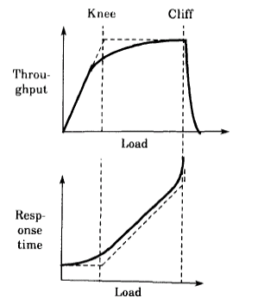
Design Goals
Congestion avoidance: making the system operate around the knee to obtain low latency and high throughput
Congestion control: making the system operate left to the cliff to avoid congestion collapse
Congestion avoidance: making the system operate around the knee to obtain low latency and high throughput
Congestion control: making the system operate left to the cliff to avoid congestion collapse

Slide 41
Key Improvements
RTT variance estimate
  Old design: RTT_{n+1} = α RTT + (1- α ) RTT_{n}
  RTO = β RTTn+1
Exponential backoff
Slow-start
Dynamic window sizing
Fast retransmit

Slide 42
Challenge
Send at the “right” speed
  Fast enough to keep the pipe full
  But not to overrun the “pipe”
    Drawback?
  Share nicely with other senders

Slide 43
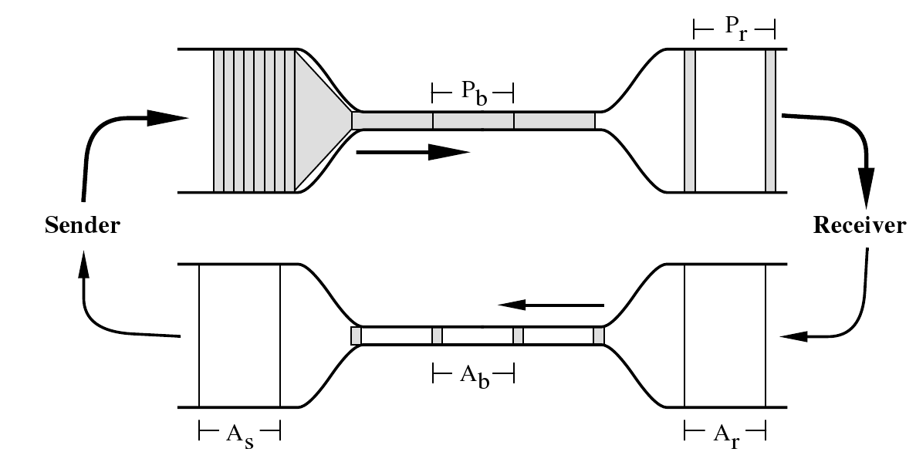
Key insight: packet conservation principle and self-clocking
When pipe is full, the speed of ACK returns equals to the speed new packets should be injected into the network

Slide 44
Solution: Dynamic window sizing
Sending speed: SWS / RTT
→ Adjusting SWS based on available bandwidth
The sender has two internal parameters:
  Congestion Window (cwnd)
  Slow-start threshold Value (ssthresh)
SWS is set to the minimum of (cwnd, receiver advertised win)

Slide 45
Two Modes of Congestion Control
Probing for the available bandwidth
  slow start (cwnd < ssthresh)
Avoid overloading the network
  congestion avoidance (cwnd >= ssthresh)

Slide 46
Slow Start
Initial value: Set cwnd = 1 MSS
    Modern TCP implementation may set initial cwnd to 2
When receiving an ACK, cwnd+= 1 MSS
    If an ACK acknowledges two segments, cwnd is still increased by only 1 segment.
    Even if ACK acknowledges a segment that is smaller than MSS bytes long, cwnd is increased by 1.
    Question: how can you accelerate your TCP download?
Notes:
Note: Unit is a segment size. TCP actually is based on bytes and increments by 1 MSS (maximum segment size)

Slide 47
Congestion Avoidance
If cwnd >= ssthresh then each time an ACK is received, increment cwnd as follows:
    cwnd += MSS * (MSS / cwnd) (cwnd measured in bytes)
So cwnd is increased by one MSS only if all cwnd/MSS segments have been acknowledged.

Slide 48
Example of
Slow Start/Congestion Avoidance
Assume ssthresh = 8 MSS
ssthresh
Cwnd (in segments)
Roundtrip times

Slide 49
Congestion detection
What would happen if a sender keeps increasing cwnd?
  Packet loss
TCP uses packet loss as a congestion signal
Loss detection
  Receipt of a duplicate ACK (cumulative ACK)
  Timeout of a retransmission timer

Slide 50
Reaction to Congestion
Reduce cwnd
Timeout: severe congestion
  cwnd is reset to one MSS:
      cwnd = 1 MSS
  ssthresh is set to half of the current size of the congestion window:
      ssthressh = cwnd / 2
  entering slow-start

Slide 51
Reaction to Congestion
Duplicate ACKs: not so congested (why?)
Fast retransmit
  Three duplicate ACKs indicate a packet loss
  Retransmit without timeout

Slide 52
Duplicate ACK example

Slide 53
Reaction to congestion: Fast Recovery
Avoiding slow start
  ssthresh = cwnd/2
  cwnd = cwnd+3MSS
  Increase cwnd by one MSS for each additional duplicate ACK
When ACK arrives that acknowledges “new data,” set:
  cwnd=ssthresh
  enter congestion avoidance

Slide 54
Flavors of TCP Congestion Control
TCP Tahoe (1988, FreeBSD 4.3 Tahoe)
  Slow Start
  Congestion Avoidance
  Fast Retransmit
TCP Reno (1990, FreeBSD 4.3 Reno)
  Fast Recovery
  Modern TCP implementation
New Reno (1996)
SACK (1996)

Slide 55
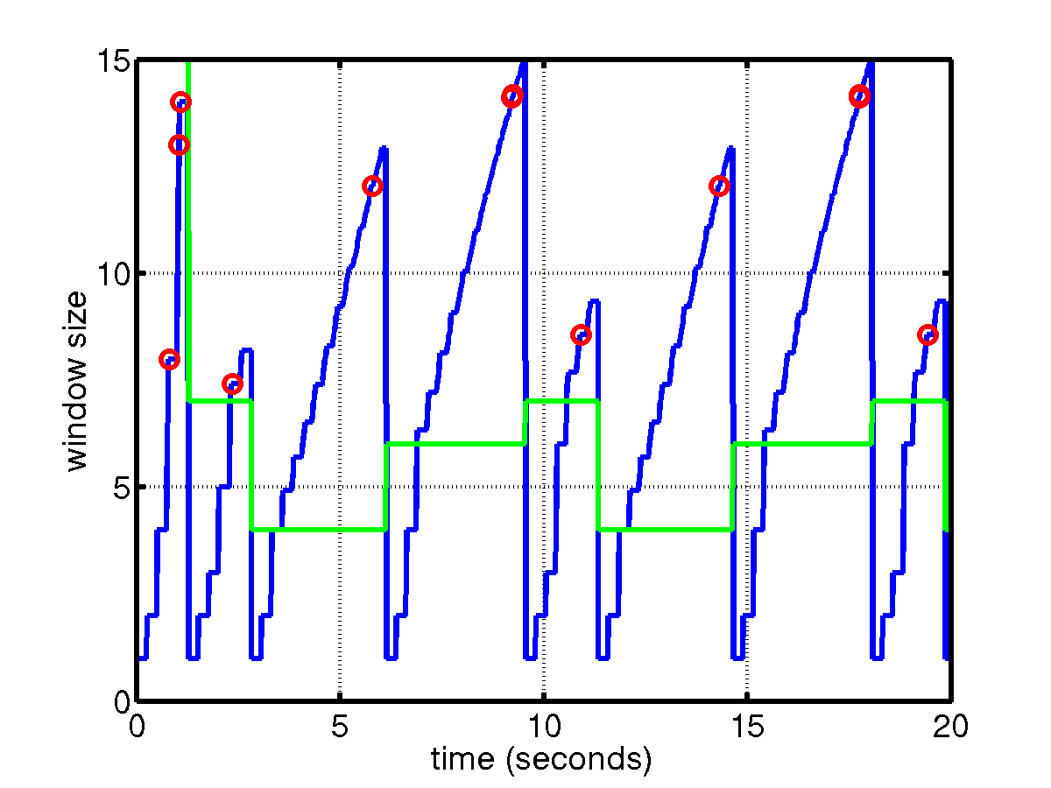
TCP Tahoe

Slide 56
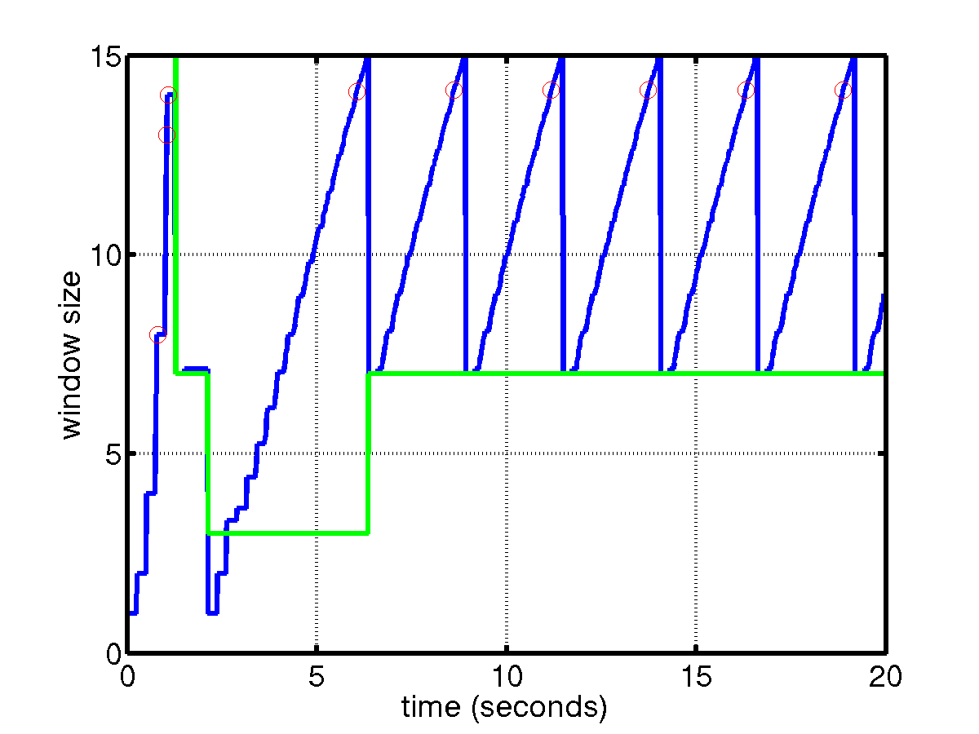
TCP Reno
TCP saw tooth
SS
CA
Fast retransmission/fast recovery

Slide 57
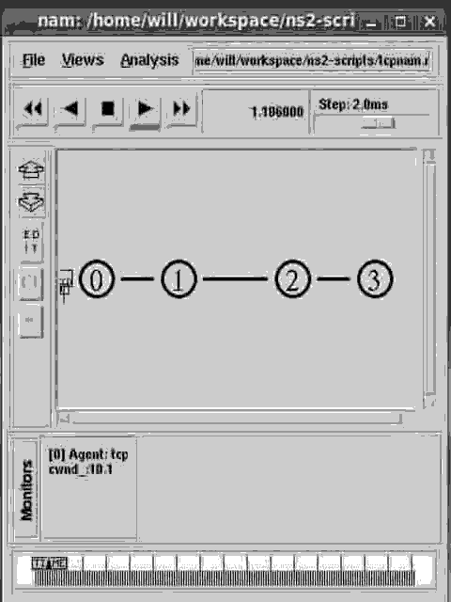

Slide 58
Summary
TCP
  Connection management
  Flow control
  When to transmit a segment
  Adaptive retransmission
  TCP options
  Modern extensions
  Congestion Control
Next: network resource management

Slide 59
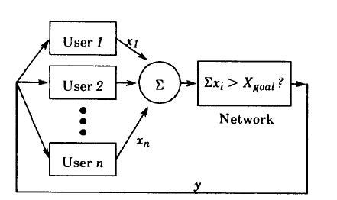
Why does it work? [Chiu-Jain]
  A feedback control system
  The network uses feedback y to adjust users’ load ∑x_i

Slide 60

Goals of Congestion Avoidance
  Efficiency: the closeness of the total load on the resource ot its knee
  Fairness:
    When all x_i’s are equal, F(x) = 1
    When all x_i’s are zero but x_j = 1, F(x) = 1/n
  Distributedness
    A centralized scheme requires complete knowledge of the state of the system
  Convergence
    The system approach the goal state from any starting state

Slide 61
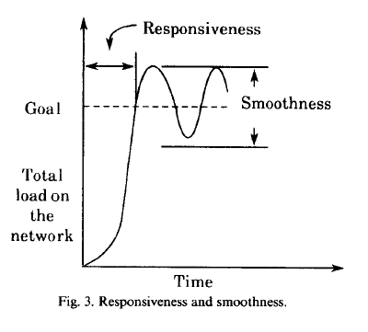
Metrics to measure convergence
Responsiveness
Smoothness

Slide 62
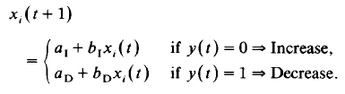
Model the system as a linear control system
Four sample types of controls
AIAD, AIMD, MIAD, MIMD

Slide 63
Phase plot
x₂
x₁
Notes:
1. efficiency line
2. fairness line
AIMD

Slide 64
Summary
TCP Congestion Control
  Slow start: cwnd +=1 for every ack received
  Congestion avoidance (cwnd > ssthresh):
    cwnd += MSS/cwnd
  After three duplicate ACKs
    ssthressh = cwnd / 2
    cwnd = ssthresh
Control Algorithm is Additive Increase and Multiplicative Decrease (AIMD)

