Slide 1
CS 356: Computer Network Architectures
Lecture 17: Network Resource Allocation
Chapter 6.1-6.4
Xiaowei Yang
xwy@cs.duke.edu

Slide 2
Overview
TCP congestion control
The problem of network resource allocation
  Case studies
    TCP congestion control
    Fair queuing
Congestion avoidance
  Case studies
    Router + Host
      DECbit, Active queue management
    Source-based congestion avoidance

Slide 3
Two Modes of Congestion Control
Probing for the available bandwidth
  slow start (cwnd < ssthresh)
Avoid overloading the network
  congestion avoidance (cwnd >= ssthresh)

Slide 4
Slow Start
Initial value: Set cwnd = 1 MSS
    Modern TCP implementation may set initial cwnd to 2
When receiving an ACK, cwnd+= 1 MSS
    If an ACK acknowledges two segments, cwnd is still increased by only 1 segment.
    Even if ACK acknowledges a segment that is smaller than MSS bytes long, cwnd is increased by 1.
    Question: how can you accelerate your TCP download?
Notes:
Note: Unit is a segment size. TCP actually is based on bytes and increments by 1 MSS (maximum segment size)

Slide 5
Congestion Avoidance
If cwnd >= ssthresh then each time an ACK is received, increment cwnd as follows:
    cwnd += MSS * (MSS / cwnd) (cwnd/MSS is the number of maximum sized segments within one cwnd)
So cwnd is increased by one MSS only if all cwnd/MSS segments have been acknowledged.

Slide 6
Example of
Slow Start/Congestion Avoidance
Assume ssthresh = 8 MSS
ssthresh
Cwnd (in segments)
Roundtrip times

Slide 7
Congestion detection
What would happen if a sender keeps increasing cwnd?
  Packet loss
TCP uses packet loss as a congestion signal
Loss detection
  Receipt of a duplicate ACK (cumulative ACK)
  Timeout of a retransmission timer

Slide 8
Reaction to Congestion
Reduce cwnd
Timeout: severe congestion
  cwnd is reset to one MSS:
      cwnd = 1 MSS
  ssthresh is set to half of the current size of the congestion window:
      ssthressh = cwnd / 2
  entering slow-start

Slide 9
Reaction to Congestion
Duplicate ACKs: not so congested (why?)
Fast retransmit
  Three duplicate ACKs indicate a packet loss
  Retransmit without timeout

Slide 10
Duplicate ACK example

Slide 11
Reaction to congestion: Fast Recovery
Avoiding slow start
  ssthresh = cwnd/2
  cwnd = cwnd+3MSS
  Increase cwnd by one MSS for each additional duplicate ACK
When ACK arrives that acknowledges “new data,” set:
  cwnd=ssthresh
  enter congestion avoidance

Slide 12
Flavors of TCP Congestion Control
TCP Tahoe (1988, FreeBSD 4.3 Tahoe)
  Slow Start
  Congestion Avoidance
  Fast Retransmit
TCP Reno (1990, FreeBSD 4.3 Reno)
  Fast Recovery
  Modern TCP implementation
New Reno (1996)
SACK (1996)

Slide 13
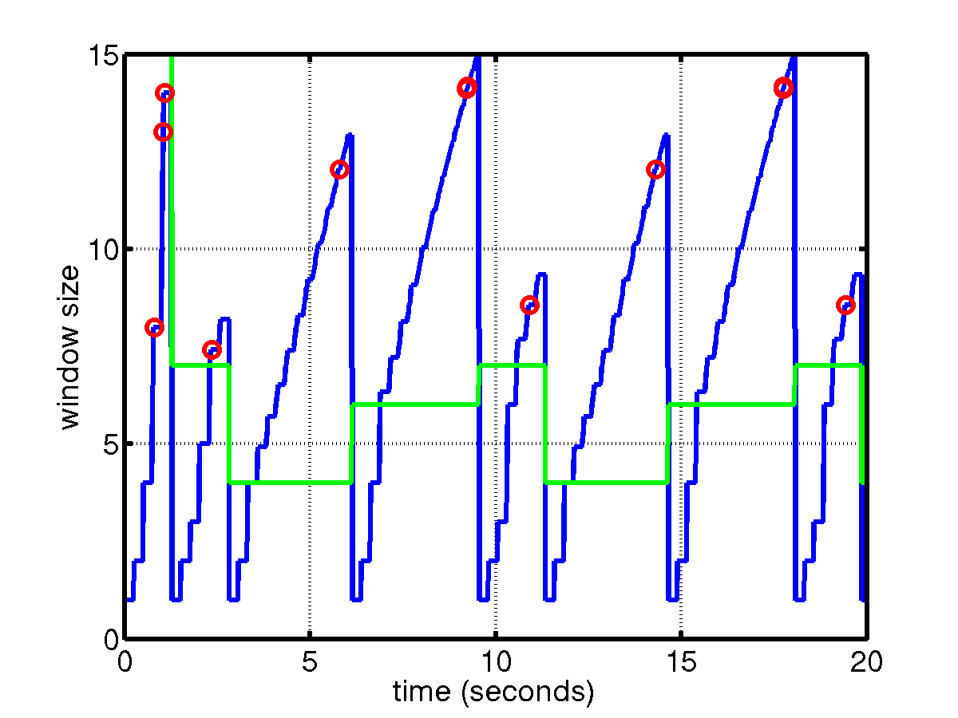
TCP Tahoe

Slide 14
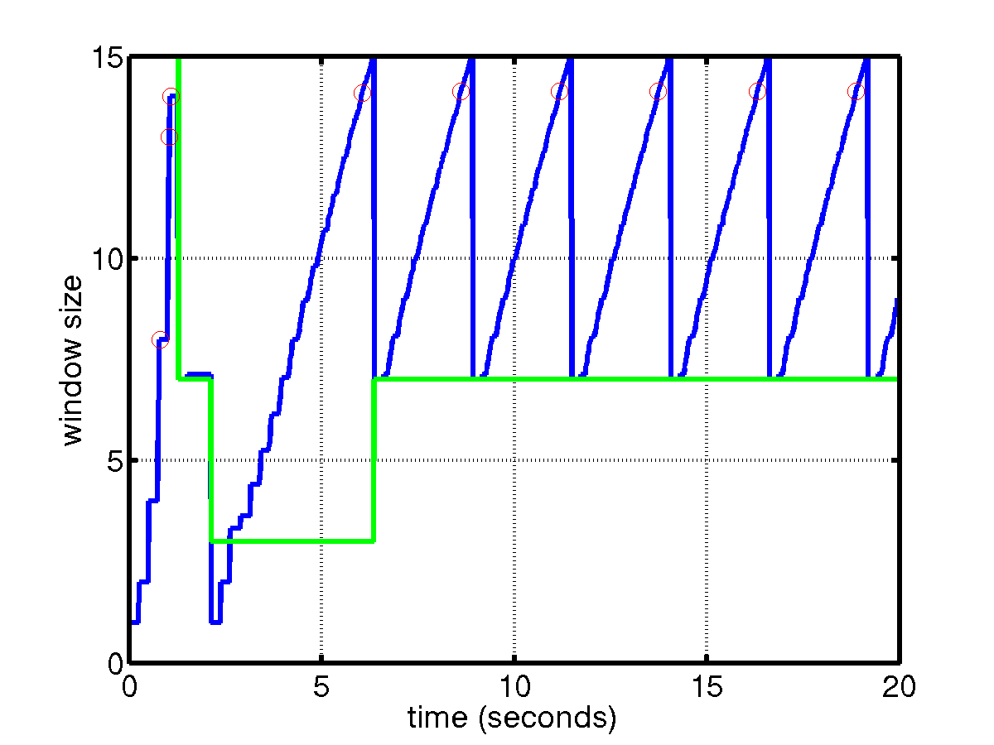
TCP Reno
TCP saw tooth
SS
CA
Fast retransmission/fast recovery

Slide 15
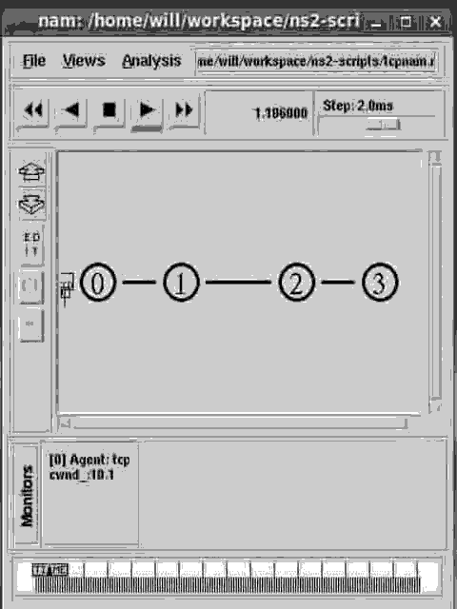

Slide 16
Overview
TCP congestion control
The problem of network resource allocation
  Case studies
    TCP congestion control
    Fair queuing
Congestion avoidance
  Case studies
    Router + Host
      DECbit, Active queue management
    Source-based congestion avoidance

Slide 17


Network resource allocation
...
Packet switching
Statistical multiplexing
Q: N users, and one bottleneck
  How fast should each user send?
  A difficult problem
    Each user/router does not know N
    Each user does not know the bottleneck capacity

Slide 18
Goals
Efficient: do not waste bandwidth
  Work-conserving
Fairness: do not discriminate users
  What is fair? (later)

Slide 19
Two high-level approaches
End-to-end congestion control
  End systems voluntarily adjust sending rates to achieve fairness and efficiency
  Good for old days
  Problematic today
    Why?
Router-enforced
  Fair queuing

Slide 20
End-to-end congestion control

Slide 21
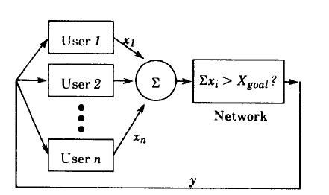
Model
  A feedback control system
  The network uses feedback y to adjust users’ load ∑x_i

Slide 22
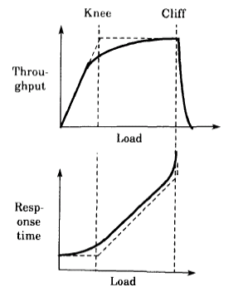

Goals
Efficiency: the closeness of the total load on the resource to its knee
Fairness:
  When all x_{i}’s are equal, F(x) = 1
  When all x_{i}’s are zero but x_{j} = 1, F(x) = 1/n
Distributed
Convergence
Notes:
A centralized scheme requires complete knowledge of the state of the system
The system approach the goal state from any starting state

Slide 23
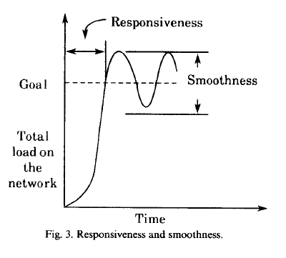
Metrics to measure convergence
Responsiveness
Smoothness

Slide 24
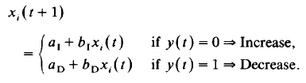
Model the system as a linear control system
Four sample types of controls
AIAD, AIMD, MIAD, MIMD
Questions: what type of control does TCP use?

Slide 25
TCP congestion control revisited
Cwnd
RTT
For every ACK received
  Cwnd += 1/cwnd
For every packet loss
  Cwnd /= 2

Slide 26
Does AIMD achieve fairness and efficiency?
x₂
Phase plot
x₁
Notes:
1. efficiency line
2. fairness line
AIMD

Slide 27
End-to-end congestion Control Challenges
Cwnd
Cwnd/2
RTT
Each source has to probe for its bandwidth
Congestion occurs first before TCP backs off
Unfair
  Long RTT flows obtain smaller bandwidth shares
  Malicious hosts, UDP applications

Slide 28
Macroscopic behavior of TCP
Throughput is inversely proportional to RTT, and
In a steady state, total packets sent in one sawtooth cycle:
  S = w/2 + (w/2+1) + … (w/2+w/2) = 3/8 w²
the maximum window size is determined by the loss rate
  p = 1/S
  w = sqrt(1/(3/8p))
The length of one cycle: w/2*RTT
Average throughput: 3/4 w * MSS / RTT

Slide 29
Router-enforced Resource Allocation

Slide 30
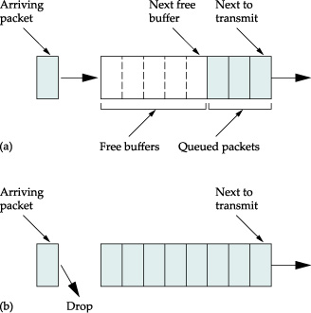
Router Mechanisms
Queuing
  Scheduling: which packets get transmitted
  Promptness: when do packets get transmitted
  Buffer: which packets are discarded
Ex: FIFO + DropTail
  Most widely used

Slide 31
Fair queuing
Using multiple queues to ensure fairness
Challenges
  Fair to whom?
    Source, Receiver, Process
    Flow / conversation: Src and Dst pair
      Flow is considered the best tradeoff
  What is fair?
    Maximize fairness index?
      Fairness = (Σx_{i})²/n(Σx_{i}²) 0<fairness<1
    What if a flow uses a long path?
    Tricky, no satisfactory solution, policy vs. mechanism

Slide 32
One definition: Max-min fairness
Many fair queuing algorithms aim to achieve this definition of fairness
Informally
  Allocate user with “small” demand what it wants, evenly divide unused resources to “big” users
Formally
  No user receives more than its request
  No other allocation satisfies 1 and has a higher minimum allocation
    Users that have higher requests and share the same bottleneck link have equal shares
  Remove the minimal user and reduce the total resource accordingly, 2 recursively holds

Slide 33
Max-min example
Increase all flows’ rates equally, until some users’ requests are satisfied or some links are saturated
Remove those users and reduce the resources and repeat step 1
  Assume sources 1..n, with resource demands X1..Xn in ascending order
  Assume channel capacity C.
    Give C/n to X1; if this is more than X1 wants, divide excess (C/n - X1) to other sources: each gets C/n + (C/n - X1)/(n-1)
    If this is larger than what X2 wants, repeat process

Slide 34
Design of fair queuing
Goals:
  Max-min fair
  Work conserving: link’s not idle if there is work to do
  Isolate misbehaving sources
  Has some control over promptness
    E.g., lower delay for sources using less than their full share of bandwidth
    Continuity

Slide 35
A simple fair queuing algorithm
Nagle’s proposal: separate queues for packets from each individual source
Different queues are serviced in a round-robin manner
Limitations
  Is it fair?
  What if a short packet arrives right after one departs?
Notes:
Different packet size causes unfairness, and no control over promptness

Slide 36
Implementing max-min Fairness
Generalized processor sharing
  Fluid fairness
  Bitwise round robin among all queues
Weighted Fair Queuing:
  Emulate this reference system in a packetized system
  Challenges: bits are bundled into packets. Simple round robin scheduling does not emulate bit- by-bit round robin

Slide 37
Emulating Bit-by-Bit round robin
Define a virtual clock: the round number R(t) as the number of rounds made in a bit-by-bit round-robin service discipline up to time t
A packet with size P whose first bit serviced at round R(t₀) will finish at round:
  R(t) = R(t₀) + P
Schedule which packet gets serviced based on the finish round number

Slide 38
Example
F=7
F = 3
F = 6
F = 10

Slide 39
Compute finish times
Arrival time of packet i from a flow: t_{i}
Packet size: P_{i}
S_{i} be the round number when the packet starts service
F_{i} be the finish round number
F_{i} = S_{i} + P_{i}
S_{i} = Max (F_{i-1}, R(t_{i}))

Slide 40
Compute R(t_{i}) can be complicated
Single flow: clock ticks when a bit is transmitted. For packet i:
  Round number R(t_{i}) ≈ Arrival time A_{i}
  F_{i} = S_{i}+P_{i} = max (F_{i-1}, A_{i}) + P_{i}
Multiple flows: clock ticks when a bit from all active flows is transmitted
  When the number of active flows vary, clock ticks at different speed: ∂ R/∂ t = linkSpeed/N_{ac}(t)

Slide 41
An example
R(t)
P=5
P=3
t=4
t=0
P=6
P=2
P=4
t=12
t=6
t=1
0
t
Two flows, unit link speed 1
Q: how to compute the (virtual) finish time of each packet?

Slide 42
Delay Allocation
Reduce delay for flows using less than fair share
  Advance finish times for sources whose queues drain temporarily
Schedule based on B_{i} instead of F_{i}
  F_{i} = P_{i} + max (F_{i-1}, A_{i}) → B_{i} = P_{i} + max (F_{i-1}, A_{i} - δ)
  If A_{i} < F_{i-1}, conversation is active and δ has no effect
  If A_{i} > F_{i-1}, conversation is inactive and δ determines how much history to take into account
    Infrequent senders do better when history is used
  When δ = 0, no effect
  When δ = infinity, an infrequent sender preempts other senders

Slide 43
Properties of Fair Queuing
Work conserving
Each flow gets 1/n

Slide 44
Weighted Fair Queuing
w=1
w=2
Different queues get different weights
  Take w_{i} amount of bits from a queue in each round
  F_{i} = S_{i}+P_{i} / w_{i}
Quality of service

Slide 45
Deficit Round Robin (DRR)
WFQ: extracting min is O(log Q)
DRR: O(1) rather than O(log Q)
  Each queue is allowed to send Q bytes per round
  If Q bytes are not sent (because packet is too large) deficit counter of queue keeps track of unused portion
  If queue is empty, deficit counter is reset to 0
  Similar behavior as FQ but computationally simpler

Slide 46
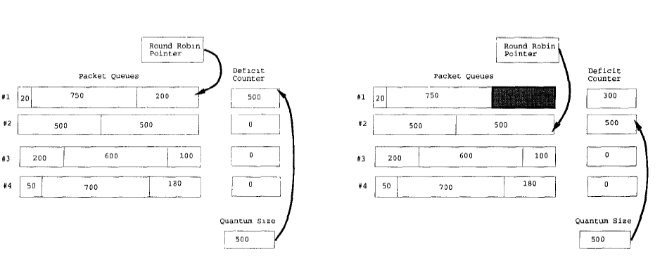
Unused quantum saved for the next round
How to set quantum size?
  Too small
  Too large
Notes:
to offset packet size unfairness

Slide 47
Review of Design Space
Router-based vs. Host-based
Reservation-based vs. Feedback-based
Window-based vs. Rate-based

Slide 48
Overview
The problem of network resource allocation
  Case studies
    TCP congestion control
    Fair queuing
Congestion avoidance
  Active queue management
  Source-based congestion avoidance

Slide 49
Congestion Avoidance

Slide 50
Design goals
Predict when congestion is going to happen
Reduce sending rate before buffer overflows
Not widely deployed
  Reducing queuing delay and packet loss are not essential

Slide 51
Mechanisms
Router+host joint control
  Router: Early signaling of congestion
  Host: react to congestion signals
  Case studies: DECbit, Random Early Detection
Host: Source-based congestion avoidance
  Host detects early congestion
  Case study: TCP Vegas

Slide 52
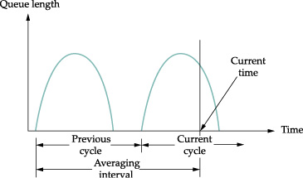
DECbit
Add a congestion bit to a packet header
A router sets the bit if its average queue length is non-zero
  Queue length is measured over a busy+idle interval
If less than 50% of packets in one window do not have the bit set
  A host increases its congest window by 1 packet
Otherwise
  Decreases by 0.875
AIMD

Slide 53
Random Early Detection
Random early detection (Floyd93)
  Goal: operate at the “knee”
  Problem: very hard to tune (why)
RED is generalized by Active Queue Managment (AQM)
A router measures average queue length using exponential weighted averaging algorithm:
  AvgLen = (1-Weight) * AvgLen + Weight * SampleQueueLen

Slide 54
RED algorithm
p
1
avg_qlen
min_thresh
max_thresh
If AvgLen ≤ MinThreshold
  Enqueue packet
If MinThreshold < AvgLen < MaxThreshold
  Calculate dropping probability P
  Drop the arriving packet with probability P
If MaxThreshold ≤ AvgLen
  Drop the arriving packet

Slide 55
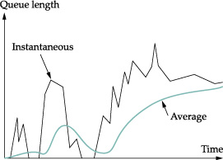
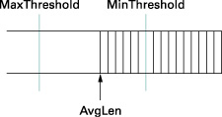

Slide 56
Even out packet drops
TempP
1
avg_qlen
min_thresh
max_thresh
TempP = MaxP x (AvgLen – Min)/(Max-Min)
P = TempP / (1 – count * TempP)
Count keeps track of how many newly arriving packets have been queued when min < Avglen < max
It keeps drop evenly distributed over time, even if packets arrive in burst

Slide 57
An example
MaxP = 0.02
AvgLen is half way between min and max thresholds
TempP = 0.01
A burst of 1000 packets arrive
With TempP, 10 packets may be discarded uniformly randomly among the 1000 packets
With P, they are likely to be more evently spaced out, as P gradually increases if previous packets are not discarded

Slide 58
Explicit Congestion Notification
A new IETF standard
We use two bits in IP header (ECN bits) for routers to signal congestion back to TCP senders
TCP halves its window size as if it suffers a packet drop
Use a Congestion Experience (CE) bit to signal congestion, instead of a packet drop
  Why is it better than a drop?
AQM is used for packet marking
CE=1
X
ECE=1
CWR=1

Slide 59
Source-based congestion avoidance
TCP Vegas
  Detect increases in queuing delay
  Reduces sending rate
Details
  Record baseRTT (minimum seen)
  Compute ExpectedRate = cwnd/BaseRTT
  Diff = ExpectedRate - ActualRate
  When Diff < α, incr cwnd linearly, when Diff > β, decr cwnd linearly
    α < β

Slide 60
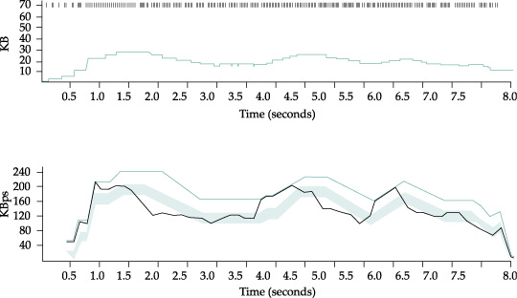
cwnd
Notes:
Top: congestion window
Bottom: expected (colred) and actual (black) throughput
The shaded area is the region between the alpha and beta thresholds.

Slide 61
Summary
The problem of network resource allocation
  Case studies
    TCP congestion control
    Fair queuing
Congestion avoidance
  Active queue management
  Source-based congestion avoidance

