Slide 1
CS 356: Computer Network Architectures
Lecture 18: Quality of Service (QoS)
Xiaowei Yang
xwy@cs.duke.edu

Slide 2
Overview
Network Resource Allocation
Congestion Avoidance
Why QoS?
  Architectural considerations
Approaches to QoS
  Fine-grained: Integrated services
    RSVP
  Coarse-grained:
    Differentiated services
    Next lecture
2
Notes:
Fine-grained: guarantees for each individual flow

Slide 3
Administrivia
Five minutes pop quiz
Lab 2 due midnight
Hw2 out, due before next Thursday’s class

Slide 4
Design Space for resource allocation
Router-based vs. Host-based
Reservation-based vs. Feedback-based
Window-based vs. Rate-based

Slide 5
Properties of Fair Queuing
Work conserving
Max-min fair

Slide 6
Weighted Fair Queuing
w=1
w=2
Different queues get different weights
  Take w_{i} amount of bits from a queue in each round
  F_{i} = S_{i}+P_{i} / w_{i}
Quality of service

Slide 7
Deficit Round Robin (DRR)
WFQ: extracting min is O(log Q)
DRR: O(1) rather than O(log Q)
  Each queue is allowed to send Q bytes per round
  If Q bytes are not sent (because packet is too large) deficit counter of queue keeps track of unused portion
  If queue is empty, deficit counter is reset to 0
  Similar behavior as FQ but computationally simpler

Slide 8
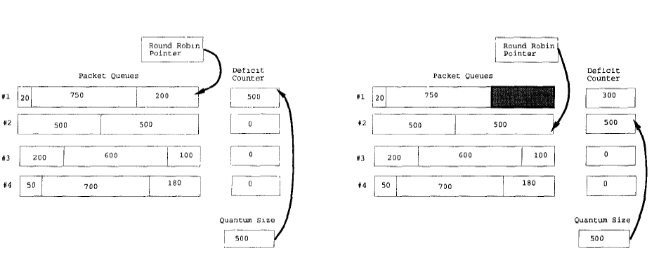
Unused quantum saved for the next round
How to set quantum size?
  Too small
  Too large
Notes:
to offset packet size unfairness

Slide 9
Congestion Avoidance

Slide 10
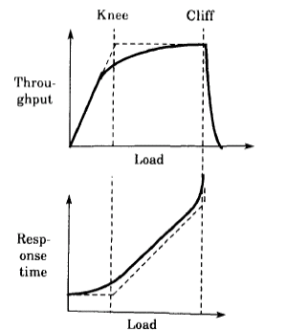
Design goals
Predict when congestion is going to happen
Reduce sending rate before buffer overflows
Not widely deployed
  Reducing queuing delay and packet loss are not essential

Slide 11
Mechanisms
Router+host joint control
  Router: Early signaling of congestion
  Host: react to congestion signals
  Case studies: DECbit, Random Early Detection
Host: Source-based congestion avoidance
  Host detects early congestion
  Case study: TCP Vegas

Slide 12
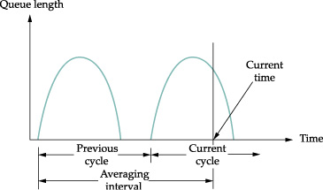
DECbit
Add a congestion bit to a packet header
A router sets the bit if its average queue length is non-zero
  Queue length is measured over a busy+idle interval
If less than 50% of packets in one window do not have the bit set
  A host increases its congest window by 1 packet
Otherwise
  Decreases by 0.875
AIMD

Slide 13
Random Early Detection
Random early detection (Floyd93)
  Goal: operate at the “knee”
  Problem: very hard to tune (why)
RED is generalized by Active Queue Managment (AQM)
A router measures average queue length using exponential weighted averaging algorithm:
  AvgLen = (1-Weight) * AvgLen + Weight * SampleQueueLen

Slide 14
RED algorithm
p
1
avg_qlen
min_thresh
max_thresh
If AvgLen ≤ MinThreshold
  Enqueue packet
If MinThreshold < AvgLen < MaxThreshold
  Calculate dropping probability P
  Drop the arriving packet with probability P
If MaxThreshold ≤ AvgLen
  Drop the arriving packet

Slide 15
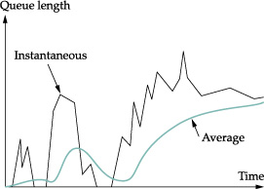
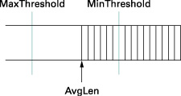

Slide 16
Even out packet drops
TempP
1
avg_qlen
min_thresh
max_thresh
TempP = MaxP x (AvgLen – Min)/(Max-Min)
P = TempP / (1 – count * TempP)
Count keeps track of how many newly arriving packets have been queued when min < Avglen < max
It keeps drop evenly distributed over time, even if packets arrive in burst

Slide 17
An example
MaxP = 0.02
AvgLen is half way between min and max thresholds
TempP = 0.01
A burst of 1000 packets arrive
With TempP, 10 packets may be discarded uniformly randomly among the 1000 packets
With P, they are likely to be more evently spaced out, as P gradually increases if previous packets are not discarded

Slide 18
Explicit Congestion Notification
A new IETF standard
We use two bits in IP header (ECN bits) for routers to signal congestion back to TCP senders
TCP halves its window size as if it suffers a packet drop
Use a Congestion Experience (CE) bit to signal congestion, instead of a packet drop
  Why is it better than a drop?
AQM is used for packet marking
CE=1
X
ECE=1
CWR=1

Slide 19
Source-based congestion avoidance
TCP Vegas
  Detect increases in queuing delay
  Reduces sending rate
Details
  Record baseRTT (minimum seen)
  Compute ExpectedRate = cwnd/BaseRTT
  Diff = ExpectedRate - ActualRate
  When Diff < α, incr cwnd linearly, when Diff > β, decr cwnd linearly
    α < β

Slide 20
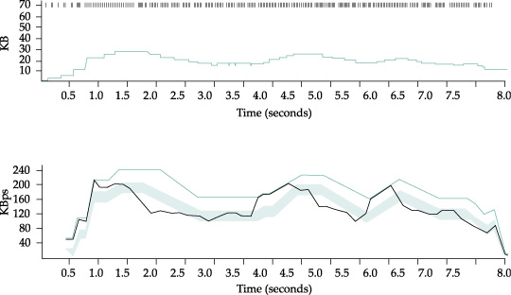
cwnd
Notes:
Top: congestion window
Bottom: expected (colred) and actual (black) throughput
The shaded area is the region between the alpha and beta thresholds.

Slide 21
Summary
The problem of network resource allocation
  Case studies
    TCP congestion control
    Fair queuing
Congestion avoidance
  Active queue management
  Source-based congestion avoidance

Slide 22
Overview
Network Resource Allocation
Congestion Avoidance
Why QoS?
  Architectural considerations
Approaches to QoS
  Fine-grained: Integrated services
    RSVP
  Coarse-grained:
    Differentiated services
    Next lecture
22
Notes:
Fine-grained: guarantees for each individual flow

Slide 23
Motivation
23
Internet currently provides one single class of “best-effort” service
  No assurance about delivery
Many existing applications are elastic
  Tolerate delays and losses
  Can adapt to congestion
“Real-time” applications may be inelastic

Slide 24
Inelastic Applications
Continuous media applications
  Lower and upper limit on acceptable performance
  Below which video and audio are not intelligible
  Internet telephones, teleconferencing with high delay (200 - 300ms) impair human interactions
Hard real-time applications
  Require hard limits on performance
  E.g., industrial control applications
    Internet surgery
24

Slide 25
Design question #1: Why a New Service Model?
What is the basic objective of network design?
  Maximize total bandwidth? Minimize latency? Maximize ISP’s revenues?
  the designer’s choice: Maximize social welfare: the total utility given to users
What does utility vs. bandwidth look like?
  Must be non-decreasing function
  Shape depends on application
25

Slide 26
Utility Curve Shapes
U
Elastic
U
Hard real-time
BW
BW
U
Delay-adaptive
Stay to the right and you
are fine for all curves
BW
26

Slide 27

Playback Applications
Sample signal → packetize → transmit → buffer → playback
  Fits most multimedia applications
Performance concern:
  Jitter: variation in end-to-end delay
    Delay = fixed + variable = (propagation + packetization) + queuing
Solution:
  Playback point – delay introduced by buffer to hide network jitter
27

Slide 28
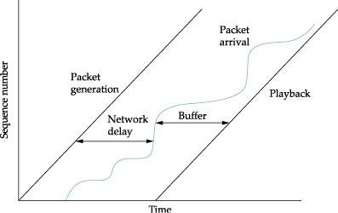

Slide 29
Characteristics of Playback Applications
In general lower delay is preferable
Doesn’t matter when packet arrives as long as it is before playback point
Network guarantees (e.g., bound on jitter) would make it easier to set playback point
Applications can tolerate some loss
29

Slide 30
Applications Variations
Rigid and adaptive applications
  Delay adaptive
    Rigid: set fixed playback point
    Adaptive: adapt playback point
      E.g. Shortening silence for voice applications
  Rate adaptive
Loss tolerant and intolerant applications
Four combinations
30
Notes:
Move playback point around based on observed network delay
Gamble that network conditions will be the same as in the past
Are prepared to deal with errors in their estimate
Will have an earlier playback point than rigid applications
How to adapt:

Slide 31
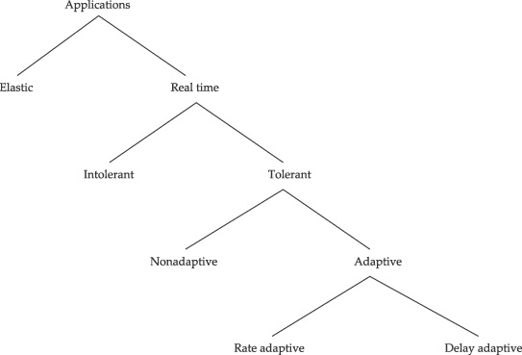

Slide 32
Applications Variations
Really only two classes of applications
  1) Intolerant and rigid
  Tolerant and adaptive
Other combinations make little sense
  3) Intolerant and adaptive
    - Cannot adapt without interruption
  Tolerant and rigid
  - Missed opportunity to improve delay
32

Slide 33
Design question 2: How to maximize V = ∑ U(s_{i})
Choice #1: add more pipes
  Discuss later
Choice #2: fix the bandwidth but offer different services
  Q: can differentiated services improve V?

Slide 34
If all users’ utility functions are elastic
U
Elastic
Does equal allocation of bandwidth maximize total utility?
Bandwidth
∑ s_{i} = B
Max ∑ U(s_{i})
34

Slide 35
Design question: is Admission Control needed?
If U(bandwidth) is concave
→ elastic applications
  Incremental utility is decreasing with increasing bandwidth
    U(x) = log(x^{p)}
    V = nlog(B/n) ^{p}= logB^{p}n^{1-p}
  Is always advantageous to have more flows with lower bandwidth
    No need of admission control;
  This is why the Internet works! And fairness makes sense
U
Elastic
BW
35

Slide 36
Utility Curves – Inelastic traffic
Delay-adaptive
U
U
Hard real-time
BW
BW
Does equal allocation of bandwidth maximize total utility?
36

Slide 37
Is Admission Control needed?
If U is convex → inelastic applications
  U(number of flows) is no longer monotonically increasing
  Need admission control to maximize total utility
Admission control → deciding when the addition of new people would result in reduction of utility
  Basically avoids overload
U
Delay-adaptive
BW
37

Slide 38
Incentives
Who should be given what service?
  Users have incentives to cheat
  Pricing seems to be a reasonable choice
  But usage-based charging may not be well received by users

Slide 39
Over provisioning
Pros: simple
Cons
  Not cost effective
  Bursty traffic leads to a high peak/average ratio
    E.g., normal users versus leading edge users
  It might be easier to block heavy users

Slide 40
Comments
End-to-end QoS has not happened
Why?
Can you think of any mechanism to make it happen?

Slide 41
Overview
41
Why QOS?
  Architectural considerations
Approaches to QoS
  Fine-grained: Integrated services
    RSVP
  Coarse-grained:
    Differentiated services
    Next lecture
Notes:
Fine-grained: guarantees for each individual flow

Slide 42
Components of Integrated Services
Service classes
  What does the network promise?
Service interface
  How does the application describe what it wants?
Establishing the guarantee
  How is the promise communicated to/from the network
  How is admission of new applications controlled?
Packet scheduling
  How does the network meet promises?
42

Slide 43
1. Service classes
  What kind of promises/services should network offer?
  Depends on the characteristics of the applications that will use the network ….
43

Slide 44
Service classes
Guaranteed service
  For intolerant and rigid applications
  Fixed guarantee, network meets commitment as long as clients send at match traffic agreement
Controlled load service
  For tolerant and adaptive applications
  Emulate lightly loaded networks
Datagram/best effort service
  Networks do not introduce loss or delay unnecessarily
44
Notes:
Two components
If conditions do not change, commit to current service
If conditions change, take steps to deliver consistent performance (help apps minimize playback delay)
Implicit assumption – network does not change much over time

Slide 45
Components of Integrated Services
Type of commitment
  What does the network promise?
Service interface
  How does the application describe what it wants?
Establishing the guarantee
  How is the promise communicated to/from the network
  How is admission of new applications controlled?
Packet scheduling
  How does the network meet promises?
45

Slide 46
Service interfaces
Flowspecs
  TSpec: a flow’s traffic characteristics
    Difficult: bandwidth varies
  RSpec: the service requested from the network
    Service dependent
      E.g. controlled load

Slide 47
A Token Bucket Filter
Tokens enter bucket
at rate r
Operation:
  If bucket fills, tokens are discarded
  Sending a packet of size P uses P tokens
  If bucket has P tokens, packet sent at max rate, else must wait for tokens to accumulate
Bucket depth b: capacity of bucket
47

Slide 48
Token Bucket Operations
Tokens
Tokens
Tokens
Overflow
Packet
Packet
Enough tokens →
packet goes through,
tokens removed
Not enough tokens → wait for tokens to accumulate
48

Slide 49
Token Bucket Characteristics
49
In the long run, rate is limited to r
In the short run, a burst of size b can be sent
Amount of traffic entering at interval T is bounded by:
  Traffic = b + r*T
Information useful to admission algorithm

Slide 50
Token Bucket Specs
BW
Flow B
2
Flow A: r = 1 MBps, B=1 byte
1
Flow A
Flow B: r = 1 MBps, B=1MB
1
2
3
Time
50

Slide 51
TSpec
TokenBucketRate
TokenBucketSize
PeakRate
MinimumPolicedUnit
MaximumPacketSize

Slide 52
Service Interfaces: RSpec
Guaranteed Traffic
  TokenRate and DelayVariation
  Or DelayVariation and Latency
Controlled load
  Type of service
52

Slide 53
Components of Integrated Services
Type of commitment
  What does the network promise?
Service interface
  How does the application describe what it wants?
Establishing the guarantee
  How is the promise communicated to/from the network
  How is admission of new applications controlled?
Packet scheduling
  How does the network meet promises?
53

Slide 54
RSVP Goals
Used on connectionless networks
  Robust
  Should not replicate routing functionality
  Should co-exist with route changes
Support for multicast
Modular design – should be generic “signaling” protocol
Approaches
  Receiver-oriented
  Soft-state
54
Notes:
Different receivers have different capabilities and want different QOS
Changes in group membership should not be expensive
Reservations should be aggregate – I.e. each receiver in group should not have to reserve
Should be able to switch allocated resource to different senders

Slide 55
RSVP Service Model
Make reservations for simplex data streams
Receiver decides whether to make reservation
Control msgs in IP datagrams (proto #46)
PATH/RESV sent periodically to refresh soft state
55
Notes:
One pass:
Failed requests return error messages - receiver must try again
No e2e ack for success

Slide 56
PATH Messages
PATH messages carry sender’s Tspec
  Token bucket parameters
Routers note the direction PATH messages arrived and set up reverse path to sender
Receivers send RESV messages that follow reverse path and setup reservations
If reservation cannot be made, user gets an error
56

Slide 57
RESV Messages
Forwarded via reverse path of PATH
A receiver sends RESV messages
  TSpec from the sender
  Rspec
57

Slide 58
Admission control
Router performs admission control and reserves resources
  If request rejected, send error message to receiver
  Guaranteed service: a yes/no based on available bandwidth
  Controlled load: heuristics
    If delay has not exceeded the bound last time after admitting a similar flow, let it in

Slide 59
Soft State to Adapt to Routing Changes
Problems: Routing protocol makes routing changes
Solution:
  PATH and RESV messages sent periodically
  Non-refreshed state times out automatically
Ex: a link fails. How is a new reservation established?
59

Slide 60
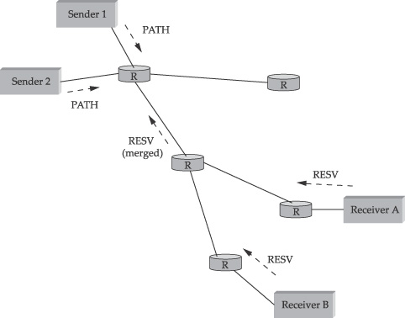
Merging multicast reservations
A requests a delay < 100ms
B requests a delay < 200ms

Slide 61
Components of Integrated Services
Type of commitment
  What does the network promise?
Service interface
  How does the application describe what it wants?
Establishing the guarantee
  How is the promise communicated to/from the network
  How is admission of new applications controlled?
Packet scheduling
  How does the network meet promises?
61

Slide 62
Packet classification and scheduling
Map a packet to a service class
  (src addr, dst addr, proto, src port, dst port)
Use scheduling algorithms to provide the service
  An implementation issue

Slide 63
Scheduling for Guaranteed Traffic
Use WFQ at the routers
  Q: will DRR work?
Each flow is assigned to its individual queue
Parekh’s bound for worst case queuing delay = b/r
  b = bucket depth
  r = rate of arrival
63

Slide 64
Controlled Load Service
Goals:
Isolation
  Isolates well-behaved from misbehaving sources
Sharing
  Mixing of different sources in a way beneficial to all
Possible Mechanisms:
WFQ
  Aggregate multiple flows into one WFQ
64

Slide 65
Unified Scheduling
Guaranteed Service
Guaranteed Service
Controlled Load
Class I
Controlled Load
Class II
Best Effort
Scheduling: use WFQ in routers
65
Notes:
Each guaranteed flow gets its own queue
All controlled load service flows and best effort aggregates in single separate queue
Controlled load classes
Worst case delay for classes separated by order of magnitude
When high priority needs extra bandwidth – steals it from lower class
Best effort traffic acts as lowest priority class

Slide 66
Scalability
A lot of requests and state!
ISPs feel it is not the right service model for them!
Per-flow reservation/queue
  OC-48 link 2.5Gbps
  64Kbps audio stream
  → 39,000 flows
  Reservation and state needs to be stored in memory, and refreshed periodically
  Classify, police, nd queue each flows

Slide 67
Comments on RSVP
Not widely deployed as a commercial service
Used for other purposes
  Setting up MPLS tunnels etc.

Slide 68
Summary
Why QOS?
  Architectural considerations
Approaches to QoS
  Fine-grained: Integrated services
    RSVP
  Coarse-grained:
    Differentiated services
Next lecture:
  DiffServ
  Net Neutrality
68
Notes:
Fine-grained: guarantees for each individual flow

