Slide 1
CompSci 356: Computer Network Architectures
Lecture 20: Domain Name System and Content distribution networks
Chapter 9.3.1
Xiaowei Yang
xwy@cs.duke.edu

Slide 2
Overview
Domain Name System
Content Distribution Networks

Slide 3
Domain Name System (DNS)

Slide 4
Outline
Functions of DNS
Design goals of DNS
History of DNS
DNS architecture: hierarchy is the key
  Name space and resource records
  Name servers
  Name resolvers
Notes:
http://www.redhat.com/docs/manuals/enterprise/RHEL-3-Manual/ref-guide/s1-bind-zone.html

Slide 5
Functions of DNS
Map an easy-to-remember name to an IP address
  Without DNS, to send an IP packet, we’d have to remember
    66.102.7.99
    64.236.24.28
  With DNS
    www.google.com→ 66.102.7.99
    www.cnn.com→ 64.236.24.28
DNS also provides inverse look up that maps an IP address to an easy-to-remember name

Slide 6
Design goals of DNS
The primary goal is a consistent name space which will be used for referring to resources.
  Consistent: same names should refer to same resources
  Resources: IP addresses, mail servers
Enable Distributed management
  The size of the name database will be large
  The updates will be frequent
Design goals determine its structure
  A hierarchical name space
  A distributed directory service

Slide 7
Before there was DNS ….
…. there was the HOSTS.TXT file maintained on a host at SRI Network Information Center (NIC)
Before DNS (until 1985), the name-to-IP address was done by downloading a single file (hosts.txt) from a central server with FTP
  Names in hosts.txt are not structured
  The hosts.txt file still works on most operating systems. It can be used to define local names

Slide 8
Key components in DNS Architecture
Domain name space and resource records (RRs)
Name servers
Name resolution

Slide 9
Domain Namespace
.(root)
Top-level domains
org
edu
com
gov
duke
mit
cs
ece
www
smtp
spirit
Domain namespace is a hierarchical and logical tree structure
The label from a node to root in the DNS tree represents a DNS name
Each subtree below a node is a DNS domain.
  DNS domain can contain hosts or other domains (subdomains)
Examples of DNS domains: .edu, duke.edu, cs.duke.edu

Slide 10
Distributed Management
.(root)
Top-level domains
org
edu
com
gov
Managed by CS
Managed by Duke
duke
mit
cs
ece
www
spirit
smtp
Below top-level domain, administration of name space is delegated to organizations
Each organization can delegate further

Slide 11
Domain names
Names of hosts can be assigned independent of host locations on a link layer network, IP network or autonomous system
  My computer’s DNS name xiaowei.net needs not change even if my computer’s IP address has changed

Slide 12
Fully Qualified Domain Names
.(root)
org
edu
com
gov
duke
mit
cs
ece
www
spirit
smtp
Every node in the DNS domain tree can be identified by a unique Fully Qualified Domain Name (FQDN)
A FQDN (from right to left) consists of labels (“cs”,“duke”,”edu”) separated by a period (“.”) from root to the node
Each label can be up to 63 characters long. The total number of characters of a DNS name is limited to 255.
FQDN contains characters, numerals, and dash character (“-”)
FQDNs are not case-sensitive

Slide 13
Top-level domains
Three types of top-level domains:
  Generic Top Level Domains (gTLD): 3-character code indicates the function of the organization
    Used primarily within the US
    Examples: gov, mil, edu, org, com, net
  Country Code Top Level Domain (ccTLD): 2-character country or region code
    Examples: us, va, jp, de
  Reverse domains: A special domain (in-addr.arpa) used for IP address-to-name mapping
There are more than 200 top-level domains.

Slide 14
Generic Top Level Domains (gTLD)
com | Commercial organizations
edu | Educational institutions
gov | Government institutions
int | International organizations
mil | U.S. military institutions
net | Networking organizations
org | Non-profit organizations
gTLDs are authoritatively administered by the Internet central name registration authority ICANN

Slide 15
DNS architecture
Domain name space and resource records (RRs)
  Domain namespace is a hierarchical tree structure
  A domain can be delegated to an organization
  We’ll discuss resource records shortly
Name servers
  Doman name hierarchy exists only in the abstract
  Name servers implement the hierarchy
  A host’s name servers are specified in /etc/resolv.conf
Name resolution

Slide 16
Hierarchy of name servers
The resolution of the hierarchical name space is done by a hierarchy of name servers
Namespace is partitioned into zones. A zone is a contiguous portion of the DNS name space
Each server is responsible (authoritative) for a zone.
DNS server answers queries about host names in its zone

Slide 17
DNS domain and zones
Each zone is anchored at a specific domain node, but zones are not domains.
A DNS domain is a subtree of the namespace
A zone is a portion of the DNS namespace generally stored in a file (It could consists of multiple nodes)
A server can divide part of its zone and delegate it to other servers
A name server implements the zone information as a collection of resource records

Slide 18
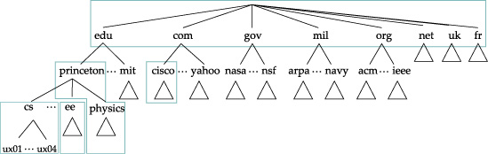

Slide 19
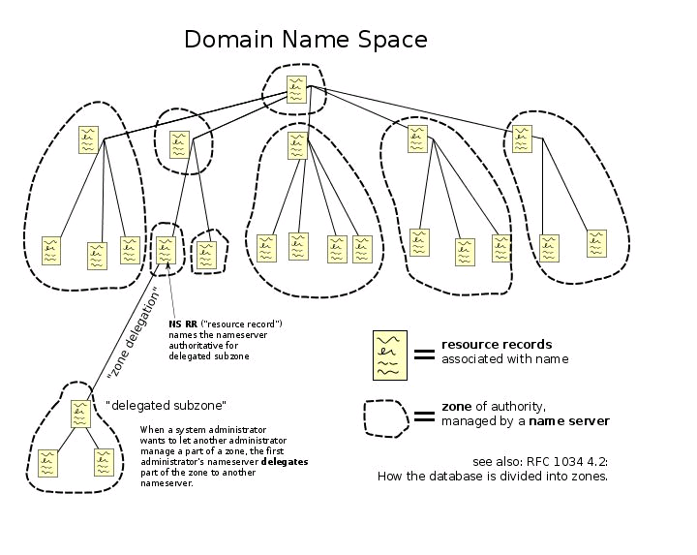
Zone and sub-domain

Slide 20
Primary and secondary name servers
For each zone, there must be a primary name server and a secondary name server for reliability reason
  The primary server (master server) maintains a zone file which has information about the zone. Updates are made to the primary server
  The secondary server copies data stored at the primary server
Adding a host:
When a new host is added (“spirit.cs.duke.edu”) to a zone, the administrator adds the IP information on the host (IP address and name) to a configuration file on the primary server

Slide 21
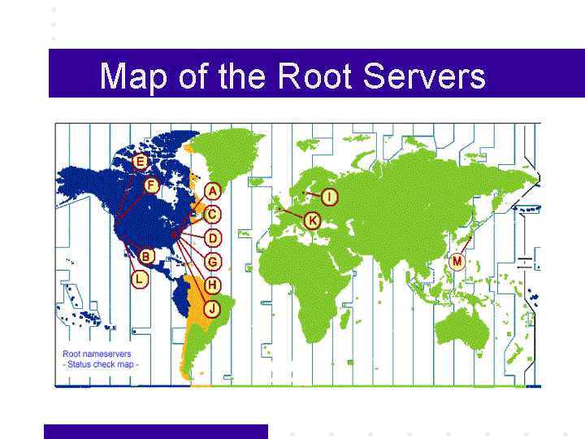
Root name servers
The root name servers know how to find the authoritative name servers for all top-level zones.
There are 13 (virtual) root name servers
Root servers are critical for the proper functioning of name resolution

Slide 22
Addresses of root servers
A.ROOT-SERVERS.NET. (VeriSign, Dulles, VA) 198.41.0.4
B.ROOT-SERVERS.NET. (ISI, Marina Del Rey CA) 192.228.79.201
C.ROOT-SERVERS.NET. (Cogent Communications) 192.33.4.12
D.ROOT-SERVERS.NET. (University of Maryland) 128.8.10.90
E.ROOT-SERVERS.NET. (Nasa Ames Research Center) 192.203.230.10
F.ROOT-SERVERS.NET. (Internet Systems Consortium) 192.5.5.241
G.ROOT-SERVERS.NET. (US Department of Defense) 192.112.36.4
H.ROOT-SERVERS.NET. (US Army Research Lab) 128.63.2.53
I.ROOT-SERVERS.NET. (Stockholm, Sweden) 192.36.148.17
J.ROOT-SERVERS.NET. (Herndon, VA) 192.58.128.30
K.ROOT-SERVERS.NET. (London, United Kingdom) 193.0.14.129
L.ROOT-SERVERS.NET. (IANA, Los Angeles) 198.32.64.12
M.ROOT-SERVERS.NET. (WIDE, Tokyo) 202.12.27.33

Slide 23
Resource Records
A zone file includes a collection of resource records (RRs)
(Name, Value, Type, Class, TTL)
  Name and value are exactly what you expect
  Type specifies how the Value should be interpreted
    A, NS, CNAME, MX, AAAA
  Class: allows other entities to define record types; IN is the widely used one to date
  TTL: how long the record should be cached

Slide 24
Resource Records
db.mylab.com
The database records of the DNS distributed database are called resource records (RR)
Resource records are stored in configuration files (zone files) at name servers.
Resource records for a zone→
$TTL 86400
mylab.com. IN SOA PC4.mylab.com.
hostmaster.mylab.com. (
1 ; serial
28800 ; refresh
7200 ; retry
604800 ; expire
86400 ; minimum ttl
)
;
mylab.com.
IN
NS
PC4.mylab.com.
;
localhost
A
127.0.0.1
PC4.mylab.com.
A
10.0.1.41
PC3.mylab.com.
A
10.0.1.31
PC2.mylab.com.
A
10.0.1.21
PC1.mylab.com.
A
10.0.1.11

Slide 25
Resource Records
$TTL 86400
mylab.com. IN SOA PC4.mylab.com. Hostmaster.mylab.com. (
1 ; serial
28800 ; refresh
7200 ; retry
604800 ; expire
86400 ; minimum ttl
)
;
mylab.com. IN NS PC4.mylab.com.
;
localhost A 127.0.0.1
PC4.mylab.com. A 10.0.1.41
PC3.mylab.com. A 10.0.1.31
PC2.mylab.com. A 10.0.1.21
PC1.mylab.com. A 10.0.1.11
Max. age of cached data
in seconds
Start of authority (SOA) record.
Means: “This name server is
authoritative for the zone
Mylab.com”
PC4.mylab.com is the
name server
hostmaster@mylab.com is the
email address of the person
in charge
Name server (NS) record.
One entry for each authoritative
name server
Address (A) records.
One entry for each host address
Notes:
The MINIMUM field of the SOA controls the length of time that the negative result may be cached.
when a name server loads a zone, it forces the TTL of all authoritative RRs to be at least the MINIMUM field of the SOA, here 86400 seconds, or one day.
The <time-to-refresh> directive is the numerical value slave servers use to determine how long to wait before asking the master nameserver if any changes have been made to the zone.
The <time-to-refresh> directive is the numerical value slave servers use to determine how long to wait before asking the master nameserver if any changes have been made to the zone.
The <time-to-refresh> directive is the numerical value slave servers use to determine how long to wait before asking the master nameserver if any changes have been made to the zone.
http://rscott.org/dns/soa.html: yes. Hostmaster.mylab.com is an email addfress. @ sign is not allowed in a rr.

Slide 26
Domain name resolution
User program issues a request for the IP address of a hostname gethostbyname()
Local resolver formulates a DNS query to the name server of the host
Name server checks if it is authorized to answer the query.
  If yes, it responds.
  Otherwise, it will query other name servers, starting at the root tree
When the name server has the answer it sends it to the resolver.

Slide 27
Recursive and Iterative Queries
There are two types of queries:
  Recursive queries
  Iterative (non-recursive) queries
The type of query is determined by a bit in the DNS query
Recursive query: When the name server of a host cannot resolve a query, the server issues a query to resolve the query
Iterative queries: When the name server of a host cannot resolve a query, it sends a referral to another server to the resolver

Slide 28
Recursive name servers
1st query: spirit.cs.duke.edu
root server
In a recursive query, the resolver expects the response from the name server
If the server cannot supply the answer, it will send the query to the “closest known” authoritative name server (here: In the worst case, the closest known server is the root server)
The root sever sends a referral to the “edu” server. Querying this server yields a referral to the server of “duke.edu”
  A “referral” is IP address to an intermediate name server
… and so on
Referral to edu name server
2nd query: spirit.cs.duke.edu
Referral to duke.edu name server
Name
edu server
server
3rd query:
spirit.cs.duke.edu
response
query
Referral to cs.duke.edu
name sever
duke.edu
server
4th query:
spirit.cs.duke.edu
Resolver
IP address of
spirit.cs.duke.edu
cs.duke.edu
server

Slide 29
Iterative name servers
root server
In an iterative query, the name server sends a closest known authoritative name server, if it does not know the answer to the query.
The resolver queries the referral.
This involves more work for the resolver
Name
server
1st query: spirit.cs.duke.edu
referral to root server
referral to edu server
edu server
query
2nd query
referral to duke.edu server
duke.edu
3rd query
server
referral to cs.duke.edu server
Resolver
4th query
cs.duke.edu
server
IP address of spirit.cs.duke.edu

Slide 30
Inverse query
.(root)
org
edu
com
gov
arpa
due
mit
in-addr
cs
eng
150.4.195.128
www
spirit
smtp
What’s the host name for IP address 128.195.4.150
  IP address is converted to domain name: 150.4.195.128.in-addr.arpa
  Resolver sends query for this address

Slide 31
Canonical names and aliases
;; ANSWER SECTION:
www.cs.duke.edu. 86400 IN CNAME prophet.cs.duke.edu.
prophet.cs.duke.edu. 86400 IN A 152.3.140.5
Hosts can have several names.
One is called canonical names and others are called aliases

Slide 32
Caching
To reduce DNS traffic, name servers caches information on domain name/IP address mappings
When an entry for a query is in the cache, the server does not contact other servers
Note: If an entry is sent from a cache, the reply from the server is marked as “unauthoritative”
Caching-only servers

Slide 33
Negative caching
Two negative responses
  Name in question does not exist
  The name in record exists, but the requested data do not
Negative responses will be cached too

Slide 34
Dig
DNS lookup utility
xwy@liberty:~$ dig +norecurse @a.root-servers.net NS www.cs.duke.edu
…..
;; QUESTION SECTION:
;www.cs.duke.edu. IN NS
;; AUTHORITY SECTION:
edu. 172800 IN NS L.GTLD-SERVERS.NET.
edu. 172800 IN NS G.GTLD-SERVERS.NET.
edu. 172800 IN NS C.GTLD-SERVERS.NET.
edu. 172800 IN NS D.GTLD-SERVERS.NET.
edu. 172800 IN NS A.GTLD-SERVERS.NET.
edu. 172800 IN NS F.GTLD-SERVERS.NET.
edu. 172800 IN NS E.GTLD-SERVERS.NET.
;; ADDITIONAL SECTION:
A.GTLD-SERVERS.NET. 172800 IN A 192.5.6.30
A.GTLD-SERVERS.NET. 172800 IN AAAA 2001:503:a83e::2:30
C.GTLD-SERVERS.NET. 172800 IN A 192.26.92.30
D.GTLD-SERVERS.NET. 172800 IN A 192.31.80.30
E.GTLD-SERVERS.NET. 172800 IN A 192.12.94.30
F.GTLD-SERVERS.NET. 172800 IN A 192.35.51.30
G.GTLD-SERVERS.NET. 172800 IN A 192.42.93.30
L.GTLD-SERVERS.NET. 172800 IN A 192.41.162.30

Slide 35
DNS Message Format
Identification
Flags
12 bytes
No. of Questions
No. of Answer RRs
No. of Authority RRs
No. of Additional RRs
Name, type fields for a query
Questions (variable number of questions)
RRs in response to query
Answers (variable number of resource records)
Records for authoritative servers
Authority (variable number of resource records)
Additional Info (variable number of resource records)
Additional “helpful info that may be used
35

Slide 36
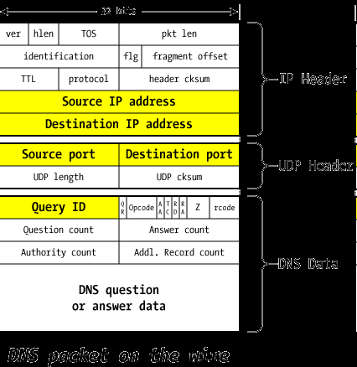
Port 53
Question repeated in answer
Notes:
Source / Destination IP address
These reflect the IP addresses of the machines that sent and should receive the packet. It's possible to forge the source address, but pointless to forge the destination.
Analog in the real world: on an envelope sent in the US Mail, you can put anything you want as the return address — the source address — but if you lie about the recipient, it's not going to go where you want.
Source / Destination port numbers
DNS servers listen on port 53/udp for queries from the outside world, so the first packet of any exchange always includes 53 as the UDP destination port.
The source port varies considerably (though not enough, as we'll find shortly): sometimes it's also port 53/udp, sometimes it's a fixed port chosen at random by the operating system, and sometimes it's just a random port that changes every time.
As far as DNS functionality is concerned, the source port doesn't really matter as long as the replies get routed to it properly. But this turns out to be the crux of the problem at hand.
Query ID
This is a unique identifier created in the query packet that's left intact by the server sending the reply: it allows the server making the request to associate the answer with the question.
A nameserver might have many queries outstanding at one time — even multiple queries to the same server — so this Query ID helps match the answers with the awaiting questions.
This is also sometimes called the Transaction ID (TXID).
QR (Query / Response)
Set to 0 for a query by a client, 1 for a response from a server.
Opcode
Set by client to 0 for a standard query; the other types aren't used in our examples.
AA (Authoritative Answer)
Set to 1 in a server response if this answer is Authoritative, 0 if not.
TC (Truncated)
Set to 1 in a server response if the answer can't fit in the 512-byte limit of a UDP packet response; this means the client will need to try again with a TCP query, which doesn't have the same limits.
RD (Recursion Desired)
The client sets this to 1 if it wishes that the server will perform the entire lookup of the name recursively, or 0 if it just wants the best information the server has and the client will continue with the iterative query on its own. Not all nameservers will honor a recursive request (root servers, for instance, won't ever perform recursive queries).
RA (Recursion Available)
The server sets this to indicate that it will (1) or won't (0) support recursion.
Z — reserved
This is reserved and must be zero
rcode
Response code from the server: indicates success or failure
Question record count
The client fills in the next section with a single "question" record that specifies what it's looking for: it includes the name (www.unixwiz.net), the type (A, NS, MX, etc.), and the class (virtually always IN=Internet).
The server repeats the question in the response packet, so the question count is almost always 1.
Answer/authority/additional record count
Set by the server, these provide various kinds of answers to the query from the client: we'll dig into these answers shortly.
DNS Question/Answer data
This is the area that holds the question/answer data referenced by the count fields above. These will be discussed in great detail later.

Slide 37
DNS Header Fields
37
Identification
  Used to match up request/response
  DNS cache poisoning attacks exploit this field
Flags
  1-bit to mark query or response
  1-bit to mark authoritative or not
  1-bit to request recursive resolution
  1-bit to indicate support for recursive resolution

Slide 38
Server Selections and CDNs

Slide 39

A traditional web application
HTTP request http://www.cs.duke.edu
A DNS lookup on www.cs.duke.edu returns the IP address of the web server
Requests are sent to the web site.

Slide 40
What problem does CDN solve?
Flash crowd may overwhelm a server and the access network
Reduce latency, and network load

Slide 41

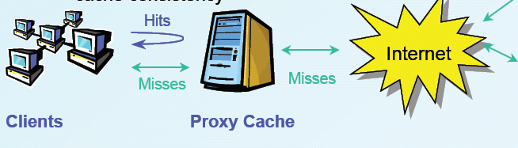
Proxy caching
Enhance web performance
  Cache content
  Reduce server load, latency, network utilization

Slide 42


A content distribution network
A single provider that manages multiple replicas.
A client obtains content from a close replica.

Slide 43
Pros and cons of CDN
Pros
  + Multiple content providers may use the same CDN → economy of scale
  + All other advantages of proxy caching
  + Fault tolerance
  + Load balancing across multiple CDN nodes
Cons
  Expensive

Slide 44
CDN challenges
Balancing load among multiple caches
Fault tolerant
Low latency
Cache consistency

Slide 45
How does Akamai works
Two key technologies:
  DNS-based redirection: load balancing, latency
  Consistent caching: fault tolerant (no time to discuss)
Static content
  Partial content

Slide 46
DNS redirection
Using a hierarchy of DNS servers that translate a client’s web request to a nearby Akamai server
  A client requests a DNS resolution (www.yahoo.com)
  Akamai’s customer’s DNS name server uses a canonical name entry redirecting it to a DNS server in akamai’s network
  A hierarchy of DNS name servers responds to the DNS name-translation request
  Name of the Akamai customer and the name of the requested content as a guide to determine the best two Akamai edge servers

Slide 47


CDNs Basics
Hierarchy of CDN DNS servers
Customer DNS servers
Internet
Multiple redirections to find nearby edge servers
Web replica servers
(3)
(4)
Client is given 2 nearby web replica servers (fault tolerance)
(5)
Client gets CNAME entry with domain name in Akamai
(2)
(6)
Client requests translation for yahoo
LDNS
(1)
Web client
Web client’s request redirected to ‘close’ by server
  Client gets web site’s DNS CNAME entry with domain name in CDN network
  Hierarchy of CDN’s DNS servers direct client to 2 nearby servers

Slide 48
; <<>> DiG 9.4.2-P2 <<>> images.pcworld.com
;; global options: printcmd
;; Got answer:
;; ->>HEADER<<- opcode: QUERY, status: NOERROR, id: 29098
;; flags: qr rd ra; QUERY: 1, ANSWER: 4, AUTHORITY: 9, ADDITIONAL: 2
;; QUESTION SECTION:
;images.pcworld.com. IN A
;; ANSWER SECTION:
images.pcworld.com. 885 IN CNAME images.pcworld.com.edgesuite.net.
images.pcworld.com.edgesuite.net. 21585 IN CNAME a1694.g.akamai.net.
a1694.g.akamai.net. 5 IN A 128.109.34.38
a1694.g.akamai.net. 5 IN A 128.109.34.45
;; AUTHORITY SECTION:
g.akamai.net. 973 IN NS n1g.akamai.net.
g.akamai.net. 973 IN NS n2g.akamai.net.
g.akamai.net. 973 IN NS n3g.akamai.net.
g.akamai.net. 973 IN NS n4g.akamai.net.
g.akamai.net. 973 IN NS n5g.akamai.net.
g.akamai.net. 973 IN NS n6g.akamai.net.
g.akamai.net. 973 IN NS n7g.akamai.net.
g.akamai.net. 973 IN NS n8g.akamai.net.
g.akamai.net. 973 IN NS n0g.akamai.net.
;; ADDITIONAL SECTION:
n1g.akamai.net. 1663 IN A 97.65.135.156
n5g.akamai.net. 889 IN A 128.109.247.10
;; Query time: 1 msec
;; SERVER: 152.3.140.1#53(152.3.140.1)
;; WHEN: Mon Feb 23 18:05:12 2009
;; MSG SIZE rcvd: 337

Slide 49
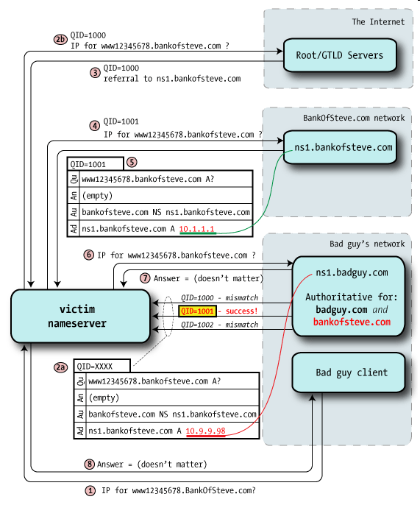
DNS Cache
Poisoning Attacks

Slide 50
Recent DNS news

Slide 51
When DNS goes bad
China’s firewall goes global
  http://www.computersolutions.cn/blog/2010/03/when-dns-goes-bad-chinas-firewall-goes-global-crossing/#more-416
One of the I root servers is operated in China
I root servers are announced via anycast
  Swedish company NetNod (aka Autonomica) has a DNS root server in China – I.ROOT-SERVERS.NET / 192.36.148.17
  China’s server is announced via BGP
  Other ISPs used it

Slide 52
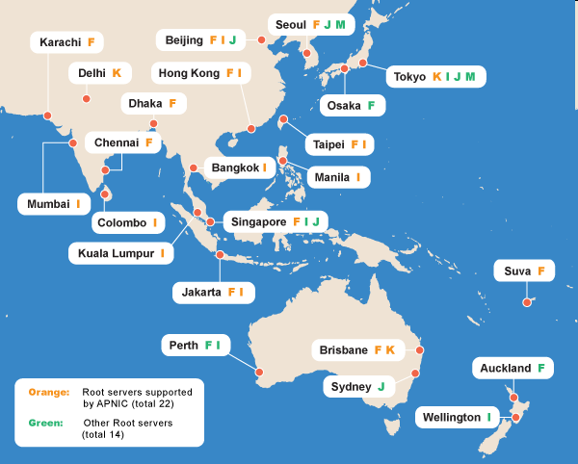

Slide 53
Conclusion
DNS
DNS and Content Distribution Networks

