Slide 1
CompSci 356: Computer Network Architectures
Lecture 21: Content Distribution
Chapter 9.4
Xiaowei Yang
xwy@cs.duke.edu

Slide 2
Overview
Problem
Evolving solutions
  IP multicast
  End system multicast
  Proxy caching
  Content distribution networks
    Akamai
  P2P cooperative content distribution
    BitTorrent, BitTyrant

Slide 3

A traditional web application
HTTP request http://www.cs.duke.edu
A DNS lookup on www.cs.duke.edu returns the IP address of the web server
Requests are sent to the web site.

Slide 4
Problem Statement
One-to-many content distribution
  Millions of clients downloading from the same server
Notes:
This an outline of the talk
We discussed the question that motivates
our work and listed our contributions
Next we are going to provide an overview
Of BitTorrent’s dissemination and
Incentive mechanism
Present the rationale behind the large
view exploit
Experimentally evaluate the exploit
We conclude and we discuss open
questions

Slide 5
Evolving Solutions
Observation: duplicate copies of data are sent
Solutions
  IP multicast
  End system multicast
  Proxy caching
  Content distribution networks
    Akamai
  P2P cooperative content distribution
    BitTorrent

Slide 6
IP multicast
End systems join a multicast group
Routers set up a multicast tree
Packets are duplicated and forwarded to multiple next hops at routers
Pros and cons
Notes:
+ efficient. No packet is sent twice on the same physical link
Not scalable
Not suitable for asynchronous downloads
Limited deployment

Slide 7
End system multicast
End systems rather than routers organize into a tree, forward and duplicate packets
Pros and cons
Notes:
+ less infrastructure requirement
- Single point of failure
- Node joins and leaves causing much chain
- one node may still be congested
- packets may traverse the same link twice

Slide 8

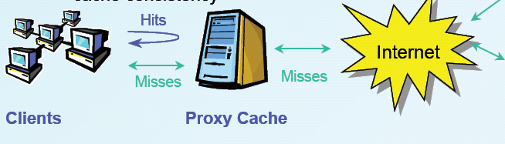
Proxy caching
Enhance web performance
  Cache content
  Reduce server load, latency, network utilization
  Pros and Cons

Slide 9


A content distribution network
A single provider that manages multiple replicas
A client obtains content from a close replica

Slide 10
Pros and cons of CDN
Pros
  + Multiple content providers may use the same CDN → economy of scale
  + All other advantages of proxy caching
  + Fault tolerance
  + Load balancing across multiple CDN nodes
Cons
  Expensive

Slide 11
Overview
Problem
Evolving solutions
  IP multicast
  End system multicast
  Proxy caching
  Content distribution networks
    Akamai
  P2P cooperative content distribution
    BitTorrent etc.

Slide 12
Peer-to-Peer Cooperative Content Distribution
Use the client’s upload bandwidth
  Almost infrastructure-less
Key challenges
  How to find a piece of data
  How to incentivize uploading

Slide 13
Data lookup
Centralized approach
  Napster
  BitTorrent trackers
Distributed approach
  Flooded queries
    Gnutella
  Structured lookup
    DHT (next lecture)

Slide 14
The Gnutella approach
All nodes are true peers
  A peer is the publisher, the uploader, and the downloader
  No single point of failure
Challenges
  Efficiency and scalability issue
    File searches span across many nodes → generate much traffic
  Integrity (content pollution)
    Anyone can claim that he publishes valid content
    No guarantee of quality of objects
  Incentive issue
    No incentive for cooperation → free riding

Slide 15
BitTorrent
Tracker for peer lookup
Rate-based Tit-for-tat for incentives

Slide 16
BitTorrent overview
File is divided into chunks (e.g. 256KB)
  ShA1 hashes of all the pieces are included in the .torrent file for integrity check
  A chunk is divided into sub-pieces to improve efficiency
Seeders have all chunks of the file
Leechers have some or no chunks of the file
Notes:
This is a depiction of a small BitTorrent swarm
In BitTorrent, the file to be distributed is
divided into chunks
The seeder is a BitTorrent client that has the
Complete file, all the chunks of the file
The leecher is a BitTorrent client that has only
some of the chunks or no chunks of the file

Slide 17
BitTorrent overview
.torrent file has address of a tracker
Tracker tracks all downloaders
Notes:
This is a depiction of a small BitTorrent swarm
In BitTorrent, the file to be distributed is
divided into chunks
The seeder is a BitTorrent client that has the
Complete file, all the chunks of the file
The leecher is a BitTorrent client that has only
some of the chunks or no chunks of the file

Slide 18
Terminology
Seeder: peer with the entire file
  Original Seed: The first seed
Leecher: peer that’s downloading the file
  Fairer term might have been “downloader”
Sub-piece: Further subdivision of a piece
  The “unit for requests” is a subpiece
  But a peer uploads only after assembling complete piece
Swarm: peers that download/upload the same file

Slide 19
BitTorrent overview
View
Seeder
Leecher A
Leecher B
Leecher C
Clients (seeders or leechers) contact the tracker
Tracker has complete view of the swarm
Notes:
Any client that wishes to join a swarm for a specific file must contact the BitTorrent tracker.
Therefore, the tracker is a BitTorrent process that at any moment has an almost complete view of all the clients that participate in the distribution of the specific file

Slide 20
BitTorrent overview
Partial View
Seeder
Leecher B
View
Seeder
Leecher A
Leecher B
Leecher C
Tracker sends partial view to clients
Clients connect to peers in their partial view
Notes:
When a client contacts the tracker, the tracker sends him a partial view of the swarm. This partial view a relatively small subset of the clients in the swarm. Typically this subset has size 50, for illustration purposes the partial view here is of size 2.
The client connects to peers in its partial view

Slide 21
BitTorrent overview
Every 10 sec, seeders sample their peers’ download rates
Seeders unchoke 4-10 interested fastest downloaders
Notes:
Clients announce available chunks to their
Peers.
Every 10 sec, the seeder samples its peers download rates.
The seeder selects to uploads in parallel to a certain number of leechers. These leechers are typically the 4 to 10 fastest downloaders that are also interested in the seeder’s chunks

Slide 22
BitTorrent overview
Notes:
In this case, the seeder has announced to its peers, leecher A and B, that it has chunks 1-3, and leecher A and B obtain them from the seeder.
Leechers schedule chunk requests according to their rareness.

Slide 23
BitTorrent overview
A node announces available chunks to their peers
Leechers request chunks from their peers (locally rarest-first)

Slide 24
BitTorrent overview
Leechers request chunks from their peers (locally rarest-first)
Notes:
Leechers A and B also announce to their peers which chunks they possess
Now we show BitTorrent’s incentive
mechanism, which is also known as rate-based tit-for-tat
In this case, leecher A makes the first step and offers
to unconditionally upload for 10 seconds chunks to
leecher B. In BT lingo, this step is called optimistic
unchoking

Slide 25
BitTorrent overview
Rate-based tit-for-tat
  Every 30 sec, leechers optimistically unchoke 1-2 peers
  Why optimistic unchoke?
Notes:
Every 10 secs leechers samples its peers download rates.

Slide 26
Roles of Optimistic Unchoking
Discover other faster peers and prompt them to reciprocate
Bootstrap new peers with no data to upload

Slide 27
BitTorrent overview
Rate-based tit-for-tat
  Every 30 sec, client optimistically unchokes 1-2 peers
  Every 10 sec, client samples its peers’ upload rates
  Leecher unchokes 4-10 fastest interested uploaders
  Leecher chokes other peers
  Q: Why does this algo encourage cooperation?
Notes:
In this case leecher B has determined that leecher A is among its 4-10 fastest uploaders, therefore in the next round it selects to upload to A.
Correspondingly, leecher A keeps B unchoked
Establishing reciprocal chunk exchanges between A and B

Slide 28
Scheduling:
Choosing pieces to request
Rarest-first: Look at all pieces at all peers, and request piece that’s owned by fewest peers
  Increases diversity in the pieces downloaded
    avoids case where a node and each of its peers have exactly the same pieces; increases throughput
  Increases likelihood all pieces still available even if original seed leaves before any one node has downloaded the entire file
  Increases chance for cooperation
Random rarest-first: rank rarest, and randomly choose one with equal rareness

Slide 29
Start time scheduling
Random First Piece:
  When peer starts to download, request random piece.
    So as to assemble first complete piece quickly
    Then participate in uploads
    May request subpieces from many peers
  When first complete piece assembled, switch to rarest-first
Notes:
the rarest may be in only one peer
so it picks a random instead which may be at many peers
and downloads subpieces in SGM from multiple peers
like in EGM
but in the other modes he only downloads it
subpieces from the same peer

Slide 30
Choosing pieces to request
End-game mode:
  When requests sent for all sub-pieces, (re)send requests to all peers.
  To speed up completion of download
  Cancel requests for downloaded sub-pieces
Notes:
The End Game is the name for the final download strategy – there is a tendency for the last few pieces of a torrent to download quite slowly. To avoid this, many BitTorrent implementations issue requests for the same remaining blocks to all its peers. When a block comes in from one peer, you send CANCEL messages to all the other peers requested from, in order to save bandwidth. Its cheaper to send a CANCEL message than to receive the full block and just discard it.
However, there is no formal definition of when to enter End Game Mode. I found two popular definitions:
1. All blocks have been requested
2. Number of blocks in transit is greater than number of blocks left, and no more than 20

Slide 31
Overview
Problem
Evolving solutions
  IP multicast
  End system multicast
  Proxy caching
  Content distribution networks
    Akamai
  P2P cooperative content distribution
    Bittorrent
    BitTyrant

Slide 32
BitTyrant: a strategic BT client
Question: can a strategic peer game BT to significantly improve its download performance for the same level of upload contribution?
Conclusion: incentives do not build robustness. Strategic peers can gain significantly in performance.

Slide 33
Key ideas
Observations:
  Unchoked as long as one is among the fastest peer set
  High capacity peers equally split its upload rates to active set peers
  Altruism comes from unnecessary contributions
Strategies:
  Maximize per connection download bandwidth
  Maximize the number of reciprocating peers
  Do not upload more than needed for reciprocation
Notes:
Do not upload to peers faster than necessary
BitTyrant dynamically chooses: a) how many
and which peers to unchoke; and b) at which rate to
upload to each individual peer. In contrast, BitTorrent
unchokes a certain number of peers.
The BitTyrant client maintains estimates of the rate at
which each peer will provide data, and the rate required to
make the peer select the BitTyrant client as uploader
Using these estimates, BitTyrant selects the highest
capacity peers and sends them data at the minimum rate
required for them to unchoke the BitTyrant client

Slide 34
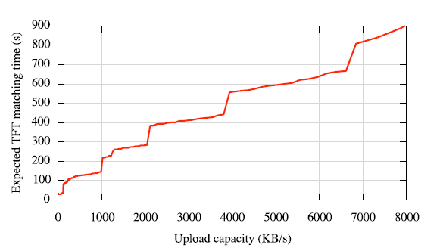
Altruism in Bittorrent
Notes:
The long convergence time suggests a potential
source of altruism: high capacity clients are forced to
peer with those of low capacity while searching for better
peers via optimistic unchokes.

Slide 35
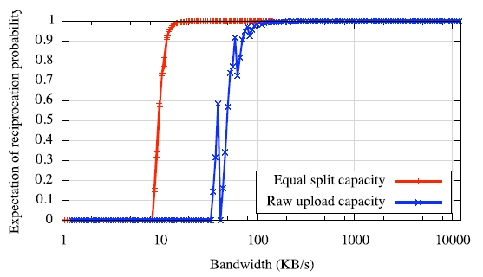
Notes:
Figure 3 gives the probability of reciprocation in terms of both raw upload capacity and, more significantly, the equal split rate. The sharp jump in reciprocation prob- ability suggests a potential source of altruism in BitTor- rent: equal split bandwidth allocation among peers in the active set. Beyond a certain equal split rate (∼14 KB/s in Figure 3), reciprocation is essentially assured, suggesting that further contribution may be altruistic.

Slide 36
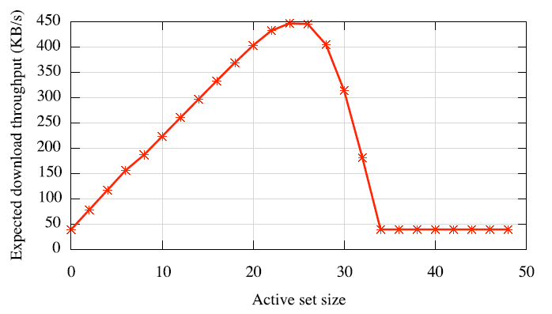

Slide 37
BitTyrant strategy
p
…
u_{p}
d_{p}
Rank peers by d_{p}/u_{p}
Unchoke in decreasing order of peer ranking until upload capacity is saturated
Assumption: data is always available, download is not limited by data scarcity

Slide 38
Challenges
Determining u_{p}
  Initialized with the expected equal split capacity obtained from measurement
  Periodically update it
    Increase multiplicatively if peer does not reciprocate
    Decrease multiplicatively if peer does
Estimating d_{p}
  Measure from the download rate if downloading from the peer
  From choked peers, estimate from peer announced block available rate U: U/ActiveSize of a default client
    May overestimate
Sizing the neighborhood
  Request as many peers as possible from trackers

Slide 39
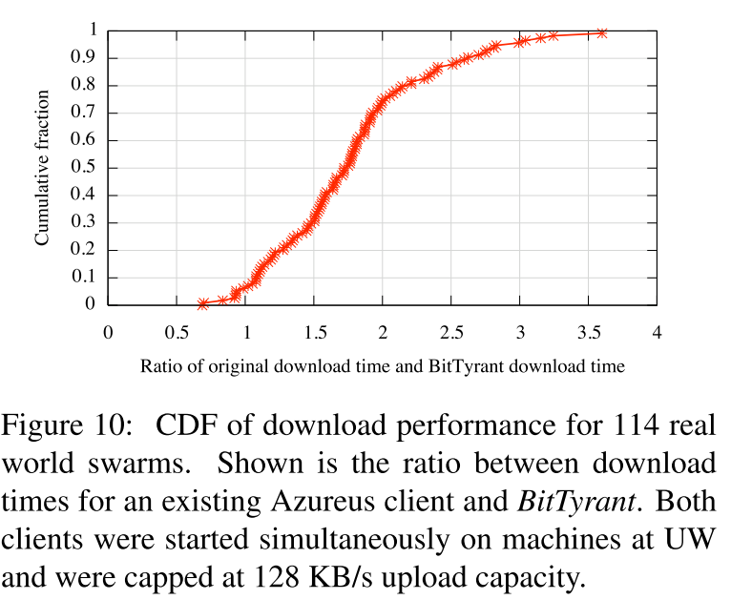
The results

Slide 40
Summary
Problem: distributing content without a hot spot near the server
Solutions
  IP multicast
  End system multicast
  Proxy caching
  Content distribution networks
    Akamai
  P2P cooperative content distribution
    Bittorrent, BitTyrant

