Slide 1
CompSci 356: Computer Network Architectures
Lecture 24: Network Security
Xiaowei Yang
xwy@cs.duke.edu

Slide 2
Overview
Why studying network security?
  The topic itself is worth another class
Basic cryptography building blocks
Security protocols
Non-cryptography based security: firewalls

Slide 3
The Internet is insecure
Attackers may eavesdrop, modify, or drop your packets!

Slide 4
Network security
Confidentiality:
  Do you want to send your credit card #, login password over the Internet in plaintext?
Integrity
  Data integrity: Imagine an Amazon transaction. Do you want your payment to be modified from $10.0 to $100?
  Replay attack: You do not want the same transaction confirmation to be sent multiple times!
  Timeliness: delay a stock purchase
Authenticity
  Entity authentication: who are you talking to? Phishing attack
  Message authentication: who sent this message?
Availability
  Denial of service attacks
Non-repudiation
  You’ve clicked the confirmation button!

Slide 5
How to address those problems
Cryptography building blocks
  Confidentiality
    Encryption
  Authenticity
    Public key signatures
    Authentication protocols
Non-cryptographic approach
  Firewalls

Slide 6
Cryptographic tools
Cryptographic algorithms
  Ciphers and Cryptographic hashes
  Not a solution in themselves, but building blocks from which a solution can be built
Key distribution
Protocols built on cryptographic algorithms
  System builders need to get familiar with the tools

Slide 7
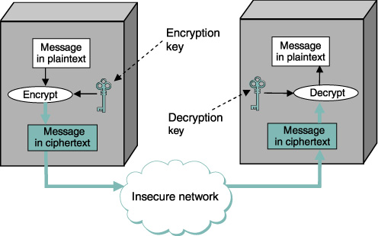
Principles of Ciphers
Encrypt_{key}(plaintext) → ciphertext
Ciphertext is unintelligible
Decry_{key}(ciphertext) → plaintext
The transformation is called a cipher

Slide 8
Security of a Cipher
Encrypt() and Decrypt() are public knowledge
Only key is secret
Designing a cipher is like a black art
No news is good news
Cryptanalysis
  Known plaintext
    Know the plaintext and its encrypted version and make use of them to guess other part of secrete information such as secrete keys
  Chosen plaintext analysis
    An attacker can get arbitrary plaintext encrypted
    Some plaintext has known vulnerability
Notes:
Wetter in a message always shows up in the same position
wl-10-190-89-78:~ xwy$ In the case of Enigma, the German High Command was very meticulous about the overall security of the Enigma system and understood the possible problem of cribs. The day-to-day trench operators, on the other hand, were less careful. The Bletchley Park team would guess some of the plaintext based upon when the message was sent. For instance, a daily weather report was transmitted by the Germans, at the same time every day. Due to the regimented style of military reports, it would contain the word Wetter (German for "weather") at the same location in every message and knowing the local weather conditions helped Bletchley Park guess other parts of the plaintext as well. Another example was an officer in the Africa Corps who helped greatly by constantly sending, "Nothing to report." Other operators too would send standard salutations or introductions.

Slide 9
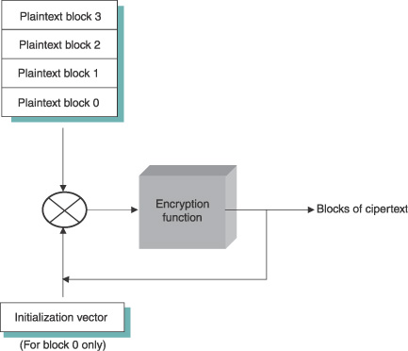
Block ciphers
CBC
XOR
Input is a fixed size block of text, eg, 64-128 bits
Modes of operation
  Electronic codebook (ECB) mode: each block is encrypted independently
    The same block value will always result in the same cipher text block
  Cipher block chaining
    Each plaintext block is XORed with the previous block’s ciphertext before being encrypted

Slide 10
Standard symmetric-key ciphers
National Institute of Standards and Technology (NIST) issued ciphers
Data encryption standard (DES)
  56-bit key
  64-bit block size
  Insecure against brute-force attacks
Triple DES (3DES)
  First encrypt using DES-key1, decrypt using DES-key2, and encrypt using DES-key3
  Backward compatible: can be decrypted by DES
Advanced encryption standard (AES)
  Originally named Rijndael
  128, 192, 256-bits

Slide 11
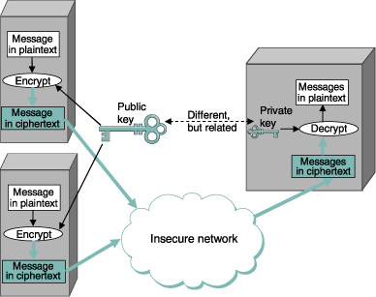
Public-key ciphers
RSA
  Difficult to factor large numbers
  Key length >= 1024 bits
ElGamal
  Discrete logarithm is hard
  Key length >= 1024 bits
Public-key ciphers are orders of magnitude slower than symmetric cipher

Slide 12
Cryptography building blocks
Confidentiality
  Encryption
Authenticity
  Public key signatures
  Authentication protocols

Slide 13
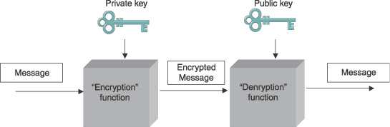
Public key authentication
Everyone can validate who sends the message
Not good enough
  “I owe you $10” → “I owe you $100000”

Slide 14
Authenticators
Message
Message
Digest (hash)
Encrypt
authenticator
Attach to a message
Detect tampering
Encryption alone does not provide data integrity
  Modifying a cipher may still allow decrypting to a valid plaintext
An authenticator is a value, to be included in a transmitted message that can be used to verify simultaneously the authenticity and the data integrity of a message
  Why are these two properties combined?
1. Message digest + encryption
  Modifying the message cannot produce the correct authenticator

Slide 15
Authenticator methods
Asymmetric cryptography
  Digital signatures
Symmetric cryptography
  Message authentication code (MAC)
    Another MAC!

Slide 16
Hash functions
A secure one-way function f(x)
  Knowing f(x) gives little knowledge about x
Collision attacks
  Attacks finding any collision
Preimage attacks
  A 2nd message that collides with a given first message
Common ones: MD5, SHA-1, SHA-2

Slide 17
Digital signatures
A digest encrypted using the private key of a public-key algorithm
Common digital signatures
  Digital signature standard (DSS)
    May use any one of three public-key ciphers
    RSA, ElGamal, Elliptic Curve Digital Signature Algorithm

Slide 18
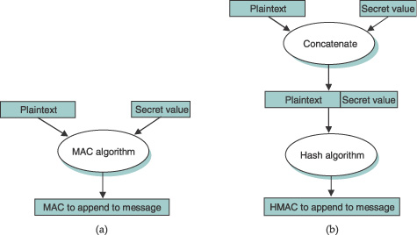
Authenticators – Message Authentication Code
Hashed message
authentication code
Instead of encrypting a hash, it uses a hash-like function that takes a secret value (known only to the sender and the receiver) as a parameter.
How does two ends obtain the key?
Security of HMAC: what if hash’s not one-way?

Slide 19
Key distribution
Two problems:
  How do participants know which entity has which public key?
    A complete scheme for certifying bindings between public keys and identities – what keys belongs to who – is called a public key infrastructure (PKI)
      Comments: not easy to scale
      People don’t use it that much
  How do each end know the symmetric shared key?

Slide 20
Distributing public keys
A public-key certificate is a digitally signed statement that binds the identity of the entity to a public key
If A trusts B, and knows B’s public key, then A can learn C’s public key if B issues a public key certification of C
X.509 certificate
  The ID of the entity
  The public key of the entity
  The identity of the signer
  The digital signature
  A digital signature algorithm
  Optional: expiration time

Slide 21
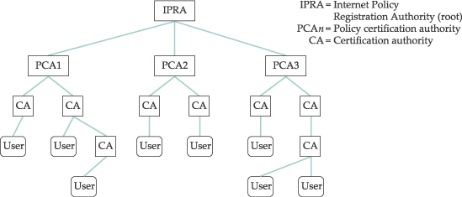
Certification authorities
A CA is an entity claimed to be trustworthy to verify identities and issuing public key certificates
  Verisign
CAs can be organized into a tree
Trust is binary: yes or no
  Everyone trusts the root

Slide 22
Multiple CAs
In the real world, there is no single rooted trust
Multiple CAs whose public keys are trusted by different people
Self-certifying certificates
  Signer is self
  Accepted by TLS

Slide 23
Web of Trust
Pretty Good Privacy:
  No single hierarchical
  Establishing trust is a personal matter and gives users the raw material to make their own decisions
IETF’s PGP signing session:
  Collect public keys from others whose identity one knows
  Provide his public key to others
  Get his public key signed by others
  Sign the public key of others
  Collect the certificate from other individuals whom he trusts enough to sign keys
Trust is a matter of degree
  A public-key certificate includes a confidence level
  Trust dependent on the number of certificates of a key, and the confidence level of each certificate

Slide 24
Certificate Revocation
Certificate revocation list
  Periodically updated and publicly available
  Digitally signed
  Lists may be large
Online certificate status protocol
  Query the status of a certificate

Slide 25
Key distribution
Two problems:
  How do participants know which entity has which public key?
    A complete scheme for certifying bindings between public keys and identities – what keys belongs to who – is called a public key infrastructure (PKI)
      Comments: not easy to scale
      People don’t use it that much
  How do each end know the symmetric shared key?

Slide 26
Symmetric key distributions
If there are N entities, N(N-1)/2 keys
Key distribution center (KDC)
  A trusted entity
  Each user maintains a key with the KDC
  KDC generates a session key when a user wants to communicate with another destination
    Kerberos is a widely used key-distribution system

Slide 27
Diffie-Hellman key agreement
gªmodp
g^{b} mod p
Long considered as the invention of public key cryptography
Establishes a session key without using any predistributed keys
Discrete log is hard

Slide 28
Diffie-Hellman Key Agreement
Two parameters: g, and p
  p: a prime; g: a primitive root of p s.t. for every number of n from 1 through p-1 there must be some value k such that n=g^k mod p
  1=2^0 mod 5, 2 = 2^1 mod 5, 3=2^3 mod 5, 4=2^2 mod 5
Alice picks a private value a, and sends gªmodp
Bob picks b, ands sends g^{b} mod p
g^{ab} mod p = g^{ba} mod p
Discrete log is hard
  Attackers cannot guess a, or b, even when they see gª mod p or g^{b} mod p

Slide 29
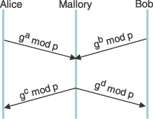
Man in the middle attack
Fixed DH: Alice and Bob has fixed a, and b values
gª mod p is certified

Slide 30
How to address those problems
Cryptography building blocks
  Confidentiality
    Encryption
  Authenticity
    Public key signatures
    Authentication protocols
Non-cryptographic approach
  Firewalls

Slide 31
Authentication protocols
Verify who one is talking to
  Originality
    Is the message replayed
  Timeliness
    Is the message delayed

Slide 32
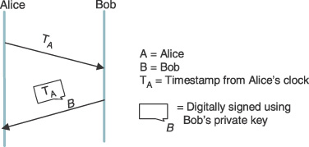
Originality and timeliness techniques
A challenge-response protocol
Timestamp:
  Synchronized clocks
Nonce
  Keep nonce state
Challenge response
  Combines timeliness and authentication

Slide 33
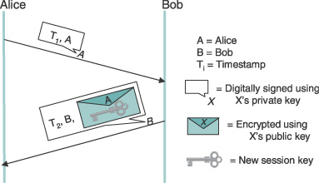
Public key authentication protocol
Alice includes her certificate in the first message sent to Bob
Relies on clock synchronization

Slide 34
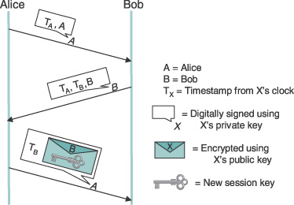
Another public key authentication protocol
Do not require clock synchronization
Timestamps are used as nonces

Slide 35
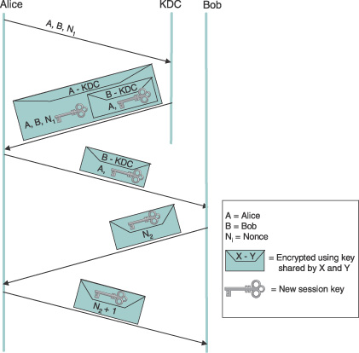
Symmetric key authentication protocol
Needham-Schroeder protocol
  Why nonce in Alice’s first 2 msgs?
  Why nonce in Bob’s message?
  Why is it flawed?
    Vulnerable to replay attack
    Replay the 3rd msg
Motivated BAN logic
  A logic to define and analyze information exchange protocols
Notes:
Q: why nonce in alice’s first two messages?
Flaw: if after a long time, someone cracked the session key, and replay the 3rd message. Bob will not know the 3rd message is not from Alice.
Q: Why nonce in Bob’s message?
Third message is fresh; the person knows the session key, not simply replaying what it intercepted before

Slide 36
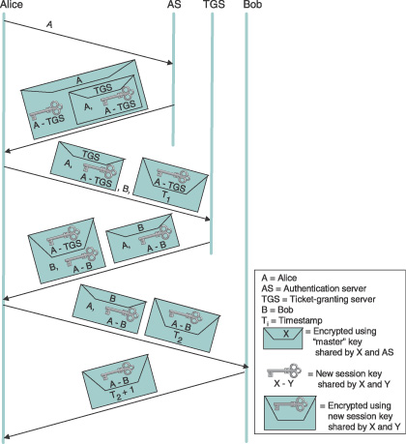
Kerberos
Goal is to minimize a user’s password exposure, not to the network, but also to the client machine
1. Separate Authentication Server from Ticket Granting Server. A only needs to authenticate once to talk to multiple Bs.
2. Requires loosely synchronized clocks
Notes:
Alice only needs to use her password to decrypt messages from KDC, but the session keys can be used to communicate with multiple Bs.
Replacing the third message to TGS with a different B.

Slide 37
Overview
Why studying network security?
  The topic itself is worth another class
Basic cryptography building blocks
Security protocols
  Case studies of using cryptography to build secure systems
Non-cryptography based security: firewalls

Slide 38
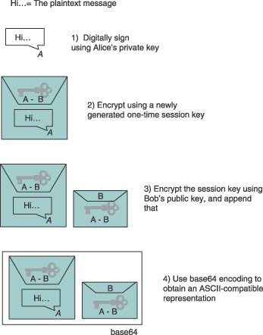
Secure systems
PGP for email security
  Works well for email
  Could be replayed, but a user can detect
  No need of prior message exchange
  Confidentiality
  Does not prove Alice is talking to Bob

Slide 39
Secure Shell (ssh)
Both the SSH protocol and applications that use it
Widely used
Replacing telnet, rsh, rcp
  No need to send plaintext passwords to authenticate
  Prior to it, passwords are sent in plaintext!
SSH 2 consists of three protocols
  SSH-TRANS: a transport layer protocol.
    Provides an encrypted channel between the client and server machines
    A secure channel is established before a client authenticates
    A client authenticates the server to establish the channel
  SSH-AUTH, an authentication protocol
    Client authenticates to the server
    You may type your password! SSH-TRANS takes care of encryption
  SSH-CONN, a connection protocol
    Used for port forwarding

Slide 40
SSH’s server key distribution
A server tells the client its public key at connection time
  Attackers are not always present
  Vulnerability window is small
The first time a key is sent, ssh asks the user
If accepts, ssh remembers the key and compares the stored key with an offered key in a subsequent connection
  Prompts the user if changed
  Otherwise accept

Slide 41
SSH’s client authentication
Password
  A secure channel is already established!
Public key encryption
  Places your public key in ~/.ssh/authorized_keys
Host authentication
  A user claiming to be so-and-so from a certain set of trusted hosts is automatically believed to be the same user on the server
  The client host authenticates itself to the server
    SSH-TRANS only authenticates server by default
    User claims to be so-and-so from a set of trusted hosts is believed to be the same user on the server

Slide 42
SSH login w/o typing in your passwords
Use ssh-keygen to generate a public/private key pair
  On spirit: ssh-keygen –t dsa
Append .id_dsa.pub to .ssh/authorized_keys on the server
  scp ~/.ssh/id_dsa.pub linux1.cs.duke.edu:~/
  ssh linux1.cs.duke.edu “cat ~/id_dsa.pub >> ~/.ssh/authorized_keys”

Slide 43
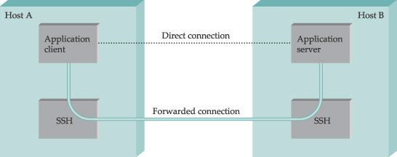
SSH port forwarding
SSH can be used to establish a secure channel between two hosts using the SSH-CONN protocol

Slide 44
Example: X11 forwarding
Local host
Remote host
X server
xterm
Localhost:10.0
ssh client
sshd
ssh –X remote-host
sshd at the remote host creates a TCP listening socket (6010), and X authentication information, and set your display variabl to localhost:10.0
When you type xterm, it speaks the X11 protocol with the sshd faked X server port (10.0), and sshd forwards it back to the ssh client at local host.
The ssh client forwards back to the X server running on your local host
You see the xterm displays on your local host, and all commands you type in the xterm is encrypted!

Slide 45
SSH port forwarding
Some legacy applications do not have security mechanism built-in: pop3
A real world application
  The free VNC servers do not have encryption
    Figure out how to do it yourself!

Slide 46
The VNC example
Local disp
Remote disp
VNC client
VNC server
Inseure network

Slide 47
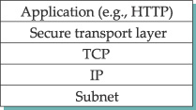
SSL/TLS
TLS is based on SSL
https: port 443
A handshake protocol for negotiating parameters, and a secret session key
  Each direction has a key
A record protocol to transmit messages

Slide 48
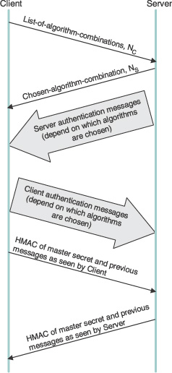
The handshake protocol
Negotiate encryption hash, symmetric key cipher, and session key establishment protocol
Optional: compression

Slide 49
The record protocol
Fragmented or coalesced into blocks of a convenient size
Optionally compressed
Integrity-protected using an HMAC for each record
Encrypted using a symmetric key cipher
Passed to the transport layer
Each record message has its own sequence number to prevent replay attacks.
  TCP’s sequence number is not sufficient!
Comments: quite heavy
https://gmail.com is not the default!

Slide 50
IPSec
A framework specifies how to secure all IP traffic between two machines
Two parts
  Security services: Authentication header (AH): rarely used, Encapsulating Security Payload (ESP)
  Key management: Internet security assocation and key mangement protocol (ISAKMP).
    Defines message format, not the detailed key generation algos.
A security association (SA) is created for each direction
  IP is connectionless, but IPSec is not
  An SA includes connection state such as keys, and sequence numbers
  An SA is identified by a security parameter SPI
  SPI and destination address identifies an SA
  SAs are established, negotiated, modified and deleted using ISAKMP
  Internet Key Exchange (IKE) is one key exchange protocol

Slide 51
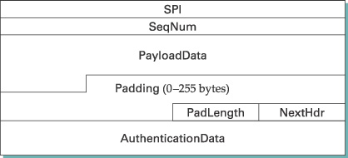
The ESP header
Payload’s encrypted

Slide 52

Modes
Company site 1
Company site 2
Internet
VPN tunnel
Tunnel mode: bump-in-the-wire
  Useful in creating VPNs
Transport model
  Upper layer payload is encrypted

Slide 53
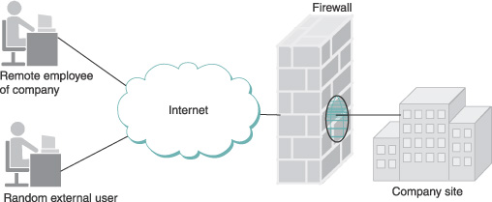
Firewalls
Firewalls create zones of trust
  The internal network
  Demilitarized zone (DMZ)
    DNS, email servers
    Hosts in DMS accessible by anyone
    Cannot access internal hosts
    DMZ can be periodically restored
  The rest of the Internet
Widely used in practice
  Unilaterally deployed

Slide 54
Firewall configurations
Access lists: similar to tcpdump’s filter lists
Allows outside connection to Duke CS’s main mail server one.cs.duke.edu:
  (*,*,152.3.140.161, 25, allow)
Disallow to internal mail server
  (152.3/16, *, 152.3.140.1, 25, allow )
  (*,*,152.3.140.1, 25, deny)

Slide 55
Conclusion
Enough for you to take on on your own!
Other references
  Network Security by Kaufman, Perlman, and Speciner
  Handbook of Cryptography
  Wikipedia
You’ll be amazed on how much you can learn on your own

Slide 56
Suppose your PoP server does not support encryption. How can you read your email without sending your password in cleartext?
  ssh –L 9999:localhost:110 mail.cs.duke.edu
  Run your pop3 mail client, and make it use localhost:9999
  All commands will be sent via an encrypted connection

