Slide 1
ZooKeeper
Some materials are from MIT EECS 6.824 and Danyang Zhuo (Duke)

Slide 2
A fault-tolerant coordination service for distributed applications
Developed by Yahoo! Open source at
https://zookeeper.apache.org/
Goals:
Provide building blocks (through client API) to implement primitives, e.g.,
leader election
locks
maintaining group membership
High throughput for read-dominated workloads
Fail-stop failure model:
A process may crash or become disconnected, but won’t behave maliciously
A process may return after a crash

Slide 3
Data tree
Structured like a hierarchical file system, but special operations
Limited data can be stored at each znode

Slide 4
Two types of znodes
Regular
Creation and deletion must be explicit
Ephemeral
Deletion is automatic when client session ends

Slide 5
Operations on znodes
create (path, data, flags)
Exclusive – only first create indicates success; flags indicate regular/ephemeral
delete (path, version)
If znode.version = version, then delete
exists (path, watch)
Watch=true means send notification if path is later created/deleted
getData (path, watch)
Returns data and metadata, including version
setData (path, data, version)
If znode.version = version, then update
getChildren(path, watch)
Returns names of children of znode
sync()
Returns when writes before the sync are visible to the client

Slide 6
Watches
Client sets the watch flag to indicate that it wants to be notified if something changes
Benefit: clients can cache data locally
Clients don’t have to poll for changes
Example:
getData(′/foo′, true)
Client is notified (once) when ′/foo′ znode changes

Slide 7
ZooKeeper API well tuned for concurrency and synchronization
exclusive file creation; exactly one concurrent create returns success (e.g., use for leader election)
sessions and ephemeral znodes automate actions when clients fail (e.g., release lock on failure)
getData()/setData(x, version) supports mini-transactions, i.e.,
conditional setData: check version, update data on match

Slide 8
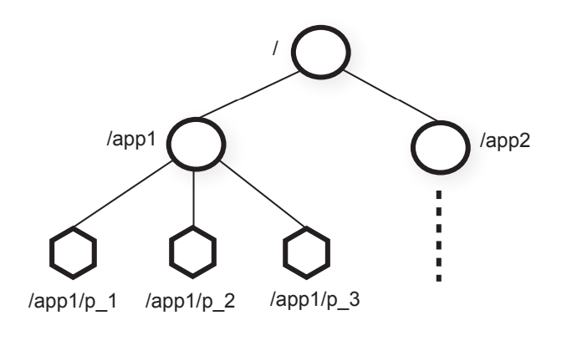
Canonical application: configuration management
/app1/ready
Master process writes configuration data for worker processes (e.g., as in MapReduce)
But note that MapReduce doesn’t survive master failure
Zookeeper provides fault tolerance, leader election used to select master
Configuration data for each process may be stored in a separate znode in the tree, e.g., /app1/p_1
Special ephemeral /app1/ready znode indicates new leader’s configuration changes are ready
Processes watch for changes in ready znode

Slide 9
Write/notification ordering guarantee
What if a client is reading its configuration when a new leader deletes the ready node and starts to write the new configuration?
delete(′ready′)
write f1
write f2
create(′ready′)
exists (′ready′, watch = true)
read f1
read f2
Client will receive watch notification for delete(′ready′) before it sees effect of write f2.

Slide 10
Linearizability
At a high-level, we want a replicated system to behave as a single copy
Replication is just for fault-tolerance
Clients should not “feel” the difference between a replicated system and a single-copy system
What’s the formal definition?

Slide 11
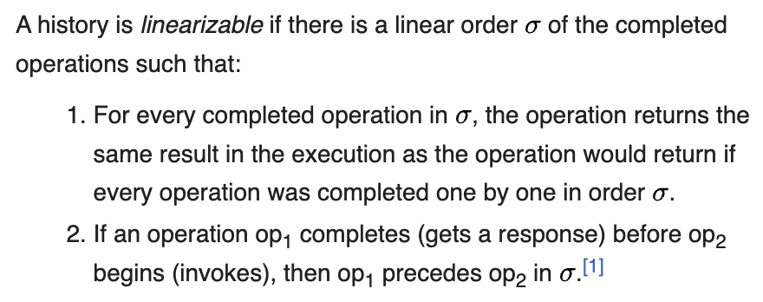
Linearizability
A history is a sequence of invocations and responses made of an object by a set of threads or processes. An invocation can be thought of as the start of an operation, and the response being the signaled end of that operation.

Slide 12
Is this history linearizable?
C1
Wx=1
Wx=2
C2
Rx=2
C3
Rx=1

Slide 13
Is this history linearizable?
C1
Wx=1
Wx=2
C2
Rx=2
C3
Rx=1
C1:Wx=1
C3:Rx=1
C1:Wx=2
C2:Rx=2

Slide 14
Is this history linearizable?
C1
Wx=1
Wx=2
C2
Rx=2
C3
Rx=1

Slide 15
ZooKeeper guarantees
Linearizable writes
FIFO client ordering
This means read may return stale data!

Slide 16
Atomic Broadcast
Zookeeper relies on an atomic broadcast algorithm called Zab (not described in the paper)
All processes receive the same messages in the same order, even if some processes fail

Slide 17
RAFT consensus algorithm
Will be covered in Lecture 17
All processes agree on a replicated log of operations
Atomic broadcast can be used to implement replicated logs
Replicated logs can be used to implement atomic broadcast

Slide 18
ZooKeeper implementation
Multiple servers for fault tolerance, read throughput
Each client connects to a single server, starts a session
Server keeps database in memory, writes snapshots to disk
Client read operations processed without synchronization
Servers rely on atomic broadcast to provide replication, linearizable writes

Slide 19
Recovery of replicated data tree
ZooKeeper uses periodic snapshots and only requires redelivery of messages since the start of the snapshot.
Snapshots are fuzzy since we do not lock the ZooKeeper state to take the snapshot
The result may not correspond to the state of ZooKeeper at any point in time
Since state changes are idempotent, we can apply them twice as long as we apply the state changes in order

Slide 21
How is FIFO client ordering ensured?
Easy if the client stays connected to the same server. Trickier if client connects to a new server that is behind its old server.
When a client sends a request, the replica returns zxid
zxid is the id of the last write
Clients keeps the most recent zxid and sends it long with a read request
If replica is not updated (till zxid), e.g., after changing servers, wait
Otherwise return data from the database
How can a stale read happen?
Server is not yet aware of a write
sync operator provided if global synchronization is needed

Slide 22
Simple locks
Lock:
Create(“lock”, EPHEMERAL, watch=true)
Unlock:
Delete(“lock”)
This will have herd behavior: all clients will vie for the lock when it is released.

Slide 23
Sequential flag
If provided during create operation, sequence value automatically appended to znode name
Sequence value is monotonically increasing
New child has sequence value larger than any other child of same parent
/app1
/app1
/app1/lock_0001
/app1/lock_0003
/app1/lock_0001
/app1/lock_0003
/app1/lock_0004

Slide 24
Simple locks without herd effect
Lock:
n = create(l +”lock-”, EPHEMERAL | SEQUENTIAL)
While (true) {
C = getchildren(l, false)
If n is lowest znode in C, exit
p = znode in C ordered just before n
If exists(p, watch = true) wait for watch event
}
Unlock:
Delete(n)

Slide 25
For all-read workload, throughput increases with number of servers
For all-write workload, throughput decreases with number of servers
Writes are much slower than reads

