Slide 1
TensorFlow
Some materials are from Danyang Zhuo’s and Jeff Dean’s slides

Slide 2
TensorFlow goal and features
Support training and inference of large-scale machine-learning models
Represents network computation and shared state as dataflow graphs
Training algorithms are also expressed as dataflow graphs
Automatically maps nodes of the dataflow graph across servers, or across CPUs, GPUs, or TPUs
But also runs on a laptop

Slide 4
Neuron
output
Rectified Linear Unit (ReLU) shown here
inputs

Slide 6
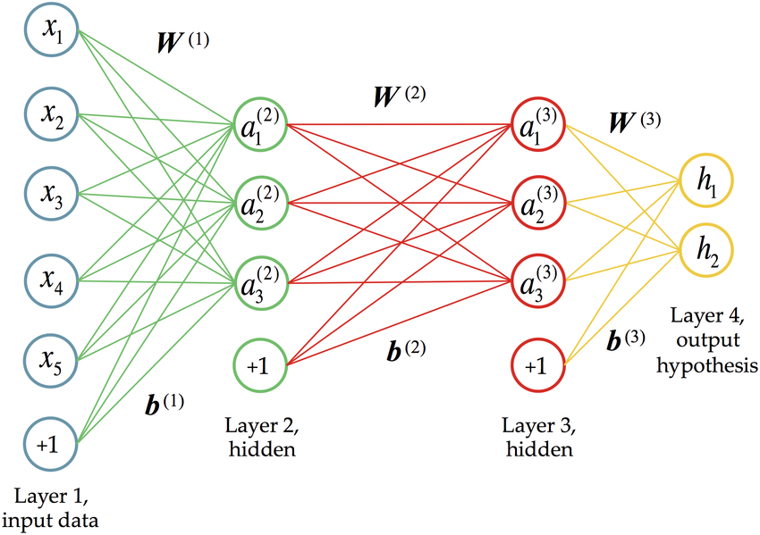
Feedforward neural network
Figure from ``Deep Learning for Population Genetic Inference,’’ by Sara Sheehan and Yun S. Song. PLoS Comput Biol 12(3), 2016

Slide 8
Learning algorithm
While not done:
Pick a random training example (input, ground-truth label)
Run neural network on input
Adjust weights on edges to make output closer to label

Slide 9
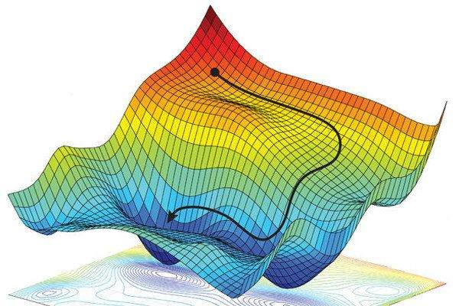
Stochastic gradient descent and backpropagation
Stochastic gradient descent: algorithm for minimizing loss on a training dataset
(negative of) gradient points in direction of greatest decrease in loss
https://dtmvamahs40ux.cloudfront.net/gl-academy/course/course-1281-Non-convex-optimization-We-utilize-stochastic-gradient-descent-to-find-a-local-optimum.jpg
Backpropagation: algorithm for computing the gradient in the loss function of each weight, working backwards from outputs to inputs, applying the chain rule from calculus

Slide 10
Stochastic gradient descent
Example loss function: L = | Y - F(W, X) | ^2
Training data: randomly chosen X1, Y1
dL/dW = 2 (Y1 – F(W, X1)) dF(W, X1)/dW
W = W – learning_rate * dL/dW

Slide 14
How to train a large neural network with a lot of training data?
Data parallel
A set of compute devices holding the same replica of the neural network
They use different training data
Synchronize model weights by training iteration
Model parallel
A set of compute devices holding different components of the neural network
Passing activations and gradients within a training iteration

Slide 22
Why not a parameter server (DistBelief)?
Flexibility in defining new layers
DistBelief uses separate C++ classes to implement predefined complex network layers
Flexibility in refining the training algorithm
Training algorithm baked into DistBelief
Flexibility in defining new training algorithm
Want a single platform for different execution environments
DistBelief runs on a cluster of servers

Slide 23
TensorFlow partitions subgraphs across devices, e.g., servers/CPUs/GPUs/TPUs.
Subgraphs execute concurrently.
TensorFlow replaces edges that cross subgraphs with Send/Recv operations.

Slide 24
TensorFlow
General dataflow instead of put/get for parameter servers
Unifying computation and state management in a single programming model
Allows programmers to experiment with different parallelization schemes
Can run a single laptop!

Slide 25
Image classifier using TensorFlow Python API

Slide 27
(hence the name TensorFlow)

Slide 28
(e.g., weights and biases)

Slide 29
Design principles
Dataflow on individual mathematical operator levels
Easy to compose neural network layers
Deferred execution
TensorFlow can optimize execution based on the global computation graph
Common abstraction for heterogeneous accelerators

Slide 30
Dataflow graph for a training pipeline

Slide 31
Checkpointing for fault tolerance
There is no need to make every write to the parameter state durable, because we can recompute any update from the input data.
Many learning algorithms do not require strong consistency.
User-level checkpointing (users have to write code to trigger these functions):
Save: writes tensors to files
Restore: read tensors from files

Slide 32
Synchronization schemes for parallel stochastic gradient descent
working with stale parameters
A white square is a parameter update. A dashed rectangle in (c) is a backup worked whose result is discarded.
Asynchronous replication has higher throughput, but updates are calculated using stale parameter values.

