Slide 1
Computation + journalism in the public interest
Sarah Cohen, DeWitt Wallace Center

Slide 2
Public interest reporting defined
Information of importance to the public that powerful institutions would prefer to be kept hidden or secret.
A method of comparing what ought to happen with what actually happens
Breaking laws or rules
Taking advantage of the helpless
Comforting the afflicted and afflicting the comfortable.

Slide 3
Common traits
Reporting shares some traits with other investigative or exploratory fields :
Use of multiple sources with varying accuracy and collection methods
Practitioners have little or no technical ability or interest
Much of the data is in the form of unstructured text
Start with broad, ill-defined questions, not discrete goals
Combines field work and lab work (street reporting and data or document analysis)
Notes:
Investigative reporters share some problems with law enforcement and intelligence investigators: Most of our sources start with unstructured data. That is, that they are documents not databases, that they come from multiple sources and that we are looking for commonalities of place, time and networks.
But a lot of this isn’t the same.

Slide 4
Uncommon traits
Rarely spend much time on a given data source or question
Reporters look for tips and examples, not evidence or statistical patterns.
Work from primary sources
Analysis is not mission-critical
Unique identifiers are censored.
Little or no control over the form of the data: it’s up to the source

Slide 5
Typical data sources
Interview notes, both on the record and for background only. Very little is taped, especially early in a story.
Taped or videotaped hearings, sometimes transcribed already
Calendars, correspondence, investigative and inspection reports
Emails and press releases
Excel spreadsheets created for printing, not analysis
Structured databases
Court documents: complaints, indictments, settlements, discovery.
Online document collections, such as regulatory enforcement actions or audits.
Handwritten forms, such as inspections or police incident reports, usually heavily redacted

Slide 6
Transparency myths
Government records are easy to get in a usable form? Not so much.
Examples, even when it is:
Recovery Act
Campaign finance
Crime
Most government information is still hidden, secret or difficult to access
data.gov: Promise of 100,000 datasets. Currently have 728, half of which are annual state-level cuts of existing EPA data that has been available for years. No records, mainly just aggregated statistics. Almost nothing on it that wasn’t already readily available.

Slide 7
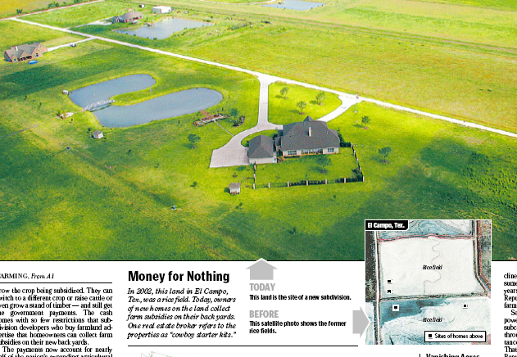
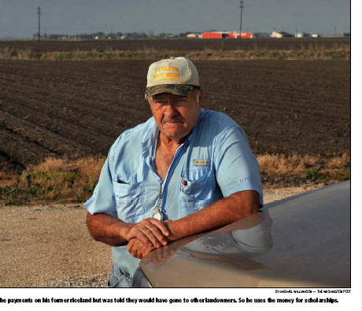
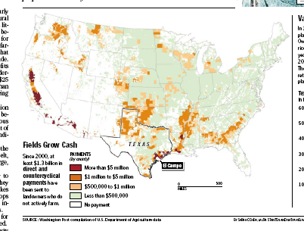
Harvesting Cash
Sources:
People
database of 200 million farm subsidy payment
crop estimates
weather records
emergency records
property ownership records (local)
letters from members of Congress

Slide 8
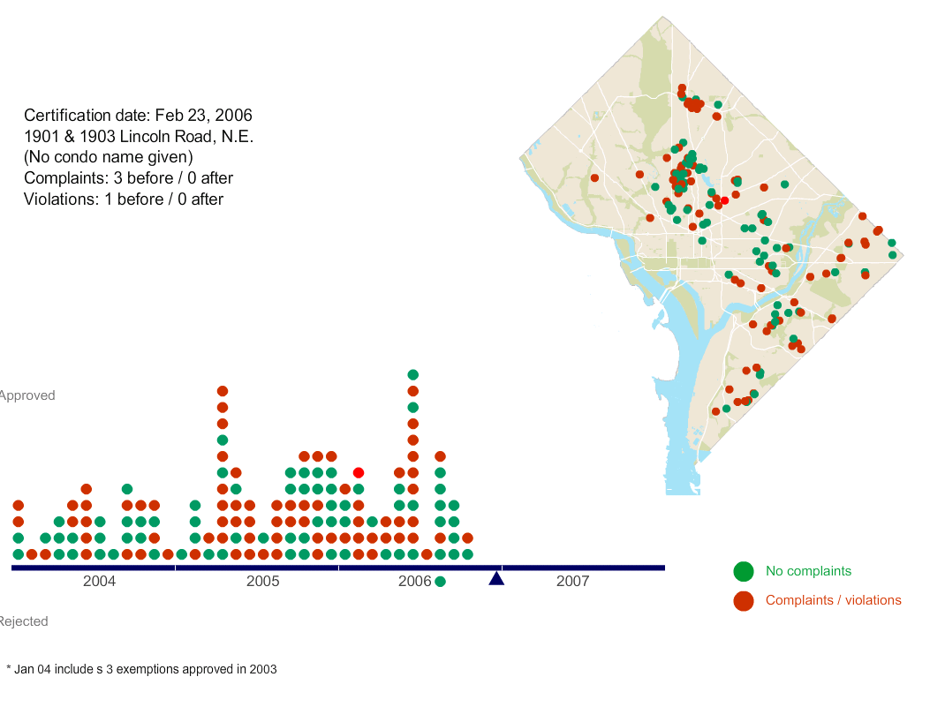
Forced Out
Sources:
File cabinets (some missing)
Spreadsheet where the color meant different things.
200,000 or so housing code complaints and violations
Paper records from court
People (residents, activists, government officials)
Physical inspection of properties
Landlord-tenant court disputes
Property assessments and deeds
Notes:
Here is another story that I worked on last year, where we discovered a tax loophole that allowed landlords to let their building deteriorate, often leaving tenants in dangerous and unsanitary conditions in an attempt to force them to move out and let them convert the building to a condominium.
This is a simple analysis of the timing of these tax breaks, and their locations in the city.We used it to find the best people , places and time to talk with people, but it eventually became an element of the story.

Slide 9
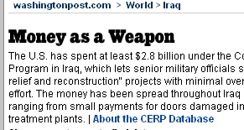
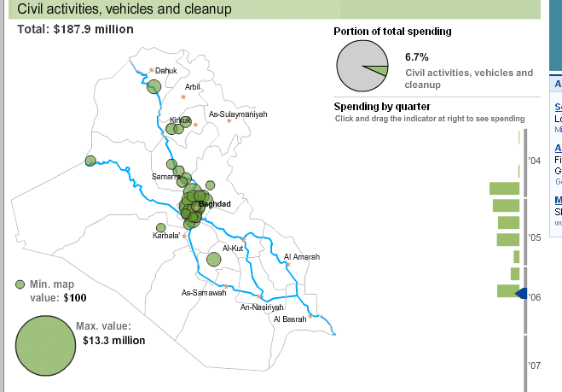
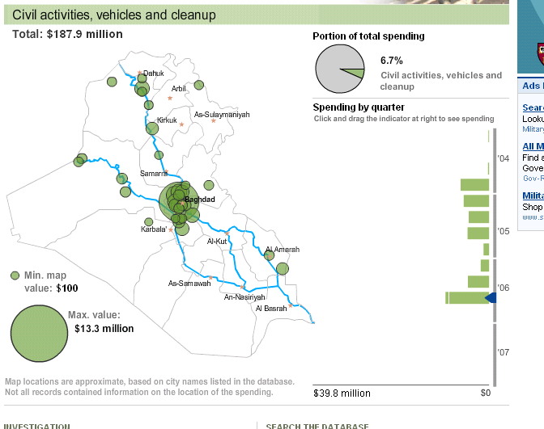
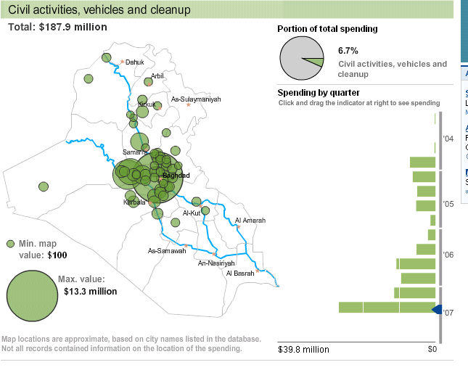
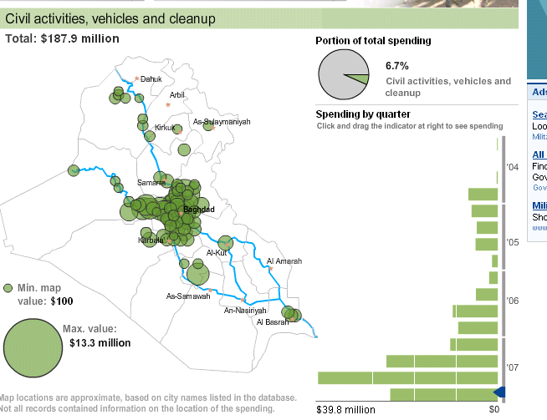
Source: Freedom of Information response from the Army Corps of Engineers in Iraq (Iraq Reconstruction Management System) and inspector general reports
Notes:
Sometimes your data analysis both leads to good stories, and to good online presentations. Here is a story I worked on, called “Money as a Weapon.” It was an analysis of a little-known fund used in the Iraq War called the Commanders’ Emergency Releft fund. Here is a paragraph from that story. At the time, the U.S. had spent nearly $3 billion with virtually no oversight and no particular rules around how the money was used.
Here’s a list of a few things it bought:
Army documents show that $48,000 was spent on 6,000 pairs of children's shoes; an additional $50,000 bought 625 sheep for people described in records as "starving poor locals" in a Baghdad neighborhood. Soldiers ordered $100,000 worth of dolls and $500,000 in action figures made to look like Iraqi Security Forces. About $14,250 was spent on "I Love Iraq" T-shirts. More than $75,000 sent a delegation to a women's and civil rights conference in Cairo. And $12,800 was spent for two pools to cool bears and tigers at Zawra Park Zoo in Baghdad.
This interactive was used to both guide our reporting, and to publish the data.

Slide 10
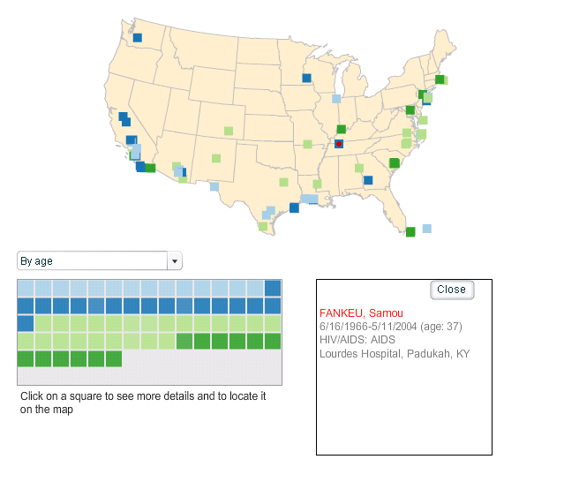
Unnamed source

Slide 11
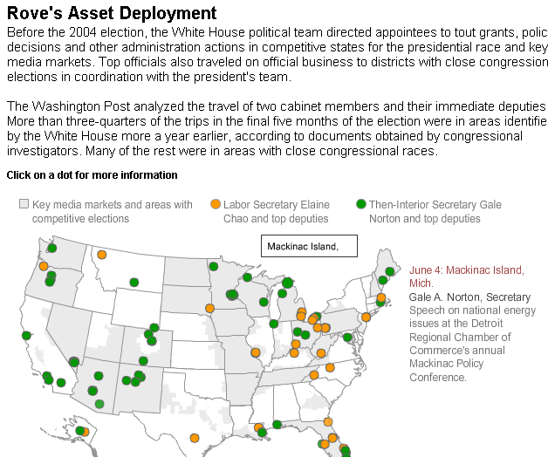
Notes:
This was a very quick-hit story. We had heard that there were efforts throughout the administration to direct grants to politically favored congressional districts and media markets, but couldn’t find any clear-cut evidence of it until we learned of the “Asset deployment teams” created by Karl Rove, and set up in most cabinet level departments. We also obtained some of the briefings, showing which markets he considered crucial and which states he was directing officials to travel to. We didn’t have time to get the proper public records – the travel records of the secretaries. But we could trace their movements in cases in which they wanted the public to know where they were. We tracked something like 200 trips made by top officials in two departments simply using press releases. Here’s the result.

Slide 12
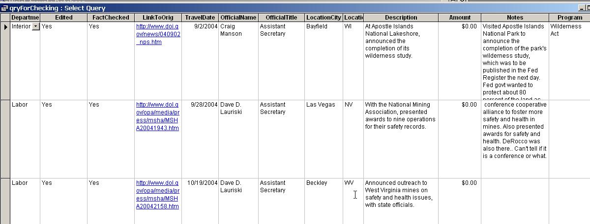
Notes:
Here’s what a little of that database looked like. Notice a couple of things here – mainly that it’s built to minimize errors in the paper: It has fields for “edited”, “factchecked” and a link to the original document that provided the detail. The “description” flowed directly into the graphic you see on the web.

Slide 13
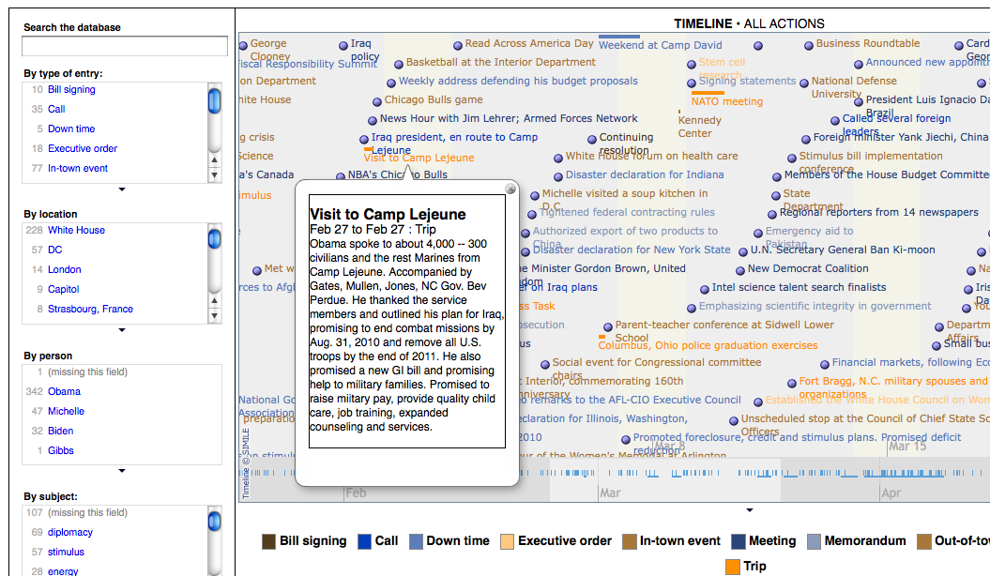
Resulting graphics at: http://www.washingtonpost.com/wp-srv/politics/obama/100days/
Notes:
Here’s another really bad attempt to visualize what Obama did in the first 100 days. The end result was something that we had to boil down into something like this:

Slide 14
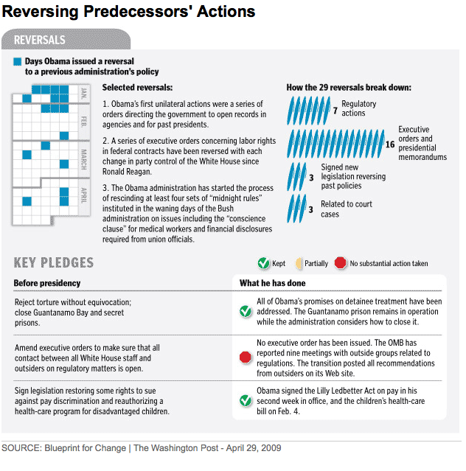
Sources: Original presidential documents, mainly in press release or pdf form
Notes:
There were several of these graphics, each of which involved examining that schedule. The process of building it helped, but the visualization didn’t.

Slide 15
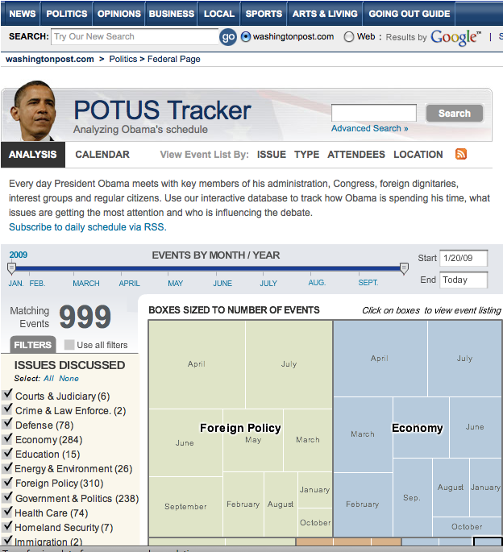
Sources:
Daily press releases and “pool” reports from the White House press corps, hand-coded

Slide 16
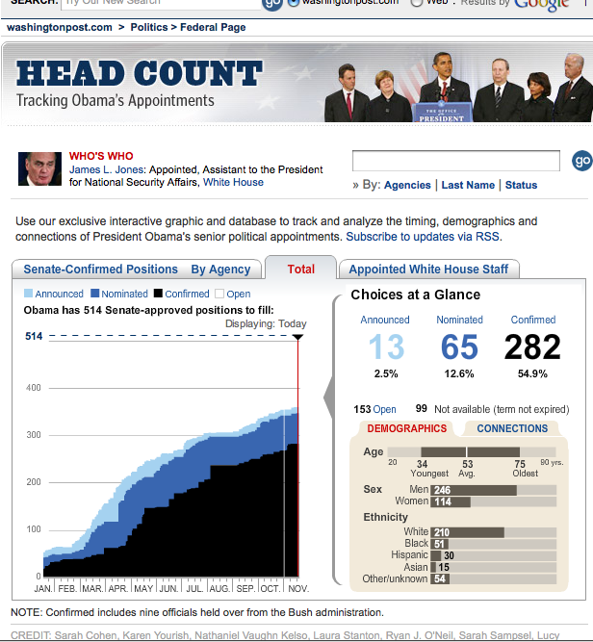
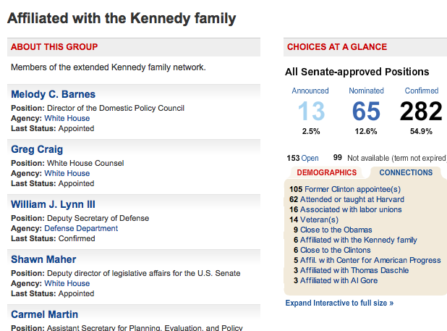
Source: “Plum Book” list of jobs, original research on each person and congressional records

Slide 17
Theories of open data
Governments prefer to lead you to the “right” answer, so they like colorful and “user-friendly” websites that convey their message.
Transparency advocates look for government to first “wholesale” data, then work on their own website. They’ve had little luck.

Slide 18
New directions in newsgathering
What’s New? Smart scraping and text mining – indictments, settlements and regulatory actions across agencies; lawmaker releases and grant announcements.
The Real Story: Anti-aggregation of stories and news from blogs, news sites, RSS feeds, government agencies grouped by story, not by source.
Chronologies and social network tools to organize notes and see new connections
Text mining of government documents: Jigsaw, Meandre, Document Cloud
Audio and video analysis
Notes:
But there are many datasets and databases that are harder to use, and haven’t been fully explored by reporters. I just want to show you a few from the national level, which require someone to work with them, clean them up, and afind a way to analyze them well.
On lobbying, the way to get these records (which are better than some of the others), you have to go through each quarter and download one by one. (Someone sent me a program to do this, but it didn’t work on Windows machines for some reason. It worked fine on a mac!)

Slide 19
Opportunities for Computer Science students
DukeEngage project (look on the DeWitt Wallace Center’s website for a link) to create newsgathering tools
“Middle layer” of sense-making on unexplored local and national datasets
Stimulus
Contracts and grants
Dispersed records (calendars, etc.)
Entity extraction, geocoding tools
Visualizations that say something new

