Slide 1
Scale and Performance
Jeff Chase
Duke University

Slide 2
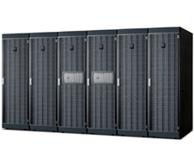
“Filers”
Network-attached (IP)
RAID appliance
Multiple protocols
  iSCSI, NFS, CIFS
Admin interfaces
Flexible configuration
Lots of virtualization: dynamic volumes
Volume cloning, mirroring, snapshots, etc.
NetApp technology leader since 1994 (WAFL)

Slide 3
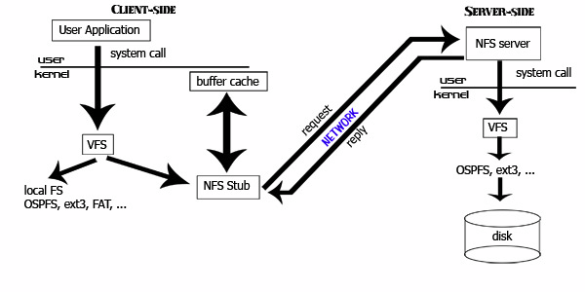
Example of RPC: NFS
[ucla.edu]

Slide 4
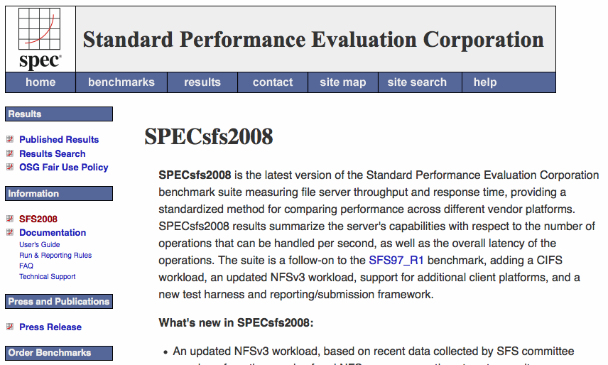
http://www.spec.org/sfs2008/

Slide 5
Benchmarks and performance
Benchmarks enable standardized comparison under controlled conditions.
They embody some specific set of workload assumptions.
Subject a system to a selected workload, and measure its performance.
Server/service metrics:
  Throughput: request/sec at peak (saturation)
  Response time: t(response) – t(request)

Slide 6

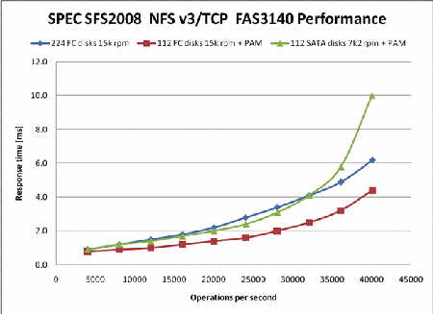

Slide 7
Servers Under Stress
saturation
Ideal
Response rate (throughput)
Response time
Overload
Thrashing
Collapse
Request arrival rate (offered load)
Load (concurrent requests, or arrival rate)
[Von Behren]

Slide 8
Ideal throughput: cartoon version
throughput == arrival rate
The server is not saturated: it completes requests at the rate requests are submitted.
throughput == peak rate
The server is saturated. It can’t go any faster, no matter how many requests are submitted.
Ideal throughput
Response rate (throughput)
i.e., request completion rate
This graph shows throughput (e.g., of a server) as a function of offered load. It is idealized: your mileage may vary.
saturation
peak rate
Request arrival rate (offered load)

Slide 9
Utilization: cartoon version
U = XD
X = throughput
D = service demand, i.e., how much time/work to complete each request.
U = 1 = 100%
The server is saturated. It has no spare capacity. It is busy all the time.
saturated
1 == 100%
This graph shows utilization (e.g., of a server) as a function of offered load. It is idealized: each request works for D time units on a single service center (e.g., a single CPU core).
Utilization
(also called load factor)
saturation
peak rate
Request arrival rate (offered load)

Slide 10
Throughput: reality
Thrashing, also called congestion collapse
Real servers/devices often have some pathological behaviors at saturation. E.g., they abort requests after investing work in them (thrashing), which wastes work, reducing throughput.
delivered throughput
(“goodput”)
Response rate (throughput)
i.e., request completion rate
saturation
Illustration only
Saturation behavior is highly sensitive to implementation choices and quality.
peak rate
Request arrival rate (offered load)

Slide 11
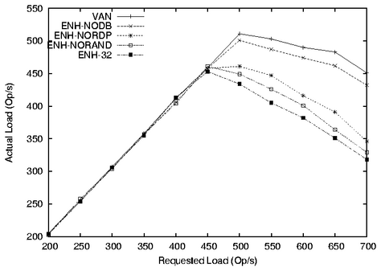
This graph shows how these alternatives impact a server’s peak rate (saturation throughput).
(The schemes themselves are not important to us.)
saturation
???
throughput
Offered load (request/sec)

Slide 12
Response Time
Components
Wire time +
Queuing time +
Service demand +
Wire time (response)
Depends on
Cost/length of request
Load conditions
latency
offered load

Slide 13
Response time
R == D
The server is idle. The response time of a request is just the time to service the request (do requested work).
R = D + queuing delay
As the server approaches saturation, the queue of waiting request grows without bound.
(We will see why in a moment.)
saturation (U = 1)
Average response time R
Illustration only
Saturation behavior is highly sensitive to implementation choices and quality.
U
R
saturation
D
Request arrival rate (offered load)

Slide 14

Growth and scale
The Internet
How to handle all those client requests raining on your server?

Slide 15
Scaling a service
Dispatcher
Work
Support substrate
Server cluster/farm/cloud/grid
Data center
Add servers or “bricks” for scale and robustness.
Issues: state storage, server selection, request routing, etc.

Slide 16
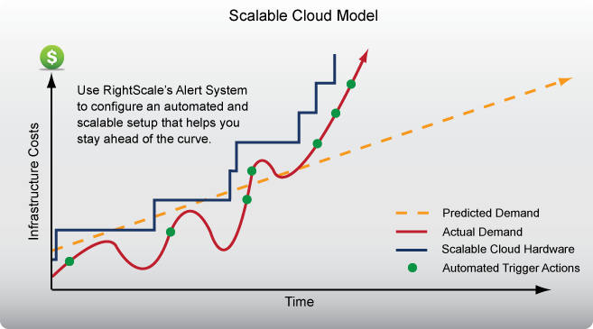
Automated scaling

Slide 17
Incremental Scalability
Scalability is part of the “enhanced standard litany” [Fox]. What does it really mean?
How do we measure or validate claims of scalability?
not
scalable
scalable
cost
marginal
cost of capacity
No hockey sticks!
capacity

Slide 18
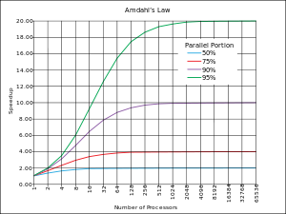
Amdahl’s Law
Normalize runtime = 1
Now parallelize:
Parallel portion P
N-way parallelism
Runtime is now:
P/N + (1-P)
“Law of Diminishing Returns”
“The bottleneck limits performance”
“Optimize for the primary bottleneck”

Slide 19
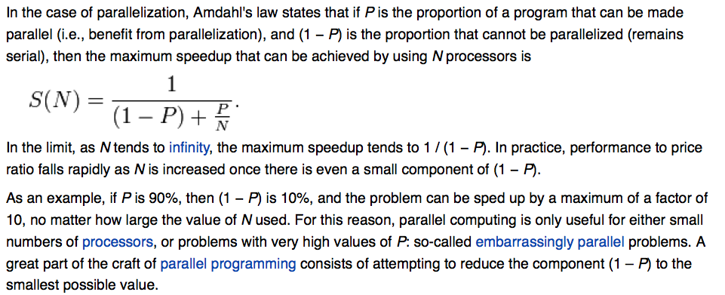
Amdahl’s Law

Slide 20
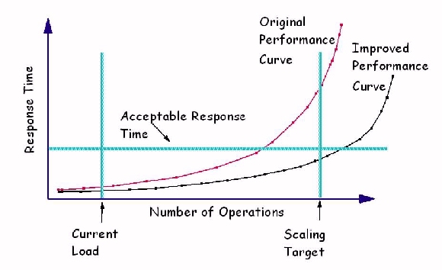
Scaling and response time
[IBM.com]

Slide 21

The same picture, only different
Queuing delay is proportional to:
Response time,
determined by:
rho is “load factor”
= r/rmax
= utilization
“stretch factor”
R/D
(normalized
response time)
(Max request load)
“saturation”
Offered load
(request/sec)
also called lambda
Principles of Computer System Design ♥ Saltzer & Kaashoek 2009

Slide 22
Queuing Theory for Busy People
wait here in queue
offered load
request stream @
arrival rate λ
Process for mean service demand D
“M/M/1” Service Center
Big Assumptions
  Single service center (e.g., one core)
  Queue is First-Come-First-Served (FIFO, FCFS).
  Request arrivals are independent (poisson arrivals).
  Requests have independent service demands.
  i.e., arrival interval and service demand are exponentially distributed (noted as “M”).
  These assumptions are rarely true for real systems, but they give a good “back of napkin” understanding of behavior.

Slide 23
Little’s Law
For an unsaturated queue in steady state, mean response time R and mean queue length N are governed by:
      Little’s Law: N = λR
Suppose a task T is in the system for R time units.
During that time:
  λR new tasks arrive.
  N tasks depart (all tasks ahead of T).
But in steady state, the flow in balances flow out.
  Note: this means that throughput X = λ.

Slide 24
Utilization
What is the probability that the center is busy?
  Answer: some number between 0 and 1.
What percentage of the time is the center busy?
  Answer: some number between 0 and 100
These are interchangeable: called utilization U
If the center is not saturated, i.e., it completes all its requests in some bounded time, then:
    U = λD = (arrivals/T * service demand)
    “Utilization Law”
The probability that the service center is idle is 1-U.

Slide 25
Inverse Idle Time “Law”
Service center saturates as 1/ λ approaches D: small increases in λ cause large increases in the expected response time R.
R
U
1(100%)
Little’s Law gives response time R = D/(1 - U).
  Intuitively, each task T’s response time R = D + DN.
  Substituting λR for N: R = D + D λR
  Substituting U for λD: R = D + UR
  R - UR = D --> R(1 - U) = D --> R = D/(1 - U)

Slide 26
Why Little’s Law Is Important
1. Intuitive understanding of FCFS queue behavior.
    Compute response time from demand parameters (λ, D).
    Compute N: how much storage is needed for the queue.
2. Notion of a saturated service center.
  Response times rise rapidly with load and are unbounded.
    At 50% utilization, a 10% increase in load increases R by 10%.
    At 90% utilization, a 10% increase in load increases R by 10x.
3. Basis for predicting performance of queuing networks.
    Cheap and easy “back of napkin” estimates of system performance based on observed behavior and proposed changes, e.g., capacity planning, “what if” questions.

Slide 27
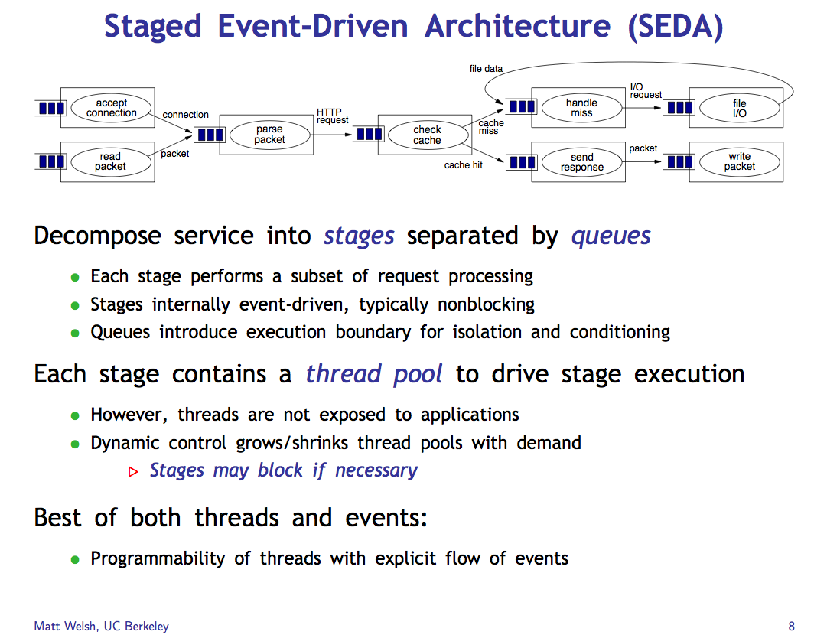

Slide 28
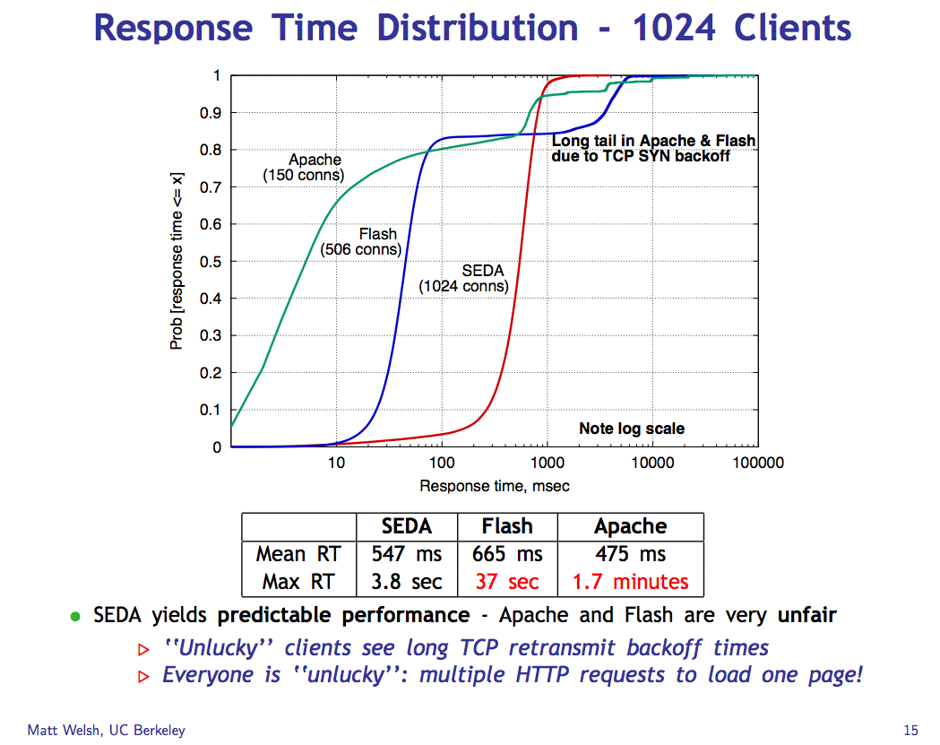

Slide 29
Cumulative Distribution Function (CDF)
80% of the requests have response time r with x1 < r < x2.
“Tail” of 10% of requests with response time r > x2.
90%
quantile
A few requests have very long response times.
What’s the mean r?
50%
median
10%
quantile
x1
x2
Understand how the mean (average) response time can be misleading.

Slide 30
SEDA Lessons
Means/averages are almost never useful: you have to look at the distribution.
Pay attention to quantile response time.
All servers must manage overload.
Long response time tails can occur under overload, and that is bad.
A staged structure with multiple components separated by queues can help manage performance.
The staged structure can also help to manage concurrency and and simplify locking.

Slide 31
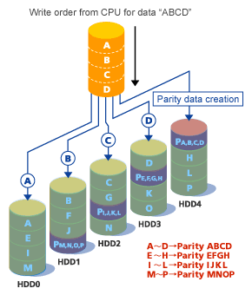
Building a better disk: RAID 5
Redundant Array of Independent Disks
Striping for high throughput for pipelined reads.
Data redundancy: parity
Enables recovery from one disk failure
RAID5 distributes parity: no“hot spot” for random writes
Market standard
Fujitsu

Slide 32
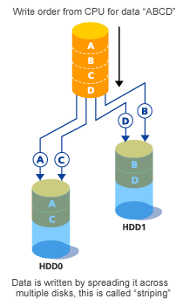
RAID 0
Striping
Sequential throughput?
Random throughput?
Random latency?
Read vs. write?
MTTF/MTBF?
Cost per GB?
Fujitsu

Slide 33
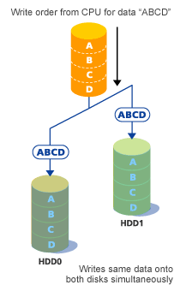
RAID 1
Mirroring
Sequential throughput?
Random throughput?
Random latency?
Read vs. write?
MTTF/MTBF?
Cost per GB?
Fujitsu

Slide 34
WAFL & NVRAM
NVRAM provides low latency pending request stable storage
  Many clients don’t consider a write complete until it has reached stable storage
Allows WAFL to defer writes until many are pending (up to ½ NVRAM)
  Big write operations: get lots of bandwidth out of disk
  Crash is no problem, all pending requests stored; just replay
  While ½ of NVRAM gets written out, other is accepting requests (continuous service)

