Slide 1
Horizontal Scaling and Coordination
Jeff Chase
Duke University

Slide 2

Growth and scale
The Internet
How to handle all those client requests raining on your server?

Slide 3
Servers Under Stress
saturation
Ideal
Response rate (throughput)
Response time
Overload
Thrashing
Collapse
Request arrival rate (offered load)
Load (concurrent requests, or arrival rate)
[Von Behren]

Slide 4
Scaling a service
Dispatcher
Work
Support substrate
Server cluster/farm/cloud/grid
Data center
Add servers or “bricks” for scale and robustness.
Issues: state storage, server selection, request routing, etc.

Slide 5

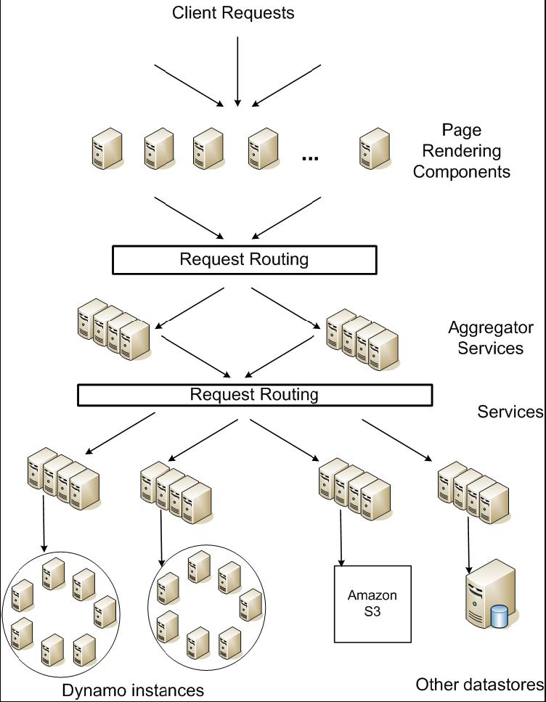
Service-oriented architecture of
Amazon’s platform

Slide 6
Caches are everywhere

Slide 7
Caches are everywhere
Inode caches, directory entries (name lookups), IP address mappings (ARP table), …
All large-scale Web systems use caching extensively to reduce I/O cost.
Many mega-services are built on key-value stores.
Variable-length content object (value)
Named by a fixed-size “key”, often a secure hash of the content
Looks a lot like DeFiler!
Memory cache may be a separate shared network service.
Web content delivery networks (CDNs) cache content objects in web proxy servers around the Internet.

Slide 8
Scaling database access
Many services are data-driven.
Multi-tier services: the “lowest” layer is a data tier with authoritative copy of service data.
Data is stored in various stores or databases, some with advanced query API.
e.g., SQL
Databases are hard to scale.
Complex data: atomic, consistent, recoverable, durable. (“ACID”)
web
servers
SQL query API
database servers
SQL: Structured Query Language
Caches can help if much of the workload is simple reads.

Slide 9
Memcached
memcached servers
“Memory caching daemon”
It’s just a key/value store
Scalable cluster service
array of server nodes
distribute requests among nodes
how? distribute the key space
scalable: just add nodes
Memory-based
LRU object replacement
Many technical issues:
get/put API
etc…
web
servers
SQL query API
database servers
Multi-core server scaling, MxN communication, replacement, consistency

Slide 10
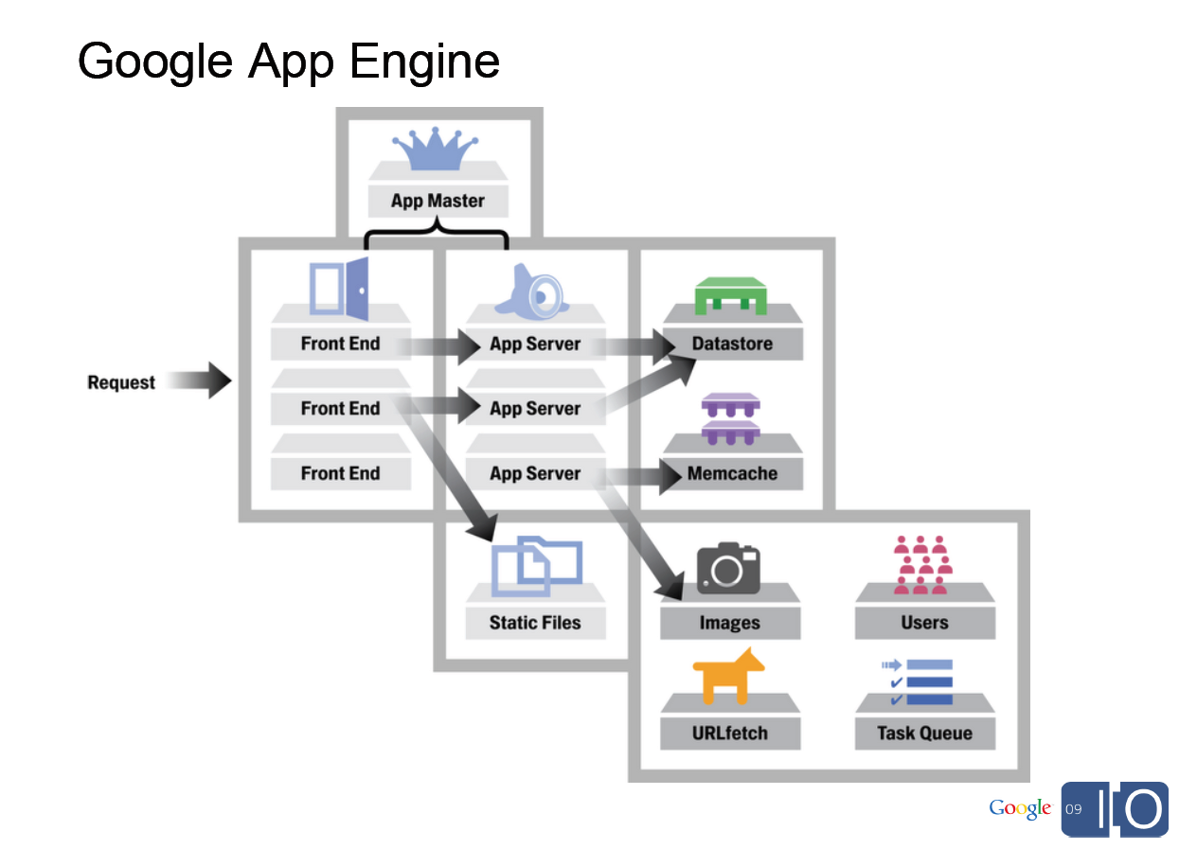
[From Spark Plug to Drive Train: The Life of an App Engine Request, Along Levi, 5/27/09]

Slide 11

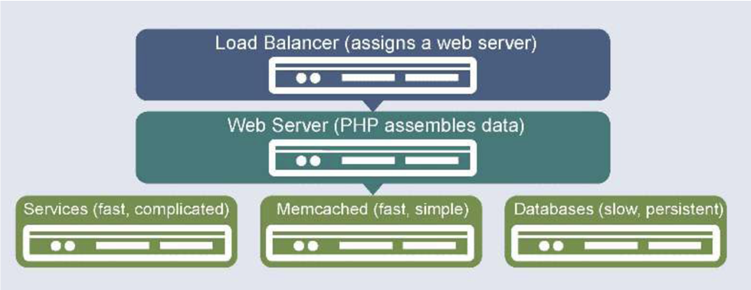

Slide 12
Issues
How to be sure that the cached data is consistent with the “authoritative” copy of the data?
Can we predict the hit ratio in the cache? What factors does it depend on?
“popularity”: distribution of access frequency
update rate: must update/invalidate cache on a write
What is the impact of variable-length objects/values?
Metrics must distinguish byte hit ratio vs. object hit ratio.
Replacement policy may consider object size.
What if the miss cost is variable? Should the cache design consider that?

Slide 13
Caching in the Web
Web “proxy” caches are servers that cache Web content.
Reduce traffic to the origin server.
Deployed by enterprises to reduce external network traffic to serve Web requests of their members.
Also deployed by third-party companies that sell caching service to Web providers.
Content Delivery/Distribution Network (CDN)
Help Web providers serve their clients better.
Help absorb unexpected load from “flash crowds”.
Reduce Web server infrastructure costs.

Slide 14
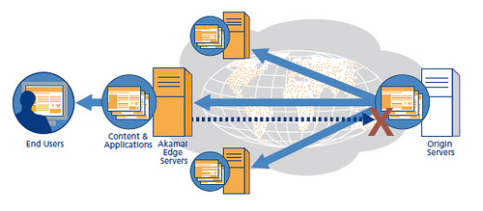

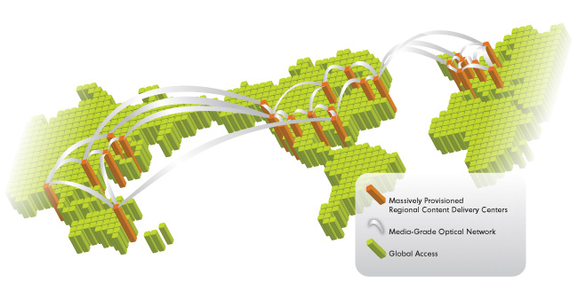

Content Delivery Network (CDN)

Slide 15
Zipf popularity
Web accesses can be modeled using Zipf-like probability distributions.
Rank objects by popularity: lower rank i ==> more popular.
The probability that any given reference is to the ith most popular object is given by p_{i}
Zipf says: p_{i} is proportional to 1/i^{α}
“frequency is inversely proportional to rank”
α parameter with 0 < α < 1
Higher α gives more skew: popular objects are way popular.
Lower α gives a more heavy-tailed distribution.
In the Web, α ranges from 0.6 to 0.8 [Breslau/Cao99].
With α=0.8, 0.3% of the objects get 40% of requests.

Slide 16
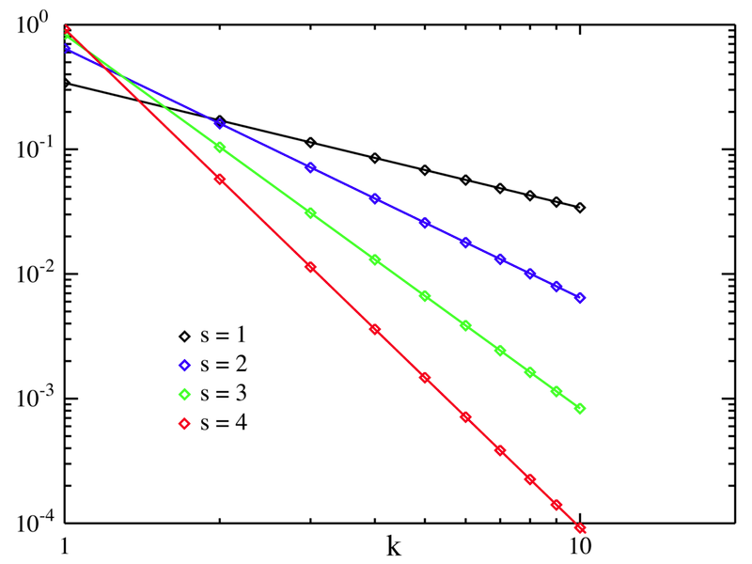
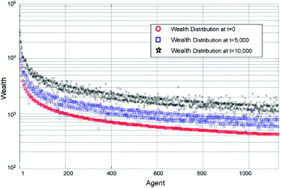
Zipf
log-log scale
x: log rank
y: log share of accesses
“head”
x: rank
y: log $$$
“tail”

Slide 17
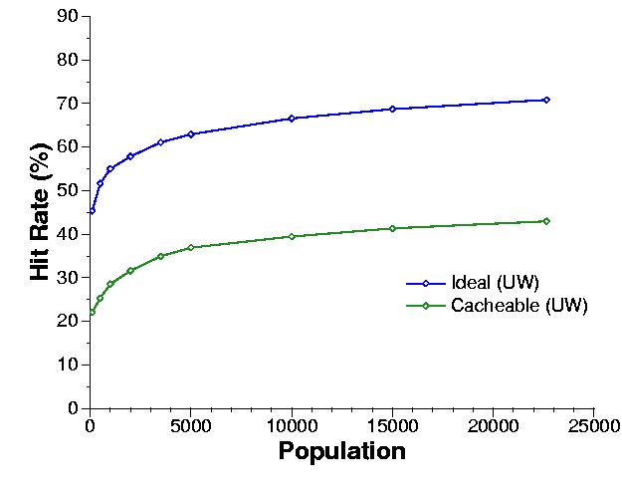
Hit rates of Internet caches
It turns out this matters.
With Zipf power-law popularity distributions, the best possible (ideal) hit rate of a cache is logarithmic in its size.
…and logarithmic in the population served.
The hit rate also depends on how frequently objects are updated at their source.
Wolman/Voelker/Levy 1997
Intuition. The “head” (most popular objects) is cached easily. After that: diminishing benefits. The “tail” is effectively random.

Slide 18
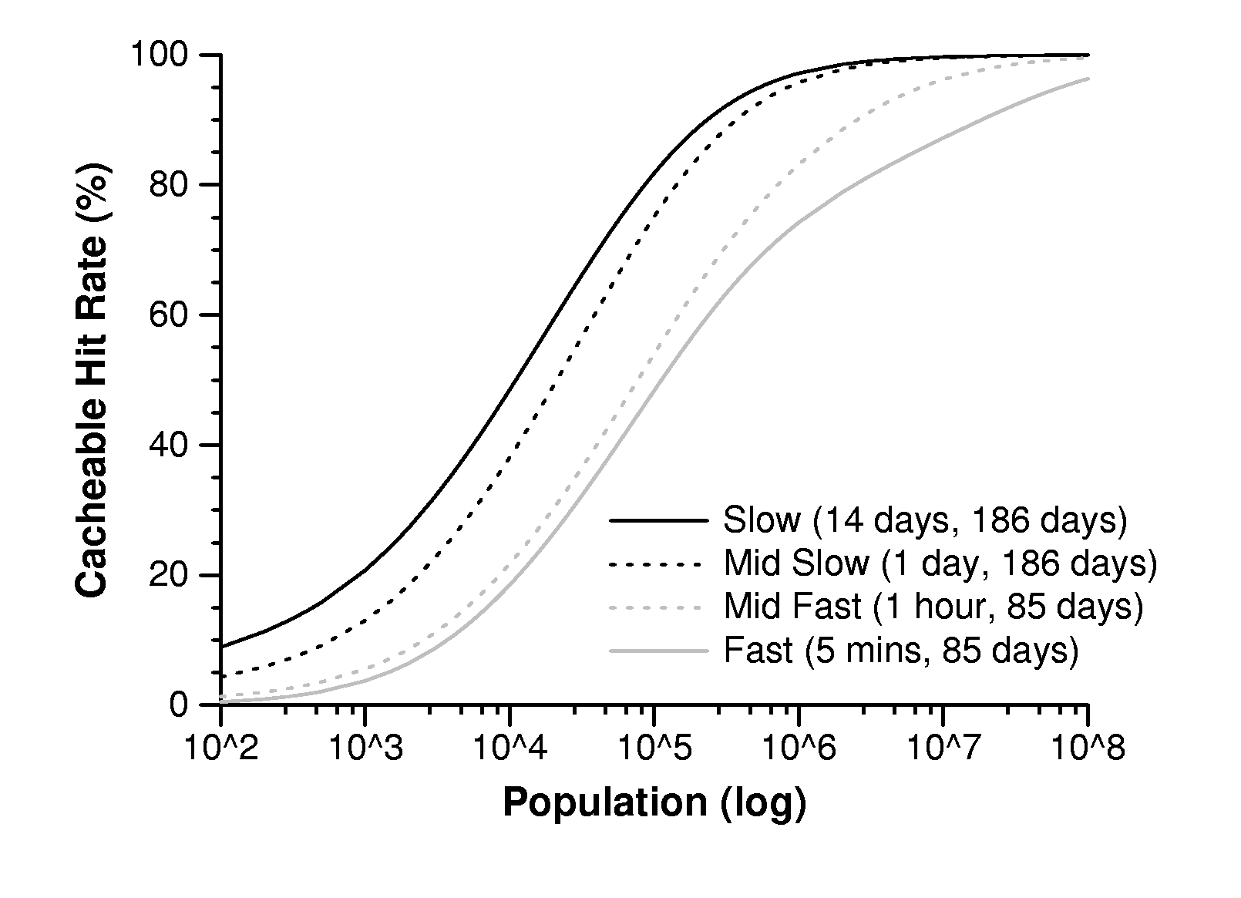
Hit ratio by population size, with different update rates
Wolman/Voelker/Levy 1997

Slide 19
For people who want the math
Approximates a sum over a universe of n objects...
...of the probability of access to each object x...
…times the probability x was accessed since its last change.
C is just a normalizing constant for the Zipf-like popularity distribution, which must sum to 1. C is not to be confused with C_{N}.
λ N
C = 1/α
0 < α < 1

Slide 20
You don’t need to know this
But you should know what it is and where to look for it.
Zipf and power law distributions seem to be axiomatic for human population behavior.
Popularity, interests, traffic, wealth, market share, population, word frequency in natural language.
Heavy-tailed distributions like these are amenable to closed-form analysis.
They lead to lots of counterintuitive behaviors.
E.g., multi-level caching has limited value: L1 absorbs the head, L2 has the detritus on the tail: “your cache ain’t nuthin but trash”.
How to balance load in cache arrays (e.g., memcached)?

Slide 21
It’s all about reads
The last few slides (memcached, web) focus on caches for read accesses: no-write caches.
In CDNs the object is modified only at the origin server.
Updates propagate out to the caches “eventually”.
Web caches may deliver stale data
Web objects have a “freshness date” or “time-to-live” (TTL).
In memcached database cache, writes occur only at the database servers.
Writer must invalidate and/or update the cache on write.
In contrast, file caches and VM systems are write-back.
We might lose data in a crash: introduces problems of recovery and failure-atomicity.

Slide 22
Postnote
Due to an oversight, the following slides were not posted until 12/11/12, so they will not be tested on the final.

Slide 23
What about coordination for more general services?
How to assign data and functions among servers?
To spread the work across an elastic server cluster, to scale a service tier?
How to know which server is “in charge” of a given function or data object?
E.g., to serialize reads/writes on each object, or otherwise ensure consistent behavior.
Goals: safe, robust, even, balanced, dynamic, etc.
Two key techniques:
Leases (leased locks)
Consistent hashing

Slide 24

Problem: spreading the load
Server clusters must spread data and functions across the cluster.
Goals:
Balance the load.
Find the “right” server for a given request.
Adapt to change efficiently and reliably.
Bound the spread of each object/function.
Warning: it’s a consensus problem!

Slide 25

Solution: consistent hashing
Consistent hashing is a technique to assign data objects (or functions) to servers
Key benefit: adjusts efficiently to churn.
Adjust as servers leave (fail) and join (recover)
Used in Internet server clusters and also in distributed hash tables (DHTs) for peer-to-peer services. (later)
Developed at MIT for Akamai CDN
Consistent hashing and random trees: distributed caching protocols for relieving hot spots on the WWW. Karger, Lehman, Leighton, Panigrahy, Levine, Lewin. ACM STOC, 1997. 1000+ citations

Slide 26

Consistent Hashing
Bruce Maggs
Idea: Map both objects and buckets to unit circle.
object
bucket
new bucket
Assign object to next bucket on circle in clockwise order.
[Bruce Maggs]

Slide 27
Consistent hashing in practice
Use it to implement a distributed key/value store
Data objects in a “flat” name space (e.g., “serial numbers”)
Hash the names into the key space (e.g., SHA-1)
Is put/get sufficient to implement non-trivial apps?
Distributed application
put(key, data)
get (key)
data
Distributed hash table
lookup(key)
node IP address
Lookup service
node
node
….
node
[image from Morris, Stoica, Shenker, etc.]

Slide 28

Coordination and Consensus
If the key to availability and scalability is to decentralize and replicate functions and data, how do we coordinate the nodes?
data consistency
update propagation
mutual exclusion
consistent global states
failure notification
group membership (views)
group communication
event delivery and ordering

Slide 29

Consensus
P₁
P₁
v₁
d₁
Unreliable multicast
Consensus algorithm
P₂
P₃
P₂
P₃
v₂
v₃
d₂
d₃
Step 1
Propose.
Step 2
Decide.
Each P proposes a value to the others.
All nonfaulty P agree on a value in a bounded time.
Coulouris and Dollimore

Slide 30
A network partition
A network partition is any event that blocks all message traffic between subsets of nodes.

Slide 31

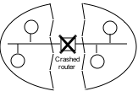
Fischer-Lynch-Patterson (1985)
No consensus can be guaranteed in an asynchronous system in the presence of failures.
Intuition: a “failed” process may just be slow, and can rise from the dead at exactly the wrong time.
Consensus may occur recognizably, rarely or often.
Network partition
Split brain

Slide 32

consistency
C
C-A-P choose two
CA: available, and consistent, unless there is a partition.
CP: always consistent, even in a partition, but a reachable replica may deny service if it is unable to agree with the others (e.g., quorum).
A
P
AP: a reachable replica provides service even in a partition, but may be inconsistent.
Availability
Partition-resilience

Slide 33
Properties for Correct Consensus
Termination: All correct processes eventually decide.
Agreement: All correct processes select the same d_{i}.
Or…(stronger) all processes that do decide select the same d_{i}, even if they later fail.
Consensus “must be” both safe and live.
FLP and CAP say that a consensus algorithm can be safe or live, but not both.

Slide 34
Now what?
We have to build practical, scalable, efficient distributed systems that really work in the real world.
But the theory says it is impossible to build reliable computer systems from unreliable components.
So what are we to do?

Slide 35

Butler W. Lampson
http://research.microsoft.com/en-us/um/people/blampson/
Butler Lampson is a Technical Fellow at Microsoft Corporation and an Adjunct Professor at MIT…..He was one of the designers of the SDS 940 time-sharing system, the Alto personal distributed computing system, the Xerox 9700 laser printer, two-phase commit protocols, the Autonet LAN, the SPKI system for network security, the Microsoft Tablet PC software, the Microsoft Palladium high-assurance stack, and several programming languages. He received the ACM Software Systems Award in 1984 for his work on the Alto, the IEEE Computer Pioneer award in 1996 and von Neumann Medal in 2001, the Turing Award in 1992, and the NAE’s Draper Prize in 2004.

Slide 36
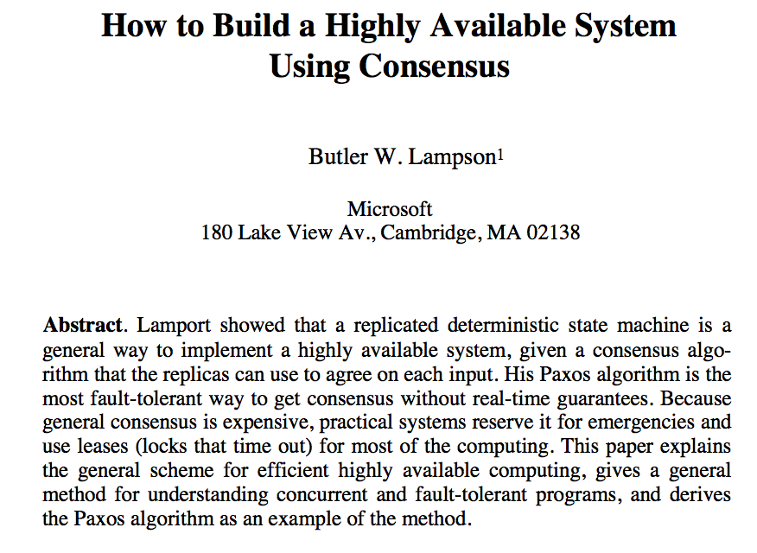
[Lampson 1995]

Slide 37
Summary/preview
Master coordinates, dictates consensus
e.g., lock service
Also called “primary”
Remaining consensus problem: who is the master?
Master itself might fail or be isolated by a network partition.
Requires a high-powered distributed consensus algorithm (Paxos).

Slide 38


[From Spark Plug to Drive Train: The Life of an App Engine Request, Along Levi, 5/27/09]

Slide 39


Example: mutual exclusion
It is often necessary to grant some node/process the “right” to “own” some given data or function.
Ownership rights often must be mutually exclusive.
At most one owner at any given time.
How to coordinate ownership?
Warning: it’s a consensus problem!

Slide 40

One solution: lock service
acquire
acquire
grant
x=x+1
release
A
grant
x=x+1
release
B
lock service

Slide 41

A lock service in the real world
acquire
acquire
grant
X
???
???
x=x+1
A
B
B

Slide 42


Solution: leases (leased locks)
A lease is a grant of ownership or control for a limited time.
The owner/holder can renew or extend the lease.
If the owner fails, the lease expires and is free again.
The lease might end early.
lock service may recall or evict
holder may release or relinquish

Slide 43

A lease service in the real world
acquire
acquire
grant
X
???
x=x+1
A
grant
x=x+1
release
B

Slide 44
Leases and time
The lease holder and lease service must agree when a lease has expired.
i.e., that its expiration time is in the past
Even if they can’t communicate!
We all have our clocks, but do they agree?
synchronized clocks
For leases, it is sufficient for the clocks to have a known bound on clock drift.
|T(C_{i}) – T(C_{j})| < ε
Build in slack time > ε into the lease protocols as a safety margin.

Slide 45
OK, fine, but…
What if the A does not fail, but is instead isolated by a network partition?

Slide 46
Never two kings at once
acquire
acquire
grant
x=x+1
???
A
grant
x=x+1
release
B

Slide 47
OK, fine, but…
What if the lock manager itself fails?
X

Slide 48
The Answer
Replicate the functions of the lock manager.
Or other coordination service…
Designate one of the replicas as a primary.
Or master
The other replicas are backup servers.
Or standby or secondary
If the primary fails, use a high-powered consensus algorithm to designate and initialize a new primary.

Slide 49


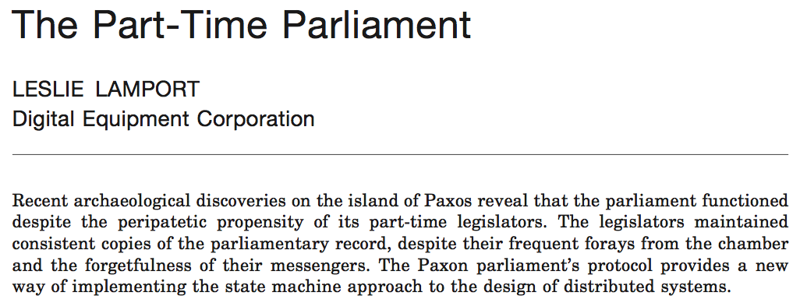
A Classic Paper
ACM TOCS:
Transactions on Computer Systems
Submitted: 1990. Accepted: 1998
Introduced:

Slide 50
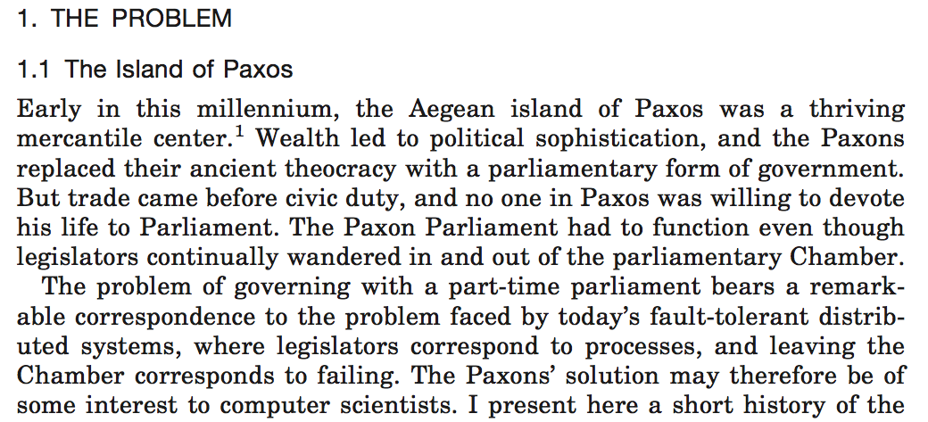



Slide 51
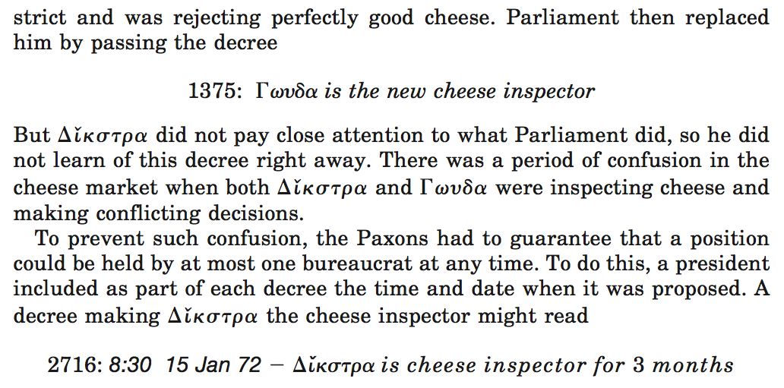
???

Slide 52
A Paxos Round
Self-appoint
Wait for majority
Wait for majority
“Can I lead b?”
“OK, but”
“v?”
“OK”
“v!”
L
N
1a
1b
2a
2b
3
log
log
safe
Propose
Promise
Accept
Ack
Commit
Nodes may compete to serve as leader, and may interrupt one another’s rounds. It can take many rounds to reach consensus.
Notes:
Consensus point of no return occurs when a majority of agents accept v and log it. At that point it’s done, the round has succeeded and consensus has been reached, and nobody can ever be permitted to choose a new/different value. However, it may take more rounds to recognize the success.

Slide 53
Consensus in Practice
Lampson: “Since general consensus is expensive, practical systems reserve it for emergencies.”
e.g., to select a primary/master, e.g., a lock server.
Centrifuge, GFS master, Frangipani, etc.
Google Chubby service (“Paxos Made Live”)
Pick a primary with Paxos. Do it rarely; do it right.
Primary holds a “master lease” with a timeout.
Renew by consensus with primary as leader.
Primary is “czar” as long as it holds the lease.
Master lease expires? Fall back to Paxos.
(Or BFT.)

Slide 54
Google File System
Similar: Hadoop HDFS

Slide 55
[From Spark Plug to Drive Train: The Life of an App Engine Request, Along Levi, 5/27/09]

Slide 56
Coordination services
Build your cloud apps around a coordination service with consensus at its core.
This service is a fundamental building block for consistent scalable services.
Chubby (Google)
Zookeeper (Yahoo!)
Centrifuge (Microsoft)

Slide 57
Chubby: The Big Picture
Google has tens of thousands of employees and thousands of programmers.
Google has only a few people as smart as Mike Burrows.
Mike Burrows knows how to build robust, adaptive services at massive scale.
Google has thousands of other people who don’t.
Solution:
let the masses code
let a thousand flowers bloom
let Mike Burrows handle the tricky parts

Slide 58
Chubby in a nutshell
Chubby generalizes leased locks
easy to use: hierarchical name space (like file system)
more efficient: session-grained leases/timeout
more robust
Replication (cells) with master failover and primary election through Paxos consensus algorithm
more general
general notion of “jeopardy” if primary goes quiet
more features
atomic access, ephemeral files, event notifications
It’s a swiss army knife!

