Slide 1

Commitment to Correlated Strategies
Dima
[Vincent Conitzer, Dmytro Korzhyk. Commitment to Correlated
Strategies. In AAAI-2011.]

Slide 2
Games in Normal Form
Player 2
L
R
1, 1 | 3, 0
0, 0 | 2, 1
U
Player 1
D
A player’s strategy is a distribution over the player’s actions
An outcome of the game is an entry in the matrix
A strategy profile is a pair of strategies (pure or randomized)

Slide 3
Nash equilibrium
An NE is a strategy profile in which no player has an incentive to deviate.
Player 2
L
R
1, 1 | 3, 0
0, 0 | 2, 1
U
Player 1
D

Slide 4
Computing a Nash Equilibrium
Iterated dominance works in this case
Player 2
L
R
1, 1 | 3, 0
0, 0 | 2, 1
U
Player 1
D
Dominated
Generally, there is no known polytime algorithm
[PPAD-completeness: Daskalakis, Goldberg & Papadimitriou ‘06; Chen & Deng ’06; NP-hardness of NE with certain properties: Gilboa & Zemel ’89; Conitzer & Sandholm ‘08]

Slide 5
Stackelberg model
Suppose the row player (the leader) can commit to a strategy
Follower
L
R
1, 1 | 3, 0
0, 0 | 2, 1
U
Leader
D
The leader benefits from commitment!

Slide 6
Commitment to a mixed strategy
Suppose the leader commits to (2/3 Down, 1/3 Up)
Follower
L
R
1, 1 | 3, 0
0, 0 | 2, 1
1/3
U
Leader
2/3
D
Commitment to a mixed strategy benefits the leader even more
The optimal strategy to commit to is (50%-eps, 50%+eps)
Can be computed in polytime [Conitzer & Sandholm ’06, von Stengel & Zamir ‘10]

Slide 7


Applications of the Stackelberg model
Resource allocation for
airport security
[Pita et al., AI Magazine ‘09]
Scheduling of federal
air marshals
[Tsai et al., AAMAS ‘09]
GUARDS system for TSA
resource allocation
[Pita et al., AAMAS ’11]
Photo STL airport
Photo AP

Slide 8
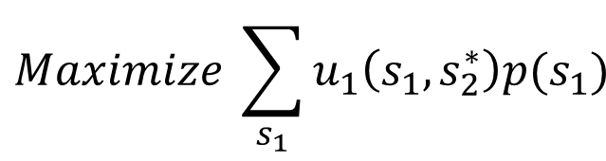
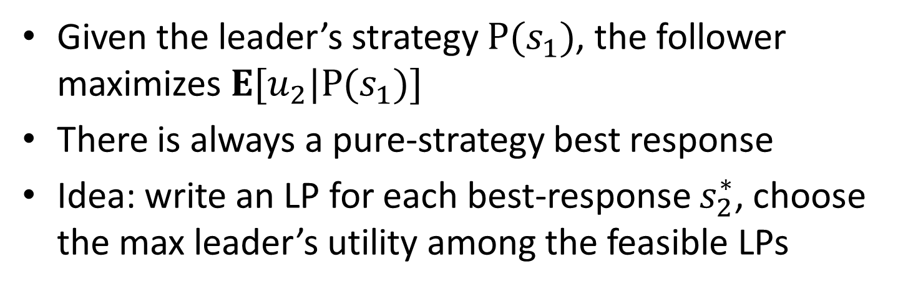

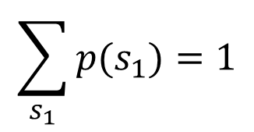
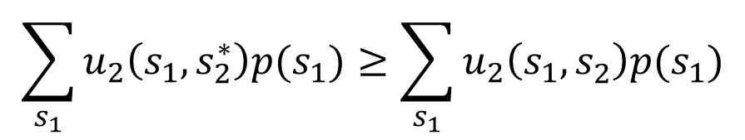
LP1: Computing a Stackelberg strategy
[Conitzer and Sandholm ’06, von Stengel and Zamir ‘10]
Given the leader’s strategy $P(s_{1})$, the follower maximizes $E[u_{2}|P(s_{1})]$
There is always a pure-strategy best response
Idea: write an LP for each best-response $s_{2}^{∗}$, choose the max leader’s utility among the feasible LPs
Objective:
leader’s utility
$$Maximize \sum_{s_{1}}{u_{1}\left(s_{1},s_{2}^{∗}\right)p(s_{1})}$$
Subject to the follower’s rationality
$$\sum_{s_{1}}{u_{2}\left(s_{1},s_{2}^{∗}\right)p(s_{1})}≥\sum_{s_{1}}{u_{2}\left(s_{1},s_{2}^{}\right)p(s_{1})}$$
$$∀s_{2}:$$
$$\sum_{s_{1}}{p(s_{1})}=1$$

Slide 9
New idea: Commitment to a correlated strategy
The leader draws from a distribution over the outcomes
L
Follower
R
1, 1 | 3, 0
0, 0 | 2, 1
U
40%
20%
Leader
10%
30%
D
The follower only gets to know the column
The follower should have no incentive to deviate
We will look for a correlated strategy that maximizes the leader’s utility

Slide 10
Equivalence to Stackelberg
Proposition 1. There exists an optimal correlated strategy to commit to
in which
the follower always gets the same recommendation.

Slide 11
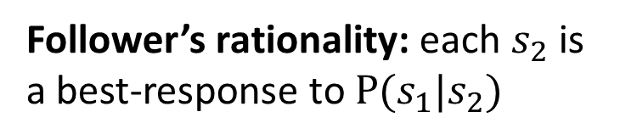

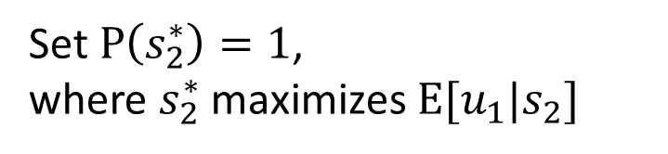
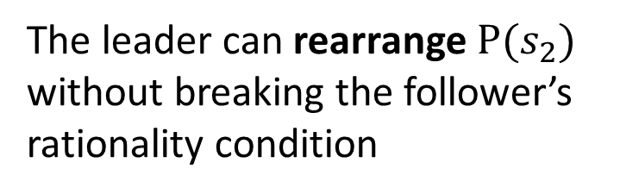


Proof of Proposition 1
Break the correlated strategy into two components:
$$P\left(s_{1},s_{2}\right)=P\left(s_{2}\right) P(s_{1}|s_{2})$$
L
M
R
Follower’s rationality: each $s_{2}$ is a best-response to $P(s_{1}|s_{2})$
$$P(s_{2})$$
The leader can rearrange $P(s_{2})$ without breaking the follower’s rationality condition
U
C
$$P(s_{1}|s_{2})$$
D
Set $P\left(s_{2}^{∗}\right)=1$,
where $s_{2}^{∗}$ maximizes $E[u_{1}|s_{2}]$

Slide 12
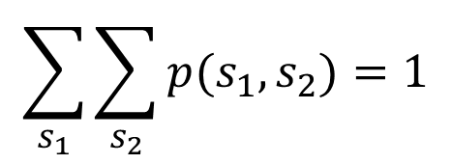
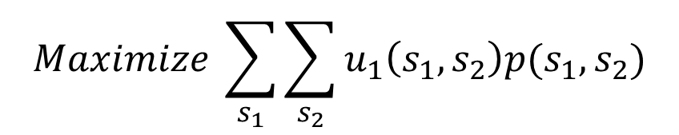

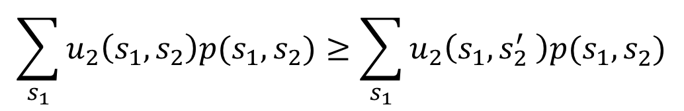
LP2 for computing an optimal correlated strategy to commit to
Objective –
leader’s utility
$$Maximize \sum_{s_{1}}{\sum_{s_{2}}{u_{1}\left(s_{1},s_{2}\right)p(s_{1},s_{2})}}$$
Follower’s
rationality
$$\sum_{s_{1}}{u_{2}\left(s_{1},s_{2}\right)p(s_{1},s_{2})}≥\sum_{s_{1}}{u_{2}\left(s_{1},s_{2}^{′} \right)p(s_{1},s_{2}^{})}$$
$$∀s_{2},s_{2}^{′}:$$
$$\sum_{s_{1}}{\sum_{s_{2}}{p(s_{1},s_{2})}}=1$$
We can use this LP to compute an optimal Stackelberg strategy!

Slide 13
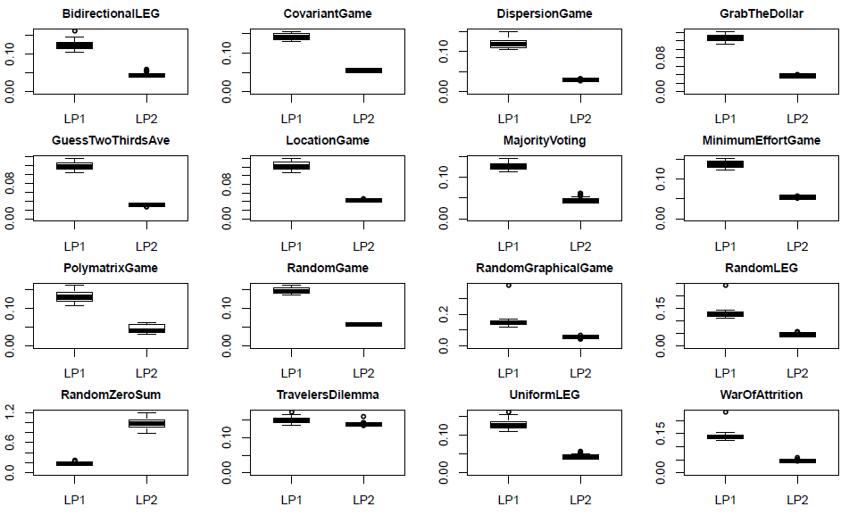
Experimental evaluation
The single LP actually runs faster than LP1, MIP for many game classes
(on 50x50 games, using CPLEX, GAMUT games [Nudelman et al. ‘04]):
BidirectionalLEG
CovariantGame
DispersionGame
GrabTheDollar
GuessTwoThirds
LocationGame
MajorityVoting
MinimumEffort
PolymatrixGame
RandomGame
RandomGraphical
RandomLEG
RandomZeroSum
TravelersDilemma
UniformLEG
WarOfAttrition
Downside: the single LP uses more memory.

Slide 14
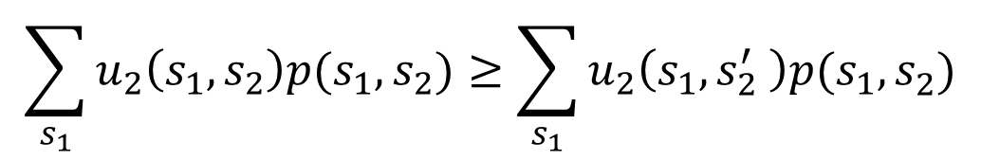
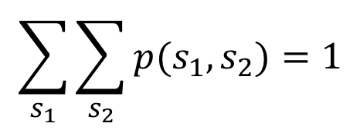

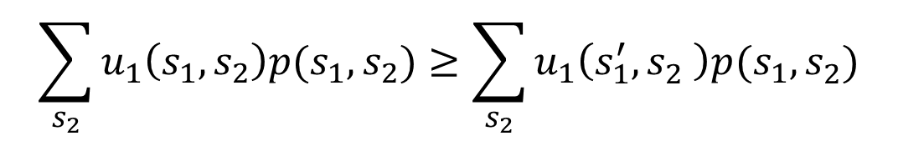

Correlated equilibrium
A 3rd party proposes a distribution over the outcomes
Now, both players should have no incentive to deviate
Player 1’s rationality
$$\sum_{s_{2}}{u_{1}\left(s_{1},s_{2}\right)p(s_{1},s_{2})}≥\sum_{s_{2}}{u_{1}\left(s_{1}^{′},s_{2}^{} \right)p(s_{1},s_{2}^{})}$$
$$∀s_{1},s_{1}^{′}:$$
Player 2’s rationality
$$\sum_{s_{1}}{u_{2}\left(s_{1},s_{2}\right)p(s_{1},s_{2})}≥\sum_{s_{1}}{u_{2}\left(s_{1},s_{2}^{′} \right)p(s_{1},s_{2}^{})}$$
$$∀s_{2},s_{2}^{′}:$$
$$\sum_{s_{1}}{\sum_{s_{2}}{p(s_{1},s_{2})}}=1$$

Slide 15
Stackelberg vs Correlated Equilibrium
[von Stengel and Zamir ‘10]
Corollary 1. The leader’s Stackelberg utility is at least as high as the leader’s utility in any correlated equilibrium of the game.

Slide 16
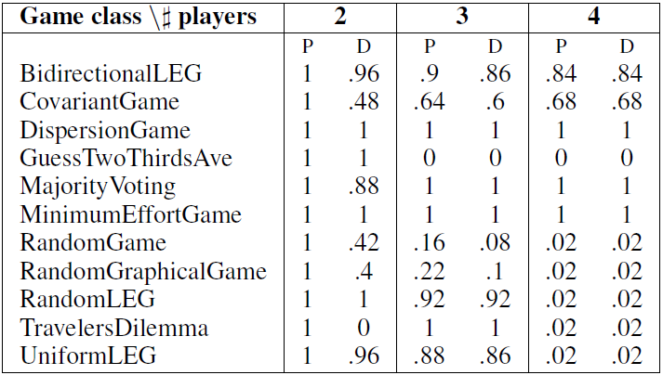
Commitment to correlated strategies for n>2 players
A generalization of LP2
With n>2 players, the optimal correlated strategy to commit to may not be a product distribution
P= product
distribution
D= degenerate
distribution

Slide 17




Example: Commitment to a correlated strategy with 3 players
Leader
Utilities
2
1
Optimal correlated strategy to commit to:
50%
Different from Stackelberg and CE!
50%

Slide 18
Advantages of commitment to a correlated equilibrium
Same as Stackelberg for n=2 players
Well defined for n>2 players (unlike the Stackelberg model)
Easy to compute for any number of players

Slide 19
Overview of contributions
A single LP for Stackelberg (for 2 players)
Easy proof of relationship between Stackelberg and correlated equilibrium (for 2 players)
Model for commitment to a correlated strategy
(for n≥2 players)
LP for commitment to a correlated strategy
(for n≥2 players)

Slide 20
Thank you!

