Slide 1
CPS 590.01 LP and IP in Game theory (Normal-form Games, Nash Equilibria and Stackelberg Games)
Joshua Letchford

Slide 2
Zero-sum game (Mini-max)
Them
L
R
1, -1 | -1, 1
-1, 1 | 1, -1
L
Us
R
Assume opponent knows our mixed strategy
If we play L 50%, R 50%...
… opponent will be indifferent between R and L…
… we get .5*(-1) + .5*(1) = 0

Slide 3
General-sum games
You could still play a minimax strategy in general-sum games
I.e., pretend that the opponent is only trying to hurt you
But this is not rational:
0, 0 | 3, 1
1, 0 | 2, 1
If Column was trying to hurt Row, Column would play Left, so Row should play Down
In reality, Column will play Right (strictly dominant), so Row should play Up
Is there a better generalization of minimax strategies in zero-sum games to general-sum games?

Slide 4


Nash equilibrium [Nash 50]
A vector of strategies (one for each player) is called a strategy profile
A strategy profile (σ₁, σ₂ , …, σ_{n}) is a Nash equilibrium if each σ_{i} is a best response to σ_{-i}
That is, for any i, for any σ_{i}’, u_{i}(σ_{i}, σ_{-i}) ≥ u_{i}(σ_{i}’, σ_{-i})
Note that this does not say anything about multiple agents changing their strategies at the same time
In any (finite) game, at least one Nash equilibrium (possibly using mixed strategies) exists [Nash 50]
(Note - singular: equilibrium, plural: equilibria)

Slide 5
The presentation game
Presenter
Put effort into presentation (E)
Do not put effort into presentation (NE)
Pay attention (A)
4, 4 | -16, -14
0, -2 | 0, 0
Audience
Do not pay attention (NA)
Pure-strategy Nash equilibria: (A, E), (NA, NE)
Mixed-strategy Nash equilibrium:
((1/10 A, 9/10 NA), (4/5 E, 1/5 NE))
Utility 0 for audience, -14/10 for presenter
Can see that some equilibria are strictly better for both players than other equilibria

Slide 6
Some properties of Nash equilibria
If you can eliminate a strategy using strict dominance or even iterated strict dominance, it will not occur (i.e., it will be played with probability 0) in every Nash equilibrium
Weakly dominated strategies may still be played in some Nash equilibrium
In 2-player zero-sum games, a profile is a Nash equilibrium if and only if both players play minimax strategies
Hence, in such games, if (σ₁, σ₂) and (σ₁’, σ₂’) are Nash equilibria, then so are (σ₁, σ₂’) and (σ₁’, σ₂)
No equilibrium selection problem here!

Slide 7
Solving for a Nash equilibrium using MIP (2 players) [Sandholm, Gilpin, Conitzer AAAI05]
maximize whatever you like (e.g., social welfare)
subject to
for both i, Σ_{si} p_{si} = 1
for both i, for all s_{i}, Σ_{s-i} p_{s-i} u_{i}(s_{i}, s_{-i}) = u_{si}
for both i, for all s_{i}, u_{i} ≥ u_{si} (u_{i} = max u_{si})
for both i, for all s_{i}, p_{si} ≤ b_{si}
for both i, for all s_{i}, u_{i} - u_{si} ≤ M(1- b_{si})
b_{si} is a binary variable indicating whether s_{i} is in the support, M is a large number

Slide 8
Stackelberg (commitment) games
L
R
L
1, -1 | 3, 1
2, 1 | 4, -1
R
Unique Nash equilibrium is (R,L)
This has a payoff of (2,1)

Slide 9
Commitment
 | L | R
L | (1,-1) | (3,1)
R | (2,1) | (4,-1)
What if the officer has the option to (credibly) announce where he will be patrolling?
This would give him the power to “commit” to being at one of the buildings
This would be a pure-strategy Stackelberg game

Slide 10
Commitment…
 | L | R
L | (1,-1) | (3,1)
If the officer can commit to always being at the left building, then the vandal's best response is to go to the right building
This leads to an outcome of (3,1)

Slide 11
Committing to mixed strategies
 | L | R
L | (1,-1) | (3,1)
R | (2,1) | (4,-1)
What if we give the officer even more power: the ability to commit to a mixed strategy
This results in a mixed-strategy Stackelberg game
E.g., the officer commits to flip a weighted coin which decides where he patrols

Slide 12
Committing to mixed strategies is more powerful
 | L | R
L | (1,-1) | (3,1)
R | (2,1) | (4,-1)
Suppose the officer commits to the following strategy: {(.5+ε)L,(.5- ε)R}
The vandal’s best response is R
As ε goes to 0, this converges to a payoff of (3.5,0)

Slide 13
Stackelberg games in general
One of the agents (the leader) has some advantage that allows her to commit to a strategy (pure or mixed)
The other agent (the follower) then chooses his best response to this

Slide 14
Visualization
 | L | C | R
U | 0,1 | 1,0 | 0,0
M | 4,0 | 0,1 | 0,0
D | 0,0 | 1,0 | 1,1
(0,1,0) = M
C
L
R
(1,0,0) = U
(0,0,1) = D

Slide 15
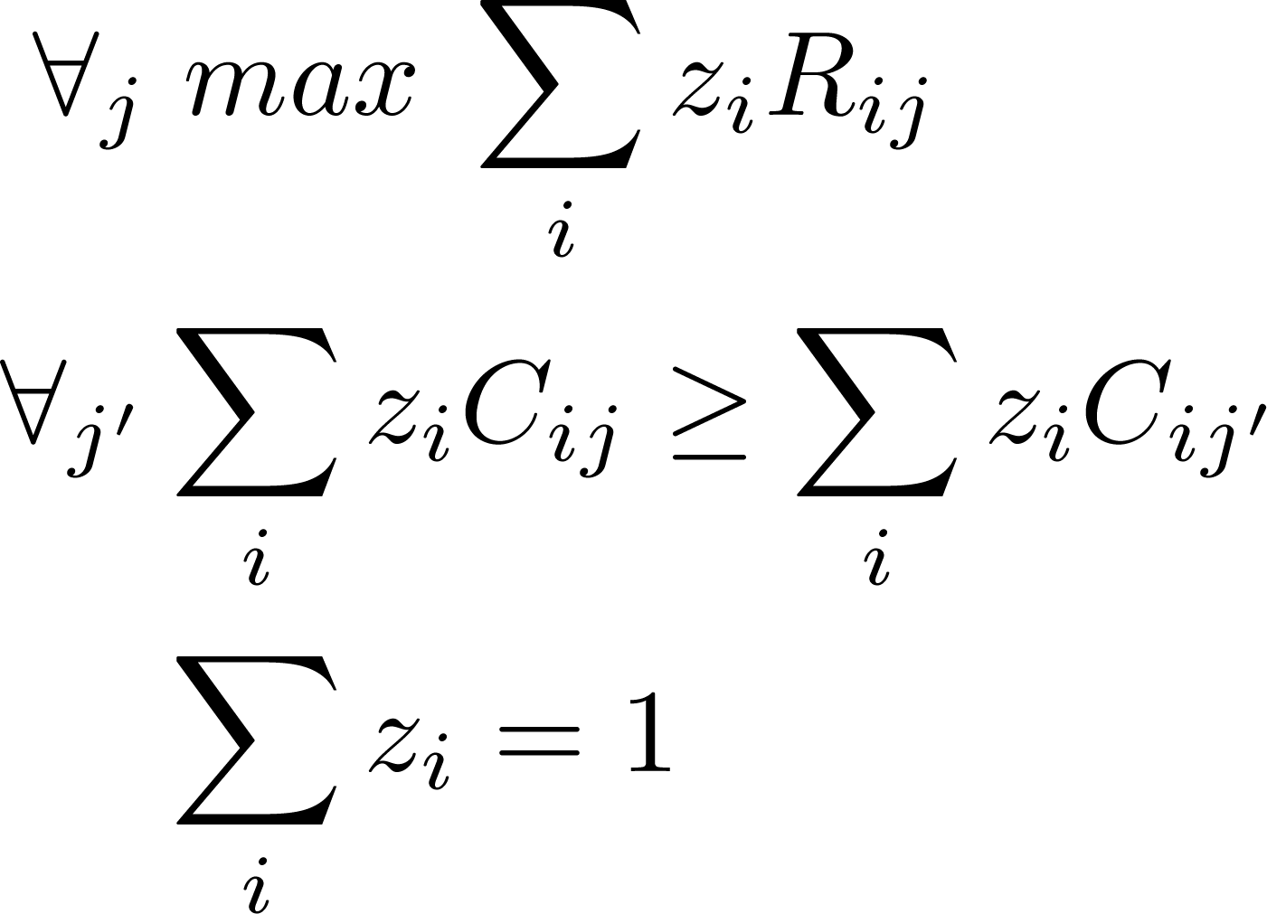
Easy polynomial-time algorithm for two players [Conitzer & Sandholm EC’06, von Stengel & Zamir GEB’10]
For every column j, we solve separately for the best mixed row strategy (defined by z_{i}) that induces player 2 to play j
(May be infeasible for some j)
Pick the j that is best for player 1
I rows
J columns
R is the defenders payoff matrix
C is the attackers payoff matrix
z_{i} is the probability that row i is played

Slide 16
Extensions
A few extensions with LP or MIP formulations:
Bayesian setting (DOBSS [1])
Uses a MIP to avoid exponential size
Multiple Defense Resources (ERASER [2])
Assumes the structure is a “Security game”
Uses this structure to achieve a compact representation
Defense Costs [3]
Explicit costs for defense rather than limited defense resources
[1] Paruchuri et al. Playing Games for Security: An Efficient Exact Algorithm for Solving Bayesian Stackelberg Games
[2] Kiekintveld et al. Computing Optimal Randomized Resource Allocations for
Massive Security Games
[3] Letchford and Vorobeychik. Computing Optimal Security Strategies for Interdependent Assets

Slide 17
(a particular kind of) Bayesian games
follower utilities
(type 1)
follower utilities
(type 2)
leader utilities
2 | 4
1 | 3
1 | 0
0 | 1
1 | 0
1 | 3
probability .6
probability .4

Slide 18
Multiple types - visualization
(0,1,0)
Combined
C
(0,1,0)
R
L
(1,0,0)
(0,0,1)
(0,1,0)
(1,0,0)
(0,0,1)
L
R
(R,C)
(1,0,0)
C
(0,0,1)

Slide 19
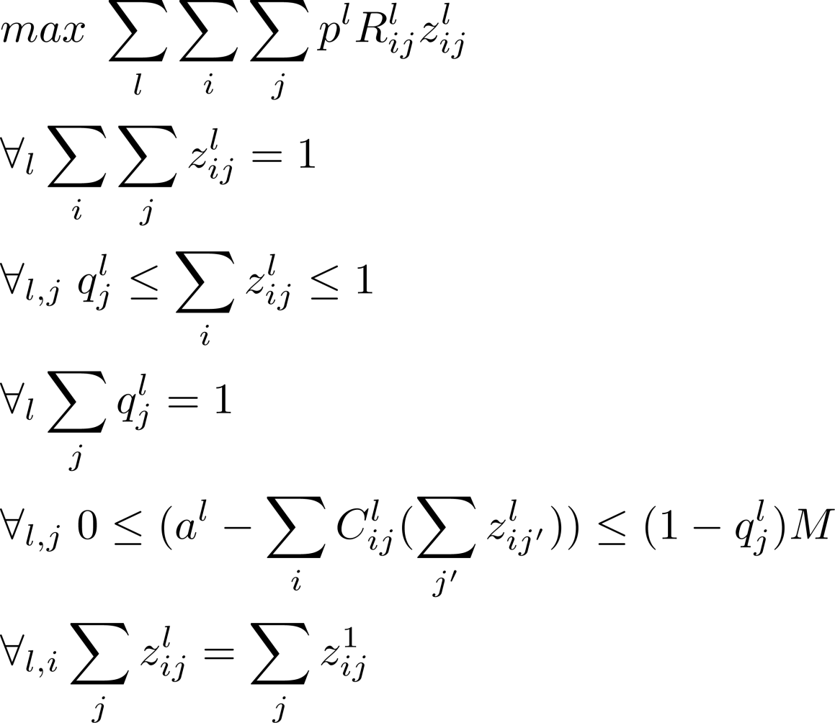
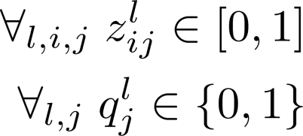
DOBSS [Paruchuri et al. AAMAS‘08] (MIP for the Bayesian setting)
I rows
J columns
p^{l} the probability that type l appears
R^{l} is the defenders payoff matrix
C^{l} is the attackers payoff matrix
z^{l}_{ij} is the probability that row i and column j are played against type l
q^{l}_{j} =1 when type l’s best response is column j
M is a large number

Slide 20
(In)approximability of Bayesian games [Letchford et al. SAGT’09]
(# types)-approximation: optimize for each type separately using the LP method. Pick the solution that gives the best expected utility against the entire type distribution.
Can’t do any better in polynomial time, unless P=NP
Reduction from INDEPENDENT-SET
For adversarially chosen types, cannot decide in polynomial time whether it is possible to guarantee positive utility, unless P=NP
Again, a MIP formulation can be given

Slide 21
Reduction from independent set
1
2
3
leader utilities
 | A | B
a_{l}¹ | 1 | 0
a_{l}² | 1 | 0
a_{l}³ | 1 | 0
follower utilities
(type 1)
follower utilities
(type 2)
follower utilities
(type 3)
 | A | B
a_{l}¹ | 3 | 1
a_{l}² | 0 | 10
a_{l}³ | 0 | 1
 | A | B
a_{l}¹ | 0 | 10
a_{l}² | 3 | 1
a_{l}³ | 0 | 10
 | A | B
a_{l}¹ | 0 | 1
a_{l}² | 0 | 10
a_{l}³ | 3 | 1

Slide 22
Security games [Kiekintveld et al. AAMAS’09]
Makes a simple assumption, namely that payoffs only depend on the identify of the target attacked and if that target is defended or not.
Often combined with an assumption that the defender is always better off when the attacked target is defended, and the attacker is always better off when the attacked target is undefended.
 | Defended | Undefended
T₁ | (5,-10) | (-20,30)
T₂ | (10,-10) | (0,0)

Slide 23
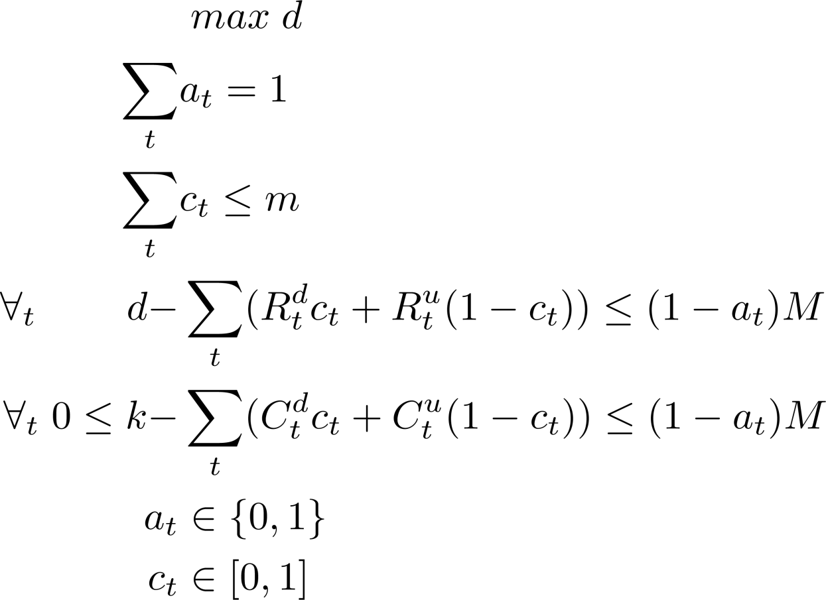
ERASER [Kiekintveld et al. AAMAS’09] (MIP for multiple resources)
T is the set of targets
R_{t} is the defenders payoff given t (d – defended and u – undefended)
C_{t} is the attackers payoff given t (d – defended and u – undefended)
c_{t} is the probability that the defender defends target t
m is the number of defense resources the defender has
a_{t} = 1 for the target that is attacked
M is a large number

Slide 24
Defense at a cost [Letchford & Vorobeychik UAI’12]
Each target t is assigned a cost c_{t}
The defender can choose to pay c_{t} to prevent an attack that originates at target t
Multiple options with different efficiency may be available
This cost is paid even when t is not attacked
Paying a fraction of c_{t} will offer partial protection
This corresponds to playing a mixed strategy
The existing MIP can be modified to solve this problem
Furthermore, using techniques similar to what are used in¹ we are able to give an efficient linear programming formulation for the problem
¹Conitzer and Sandholm 2006

Slide 25
Goals
Two conflicting goals for the defender:
Minimize expected loss from an attack
Minimize amount spent on defense
We define an optimal solution as one that minimizes the sum of these two values
Simple goal for the attacker:
Given a defense strategy for the Defender, attack the target that gives the largest expected payoff
In the zero-sum case, this corresponds to hurting the Defender as much as possible

Slide 26

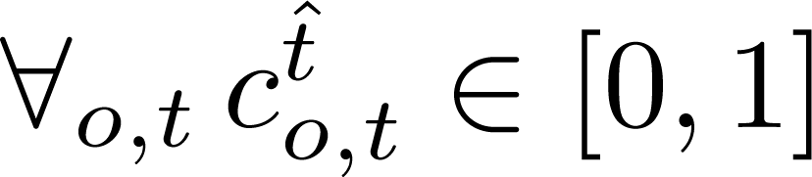
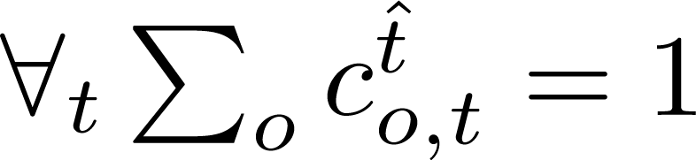
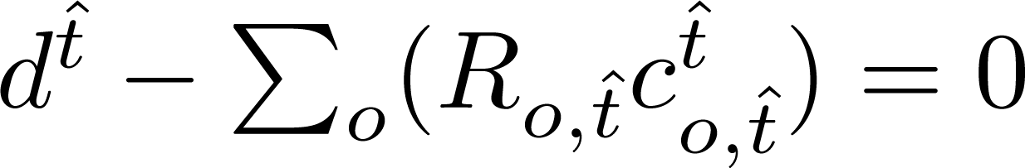
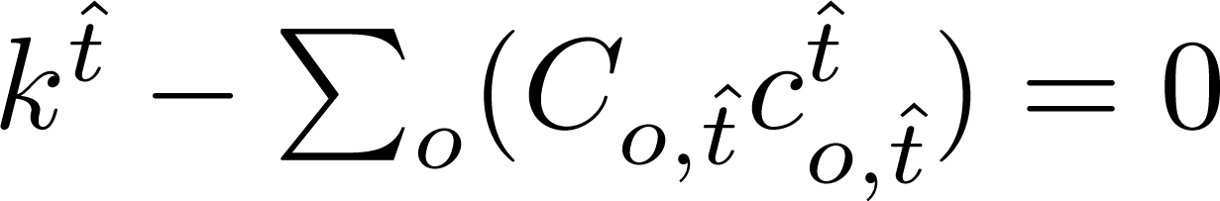
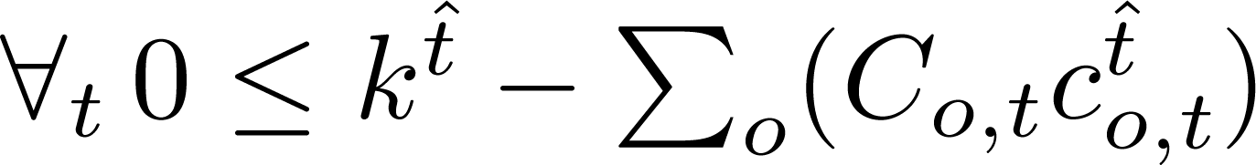
Linear program for defense costs
T is the set of targets
O is the set of defense options
R_{o,t} is the defenders payoff given o and t
C_{o,t} is the attackers payoff given o and t
p_{o,t} is the price (cost) of defense option o for target t
c_{o,t} is the probability that the defender defends target t with option o

Slide 27
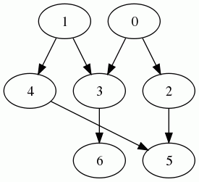
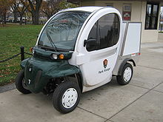

A simple example (car supply chain)
Produces
electronic components
Produces
engine components
Produces radios
Produces engines
Produces
Micro-car
Produces
SUV

Slide 28
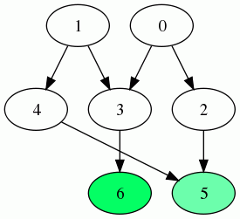
Valuation
Produces
Micro-car
Produces
SUV
Value = 2.168
Value = 1.227

Slide 29
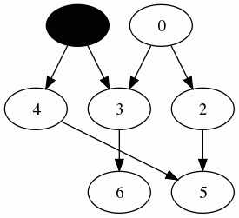
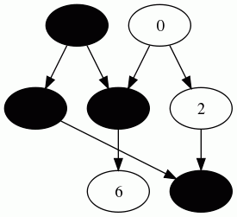
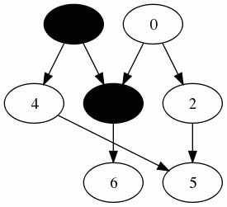
Attack model (Independent cascade)
Spread chance: .5

Slide 30
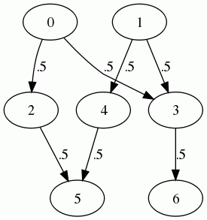
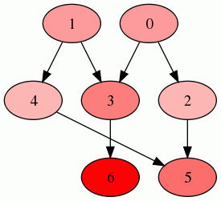
Evaluating expected loss
Expected loss = 0.8488
Expected loss = 0.6135
Cascade model
Expected loss = 1.227
Values

Slide 31
Evaluating expected loss
Related to the idea of maximizing influence
Which unfortunately is NP-hard¹
However, extremely easy to approximate through simulation¹
Fast algorithms for special cases
Two-pass algorithm for undirected trees (O(|T|))
Domain specific procedures (i.e. consequence analysis)
¹Kempe et al. 2003

Slide 32
Notation for two-pass algorithm for undirected trees
T : set of targets
O : set of defense options
z_{o,t} : probability of an attack succeeding at target t under defense option o
p_{t,t’} : probability of a cascade from t to t’
N_{t} : set of the neighbors of t
w_{t} : worth (value) of target t
P_{t} : Parent of t
¹Kempe et al. 2003

Slide 33
Expected loss in trees
Expected loss due to cascading failure:
p(failure(t’)|t) = product of probabilities of the edges on the path between t and t’
By organizing these paths, we can express the expected loss of the contagion spreading across an edge (t,t’) as:

Slide 34
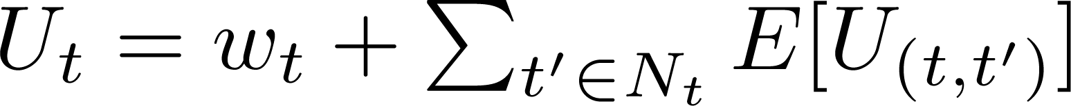
Utility evaluation
Given expected losses over edges, we can calculate expected losses for a target t:
Notes:
Maximizing the Spread of Influence through a Social Network

Slide 35
Two-pass algorithm for undirected trees
Pick a random node to be the root
Break each edge into two directed edges
Upward pass
Calculate expected loss for each edge from parent to child
Downward pass
Calculate expected loss for each edge from child to parent

Slide 36
Simple example
w = 0
P(spread) = .5
w = 1
w = 1

Slide 37
Upward pass
w = 0
P(spread) = .5
.5 * 1 = .5
.5 = .5 * 1
w = 1
w = 1

Slide 38
Downward pass
w = 0
P(spread) = .5
.5 * .5 = .25
.25 =.5 * .5
.5
.5
w = 1
w = 1

Slide 39
Expected loss calculation
w = 0
P(spread) = .5
U = 1
.25
.25
.5
.5
U = 1.25
U = 1.25
w = 1
w = 1

Slide 40
Correctness
We model this as a message passing algorithm
To calculate E[U_{(t’,t)}] requires the messages from N_{t} \ t’ to t
Upward
Each node has only one parent
All children have previously passed messages to t
Thus, each node has N_{t} \ P_{t} available when generating the message to its parent
Downward pass
All children passed messages to t in the upward pass
Parent has already passed message in this pass
Thus, each node has N_{t} available

Slide 41
Achieving linear time
As given, doesn’t achieve linear time
A node with O(n) edges (star) requires O(n^2) edge queries
To get around this, need to store values at the nodes
We can reason that:
Store a running total at each node
By the same reasoning as before the necessary calculations have been performed before they are needed as inputs
However, now need to show that we can recover the needed values from the stored value

Slide 42
Recovering the correct values
Upward pass
Already processed all of the children but not the parent
Value stored is exactly what is needed
Downward pass
Value stored is not correct
Children have not been updated yet
Can subtract out the value stored at each child to recover the needed values

Slide 43
Runtime
Visit each edge twice
Once on upward and once on downward pass
Perform a constant amount of work each time
Need to query the source of the edge
On downward pass also need to query the target of the edge
Also need to update the target of the edge
Since this is a tree, |T| - 1 = |E|
Thus, runtime is O(|T|)

Slide 44
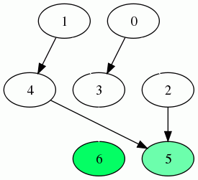
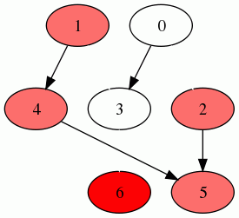
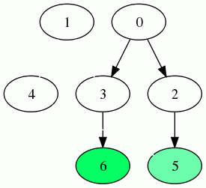
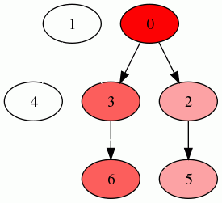
Approximation through simulation
1: Take each edge with probability proportional to its spread chance
3: Take the average
2: Propagate values from each node to every node that can reach it in the induced graph
…
…

Slide 45
Formulating this as a game (zero sum)
If target 0 is attacked
Defended | (0,0)
Not Defended | (-0.8488,0.8488)

Slide 46
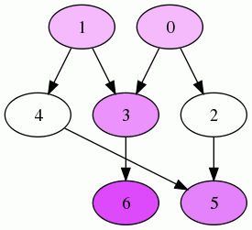
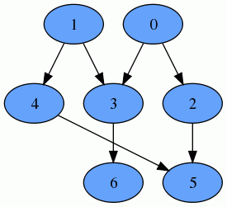
Optimal defense strategy (zero sum)
P(Defense) = .28
P(Defense) = 0
Expected loss
P(Defense) = .5
Uniform cost of .1428

Slide 47
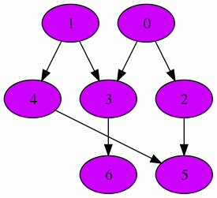
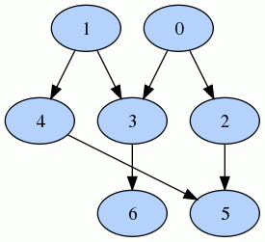
Optimal defense strategy (zero sum)
P(Defense) = 1
P(Defense) = 1
Expected loss
P(Defense) = 1
Uniform cost of .0179

Slide 48
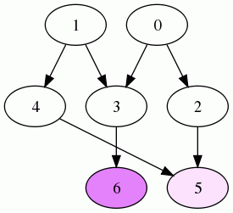
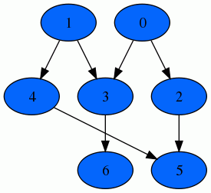
Optimal defense strategy (zero sum)
P(Defense) = 0
P(Defense) = 0
Expected loss
P(Defense) = .11
Uniform cost of .5714

