Slide 1
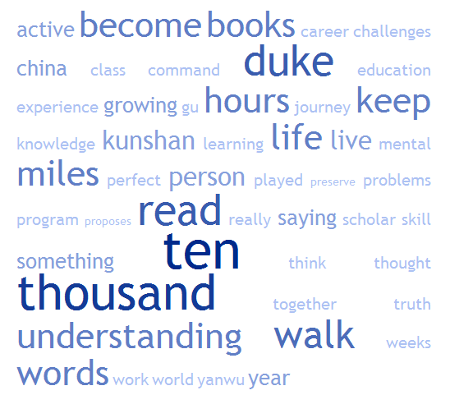
CompSci 101 Introduction to Computer Science
Sept. 9, 2014
Prof. Rodger
President Brodhead speech graduation 2010

Slide 2
DO NOT SIT IN THE LAST FOUR ROWS! Come forward and sit beside someone you haven’t met

Slide 3
Announcements
Lab 3 this week!
Reading for next time
RQ4 on Sakai Due by 10am Thursday
Assignment 2 due Thursday, Sept 11
APT Problem Set 1 due today!
APT Problem set 2 out

Slide 4
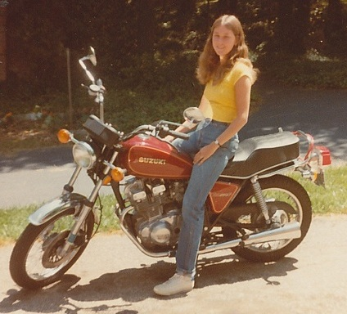
Introduction
Professor Rodger

Slide 5
How many ways can I run Python in this course?
Eclipse
Complete program
Console
APT
Online textbook
Beware Python 3 (‘/’ (2.7) vs ‘//’ (3) )
Python Tutor
Notes:
What is an APT, testing one method and it comes with free tests.
YOU WILL KNOW when an APT is correct!
You may not know for an assignment.

Slide 6
How to get Help in this class
Piazza
Consulting hours (Sunday-Thursday nights)
Office hours (Prof, Tas)
What happens if my laptop breaks and I can’t use my eclipse? Do I stop programming?
Clusters, Python Tutor, websubmit, borrow
What happens if you send Prof. Rodger an email?
46 support people vs. 1 person, may take awhile to answer
Notes:
Love to help all 316 of my students learn python but that is tough!
That is why we have so many support

Slide 7
Submitting an APT or Assignment
Use Ambient – submit
MAKE sure you select files
Don’t Successfully submit nothing – OOPS
Submit History – files submitted should be listed!
Alternative – use web submit
Tuesday midnight means Tuesday 11:59pm + 1 minute

Slide 8
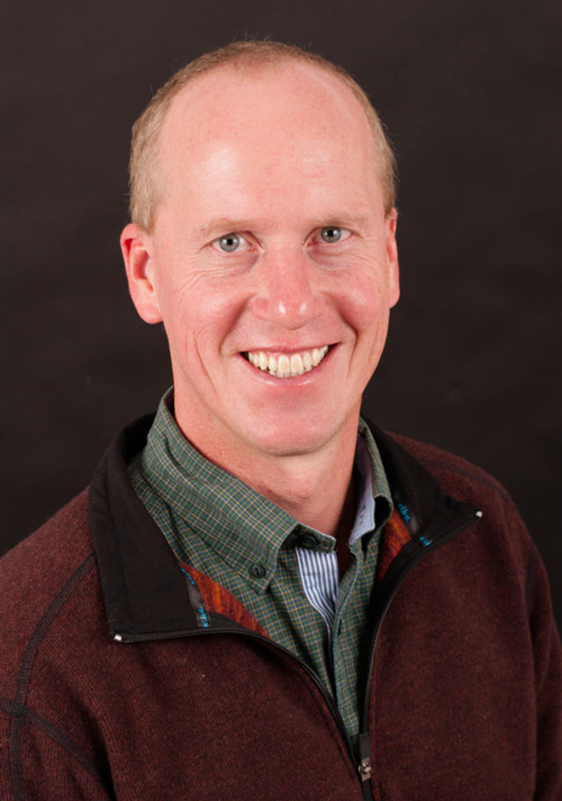
Why is this person so important to this course?
Have you donated yet?
Notes:
Brad Miller took Python book from Elkner, Downey and Meyer and created the software to allow you to experiment with the python right in the book
Without him, no free book!

Slide 9
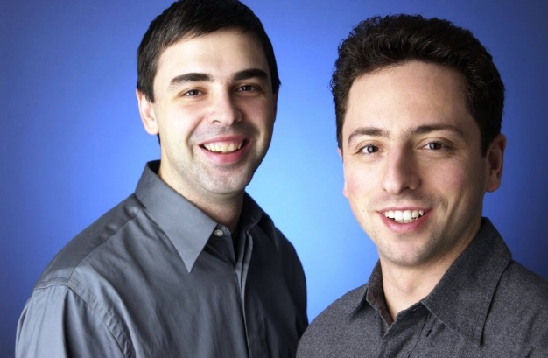
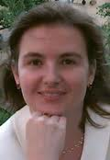
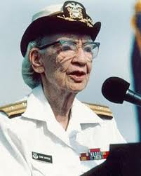
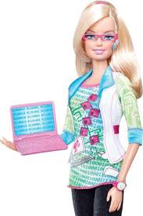
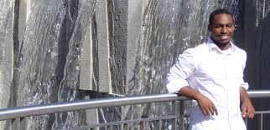
What do Computer Scientists look like?
Notes:
Sergei and Larry (google) – they came up first when I googled “famous computer scientists”, Theo Benson (cloud computing, new professor at duke), , Grace Hopper, jaron Lanier (book – you are not a gadget), daniella rus (robots that assemble themselves)and computer engineer barbie

Slide 10
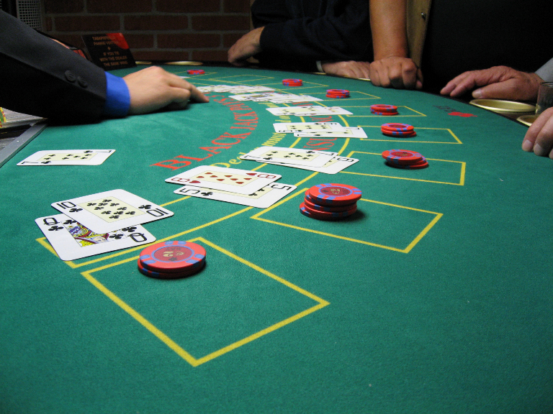
What did Prof. Astrachan teach you?
Big Thanks to Prof. Astrachan!
$$2^{10}$$
Notes:
Did you learn anything? Did you learn anything about Python?
What does Black Jack have to do with this course? Problem solving strategies to win.
I hear you watched the Price Is Right video? What does that have to do with this course? What was the technique the player was doing? (cutting in half the number of choices?

Slide 11
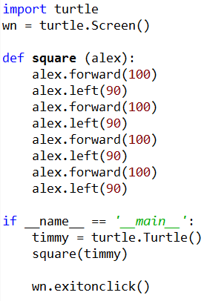
Turtles
Run in eclipse
Make square with different sizes?
Make a rectangle?
Where is the repetition?
New commands:
up(), down(), position(), goto()

Slide 12
Top 10 list for surving in CompSci 101
10. Ask questions
9. Eat lots of pizza
8. Learn how to spell Rodger
7. Read the book
6. Keep working until program is correct.

Slide 13
Top 10 list (cont)
5. Do the reading quizzes
4. Visit your prof in her office
3. Check Piazza every day
2. Seek help (one hour rule!)
1. Start programming assignments early
Notes:
Seek help (consulting hours, piazza, office hours)
Start early

Slide 14
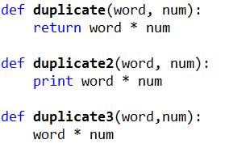
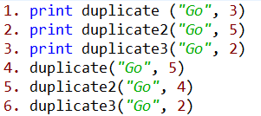
Review Functions
Online form: www.bit.ly/101fall-0909-01

Slide 15
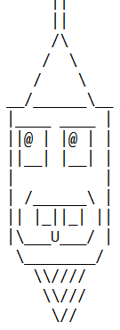
Assignment 2
How to start?
Where does import go?
Student work?

Slide 16
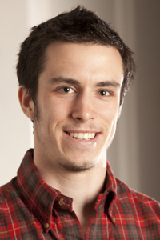
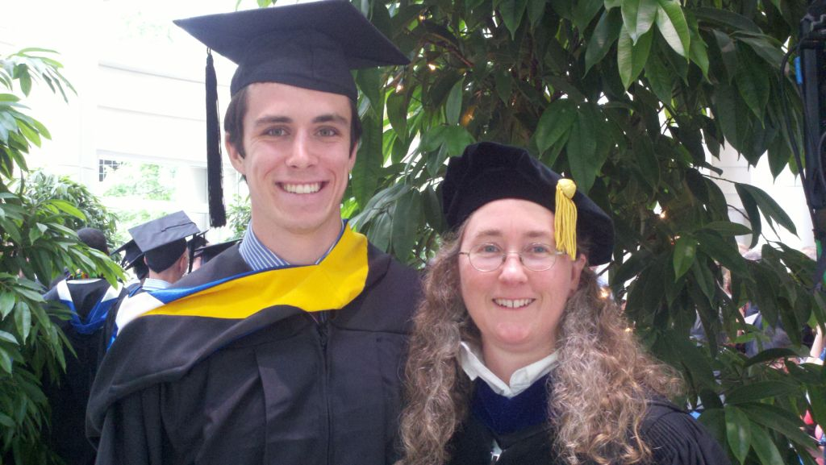
Computer Science Alum
Biology and CS
Undergraduate Research - JFLAP
Epic
Now in Med School at Vanderbilt
Notes:
Julian Genkins – he came to Duke premed. His fourth semester he took a computer science course and fell in loved it. He decided then to double major in CS and Biology. He did research with me on creating educational software. Then he took a gap year and worked at Epic for a year while he applied for med schools, and got a full scholarship to Vanderbilt.
With me just being in the hospital. It is pretty neat that Julian contributed to the EPIC medical software that Duke uses to manage my care while I am in the hospital.
He just wrote me sept 2014 and said he is on a student technology committee, focused on using technology in medical education. He is implementing new tools. “I cannot tell you how many times my experiences working on JFLAP have come in handy”

Slide 17
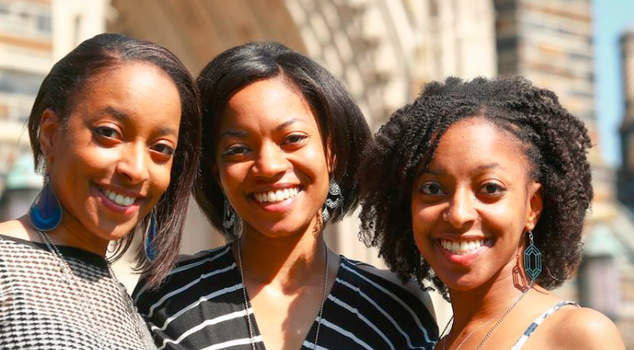
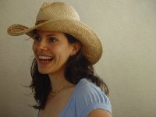
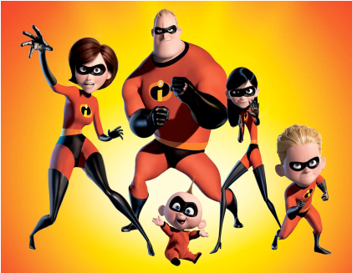
Computer Science Duke Alums
Notes:
Becky DeNardis (UTA and worked at Google two summers, then got a full time job at google, valedictorian, unfortunately, she was killed by a drunk driver last year, some of you may have heard about her. She was incredibly passionate about computer science and passionate about helping people learn computer science). , Deborah Nelson (rightmost triplet) took CompSci 101 – she taught English in Turkey for a year, then went to graduate school in Human Computer Interaction, now is a User Experience Designer for Blackbaud, Jessica Abroms (worked at Pixar, then started her own company)

Slide 18
More on Strings
Strings are indexed starting at 0
Example: ‘word’
Use [num] – to refer to a particular character in word
Use [x:y] to refer to a slice of the string starting at position x and up to but not including position y. Can leave out x or y.
w
o
r
d
0 1 2 3

Slide 19
Examples
phrase = "Duke Blue Devils"
print phrase[0]
print phrase[-3]
print phrase[1:3]
print phrase[5:10] + phrase[:4]
print (phrase[phrase.find('ev'):]).upper()
String fun
Crazy import

Slide 20
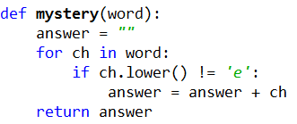
Loop over all characters in a String

Slide 21
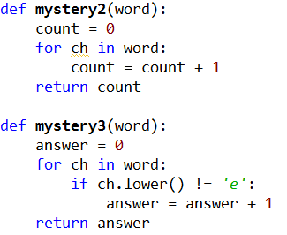
Loop over string
Online form: www.bit.ly/101fall14-0909-02

Slide 22
Loop over all words in a list

Slide 23
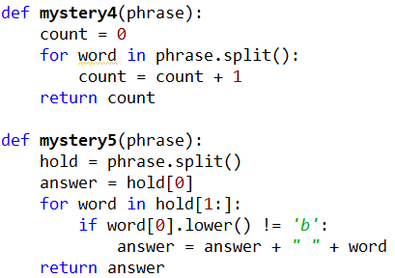
Loop over words
Online form: www.bit.ly/101fall14-0909-03

Slide 24
Solve an APT

