Slide 1
CompSci 101 Introduction to Computer Science
September 11, 2014
Prof. Rodger
National September 11 Memorial

Slide 2
DO NOT SIT IN THE LAST FOUR ROWS! (sec 01) THREE ROWS! (sec 02) Come forward and sit beside someone you haven’t met

Slide 3
Announcements
Read for next time on the calendar page
RQ will be available soon
Assignment 2 due today
Assignment 3 is out and due Sept 18
APT Problem set 2 is due Tuesday, Sept 16
New way to test APTs – via the web
Slower, but if can’t snarf, do it this way
Finish lecture notes from last time first!
Solve an APT

Slide 4
Lists
A list is a collection of objects
scores = [99, 78, 91, 84]
allAboutMe = [“Mo”,25, “934-1234”]
club=[‘Mo’,‘Jo’,‘Po’, ‘Flo’, ‘Bo’]
Lists are mutable – use [num] to change a value
Lists are indexed starting at 0, or -1 from the end
Functions: max, min, len, sum
Slice lists [:]

Slide 5
List Examples
scores = [10, 8, 10, 9]
print scores
scores[2] = 5
print scores
print max(scores)
print len(scores)
print sum(scores)
print scores[1:]
print scores[1]

Slide 6
List before/after modification
0 1 2 3
score = [10,8,10,9]
10
8
9
10
0 1 2 3
score [2] = 5
10
8
9
5
10

Slide 7
Processing List Items
Process all the items in a list, one item at a time
Format: for variable in list:
block
Example:
sum = 0
nums = [6, 7, 3, 1, 2]
for value in nums:
sum = sum + value
print sum

Slide 8
Copying vs aliasing
names = [‘jo’, ‘mo’, ‘bo’]
club = names
team = names[:]
names[1] = ‘flo’
print names
print club
print team

Slide 9
Making Decisions
Question?
True
if block
False

Slide 10
Making Decisions in Python
if condition1:
Block of code to do if condition is true
elif condition2:
Block of code to do if condition1 false, condition2 is true
else:
Block of code to do if other conditions false
Can have many elifs, leave out elif, leave out else

Slide 11
Making Decisions tools
Boolean values: True, False
Boolean operators: and, or, not
Relational operators: <, <=, >, >=
Equality operators: ==, !=
Look at if examples: miscIf.py
X | Y | X and Y | X or Y
True | True | True | True
True | False | False | True
False | True | False | True
False | False | False | False

Slide 12
More on lists
range (1,11)
Generates a list of numbers from 1 to 10
Example:
for num in range(1,11):
print num

Slide 13
Example
answer = 0
for num in range(1,10):
if num % 3 == 0:
answer = answer + num
else:
answer = answer + 1

Slide 14
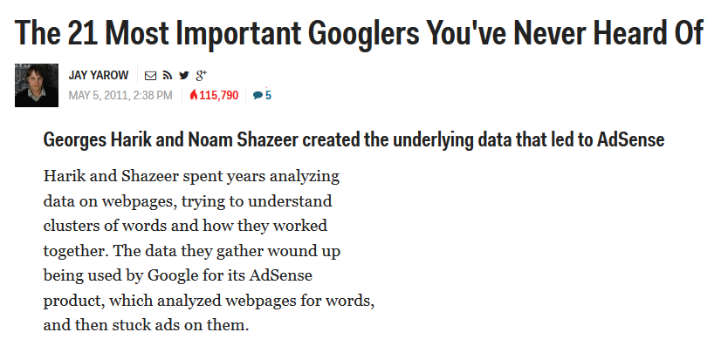
Computer Science Duke Alum
Notes:
Noam Shazeer (works at google, sat in the front row in B101 in CompSci 101!)

