Slide 1
CompSci 101 Introduction to Computer Science
September 16, 2014
Prof. Rodger

Slide 2
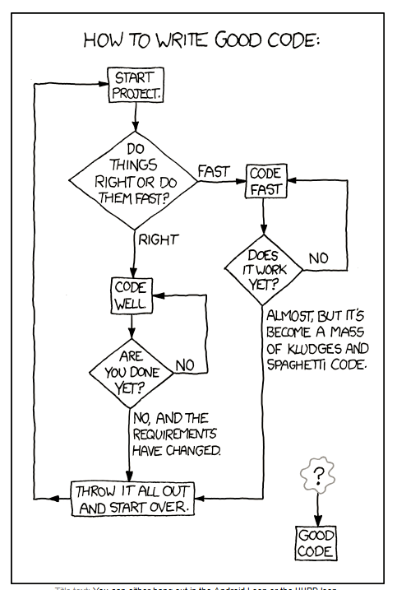
xkcd

Slide 3
Announcements
Reading for next time on the calendar page
RQ 6
APT-2 due today
Assignment 3 due Thursday
APT-3 out today, due in a week
Finish lecture notes from last time

Slide 4
Online forms for APTS
APT Emphasize:
www.bit.ly/101fall14-0916-01
APT Pancakes:
www.bit.ly/101fall14-0916-02

Slide 5
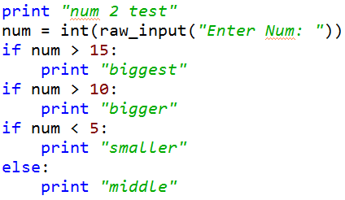
Compare Ifs

Slide 6
Dissect the for loop
for VARIABLE in STRUCTURE:
BODY
Repeat the BODY with the VARIABLE equal to each item in structure

Slide 7
What can the structure be? Variable be?
STRUCTURE → Variable
String → character
List → item in list
There are other types of structures we will see

Slide 8
Examples

