Slide 1
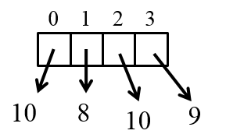
CompSci 101 Introduction to Computer Science
September 18, 2014
Prof. Rodger

Slide 2
Announcements
Reading for next time on calendar page
RQ 7 due Tuesday
Assignment 3 in
Assignment 4 out today
APT 3 due Tuesday
Tutors – Peer Tutoring Center is hiring tutors now, will be available soon
Consulting hours/office hours are free, go on non busy nights

Slide 3
Includes Notes from previous lectures

Slide 4
Lists
A list is a collection of objects
scores = [99, 78, 91, 84]
allAboutMe = [“Mo”,25, “934-1234”]
club=[‘Mo’,‘Jo’,‘Po’, ‘Flo’, ‘Bo’]
Lists are mutable – use [num] to change a value
Lists are indexed starting at 0, or -1 from the end
Functions: max, min, len, sum
Slice lists [:]

Slide 5
List Examples
scores = [10, 8, 10, 9]
print scores
scores[2] = 5
print scores
print max(scores)
print len(scores)
print sum(scores)
print scores[1:]
print scores[1]

Slide 6
List before/after modification
0 1 2 3
score = [10,8,10,9]
10
8
9
10
0 1 2 3
score [2] = 5
10
8
9
5
10

Slide 7
Processing List Items
Process all the items in a list, one item at a time
Format: for variable in list:
block
Example:
sum = 0
nums = [6, 7, 3, 1, 2]
for value in nums:
sum = sum + value
print sum
Notes:
Could put this in a function also for sum of a list

Slide 8
Copying vs aliasing
names = [‘jo’, ‘mo’, ‘bo’]
club = names
team = names[:]
names[1] = ‘flo’
print names
print club
print team
Notes:
Team is a copy of the list, club is NOT a copy
Visualize in python tutor

Slide 9
Making Decisions
Question?
True
if block
False

Slide 10
Making Decisions in Python
if condition1:
Block of code to do if condition is true
elif condition2:
Block of code to do if condition1 false, condition2 is true
else:
Block of code to do if other conditions false
Can have many elifs, leave out elif, leave out else

Slide 11
Making Decisions tools
Boolean values: True, False
Boolean operators: and, or, not
Relational operators: <, <=, >, >=
Equality operators: ==, !=
Look at if examples: miscIf.py
X | Y | X and Y | X or Y
True | True | True | True
True | False | False | True
False | True | False | True
False | False | False | False

Slide 12
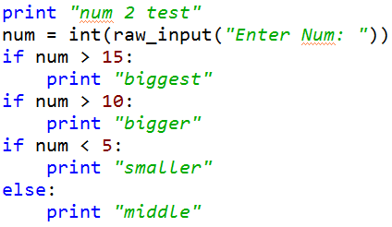
Compare Ifs Form: www.bit.ly/101fall14-0918-01
Q1
Q2
Q3
Notes:
WHAT IS THE DIFFERENCE IN Q2 and Q3?
If and elif

Slide 13
More on lists
range (1,11)
Generates a list of numbers from 1 to 10
Example:
for num in range(1,11):
print num

Slide 14
Example
answer = 0
for num in range(1,10):
if num % 3 == 0:
answer = answer + num
else:
answer = answer + 1

Slide 15
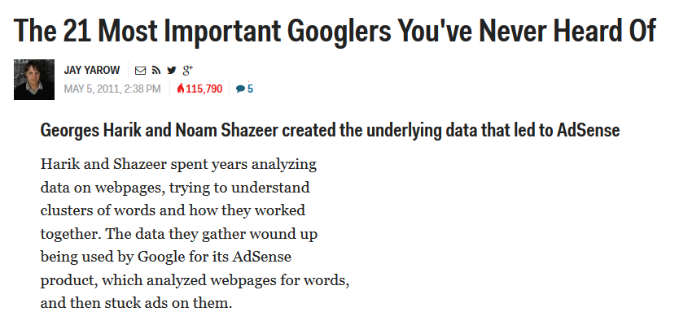
Computer Science Duke Alum
Notes:
Noam Shazeer (works at google, sat in the front row in B101 in CompSci 101!)

Slide 16
Dissect the for loop
for VARIABLE in STRUCTURE:
BODY
Repeat the BODY with the VARIABLE equal to each item in structure

Slide 17
What can the structure be? Variable be?
STRUCTURE → Variable
String → character
List → item in list
There are other types of structures we will see

Slide 18
Examples

Slide 19
Reading from Files
Must open file, close file
Easiest way, read one line as a string and then process it
inputfile = open(“datafile.txt”)
for line in inputfile:
line = line.strip()
‘’’ do something with line ‘’’
inputfile.close()

Slide 20
Dissect the for loop (again)
for VARIABLE in STRUCTURE:
BODY
inputFile = open(“somefile.txt”)
for str in inputFile:
process str
Notes:
Here the structure is a file, for each line in the file do

Slide 21
Writing to File
Must open file, close file
Open file for writing
outfile = open(“outputfile.txt”, ‘w’)
phrases = [“hello there”, … ]
for phr in phrases:
outfile.write(phr + “\n”)
outfile.close()
Note: refresh to see the file

Slide 22
Exercise with files
Snarf code
Form:
www.bit.ly/101fall14-0918-02

