Slide 1
CompSci 101 Introduction to Computer Science
September 23, 2014
Prof. Rodger

Slide 2
Announcements
No Reading for next time on calendar page
No Reading Quiz til after the exam
Must finish all RQ by Thursday!!
Assignment 4 due Thursday
APT 3 is due today
Exam 1 is in one week – Sept 30
Do the Practice Test by class Thursday
Fill out form on course web page if you have accommodations and/or cannot take the exam
One week for Regrade request
Finish lecture notes from last time

Slide 3
Assignment 4 steps
Run the program
Create the simple text file
Modify transform method
Apply transformation to every word in list of lists
Modify write_words – write to file
Modify transformations (pig-latin, rot13, etc)

Slide 4
Passing Functions as Parameters
def upperWord(word):
return word.upper()
def argWord(word):
return word + “arg”
def transformWord(func, word):
return func(word)
print transformWord(upperWord, “train”)
print transformWord(argWord, “truck”)

Slide 5
While loops
Repetition when you stop a loop based on a condition
while CONDITION:
BODY
As long as condition is true, keep executing loop.
Must have an update in the body to get closer to condition being false
Example: Repeat in chess until someone wins. When will that be?

Slide 6
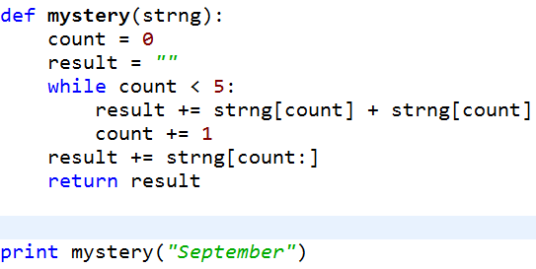
Mystery While example
www.bit.ly/101fall14-0923-02
Notes:
Where is the update? What does this do?

Slide 7
While loops
Problem 1: Does a letter, say ‘o’, appear at least three times in a string?
What if the string is very long? Can we stop early if we counted three ‘o’s?
Problem 2: Can we return the words in the phrase up until the third “o”?

Slide 8
Example www.bit.ly/101fall14-0923-01

Slide 9
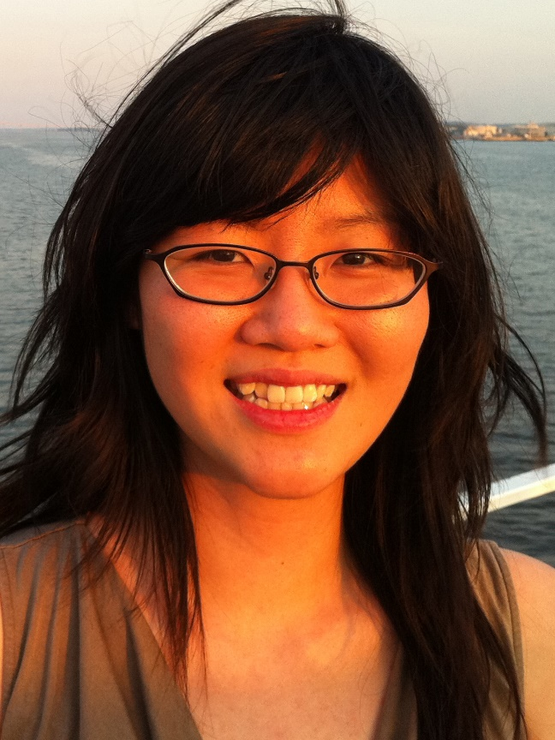
Tiffany Chen
B.S. Duke (UTA, ACM president)
Ph.D Stanford, 2012, in Biomedical Informatics
Stem Cell biology
Cancer drug screening
Director of Informatics at Cytobank
Notes:
President of ACM at Duke, UTA for several semesters including teaching,
Now works for a startup company.

Slide 10
Problem Solving
Assume vowels are: aeiou
Write vowelsOnly(word)
Returns word with only the vowels
Write allVowels(word)
- return true if word is all vowels

