Slide 1
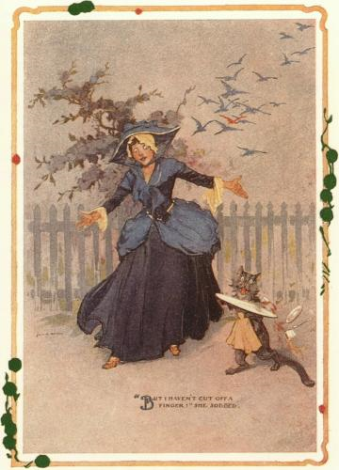
CompSci 101 Introduction to Computer Science
September 25, 2014
Prof. Rodger
“All your troubles are due to those ‘ifs’,”
declared the Wizard. If you were not a
Flutterbudget you wouldn’t worry.”
- The Emerald City of Oz by Frank Baum

Slide 2
XKCD

Slide 3
Announcements
Test 1 is Tuesday!
You must take the exam in your lecture section
Accommodations for test 1? Must fill out form on website
See Regrades form on website
See all new Forms on website – main page
Assignment 4 due today
No labs next week
Lunch with Prof. Rodger
Finish notes/code from last time

Slide 4
More Announcements
Two Review sessions
Sunday at 4:30pm-6pm
Monday at 6:15pm-7:30pm
Rooms to be posted on Piazza

Slide 5
Exam logistics
Exam is in the regular classroom
Only need a pen or pencil
No scratch paper
Will give you a reference sheet of Python information with the test (see resources page)
Closed book, closed notes, closed neighbor
Covers lecture, lab and assigned reading
Have put old quizzes back up as quiz review
This is NOT for a grade, for studying only

Slide 6
The best way to study
Write code on paper!
Resources page has old tests and solutions
Try writing code, then look at solutions
Rewrite an APT
Rewrite code we did in lecture
Rewrite code we did in lab

Slide 7
What we have not done
If looking at old exams, note we have not done the following:
List comprehensions
Code in square brackets such as
y = [w for w in alist]
There may be other things…. If it looks strange, it might be we haven’t done it….

Slide 8
Understand
What is the difference between:
[ ] and ( )
w = and w +=
print value and assigning value to a variable
print and return
When do you print? When do you return?
Does a function print or return?
if, for, range, strings, lists
Understand format and how they work
Parameters vs arguments

