Slide 1
CompSci 101 Introduction to Computer Science
October 2, 2014
Prof. Rodger

Slide 2
Announcements
Reading for next time on calendar page
RQ 9
Nothing due today!
APT 4 out today - due on Thursday, Oct 8

Slide 3
Tiffany Chen
B.S. Duke (UTA, ACM president)
Ph.D Stanford, 2012, in Biomedical Informatics
Stem Cell biology
Cancer drug screening
Director of Informatics at Cytobank
Notes:
President of ACM at Duke, UTA for several semesters including teaching,
Now works for a startup company.

Slide 4
Creating a list
Given a list of numbers, create a second list of every number squared.
nums = [8, 3, 5, 4, 1]
sqnums = []
for v in nums:
sqnums.append(v*v)
print sqnums
[64, 9, 25, 16, 1]

Slide 5
More on List operations
See list operations on next page
Mutator vs hybrid vs return
Mutator changes the list (no return value)
Hybrid changes list and returns value
Return – returns value, no change to list

Slide 6
List operations from book

Slide 7
Problem
Remove all negative numbers from list
Two ways
1) return a new list with all negative numbers removed
2) Modify a list to remove negative numbers

Slide 8
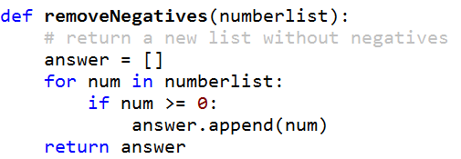
somenums = [3, -1, 8, -5, -2, 6, 7]
nonegs = removeNegatives(somenums)

Slide 9
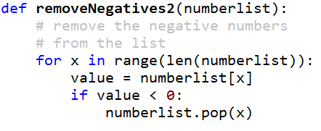
www.bit.ly/101fall14-1002-01
somenums = [3, -1, 8, -5, -2, 6, 7]
removeNegatives2(somenums)

Slide 10
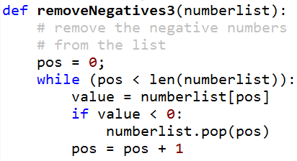
www.bit.ly/101fall14-1002-02
somenums = [3, -1, 8, -5, -2, 6, 7]
removeNegatives3(somenums)

Slide 11
Richard Stallman
MacArthur Fellowship (Genious grant)
ACM Grace Murray Hopper award
Started GNU – Free Software Foundation (1983)
GNU Compiler Collection
GNU Emacs
a
Notes:
Lived in his office at MIT until 1998
Came to Duke in 1997 – brought three people with him including a film maker

Slide 12
List Comprehension
Take advantage of patterns, make a new list based on per element calculations of another list
Format:
[<expression with variable> for <variable> in <old list>]
Example:
nums = [8, 3, 5, 4, 1]
sqnums = [v*v for v in nums]

Slide 13
Examples of List Comprehensions
[v for v in nums]
[2 for v in nums]
[v*2 for v in nums]

Slide 14
Creating a list with just the even numbers
nums = [8, 3, 5, 4, 1]
evennums = []
for v in nums:
if v % 2 == 0:
evennums.append(v)
print evennums
[8, 4]

Slide 15
List Comprehension with Filtering
Create list and use “if” to filter out elements to the list
Format:
[<expression with variable> for <variable> in <old list> if <filter with variable> ]
Example: nums = [8, 3, 5, 4, 1]
evennums =
[v for v in nums if v%2==0]

Slide 16
More on List Comprehensions www.bit.ly/101fall14-1002-03
What is the list for the following:
1) [j+1 for j in range(20) if (j%3) == 0]
2) [i*2 for i in [j+1 for j in range(20)
if (j%3 == 0] if i*i > 19]
Problem: Given a list of strings, return the longest string. If there are more than one of that length, return the first such one.
[‘kiwi’, ‘plum’,‘orange’, ‘lemon’, ‘banana’]
Write a list comprehension for this problem

