Slide 1
CompSci 101 Introduction to Computer Science
October 9, 2014
Prof. Rodger
Thanks to Prof. Azhar and Yossra Hamid for
giving this lecture!

Slide 2
Announcements
Reading for next time on calendar page
RQ
APT 4 is due today
APT 5 is out today
Exam 1 was handed out Tuesday, grades are on Sakai, you will need to see Prof. Rodger next week to get your test back
Today Sets
Prof. Rodger is at a conference this week

Slide 3
Python Sets
Set – unordered collection of distinct items
Unordered – can look at them one at a time, but cannot count on any order
Distinct - one copy of each
Operations on sets:
Modify: add, clear, remove
Create a new set: difference(-), intersection(&), union (|), symmetric_difference(^)
Boolean: issubset <=, issuperset >=
Can convert list to set, set to list

Slide 4
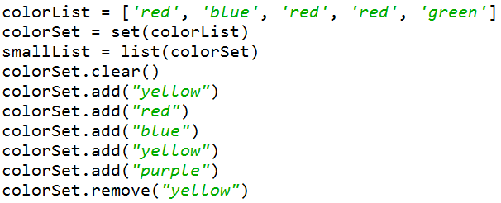
Creating and changing a set
See setsEasy.py

Slide 5
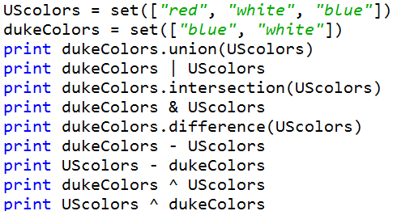
Set Operations
See setsEasy.py

Slide 6
Set Examples bit.ly/101fall14-1009-01
poloClub = set(['Mary', 'Laura', 'Dell'])
rugbyClub = set(['Fred', 'Sue', 'Mary'])
Question 1:
print [w for w in poloClub.intersection(rugbyClub)]
Question 2:
print [w for w in poloClub.union(rugbyClub)]

Slide 7
More Set Examples bit.ly/101fall14-1009-02
lista = ['apple', 'pear', 'fig', 'orange', 'strawberry']
listb = ['pear', 'lemon', 'grapefruit', 'orange']
listc = [x for x in lista if x in listb]
listd = list(set(lista)|set(listb))
Question 3:
print listc
Question 4:
print listd

Slide 8
More Set Examples
s = set(lista)
t = set(listb)
problem1 = (s-t) | (t-s)
print problem1
problem2 = (s|t) - (s&t)
print problem2
problem3 = (s|t|(s&t))
print problem3

Slide 9
Set Operations from pictures bit.ly/101fall14-1009-03
Question:Which picture is which operation?
A)
C)
D)
B)
E)
Notes:
http://en.wikipedia.org/wiki/File:Venn0111.svg
Symmetric Difference B) intersection C) everything not in either set D) Union e) Difference

Slide 10
Problems – snarf setExample.py
Given a list of strings that have the name of a course (one word), followed by last names of people in the course:
Convert list into lists of strings of names for each course
Find total number of people taking any course
Find number of people taking just one course
["econ101 Abroms Curtson Williams Smith“,
"history230 Black Wrigley“, … ]

Slide 11
Part 1 – processList bit.ly/101fall14-1009-04
Given a list of strings that have the name of a course (one word), followed by last names of people in the course:
Convert list into lists of strings of names for each course
["econ101 Abroms Curtson Williams Smith“,
"history230 Black Wrigley“, … ]

Slide 12
Part 2 – peopleTakingCourses bit.ly/101fall14-1009-05
Given a list of strings that have the name of a course (one word), followed by last names of people in the course:
Find total number of people taking any course
["econ101 Abroms Curtson Williams Smith“,
"history230 Black Wrigley“, … ]

Slide 13
Part 3 – unionAllSetsButMe bit.ly/101fall14-1009-06
Given a list of strings that have the name of a course (one word), followed by last names of people in the course:
Find number of people taking just one course
BUT FIRST, lets write this helper method
["econ101 Abroms Curtson Williams Smith“,
"history230 Black Wrigley“, … ]

Slide 14
Part 4 – peopleTakingOnlyOneCourse bit.ly/101fall14-1009-07
Given a list of strings that have the name of a course (one word), followed by last names of people in the course:
Find number of people taking just one course
["econ101 Abroms Curtson Williams Smith“,
"history230 Black Wrigley“, … ]

Slide 15
APT - UniqueZoo
How do you solve this problem?
How is it similar to the problem we just solved

