Slide 1
CompSci 101 Introduction to Computer Science
October 21, 2014
Prof. Rodger

Slide 2
Announcements
Reading for next time on calendar page
RQ 11
Assignment 5 due Oct 30 (new date)
APT 5 is due today
APT 6 out today
Finish lecture notes from last time

Slide 3
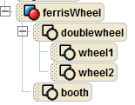
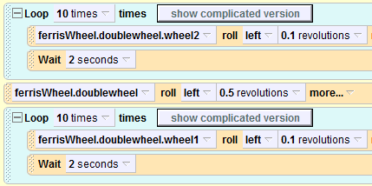
Alice programming language

Slide 4
Nested Loop

Slide 5
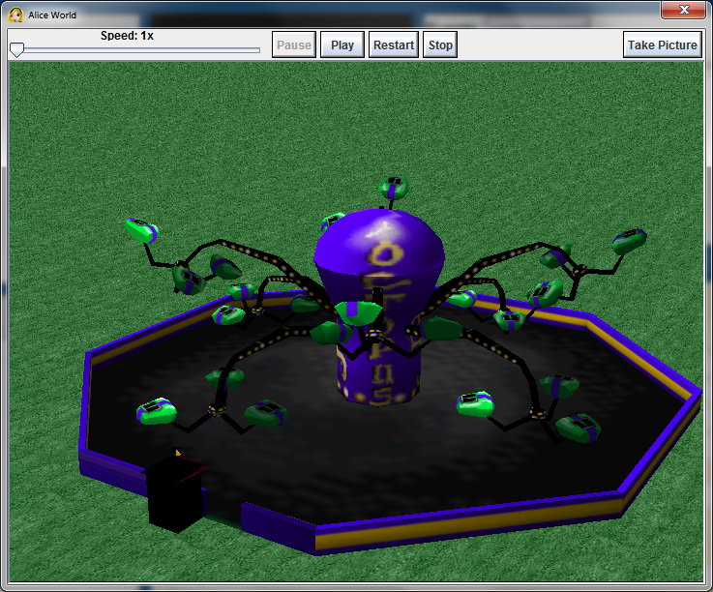
Fair Ride – Octopus

Slide 6
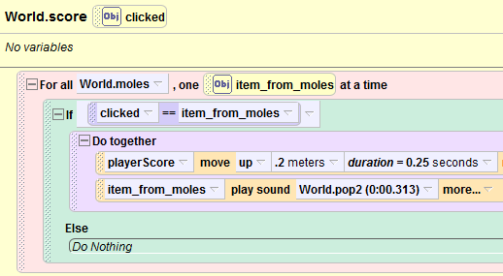
Wac-A-Mole
Notes:
How is wac a mole implemented? A list of moles, go through and check if what you clicked on is in the list

Slide 7
Tuples
Like a list, but cannot change them
Define them with “,”
(5, 7, 8) or 5, 7, 8
Use most list operations on them
they are a type of list
But immutable
Examples
Notes:
Could use an activity on tuples?

Slide 8
Example
print z
z[0][1] = 12
print z
z[0].append(4)
print z
z[0].remove(5)
z[0].remove(12)
z[0].remove(4)
print z
x = (4, 6, 8)
y = 9, 5, 6
print x
print y
print x[1]
print y[1]
y[0] = 2
z = ([5,6], [7,8])
Notes:
These are for the console only

Slide 9
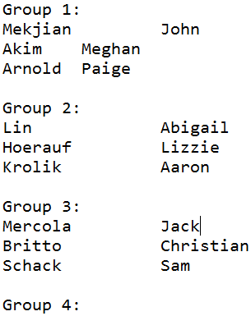
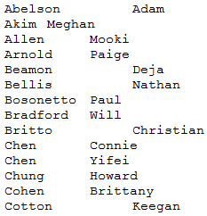
Example: Generate groups of students randomly
Sort a list of students (partially shown) into groups?

Slide 10
Example: Generate groups of students randomly
Sort a list of students into random groups?
Read list of students from a file (one per line)
Put names into a list
Randomly shuffle the names
Print them out in groups of three

Slide 11
Discuss and write code for processFile(file)
www.bit.ly/101fall14-1021-01
Read in lines from a file
One student name per line
Return a list of the student names

Slide 12
Discuss and write code for randomize(students)
www.bit.ly/101fall14-1021-02
Given a list of student names
Return a list of students in random order
random.randint(0,4) – returns integer
Notes:
Need to use random

Slide 13
Consider this attempt at Randomize www.bit.ly/101fall14-1021-03

Slide 14
Consider this attempt at Randomize www.bit.ly/101fall14-1021-03
Notes:
May get duplicate students

Slide 15
Print in groups of 3 printGroups(students)
www.bit.ly/101fall14-1021-04
Given a list of student names
Print “Group N” followed by three student names, one name per line, for each group N
Group 1:
name1
name2
name3

