Slide 1
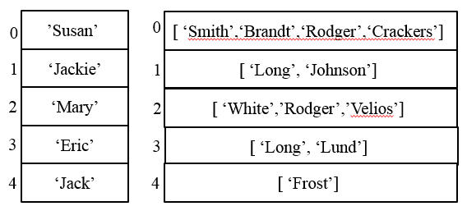
CompSci 101 Introduction to Computer Science
October 23, 2014
Prof. Rodger

Slide 2
Events of Interest coming up
ACM International Programming Contest
Sat. Nov. 1 – looking for volunteers to help
Top 3 teams – go to finals in Morroco
Hacking and Hackathons Demystified – Ladies in Tech Unite
Thursday, Oct 23, Allen Bldg (TONIGHT) 6:30pm
HackDuke.com - Hackathon Nov. 15-16

Slide 3
Announcements
Reading for next time TBA
RQ 12 to be posted
Hangman due next Thursday
APT 6 is due on Tuesday
Finish lecture notes from last time

Slide 4
Problem: Longest Name www.bit.ly/101fall14-1023-01
Given a list of names (one word only) and a letter (assume names start with capital letter, and letter is capital)
names = [‘Helen’, ‘Bob’, ‘Bart’, ‘Hugh’]
1) Find the longest name that starts with that letter
2) Find the position of the longest name that starts with that letter
See longestName.py, DO NOT use enumerate
Notes:
Mention Examples

Slide 5
Enumerate
An iterator, generates a sequence
Generates tuples of (index, item)
Used with for loop to get both index and item
for (index,item) in somelist:
You get both at the same time!
Redo find position of longest name with iterator

Slide 6
Problem: Popular Name
Given a list of names, determine the most popular first name and print that name with all of its last names.
Input: Names are always two words, names are in a file. If multiple names are on the same line they are separated by a “:”
Output: Most popular first name, followed by a “:”, followed by corresponding last names separated by a blank

Slide 7
Example Input File with 5 lines
Susan Smith:Jackie Long:Mary White
Susan Brandt
Jackie Johnson:Susan Rodger:Mary Rodger
Eric Long:Susan Crackers:Mary Velios
Jack Frost:Eric Lund
Corresponding Output
Susan: Smith Brandt Rodger Crackers

Slide 8
One way to solve
Create a list of unique first names
Create a list of lists of last names that are associated with each first name

Slide 9
Example – two lists
Unique
First names
Corresponding Last names
’Susan’’
0
[ ‘Smith’,‘Brandt’,‘Rodger’,‘Crackers’]’
0
1
‘Jackie’
1
[ ‘Long’, ‘Johnson’]’
2
‘Mary’
[ ‘White’,’Rodger’,’Velios’]’
2
3
‘Eric’
3
[ ‘Long’, ‘Lund’]’
4
‘Jack’
4
[ ‘Frost’]’

Slide 10
Now can we solve the problem?
Compute those two lists that are associated with each other
List of unique first names
List of corresponding last names
Compute the max list of last names
Now easy to print the answer.
See popular.py

Slide 11
Expanding the Problem
Suppose we want to read from multiple data files
names1.txt, names2.txt, names3.txt
See popular.py

