Slide 1
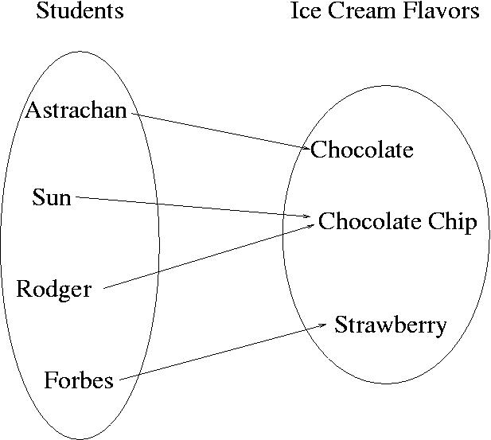
CompSci 101 Introduction to Computer Science
October 30, 2014
Prof. Rodger

Slide 2
Announcements
Reading for next time on calendar page
RQ 14
Assignment 5 due today
Assignment 6 due next Thursday
APT 7 is due on Tuesday
Finish lecture notes from last time
Today Dictionaries/Maps

Slide 3
Dictionaries/Maps
Dictionaries/maps are another way of organizing data
Keys and Values
Each key maps to a value
Some keys can map to the same value
Can change the value a key maps to

Slide 4
Example
Each student could be mapped to their favorite ice cream flavor

Slide 5
Implementing a Dictionary/Map Keys map to values
Create Empty dictionary
somemap = {}
Put in a key and its value
somemap[“Forbes”] = “Strawberry”
Get a value for a dictionary
value = somemap[“Forbes”]
OR value = somemap.get(“Forbes”, “default”)
Change a value for a dictionary
somemap[“Forbes’] = “Chocolate”

Slide 6
More on using a Dictionary/Map
Get all the keys (as a list)
listKeys = somemap.keys()
Get all the values (as a list)
listValues = somemap.values()
Other methods
clear – empty dictionary
items – return (key,value) pairs
iteritems – return (key,value) pairs more efficiently, iterator – must use with for
update – update with another dictionary

Slide 7
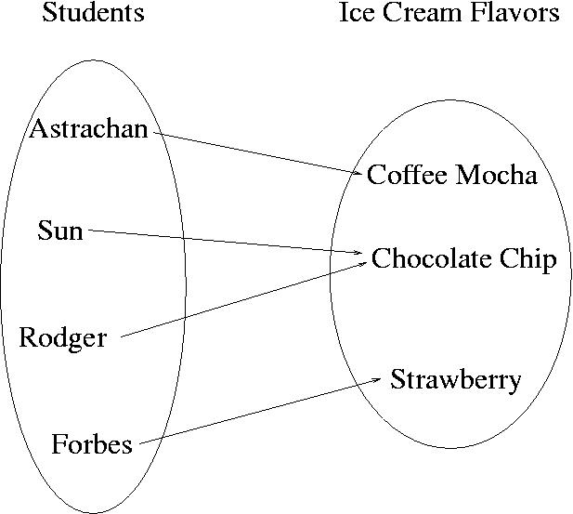
Change Astrachan’s value somemap[“Astrachan”] = Coffee Mocha

Slide 8
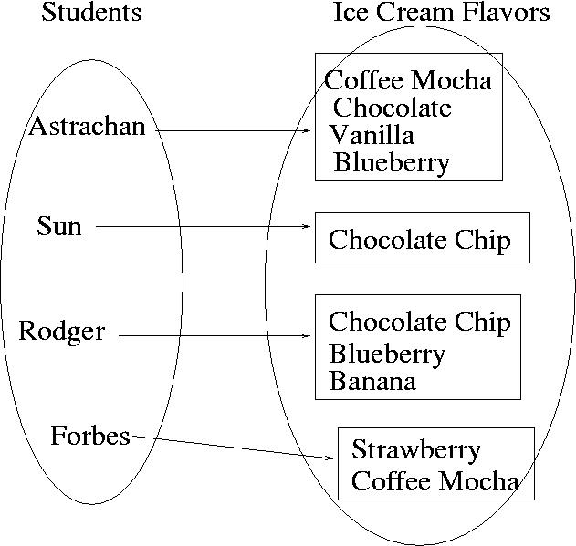
Value could be a set or list

Slide 9
Back to Popular Name Problem:
Given a list of names, determine the most popular first name and print that name with all of its last names.
Input: Names are always two words, names are in a file. If multiple names are on the same line they are separated by a “:”
Output: Most popular first name, followed by a “:”, followed by corresponding last names separated by a blank

Slide 10
Example Input File with 5 lines
Susan Smith:Jackie Long:Mary White
Susan Brandt
Jackie Johnson:Susan Rodger:Mary Rodger
Eric Long:Susan Crackers:Mary Velios
Jack Frost:Eric Lund
Corresponding Output
Susan: Smith Brandt Rodger Crackers

Slide 11
Now use a dictionary/map www.bit.ly/101fall14-1030-01
We will write three dictionaries for practice
First name to count of corresponding last names
First name to list of corresponding last names
First name to set of corresponding last names
Which dictionary is most useful to solve this problem?
popularMap.py

Slide 12
Compare
Using two parallel lists?
Using one dictionary/map

