Slide 1
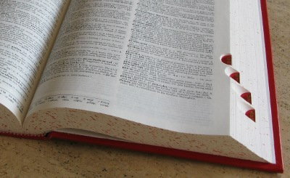
CompSci 101 Introduction to Computer Science
November 6, 2014
Prof. Rodger
Thanks to Elizabeth Down and Yossra Hamid for
giving this lecture!

Slide 2
Announcements
No Reading or RQ for next time
Assignment 6 due today
APT 8 due Tuesday!
Practice Test for Exam 2 out today
Quiz review on Sakai (not for credit)
Fill out form for Exam 2 if you cannot take on Nov 13, or if you have special accommodations
Finish lecture notes from last time

Slide 3
Classwork for Nov 6
See the classwork page under today’s date on the course calendar page
Links to google forms are on that page
Also discuss APT EmailsCourse

