Slide 1
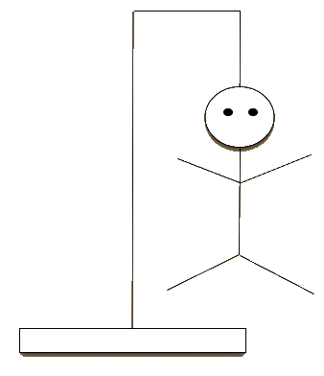
CompSci 101 Introduction to Computer Science
November 18, 2014
Prof. Rodger

Slide 2
Announcements
Reading for next time on calendar page
RQ maybe
Assignment 7 due Thursday
APT 9 is out today
Do not discuss exam until it is handed back

Slide 3
Snarky Hangman
Demo
Dictionary of categories
Start with list of words of correct size
Repeat
User picks a letter
Make dictionary of categories based on letter
New list of words is largest category
Matched letters
Letters guessed by not chosen
List shrinks in size each time

Slide 4
Regular Expressions
Powerful language for matching text patterns
Part of the compiler process
Can write a regular expression for each type of word in a programming language
Example
Key words – if, else, elif, while
Integers – 456, 78, 2, -56
Float – 3.14, 7856.2345
String – ‘word’, “this is a phrase”
Special symbols – [ ] + %

Slide 5
Regular Expressions
a- a
a* - a repeated 0 or more times
a+ - a repeated 1 or more times
a? – a 0 or 1 time, so a is optional
^ - match at the beginning of the string
$ - match at the end of the string
. – matches anything
[abc] – match a, b, or c
[a-z] – match any character from a to z
[^a] – match any character but a

Slide 6
More on regular expressions
| - or
\b - word boundary
\s - whitespace character
\d – match any digit
When using backslashes – must use r in front of string

Slide 7
Regular expressions with re
import re
re.sub(pattern, repl, str) – return string that replaces the pattern matches with repl in string str – looks from left end of string
re.compile() – create a pattern
re.findall()
See code examples

Slide 8
More on sort
Import operator
fruit = [(“pear”,5),(“apple”,9)]
fruit = sorted(fruit)
fruit.sort() OR fruit = sorted(fruit)
arguments
key=itemgetter(0)
reverse=True

