Slide 1
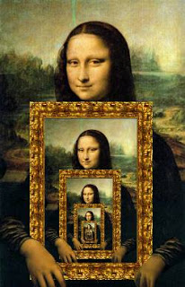
CompSci 101 Introduction to Computer Science
November 25, 2014
Prof. Rodger

Slide 2
Announcements
No Reading or RQ for next time
Assignment 8 out – due Dec 4
Assignment 9 out – due Dec 5 (extra)
APT 10 out and due – Dec 5
Lab 11 next week
Finish lecture notes from last time

Slide 3
Recursion
Method calls a clone of itself
Solves a problem by solving smaller subproblems
“looping” by recursive calls
CAUTION – don’t add a loop, it is implicit

Slide 4
Examples: recursionMisc.py
Calculates and prints the sum of integers from a list that are even
Print the numbers one per line
Mystery recursion

Slide 5
Recursion (more)
Watch out for infinite recursion
No way out, what happens?
Segmentation fault, out of memory
Rules
Base case (way out) – no recursive call
Recursive call(s) – solve a smaller problem

Slide 6
Recursion vs Iteration Which method do you use?
Iteration
Easier to define
Faster – recursion takes some overhead
Recursion
Easier to define
Shorter code

Slide 7
Types of Recursion
Tail recursion
One recursive call at the end of a method
Easy to replace with a loop
Reverse something
One recursive call “before”process
Multiple Recursion
More than one recursive call

