Slide 1
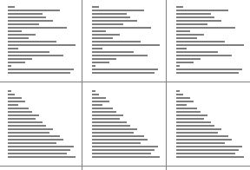
CompSci 101 Introduction to Computer Science
December 4, 2014
Prof. Rodger

Slide 2
Evaluation
Fill out course evaluation on ACES
On Sakai (under announcements) please rate your Lab UTAs and any other UTAs you interacted with

Slide 3
Announcements
Submit works now!
Final Exam – accommodations/reschedule?
Fill out form by Dec 5
APT 10 due Friday, last late day is Dec 7
Asg 8 due tonight!, Last late day is Dec 6
Asg 9 due Friday night, not accepted after midnight!
Today
More on sorting, Classwork, CS story

Slide 4
More Announcements
Be a UTA
http://www.cs.duke.edu/csed/uta/
Next course
CompSci 201
Start all over again with Java
Java has if, loops, lists, maps (dictionaries), sets
Is that familiar?
Learn about nonlinear structures that can be more efficient

Slide 5
Final Exam
Sec 01 (White Lect. Hall) – Sat Dec 13 2pm
Sec 02 (LSRC B101) – Wed Dec 10 7pm
Closed Book, Closed Notes, Closed neighbor
Python Reference Sheet
Covers all topics through today
Best way to study is practice writing code!
See old tests (no old final exams)
Fall 2014 tests – see other section tests

Slide 6
Final Exam (cont)
Test format
Multiple choice
Writing code
Topics include:
if, loops, lists, sets, maps, files, functions
recursion and regular expressions – reading level only

Slide 7
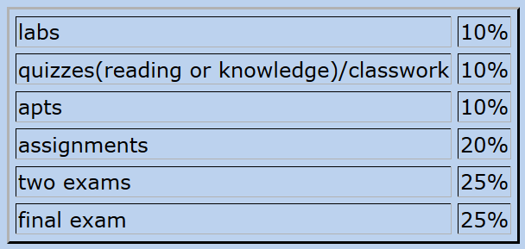
Calculate Your Grade
From “About” tab on course web page

Slide 8
More on Grades
Lecture – drop the first two weeks (drop/add period) plus 3 more
Reading Quizzes – will drop 20 points
Lab – drop 8 points (each lab is 4 pts)

Slide 9
Wrap up Sorting
Different ways to sort?
Over 50 sorting algorithms
What sorting algorithm does Python sort use?
Does President Obama know his sorts?
Sorting animations
http://www.sorting-algorithms.com/
Notes:
All do one pass to sort numbers.
Python – probably uses quicksort, a divide and conquer algorithm

Slide 10
Merge Sort
Idea: Divide and Conquer
Divide array into two halves
Sort both halves (smaller problem)
Merge the two sorted halves
Learn about this and other sorts in CompSci 201, also how to analyze them to determine which one works best.
Timsort
Shellsort
Notes:
Quite a different approach than the others. Uses recursion with multiple recursive calls
Timsort invented by Tim Peters – a hybrid sort combines mergesort and insertion sort
Shellsort invented by Donald Shell– uses insertion sort as part of it
You can invent a sort and get them named after you!

Slide 11
Classwork bit.ly/101fall14-1204-01

Slide 12
Growth of functions
As the size of the data increases, how many steps are there for an algorithm/method?

Slide 13
Timings
N | log₂N | N² | N³ | 2^{N}
10 | 3.3 | 100 | 1000 | 1024
20 | 4.3 | 400 | 8000 | 1048576
40 | 5.3 | 1600 | 64000 | 1.1 x 10¹²
80 | 6.3 | 6400 | 512000 | 1.2 x 10²⁴
160 | 7.3 | 25600 | 4096000 | 1.4 x 10⁴⁸

Slide 14
Timings
N | log₂N | N² | N³ | 2^{N}
250 | 7.9 | 62,500 | 1.56 x 10⁷ | 1.8 x 10⁷⁵
500 | 8.9 | 250,000 | 1.25 x 10⁸ | 3.2 x 10¹⁵⁰
1000 | 9.9 | 1x10⁶ | 1 x 10⁹
2000 | 10.9 | 4 x 10⁶ | 4 x 10⁶
4000 | 11.9 | 1.6 x 10⁷ | 8 x 10⁹

Slide 15
Look at the timings of the sorts
How do the sorts compare?
With size as they grow
With different types of data
Random
Reverse
Almost sorted

Slide 16
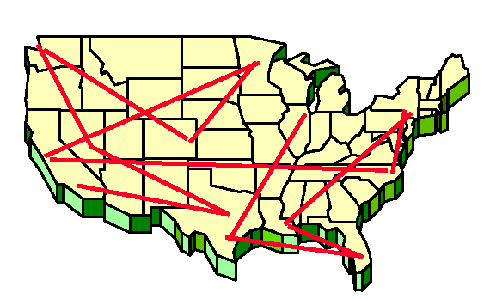
Problem: Traveling Band
Band wants you to schedule their concerts.
They don’t like to travel. Minimize the time they are on the bus!
Given N cities, what is the best schedule (shortest distance) to visit all N cities once?

Slide 17
How do you calculate the best path?
Try all paths
Atlanta, Raleigh, Dallas, Reno, Chicago
Dallas, Atlanta, Raleigh, Reno, Chicago
Etc.
Would you agree to code this up?

Slide 18
How long?
Number of Cities | All paths – N! | Time to solve - 10⁹ Instructions per second
10 | 3 million
15 | 10¹²
18 | 10¹⁵
20 | 10¹⁸
25 | 10²⁵

Slide 19
How long?
Number of Cities | All paths – N! | Time to solve - 10⁹ Instructions per second
10 | 3 million | < sec
15 | 10¹²
18 | 10¹⁵
20 | 10¹⁸
25 | 10²⁵

Slide 20
How long?
Number of Cities | All paths – N! | Time to solve - 10⁹ Instructions per second
10 | 3 million | < sec
15 | 10¹² | 16 min
18 | 10¹⁵
20 | 10¹⁸
25 | 10²⁵

Slide 21
How long?
Number of Cities | All paths – N! | Time to solve - 10⁹ Instructions per second
10 | 3 million | < sec
15 | 10¹² | 16 min
18 | 10¹⁵ | 11 days
20 | 10¹⁸
25 | 10²⁵

Slide 22
How long?
Number of Cities | All paths – N! | Time to solve - 10⁹ Instructions per second
10 | 3 million | < sec
15 | 10¹² | 16 min
18 | 10¹⁵ | 11 days
20 | 10¹⁸ | 31 years
25 | 10²⁵

Slide 23
How long?
Number of Cities | All paths – N! | Time to solve - 10⁹ Instructions per second
10 | 3 million | < sec
15 | 10¹² | 16 min
18 | 10¹⁵ | 11 days
20 | 10¹⁸ | 31 years
25 | 10²⁵ | 10⁸ years

Slide 24
P = NP?
P: Problems with polynomial time solutions
N, N²
Example: Selection sort
Easy to solve
NP: problems with not polynomial time solutions
2^{n} , N!
Hard to solve

Slide 25
Does P = NP?
Famous CS question
If yes, a whole class of difficult problems can be solve efficiently, one problem is reducible to another
If no, none of the hard problems can be solved efficiently

Slide 26
A CS Story
Notes:
Skip slides 13-17

