Slide 1
Plan for ThBThB
Programming and understanding …
Hierarchical structures and concepts
What is a file system on a computer?
What is the Internet?
How does the Domain Name System Work?
How do you access directories?
And all the files in a directory, and the …
How do you get recommendations
Based on Yelp, Amazon, Netflix,

Slide 2
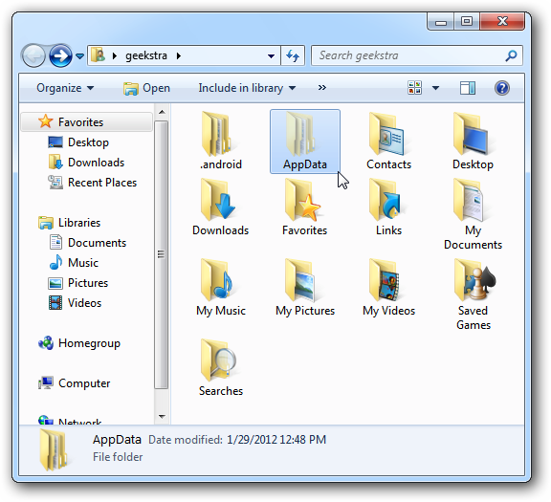
What's in a file-system Folder?

Slide 3
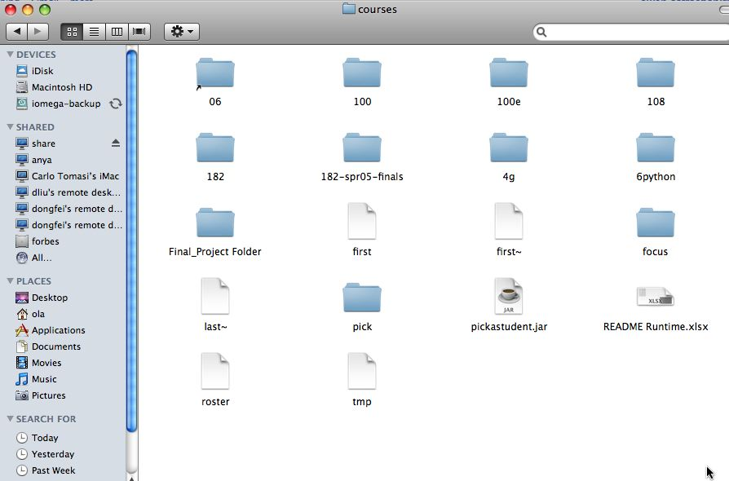
What's in a folder on your computer?
Where are the large files? How do you find them? They take up space! Erase? Backup?
Can a folder be inside a folder? Why?

Slide 4
Finding large files: FileVisit.py
def bigfiles(dirname,min_size):
large = []
for sub in os.listdir(dirname):
path = os.path.join(dirname,sub)
if os.path.isdir(path):
subs = bigfiles(path,min_size)
large.extend(subs)
else:
size = os.path.getsize(path)
if size > min_size:
large.append((path,size))
return large
bigs = bigfiles("/Users/ola/Documents",10000)

Slide 5
Does the function call itself? No!
def visit(dirname):
for inner in dirname:
if isdir(inner):
visit(inner)
else:
print name(inner), size(inner)
Is a file inside itself? No!
Does pseudo code make sense?
Details make this a little harder in Python, but close!

Slide 6
Structure matches Code
If you see a folder
Find large files, if you find a folder, …
To compress folder, must compress …
Files and repeat process for folders
Structure of list of lists
Can also lead to processing a list which requires processing a list which …
[ [ [a,b], [c,d], [a, [b,c],d] ]
(a *(b + c (d + e*f)) + (a* (b+d)))

Slide 7
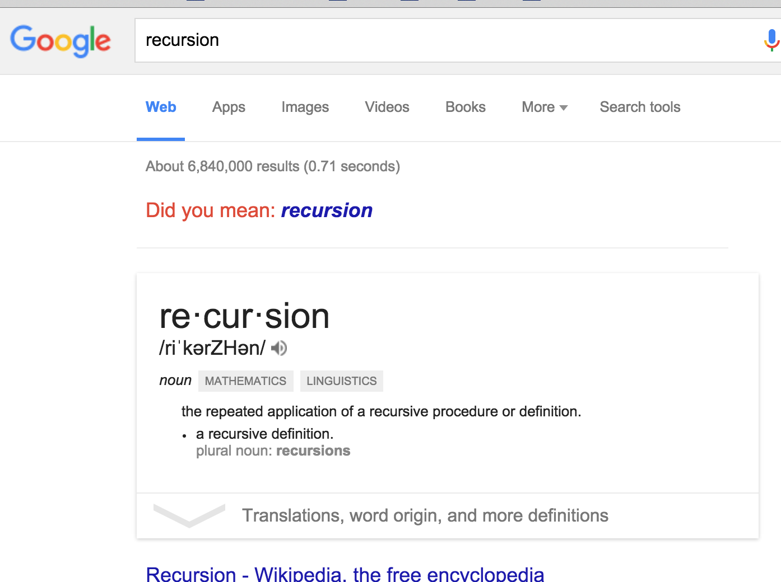
Recursion
What is recursion? What if we ask Google?
Structure matches code, or concept matches code
Must have a base case when no recursive call made
Simpler/smaller calls
The case of Quicksort
Inventor didn't get it

Slide 8
Sir Anthony (Tony) Hoare
There are two ways of constructing a software design. One way is to make it so simple that there are obviously no deficiencies. And the other way is to make it so complicated that there are no obvious deficiencies.
Turing Award, apologizes for null reference: $$$ mistake

Slide 9
The os and os.path libraries
Use an API to isolate system dependencies
C:\\x\\y
/Users/ola/Desktop
FAT-32, ReFS, WinFS, HFS, HSF+, fs
Underneath, these systems are different
Python API insulates and protects programmer
Why do we have os.path.join(x,y)?

Slide 10
Finding large files: FileVisit.py
def bigfiles(dirname,min_size):
large = []
for sub in os.listdir(dirname):
path = os.path.join(dirname,sub)
if os.path.isdir(path):
subs = bigfiles(path,min_size)
large.extend(subs)
else:
size = os.path.getsize(path)
if size > min_size:
large.append((path,size))
return large
bigs = bigfiles("/Users/ola/Documents",10000)

Slide 11
Dissecting FileVisit.py
How do we find the contents of a folder?
Another name for folder: directory
How do we identify folder? (by name)
os.listdir(dirname) returns a list of files and folder
Path is c:\user\ola\foo or /Users/ola/bar
os.path.join(dir,sub) returns full path
Platform independent paths
What's the difference between file and folder?
os.path.isdir() and os.path.getsize()

Slide 12
os. And os.path questions
http://bit.ly/101fall15-nov19-1
Notes:
After going over questions, could do sorting APTs ? Should we give those now?
Sortbyfreqs
Medltable
EatDrink?

Slide 13
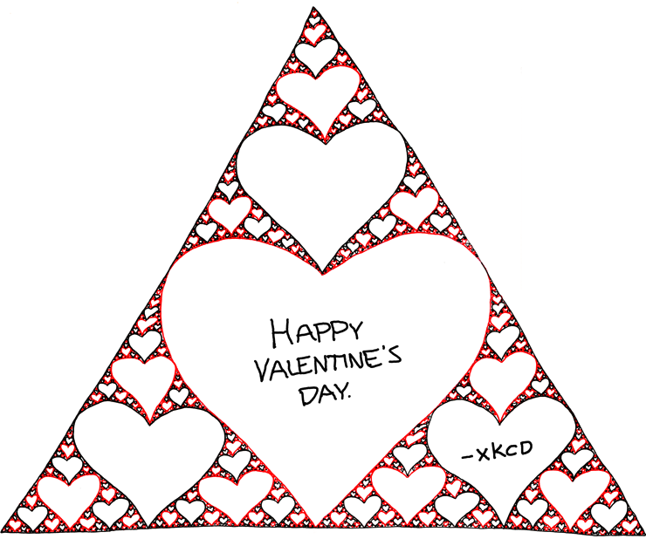
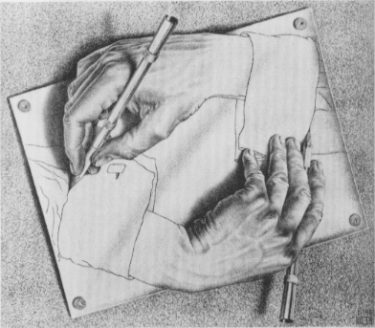
Recursion in Pictures
http://xkcd.com/688/ and http://xkcd.com/543/

Slide 14
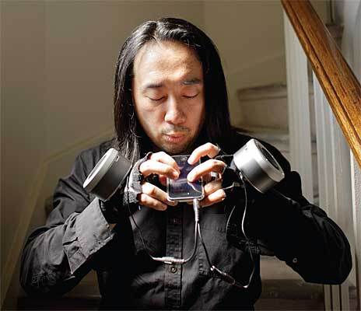
The power of working collaboratively
Interdisciplinary:
Music and Compsci
(for Compsci 308 final project)
The final product is so much more than we had hoped for though it was something that we aimed for from the beginning.
Who is Ge Wang?
http://www.youtube.com/watch?v=ADEHmkL3HBg
Our investment into a
huge and meticulous design process was a huge factor in making later progress. 35000+ lines of code / design / documentation gave us a project we were all very happy and proud to be a part of.

Slide 15
Badges APT from Quiz3
http://www.cs.duke.edu/csed/pythonapt/badges.html
Use abstraction think about structure
Similar to os.path?
def isContainedIn(seta, setb):
return True
def findLabel(labels,deeds,needs):
ds = set(deeds)
for i in range(len(needs)):
me = needs[i].split()
setme = set(me)
if isContainedIn(setme,ds):
return labels[i]
return "nobadge"

Slide 16
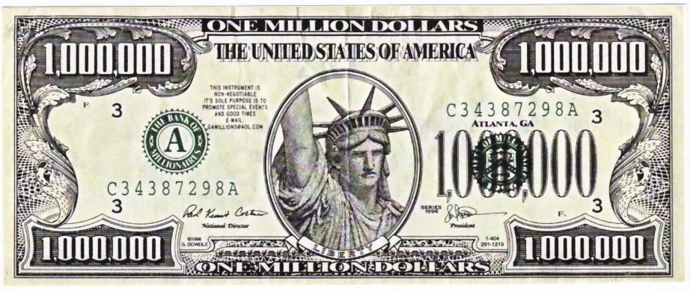
Math, Engineering, Sociology
Netflix prize in 2009
Beat the system, win
http://nyti.ms/sPvR

Slide 17
Collaborative Filtering
How does Amazon know what I want?
Lots of customers, lots of purchases
How does Pandora know music like Kanye's?
This isn't really collaborative filtering, more content-based
How doe Netflix recommend movies?
Why did they offer one million $$ to better their method?
Students at Duke who like Compsci also like …
Could this system be built?

Slide 18
From User Rating to Recommendations
Spectre | Martian | Southpaw | Everest | PitchPerfect 2
3 | -3 | 5 | -2 | -3
2 | 2 | 3 | 2 | 3
4 | 4 | -2 | 1 | -1
What should I choose to see?
What does this depend on?
Who is most like me?
How do we figure this out

