Slide 1
Plan for LDO101
Ethical webpage scraping
  Illustrate power of regular expressions
  Python makes trying things relatively easy
What's left, grades, finals, work
  Optional APT, lab, finishing, studying
What can't be done in Computer Science
  Practical knowledge of theoretical concepts
Acknowledging Completion

Slide 2
Grading
There are 11 labs, each worth 4 points
  Will grade with max of 38 points needed, 10%
Forty APTs are required (53 given)
  Grades for 41 in Sakai, missing 8-10, 10%
Reading quizzes, we drop 20 points
  Class activity will update and drop 4 points
For any concerns, fill out form by 12/4
  http://bit.ly/101fall15-concern

Slide 3
Final Exam
Material from semester, emphasizes recent material, builds on all
  Coding questions like midterm exams
Multiple choice questions similar to in-class,
  We have to grade these quickly
Best study? Look at previous midterms, be able to do our last midterm

Slide 4
Be a UTA!! Help next semester's 101
http://bit.ly/compsci-uta

Slide 5
Ignorable: Dictionary Comprehensions
Given ["x", "y", "z", "w"] create dictionary for each element, value is empty list
Use dictionary comprehension
Initializes dictionary, just update
d = {}
for val in letters:
d[val] = []
d = {elt:[] for elt in letters}
for elt in letters:
d[elt].append(word.find(elt))

Slide 6
FriendScore APT
What is a two-friend, doing an example by hand paper-and-pencil
  How do we find indexes of our friends?
  How could we find indexes of another person's friends?
  If Sam is my friend, and Pat is Sam's friend, is Pat my two-friend? Is Pat's friend Chris my 2F?
Try in-class questions toward going green
  http://bit.ly/101fall15-dec3-1

Slide 7
Answer Questions
http://bit.ly/101fall15-dec3-1

Slide 8
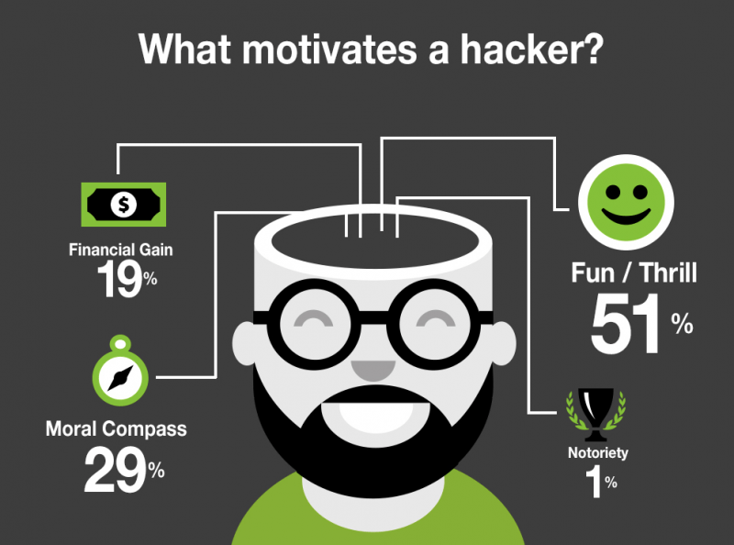
Scraping email address from websites
Suppose we want to send email to all Duke Faculty to let them know …
  Visit Departmental website, people, faculty
  View (HTML) Source
  Develop regex to access email – if possible!
RegexScraper.py
  Python makes this simple
  Ethical hacking?

Slide 9
Scraping math.duke.edu faculty
Pattern:
  r'math/faculty/(.*?)\"\>(.+?)\<'
URL
  http://fds.duke.edu/db/aas/math/faculty/
Matches:
…
('motta', 'Francis C. Motta')
('jmmza', 'James Murphy')
('ryser', 'Marc D. Ryser')
('sv113', 'Stefano Vigogna')
('haizhao', 'Haizhao Yang')

Slide 10
Scraping Sanford/PubPol faculty
Pattern:
  r'(\w+[.\w]*)@(\w+[.\w+]*)'
URL
  https://sanford.duke.edu/people…/
Matches (call 16 times with different URL)
…
('schanzer', 'duke.edu')
('steveschewel', 'gmail.com')
('michael.schoenfeld', 'duke.edu')
('schroeder', 'law.duke.edu')

Slide 11
Scraping Biology faculty
Pattern:
  r'mailto:(\w+[.\w]*)@(\w+[.\w+]*)'
URL
  https://biology.duke.edu/people/all-faculty/a
Matches (call 26 times with different URL)
…
('emily.bernhardt', 'duke.edu')
('emily.bernhardt', 'duke.edu')
('bhandawat', 'gmail.com')
('bhandawat', 'gmail.com')
('jboynton66', 'gmail.com')
('jboynton66', 'gmail.com')

Slide 12
What is Computing? Informatics?
What is computer science, what is its potential?
  What can we do with computers in our lives?
  What can we do with computing for society?
  Will networks transform thinking/knowing/doing?
  Society affecting and affected by computing?
  Changes in science: biology, physics, chemistry, …
  Changes in humanity: access, revolution (?), …
Privileges and opportunities available if you know code
  Writing and reading code, understanding algorithms
  Majestic, magical, mathematical, mysterious, …

Slide 13
What can be programmed?
What class of problems can be solved?
  Linux, Cloud, Mac, Windows10, Android,…
  Alan Turing contributions
    Halting problem, Church-Turing thesis
What class of problems can be solved efficiently?
  Problems with no practical solution
  What does practical mean?

Slide 14
Schedule students, minimize conflicts
I can’t write
this program because I’m too dumb
Given student requests, available teachers
  write a program that schedules classes
  Minimize conflicts
Add a GUI too
  Web interface
  …
  …

Slide 15
One better scenario
Still another scenario, is this better?
I can’t write this program because it’s provably impossible
I can’t write this program but neither can all these famous people

Slide 16
Summary of Problem Categories
Some problems can be solved 'efficiently'
  Run large versions fast on modern computers
  What is 'efficient'? It depends
Some cannot be solved by computer.
  Provable! We can't wait for smarter algorithms
Some problems have no efficient solution
  Provably exponential 2^{n} so for "small" n …
Some have no known efficient solution, but
  If one does they all do!

Slide 17
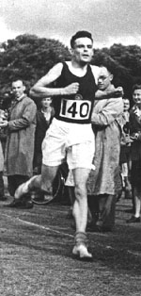
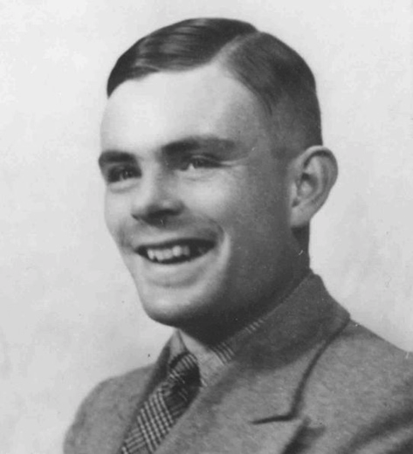
Entscheidungsproblem
What can we program?
  What kind of computer?
What can't we program?
  Can't we try harder?
Can we write a program that will determine if any program P will halt when run on input S?
  Input to halt: P and S
  Output: yes/no halts

Slide 18
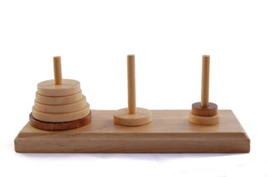
Some problems take forever, but …
Can we visit all cities, no repeats, using Southwest, for less than $123,329.50
  RDU->MCO->…->…->…->…->DEN
  RDU->DEN->…->…->…->…->MCO
  repeat and test, what's the issue here?
  Can we find shortest path for packets on Internet? Yes!
  Can we find longest path for silent meditation? No!
  We don't know how, but if we did!!!
Contrast towers of Hanoi, 2^{n} moves always!

Slide 19
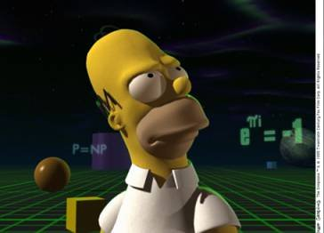
Are hard problems easy? Clay Prize
P = easy problems, NP = “hard” problems
  P means solvable in polynomial time
    Difference between N, N², N¹⁰ ?
  NP means non-deterministic, polynomial time
    guess a solution and verify it efficiently
Question: P = NP ?
  if yes, a whole class of difficult problems , the NP-complete problems, can be solved efficiently
  if no, no hard problems can be solved efficiently
  showing the first problem was NP complete was an exercise in intellectual bootstrapping, satisfiability/Cook/(1971)

Slide 20
How is Python like all other programming languages, how is it different?

Slide 21
A Rose by any other name…C or Java?
Why do we use [Python|Java] in courses ?
  [is|is not] Object oriented
  Large collection of libraries
  Safe for advanced programming and beginners
  Harder to shoot ourselves in the foot
Why don't we use C++ (or C)?
  Standard libraries weak or non-existant (comparatively)
  Easy to make mistakes when beginning
  No GUIs, complicated compilation model
  What about other languages?

Slide 22
Why do we learn other languages?
Perl, Python, PHP, Ruby, C, C++, Java, Scheme, Haskell,
  Can we do something different in one language?
    In theory: no; in practice: yes
  What languages do you know? All of them.
  In what languages are you fluent? None of them
In later courses why do we use C or C++?
  Closer to the machine, understand abstractions at many levels

Slide 23
Find all unique/different words in a file, in sorted order
Across different languages: do these languages have the same power?

Slide 24
Unique Words in Python
def main():
f = open('/data/melville.txt', 'r')
words = f.read().strip().split()
allWords = set(words)
for word in sorted(allWords):
print word
if __name__ == "__main__":
main()

Slide 25
Unique words in Java
import java.util.*;
import java.io.*;
public class Unique {
public static void main(String[] args)
throws IOException{
Scanner scan =
new Scanner(new File("/data/melville.txt"));
TreeSet<String> set = new TreeSet<String>();
while (scan.hasNext()){
String str = scan.next();
set.add(str);
}
for(String s : set){
System.out.println(s);
}
}
}

Slide 26
Unique words in C++
#include <iostream>
#include <fstream>
#include <set>
using namespace std;
int main(){
ifstream input("/data/melville.txt");
set<string> unique;
string word;
while (input >> word){
unique.insert(word);
}
set<string>::iterator it = unique.begin();
for(; it != unique.end(); it++){
cout << *it << endl;
}
return 0;
}

Slide 27
Unique words in PHP
<?php
$wholething = file_get_contents("file:///data/melville.txt");
$wholething = trim($wholething);
$array = preg_split("/\s+/",$wholething);
$uni = array_unique($array);
sort($uni);
foreach ($uni as $word){
echo $word."<br>";
}
?>

Slide 28
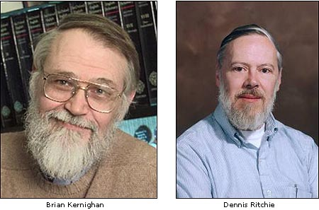
Kernighan and Ritchie
First C book, 1978
First ‘hello world’
Ritchie: Unix too!
  Turing award 1983
Kernighan: tools
  Strunk and White
Everyone knows that debugging is twice as hard as writing a program in the first place. So if you are as clever as you can be when you write it, how will you ever debug it?
Brian Kernighan

Slide 29
How do we read a file in C?
#include <stdio.h>
#include <string.h>
#include <stdlib.h>
int strcompare(const void * a, const void * b){
char ** stra = (char **) a;
char ** strb = (char **) b;
return strcmp(*stra, *strb);
}
int main(){
FILE * file = fopen("/data/melville.txt","r");
char buf[1024];
char ** words = (char **) malloc(5000*sizeof(char **));
int count = 0;
int k;

Slide 30
Storing words read when reading in C
while (fscanf(file,"%s",buf) != EOF){
int found = 0; // look for word just read
for(k=0; k < count; k++){
if (strcmp(buf,words[k]) == 0){
found = 1;
break;
}
}
if (!found){ // not found, add to list
words[count] = (char *) malloc(strlen(buf)+1);
strcpy(words[count],buf);
count++;
}
}
Complexity of reading/storing? Allocation of memory?

Slide 31
Sorting, Printing, Freeing in C
qsort(words,count,sizeof(char *), strcompare);
for(k=0; k < count; k++) {
printf("%s\n",words[k]);
}
for(k=0; k < count; k++){
free(words[k]);
}
free(words);
}
Sorting, printing, and freeing
  Ugh!

Slide 32
You have (almost) finished Compsci 101
Let's talk about next steps and finishing this semester

