Slide 1

CompSci 101 Introduction to Computer Science
www.cs.duke.edu/courses/fall16/compsci101
August 30, 2016
Prof. Rodger
Notes:
Welcome to the class, for some of you welcome to Duke. So glad that you have decided to take this class. I hope you enjoy it.
Here is the URL for the course.
This is Computer science. You are going to learn how to program in Python.

Slide 2


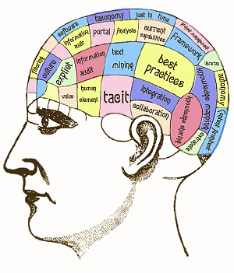
CompSci 101 Data into Information and Knowledge
Computer Science
Notes:
This is computer science. You are going to learn python programming. You are going to learn how to turn data into information and knowledge. We are opening the door for you so you can learn and make progress.
You are going to learn the Duke way for learning computer science.

Slide 3

Prerequisites for Compsci 101
Notes:
Here is the prerequisite for CompSci 101. We have a friend here with us and what does he have going for him? Or her? Is George a man or a woman? It is unclear. George could be a the name for either. This is Curious George and he or she is curious about everything. In particular George is curious to take this course. If you are curious then you are ready for this course! There is no prior programming experience required. We will give you all you need to learn programming.

Slide 4
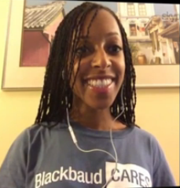
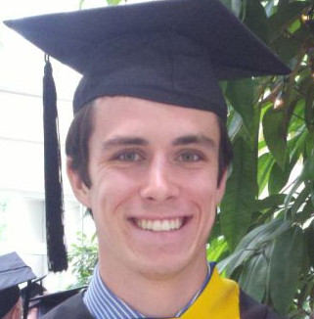
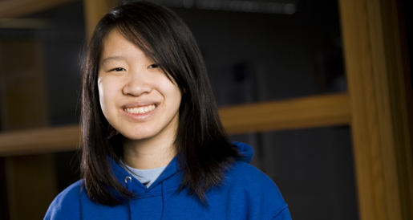
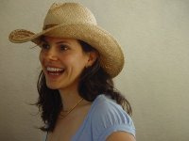
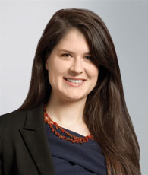
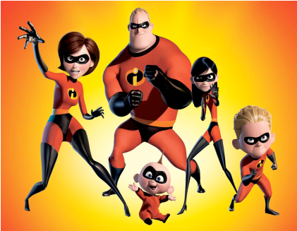
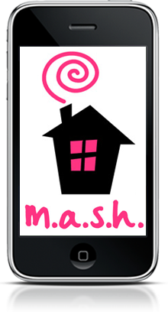

Who has taken CompSci 101?
Notes:
Deborah Nelson – now a User Experience Designer at BlackBoard, Jessica Abroms worked at Pixar and then started her own company, Jenna Hayes is now didn’t take any CS past CompSci 101, but did work for me for 3 years helping me teach teachers how to program. Now a lawyer in NYC specializing in Labor and Employment Law. Julian Genkins – now in med school, took a gap year and worked at Epic programming

Slide 5
What is Computer Science?
http://bit.ly/101f16-0830-1

Slide 6
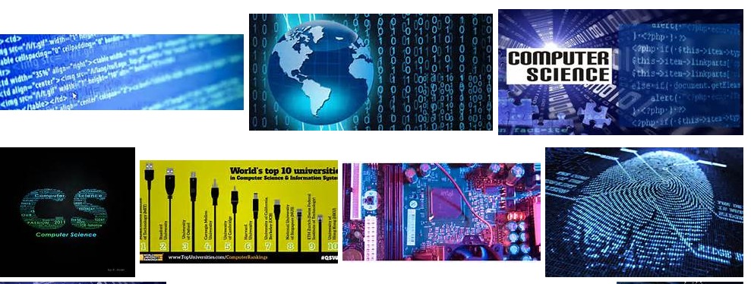
Just ask Siri (or Bing?)
http://www.bing.com/images/search?q=computer+science&go=Submit&qs=n&form=QBIR&pq=computer+science&sc=8-16&sp=-1&sk=
Notes:
Maybe I will ask Siri, Maybe siri will ask Bing. Maybe ask Google. Here I have done a search for it on Bing. You can see some images, and you can see the query string. What do you notice about it? There is information embedded in it.

Slide 7
Anatomy of a search query
https://www.google.com/search?q=what+is+computer+science&espv=2&source=lnms&tbm=isch&sa=X&ei=Ib77U_O9CtDhsAT07YDABA&sqi=2&ved=0CAcQ_AUoAg&biw=1293&bih=861
What are the parameters to the query?
What changes, what stays the same?
Notes:
Here is the query string for the google search – again there is information embedded in it. You can see that there are parameters that are assigned values and can change. ASK: What is an example of a parameter here? Here you just type in a string to query and google does the work in setting up the query string and deciding on the parameters. Bing does this to. As we learn about programming we will also learn about parameters and how they do something similar but different.

Slide 8
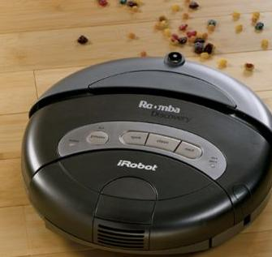
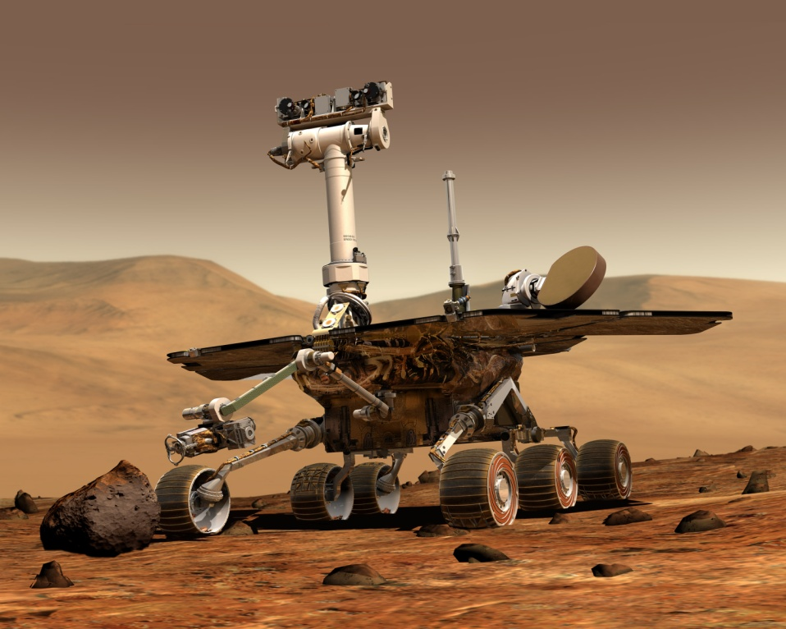
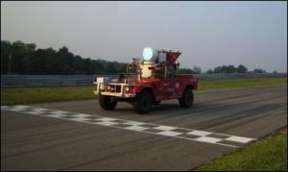
What is Computer Science?
Artificial Intelligence
Roomba
Spirit, Mars Rover
CMU’s Sandstorm

Slide 9
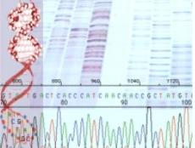
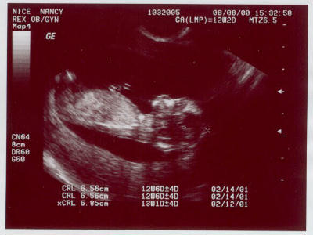
What is Computer Science?
Medicine, Genomics

Slide 10

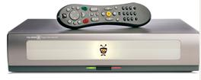
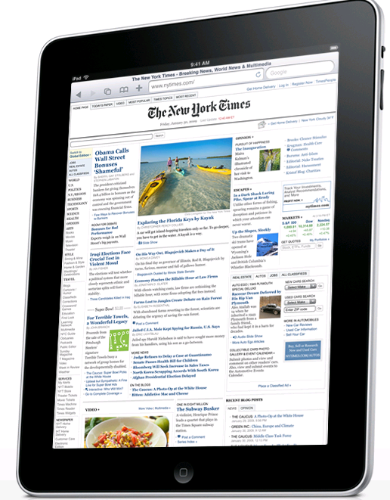
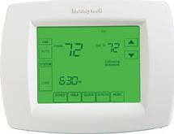
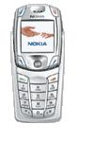
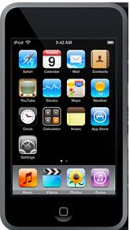
What is Computer Science?
Devices

Slide 11
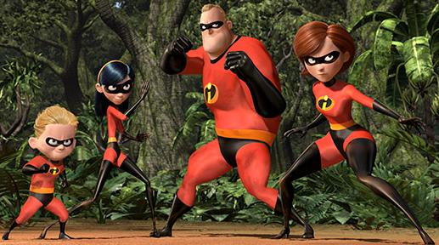
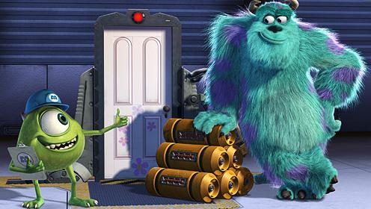
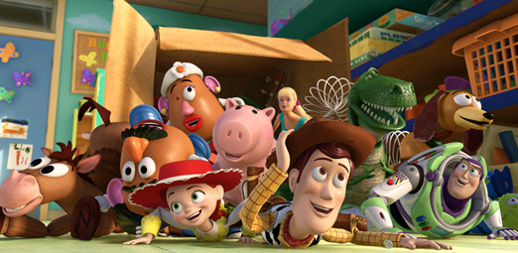
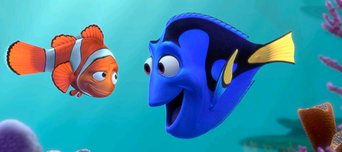
What is Computer Science?
Animation

Slide 12
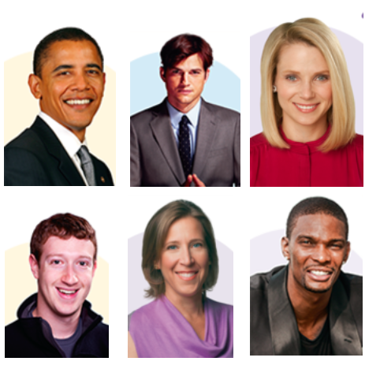
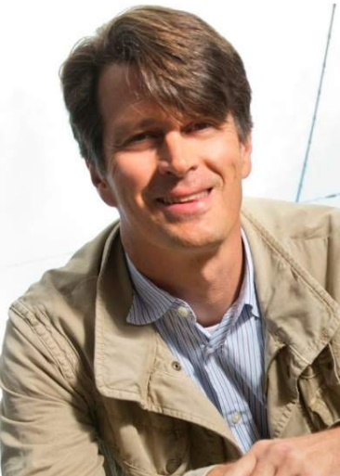
Who are all these people?
bit.ly/101f16-0830-2
1 2 3
7
4 5 6

Slide 13
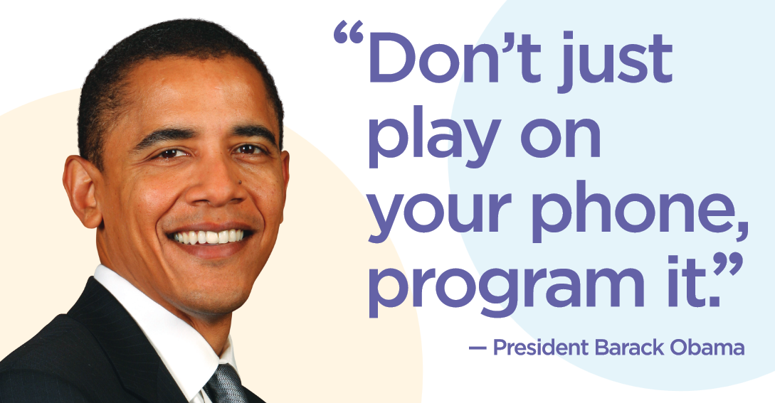
Notes:
In the state of the union address this week (Jan 2016), he mentioned that he wants every student to learn computer science. He mentioned computer science three times in his speech!

Slide 14
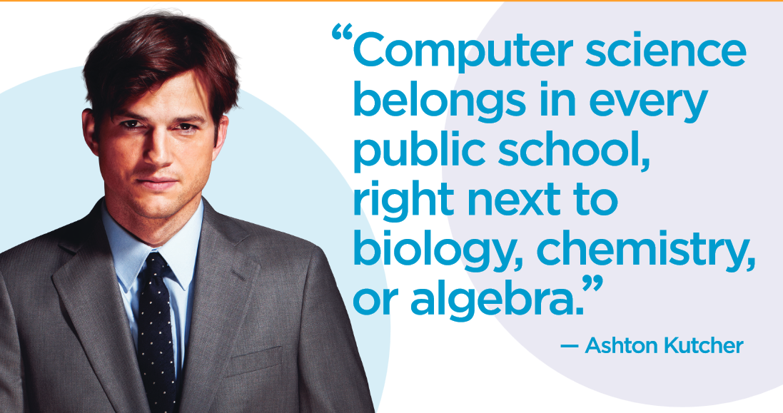

Slide 15
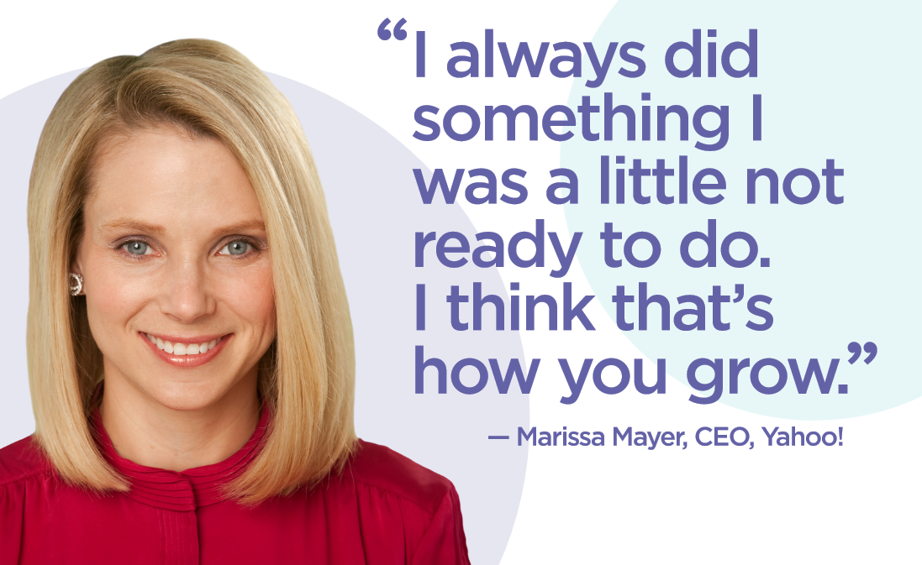

Slide 16
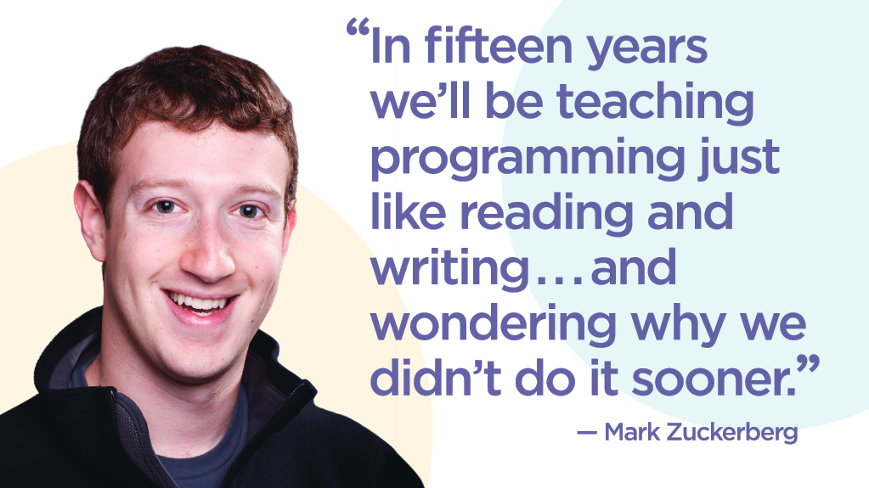

Slide 17
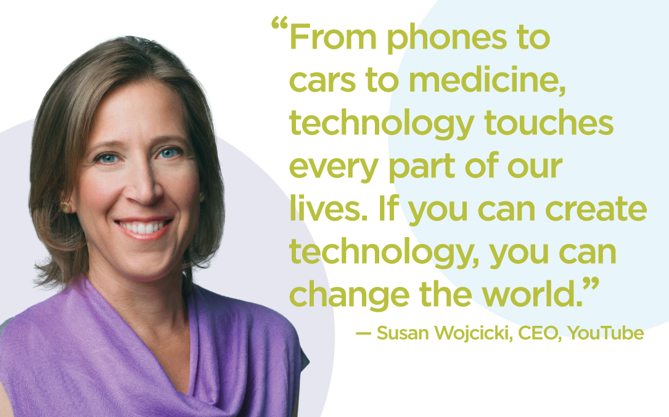

Slide 18
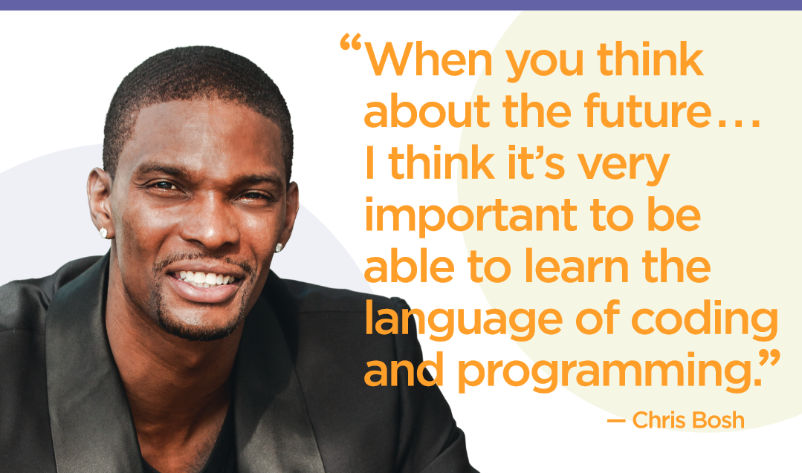

Slide 19
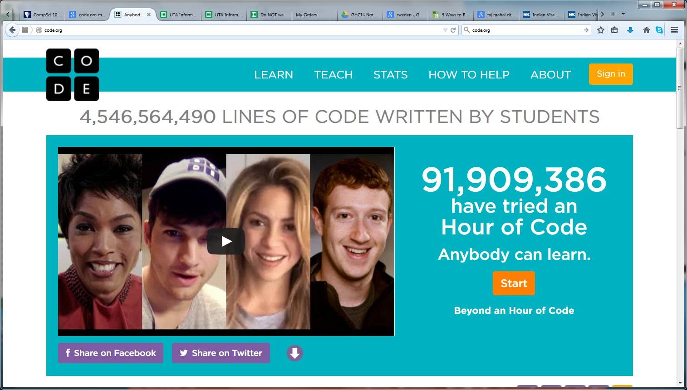
Those quotes are all from Code.org

Slide 20


Slide 21
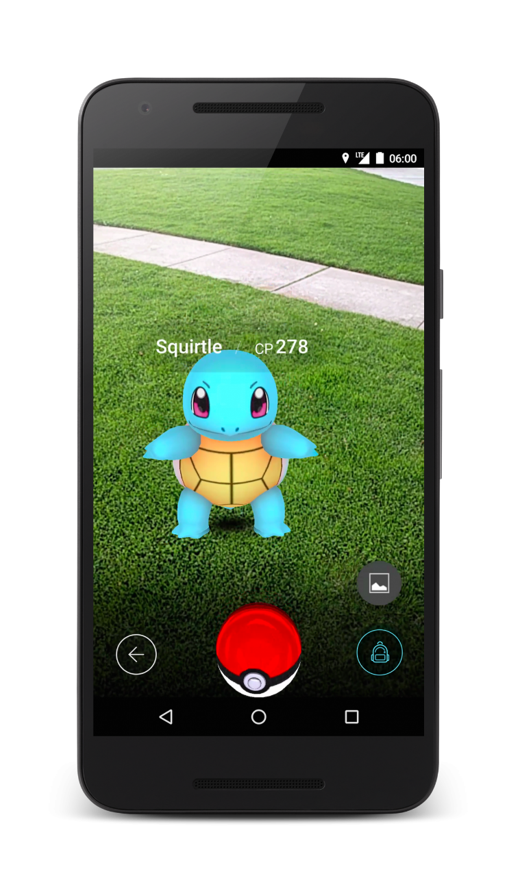
John Hanke, ‘Pokemon Go’
Notes:
Founder of Niantic – which created Pokemon Go, before that he was a big part of Google Earth and Google maps

Slide 22
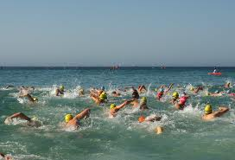
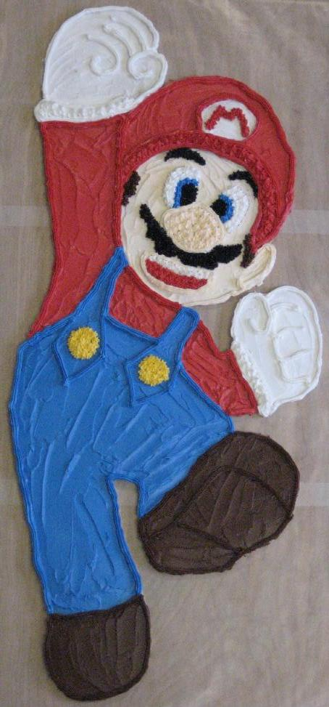
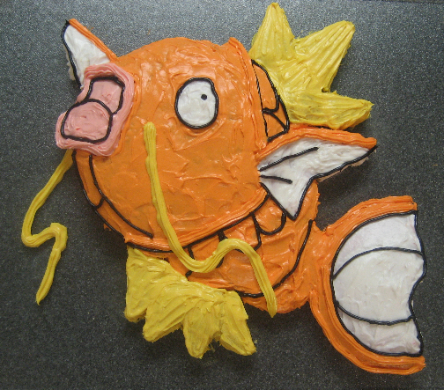
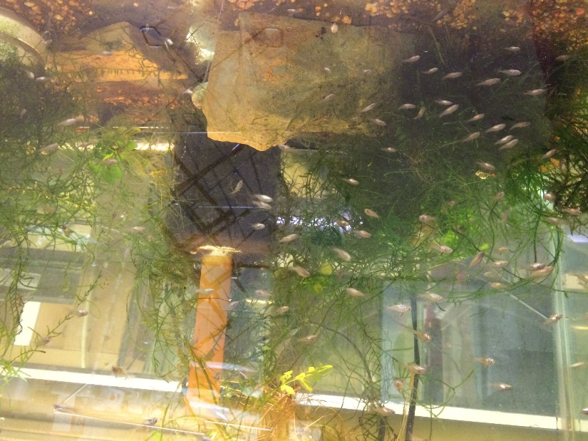
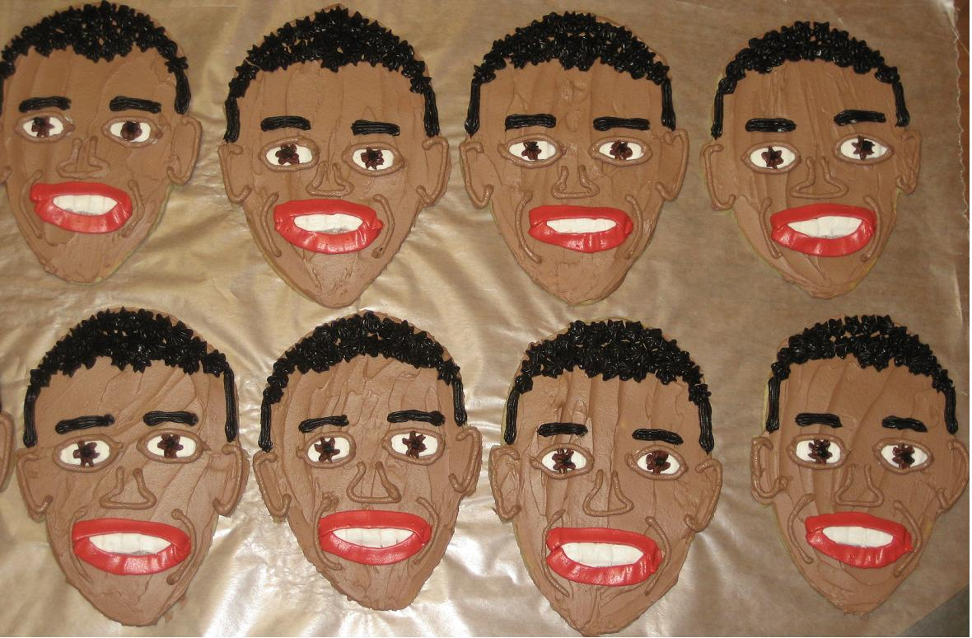
About Prof. Rodger
How do you keep
your sanity?
Notes:
St. Croix, German Rams babies, Magicarp, Supermario giant cookie, Obama cookies when he first took office

Slide 23
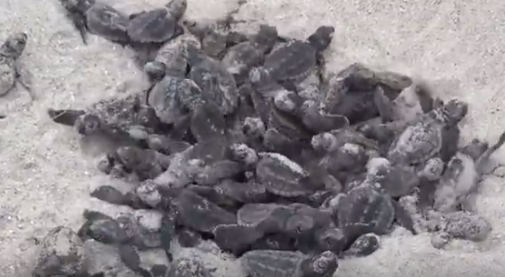
Sea turtles hatching
https://www.youtube.com/watch?v=sZYd0-egqbc
Notes:
What does this have to do with computer science? They collect data on the nests, how many hatch, etc and can analyze this data to get an idea of how this endangered species is doing. They know when the nest is layed (volunteers walk the beach every morning) and they know when the nest hatches and they count how many hatch, how many eggs did not hatch, etc.

Slide 24
Questions about Computer Science
What is it that distinguishes it from the separate subjects with which it is related? What is the linking thread which gathers these disparate branches into a single discipline? My answer to these questions is simple --- it is the art of programming a computer. It is the art of designing efficient and elegant methods of getting a computer to solve problems, theoretical or practical, small or large, simple or complex.
C.A.R. (Tony)Hoare
Notes:
Tony Hoare has been knighted by Queen Elizabeth, He also has invented one of the fastest sorts in the world and he is a turing award winner – that is like the nobel prize for CS
READ QUOTE – Note the art of programming – it is a art.

Slide 25

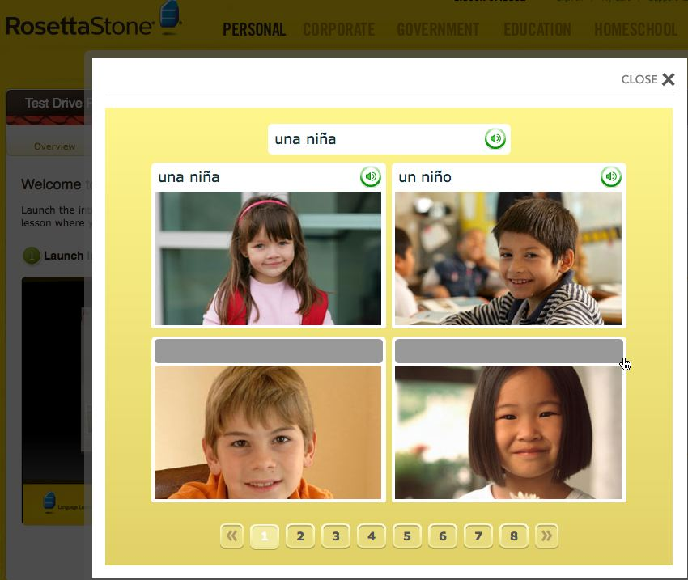
How will you learn to 'speak'?
http://www.rosettastone.com/personal/demo
http://duolingo.com
Notes:
Some of you may have learned a language. How did you learn? You may have used one of these software products. The second one was invented by another Duke Alum, Luis von ahn. He has created powerful collaboration tools to solve problems over the web and to involve people all over the world. He is translating the web in to other languages with the help of people as they learn a foreign language.
Now you will learn how to Speak another language, a programming language – python.

Slide 26
How will you learn to program?
You learn more than programming
Coding, Algorithms
UX/UI: User Experience, User Interface
Data Analytics, Software Engineering
A course, a way of thinking, a set of skills and practice that can lead to more or …
Notes:
Will you learn to program? Yes – but you will learn more than programming. Here are some of the things that you will learn in this course.
UX and UI are about making the experience better for the user or easier to use – if you are blind you can’t process information in the same way.
Data Analytics is about turning data into information and knowledge,
Software Engineering – how do you design, develop and test really large programs.
You will learn enough to get started and also to just have conversations with other people how program if you do not continue. But we hope you will like the class and continue on.

Slide 27
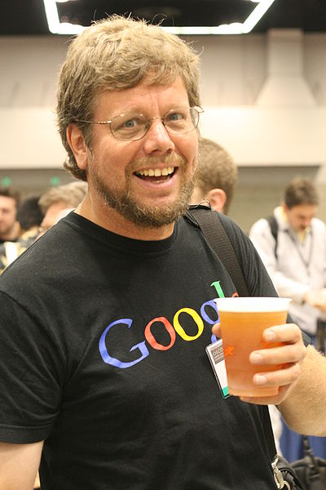
What language will we learn?
http://www.python.org/
Python is a multi-paradigm language
Procedural
Functional
Object-Oriented
Simple, libraries, widely used
Guido is BDFL
Notes:
We will learn python in this course. Python is a pretty neat programming language because it is different types of languages all rolled into one.
We will mustly use it as a procedural language , a little bit of functional part and not so much with the OO.
Probably the most widely used programming language with beginners in college.
His name is Guido von rosslam
His title is “Benevilant Dictator for Life”
He gets to do whatever he wants with Python and so do we!
We are going to get to write really cool Python programs

Slide 28

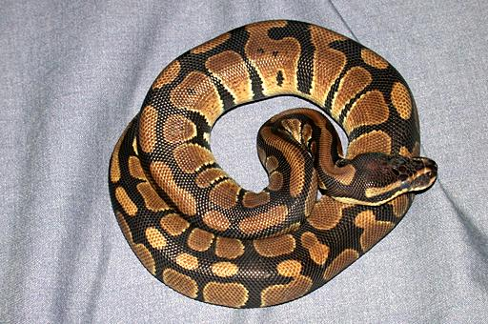
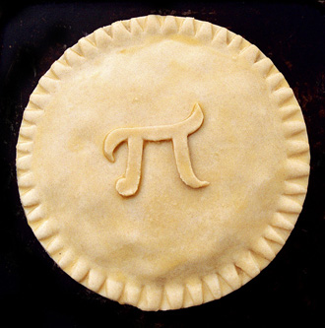
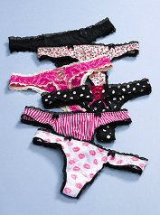
Why is it called Python?
A
B
C
+
-
9.8 m/sec²
answer
Notes:
A a snake
B Monty Python
C the solution to this rebus puzzle
Let’s vote – hold up one finger for A, two fingers for B and 3 fingers for C
Answer is B

Slide 29


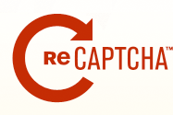
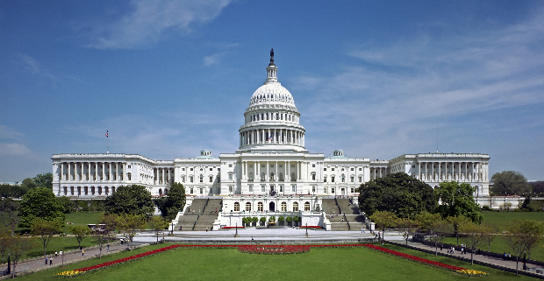
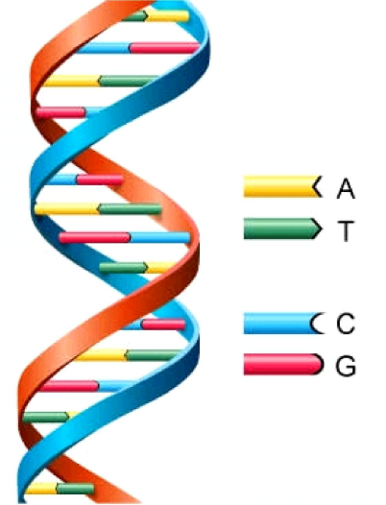


Notes:
We have several icons here – google – most of you probably know what that is
python – what we will use here,
The green robot is android – the most widely use mobile operating system in the world. You can use python to do that but we will use python to run on our desktop or latop in this course.
We will be using the web http: or www
We will be solving DNA problems – sequencing dna was enabled by the power of computation and algorithms.
The code of law happens in our country in Washington DC
The code of law and programming are related, they are both about code.
As is the code of life – DNA.
Finally we will see examples with recapture, another tool invented by Luis von ahn that shows the power of collaboration.
The icons together will help us understand the scientific, the political, the practical, and the human side of computation as we study compsci 101.

Slide 30
Who are you?
Let’s look at survey to see who is taking Compsci 101 in Fall 2016
Do you recognize yourself?
Is there a stereotypical Compsci 101 student?
Is there a stereotypical computer scientist?
Everyone can succeed! Ideally you won’t have lots of experience programming

Slide 31
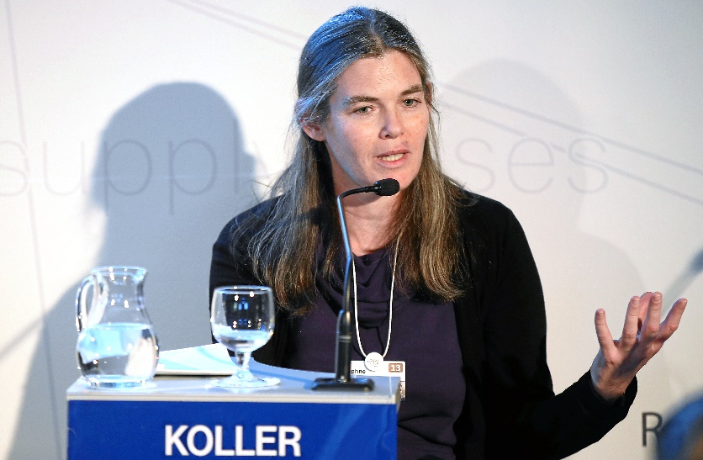
Daphne Koller, AI Pioneer, Educator
Computers learn to diagnose breast cancer? And more? The Data Scientist on a Quest to turn Computers into Doctors
http://bit.ly/koller-cancer
http://wrd.cm/1E9zFqy
On Coursera: "But to practice problem-solving, a student must first master certain concepts. By providing a cost-effective solution for this first step, we can focus precious classroom time on more interactive problem-solving activities that achieve deeper understanding — and foster creativity."
Coursera Founder, NY Times, December 5, 2011

Slide 32
Course overview, logistics www.cs.duke.edu/courses/fall16/compsci101
Programming assignments: APTs and Assignments
Acknowledge assistance, to learn to program …
Be aware of late policy
Exams: midterms and final: paper-based, different
All old midterms available
Class work/attendance
Examples today, benefits hopefully clear

Slide 33
Course Overview: Is this the right one?
Work by yourself and collaboratively on solving problems that programming
Analyze the problems, think about solving them
Create, Collaborate, Persist, Problem-Solve
Why should you come to class?
Learn things, participate in a community
Provide help, get help, wonder, dance, think
Why is this course so great?
Because you're in it

Slide 34
What's in Compsci 101?
Learning about computing, computer science, and programming
Vocabulary of Python and programming
Power of automation, repetition, scale
Understanding and changing the world
Programming using Python
Tools: Eclipse, EPD, Libraries, …
Using mathematical and scientific techniques
Art and science of programming
Notes:
Enthought Python Distribution

Slide 35
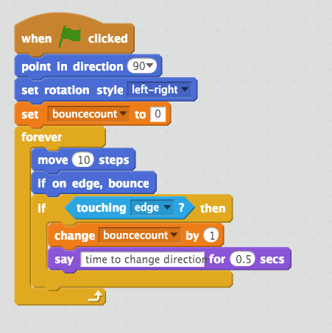
"Hello World"
Scratch Program
Colors
Duke blue: motion
Mustard: control
Light blue: sensing
Orange: data
Purple: looks
Notes:
This has a bug, you need to move the “if on edge bounce to after the “say time to change direction”

Slide 36
Analyze this Scratch Program?
http://bit.ly/101f16-0830-3

Slide 37
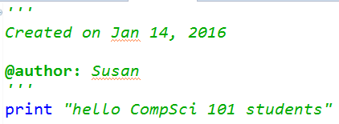
Python code hello.py

Slide 38
Python data reading code
f = open("kjv10.txt")
st = f.read()
total = len(st)
zc = st.count('z')
print "total # chars = ",total
print "number of z’s",zc
for ch in 'aeiou':
print ch, st.count(ch)
Notes:
Example of code you will understand by the first exam

Slide 39
Announcements
See assigned reading on course web page
Reading Quiz 1 (RQ1) online on Sakai (out today)
due by 10am Thurs, Sept 1.
Labs start this week! (Wed/Thur)
Assignment 1 out – Due Sept 6
Install course software
Try to install before going to lab
If you get frustrated, get help!
Today: Introduce Computer Science
Notes:
Usually the second slide of the day but today later.

Slide 40

Duke Connection: Fred Brooks '53
What Would FB Say?
"The most important single decision I ever made was to change the IBM 360 series from a 6-bit byte to an 8-bit byte, thereby enabling the use of lowercase letters. That change propagated everywhere."
"Fred Brooks" by Copyright owned by SD&M (www.sdm.de) - Request for picture sent by email to Fred Brooks by uploader (Mark Pellegrini; user:Raul654) Fred sent this photo back, along with contact information for Carola Lauber at SD&M, who gave copyright permission.. Licensed under CC BY-SA 3.0 via Wikimedia Commons - https://commons.wikimedia.org/wiki/File:Fred_Brooks.jpg#/media/File:Fred_Brooks.jpg

Slide 41

Why is programming fun? Fred Brooks
First is the sheer joy of making things
Second is the pleasure of making things that are useful
Third is the fascination of fashioning complex puzzle-like objects of interlocking moving parts
Fourth is the joy of always learning
Finally, there is the delight of working in such a tractable medium. The programmer, like the poet, works only slightly removed from pure thought-stuff.

