Slide 1
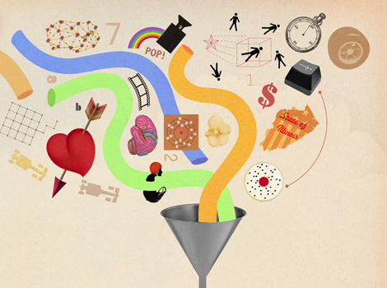
CompSci 101 Introduction to Computer Science
Sept 1, 2016
Prof. Rodger

Slide 2
Announcements
Reading for next time on calendar page
RQ 2 due Thursday
Assignment 1 due Tuesday
Have fun with Blockly
Install your environment! Get Help!
Lab 1 this week!
Plan for Today:
Problem Solving and Python
Notes:
Where do you find the assignment?
Where do you find install instructions?

Slide 3
Software Failure

Slide 4
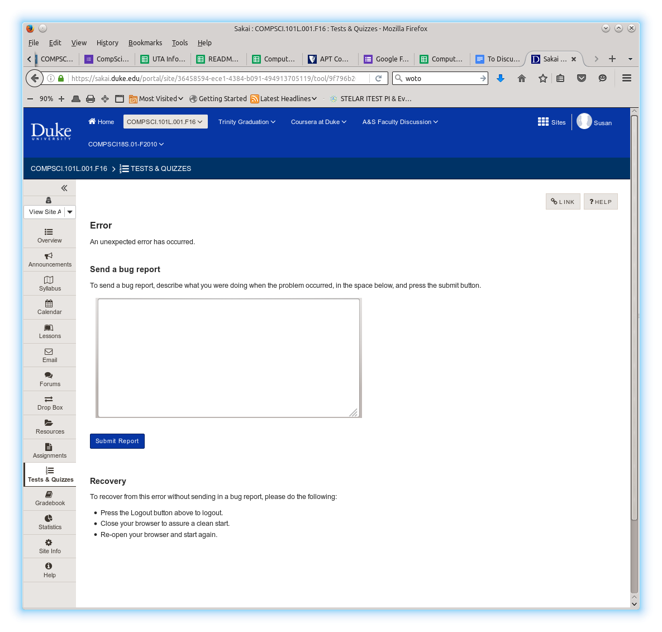
Software Failure

Slide 5

Software Failure

Slide 6
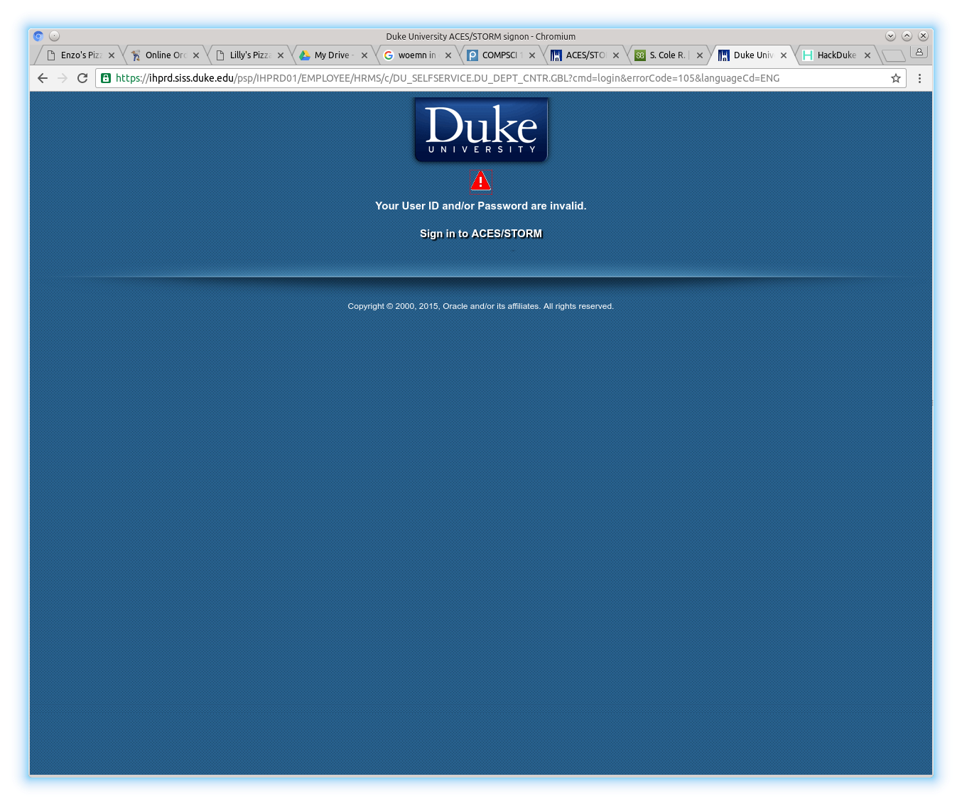
Software Failure

Slide 7
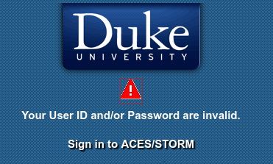
Software Failure

Slide 8
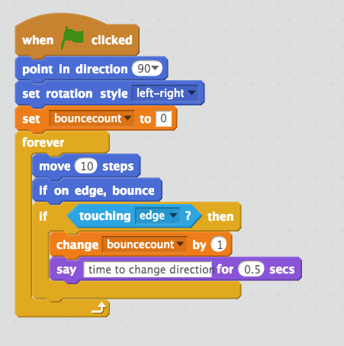
Review Scratch program
"Hello World"
Scratch Program
Colors
Duke blue: motion
Mustard: control
Light blue: sensing
Orange: data
Purple: looks
Notes:
This has a bug, you need to move the “if on edge bounce to after the “say time to change direction”
How long is forever? Will she get tired and stop?

Slide 9
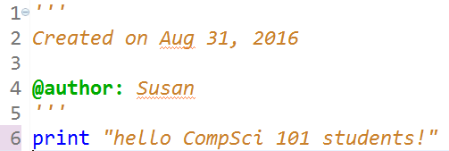
Python code: hello.py

Slide 10

Run hello.py
Notes:
Do other examples also, add two numbers? Show how in the interactive console too

Slide 11
Python data reading code
f = open("kjv10.txt")
st = f.read()
total = len(st)
zc = st.count('z')
print "total # chars = ",total
print "number of z’s",zc
for ch in 'aeiou':
print ch, st.count(ch)

Slide 12
Woa!!! Am I suppose to understand all that code right now!!!!
No!!!
We will learn all that over
The next month!

Slide 13
Explaining Python code?
http://bit.ly/101f16-0901-1

Slide 14
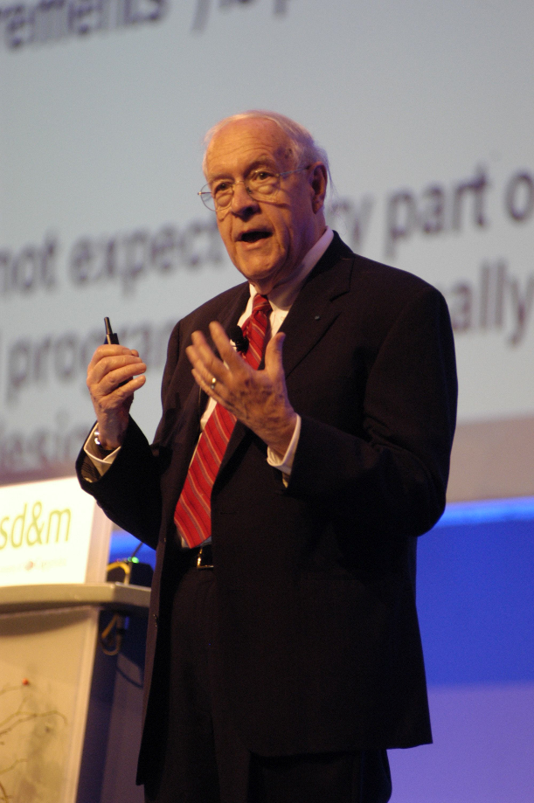
Duke Connection: Fred Brooks '53
What Would FB Say?
"The most important single decision I ever made was to change the IBM 360 series from a 6-bit byte to an 8-bit byte, thereby enabling the use of lowercase letters. That change propagated everywhere."
"Fred Brooks" by Copyright owned by SD&M (www.sdm.de) - Request for picture sent by email to Fred Brooks by uploader (Mark Pellegrini; user:Raul654) Fred sent this photo back, along with contact information for Carola Lauber at SD&M, who gave copyright permission.. Licensed under CC BY-SA 3.0 via Wikimedia Commons - https://commons.wikimedia.org/wiki/File:Fred_Brooks.jpg#/media/File:Fred_Brooks.jpg
Notes:
Duke Alum, Turing Award Winner and founded UNC Chapel Hill Computer Science Dept.

Slide 15
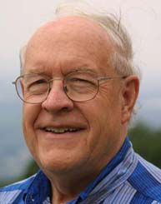
Why is programming fun? Fred Brooks
First is the sheer joy of making things
Second is the pleasure of making things that are useful
Third is the fascination of fashioning complex puzzle-like objects of interlocking moving parts
Fourth is the joy of always learning
Finally, there is the delight of working in such a tractable medium. The programmer, like the poet, works only slightly removed from pure thought-stuff.

Slide 16
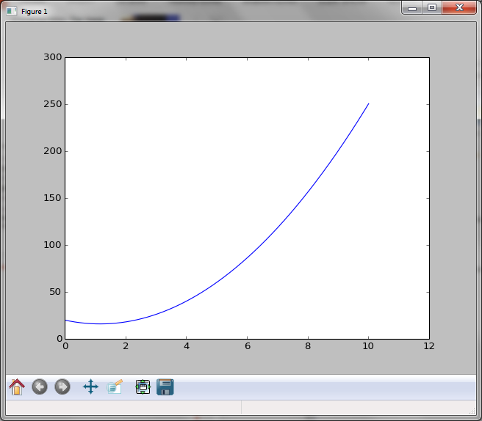
Lab 1 This Week
Install Before attending if can
Modify Python program
Scratch program

Slide 17






Our Programming Environment
Install 5 items
Why Java? – not using
Eclipse – platform for development
Python – programming language
Pydev – Python IDE for Eclipse
Canopy – python libraries
Ambient – turnin/snarf files to/from Duke

Slide 18
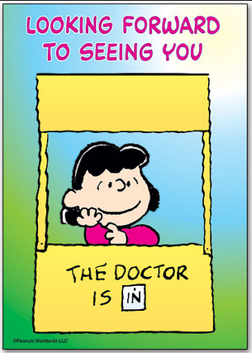
How does one get help in CompSci 101?
Consulting hours
Sunday-Thursday 7:30-11:30pm
Office hours (prof, TAs)
Collaborate with other students
Piazza
Ask questions
Do not post your code and ask what is wrong!
Post error message and line of code for error message
If added class late, may need to add yourself
Notes:
Piazza is your friend!

Slide 19
How to succeed in Compsci 101
Start assignments early, they'll take longer than you think
Read the book, we'll build on it in class
Collaborate well, but be sure you can do work on your own!
Be curious, work hard at beginning, think carefully
Notes:
Show collaboration policy and talk about it.

Slide 20
Your goal is to …
Get all assignments completed and turned in on time.
AND…

Slide 21
Your goal is to …
Get all assignments completed and turned in on time.
Understand the code you turn in.
Be able to explain the code you turn in.
AND…

Slide 22
Algorithm
Recipe
Sequence of steps that constitute instructions
Step-by-step procedure for calculations
What does Nate Silver do?
http://53eig.ht/1tZy909
How do Netflix and Amazon know me?
Compsci101 project: capable of implementation as a program, but much more basic
http://moreintelligentlife.com/content/features/anonymous/slaves-algorithm
Notes:
Cooking something - Cake and decorate with mints (BRING MINT BOWL AND Say Put 10 mints on the cake) – How do I get them out of the bowl? And the wrapper?
, Baby Names –
Nate Silver – Statitician and journalist. he has predicted presidential winner in every state – last two years, also big in sports
Recommender - project later in the semester

Slide 23
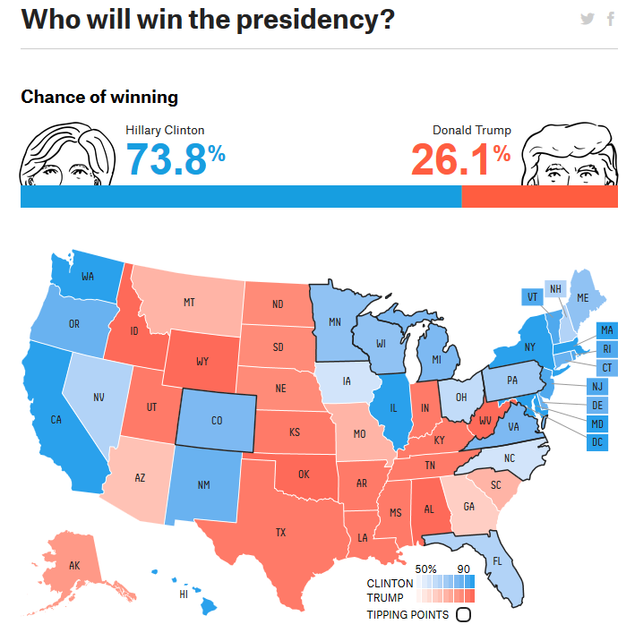

Slide 24
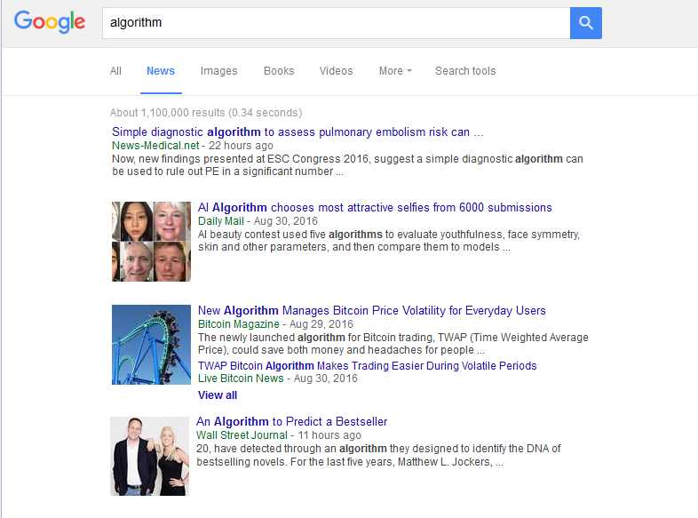
Google “algorithm”
Notes:
Google for Algorithm using news, not web. Google has an algorithm for determining what to display. How does that algorithm work? What kind of people are interested in that algorithm? Influential but we don’t know what that algorithm is….

