Slide 1
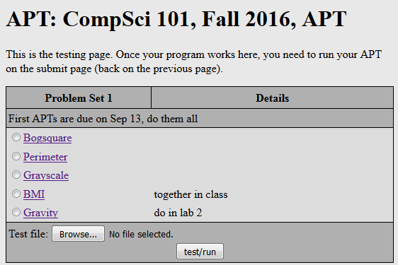
CompSci 101 Introduction to Computer Science
Sept 6, 2016
Prof. Rodger

Slide 2
Announcements
Reading and RQ3 due next class
Assignment 1 due today!
See the catch up schedule – for everyone!
APT 1 due on Tuesday, Sep 13
Need a pin to add class – fill out form
Exam accommodations – fill out form
Lab this week
try out functions, Solve APT
Today – Problem Solving, Python practice, solve an APT

Slide 3
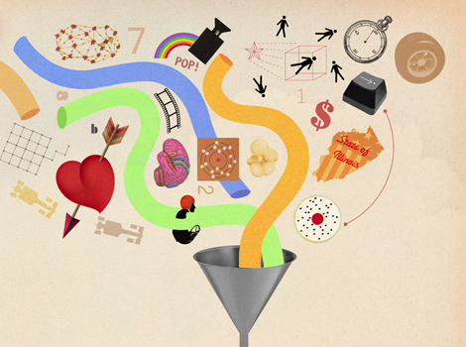
Algorithm
Recipe
Sequence of steps that constitute instructions
Step-by-step procedure for calculations
What does Nate Silver do?
http://53eig.ht/1tZy909
How do Netflix and Amazon know me?
Compsci101 project: capable of implementation as a program, but much more basic
http://moreintelligentlife.com/content/features/anonymous/slaves-algorithm
Notes:
Cooking something - Cake and decorate with mints (BRING MINT BOWL AND Say Put 10 mints on the cake) – How do I get them out of the bowl? And the wrapper?
, Baby Names –
Nate Silver – Statitician and journalist. he has predicted presidential winner in every state – last two years, also big in sports
Recommender - project later in the semester

Slide 4
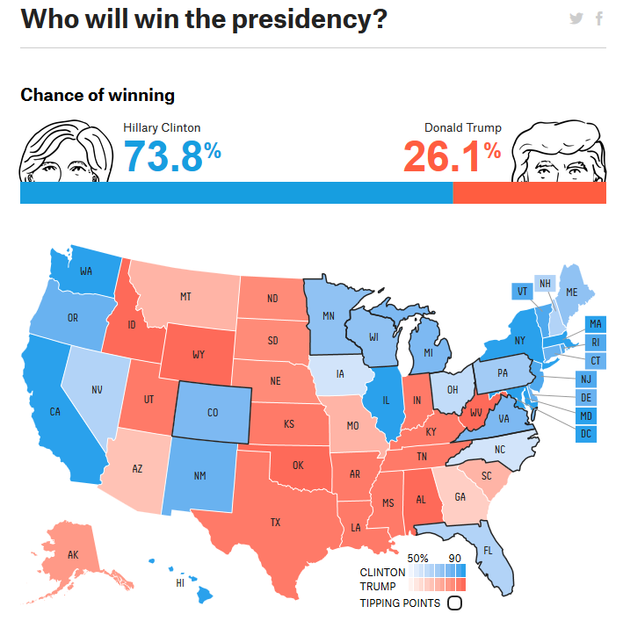

Slide 5
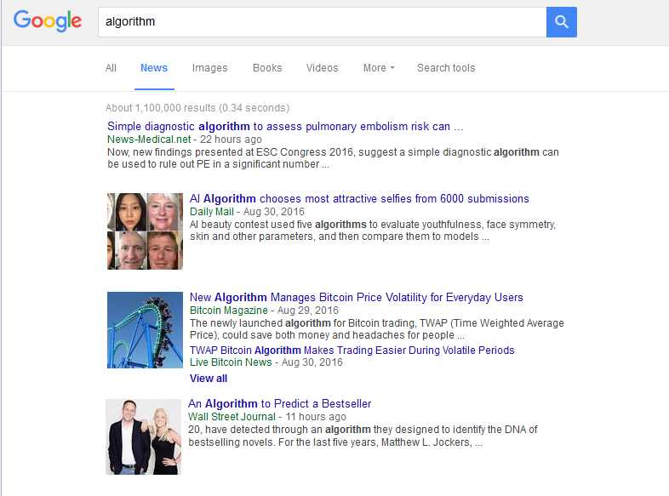
Google “algorithm”
Notes:
Google for Algorithm using news, not web. Google has an algorithm for determining what to display. How does that algorithm work? What kind of people are interested in that algorithm? Influential but we don’t know what that algorithm is….

Slide 6
Algorithms that scale: An example
Human Genome Project
Multiple approaches, relying heavily on computational power and algorithms
Combine reads of DNA sequences, we'll look at an illustrative example
These combine bio/chemistry techniques with computational techniques to recreate the sequencing, e.g., CGATTCCG… from "live data", actual DNA.
Notes:
Digitize DNA – duplicate it a lot and chop it up
Want to construct it digitally – turn it into 0’s and 1’s
Google genome shotgun – combining new sequencing scientist and algorithms working together that collaborate – CS couldn’t do this by themselves

Slide 7
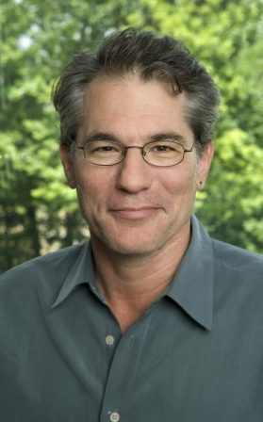
Eugene (Gene) Myers
Lead computer scientist/software engineer at Celera Genomics, then at Berkeley, now at Janelia Farms Research Institute (HHMI)
"What really astounds me is the architecture of life. The system is extremely complex. It's like it was designed." … " There's a huge intelligence there.”
BLAST and WG-Shotgun
Notes:
One of the scientist who worked with biologist to come up with this algorithm – BLAST way to look up
Where did this genome come from?
Example

Slide 8
Whole Genome Shotgun with words
olve problems.
ratively, create,
compsci101 we get t
01 we get to work colla
vely, create, and
s. In compsci1
y, create, and s
e get to work collabo
…
Creation algorithm
Take a phrase
Replicate it four times
Chop into "chunks"
15-22 characters
How to recreate original phrase?
http://bit.ly/101f16-0906-1

Slide 9
From Algorithms to Code
An algorithm that scales needs to run on a computer --- programming to the rescue!
Extensive libraries help with programming
Brain or Neuroscience
Engineering and Mathematics
Genomics
Graphic User Interfaces, …
We are using Python, extensible and simple
Notes:
Python has a lot of libraries

Slide 10
Understanding terminology: code
Move from "Hello World" to "Hello Around the World"
Look at Python, code, libraries
Learning (reviewing) terminology about Python
print "hello world"
f = open("hello.txt")
for line in f:
print line
Notes:
Hello around the world
Ask students to say hello in another language than English, Then show them this program to read in greetings from a file

Slide 11
Hello around world code
http://bit.ly/101f16-0906-2

Slide 12
Running and Understanding Code
Need Python compiler/interpreter
We're using Canopy, includes libraries
Need an editor development environment
We use Eclipse and PyDev, open source and widely used, Ambient is Duke Plugin
You need experience thinking and coding and debugging ideas and code:
Installing the suite of tools can be cumbersome
Persist, Perservere, Get Help, start over ☹
Notes:
Spending time at the beginning to get your envinroment set up – we will help you with that.
Course is not

Slide 13
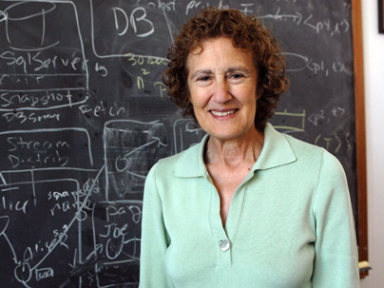
Barbara Liskov
(one of) first women to earn PhD from compsci dept
Stanford 1968
Turing award in 2008
Programming Languages
“It's much better to go for the thing that's exciting. But the question of how you know what's worth working on and what's not separates someone who's going to be really good at research and someone who's not. There's no prescription. It comes from your own intuition and judgment.”
Notes:
Created a new programming language (CLU). Not widespread use, but it had new features that are now in object oriented languages like Java and C++. She also did work on operating systems

Slide 14
Hello Around the World in Python
We open a file, and we open a URL
Syntax slightly different, concept is similar
Real-world differences between files and URLs?
Must adhere to syntactic rules of Python
Naming, whitespace, : or . or ( or ) or [ or ]
Must adhere to semantic rules of Python
Can't loop over anything, more rules to follow
f = open("hello_unicode.txt")
f = urllib2.urlopen("http://nytimes.com")
Notes:
Why is the syntax different, does it have to be urlopen instead of open? Know, but the differences can be useful, in making it clear to reader what kind of thing is being opened URL or file. Where do dots go, where do ()’s go

Slide 15
Starting with Python
Variable
Name of a storage location – holds a value
= to assign a value to a variable
Type
Different types of data
A variable can stores data of a certain type
int, float, str
operators in Python for numbers
Arithmetic: + - * / % **
Built-in functions: pow, abs, round, int, float
example: pow(2,3) + round (1.6)

Slide 16
Eclipse – Three ways to run
Write program and store in file
Create a PyDev project – a folder for programs
Create a PyDev module for each program (file)
Run in console
Create an APT in Eclipse and run on web
Run interactively
Open PyDev console
Execute each line as typed
Code not saved

Slide 17
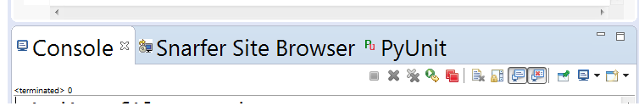
Demo: Run interactively in Eclipse PyDev Console
If Console window is not showing then
Click on Window, Show View, Console
Then at the bottom of Eclipse, click here:
Select PyDev Console, Python Console

Slide 18
Variables, Types, Expressions?
print a + b * 3
print (a + b) * 3
print a / b
print a / (b * 1.0)
a = 5
b = 4
print b
a = a + b
print a
c = "fred"
print c

Slide 19
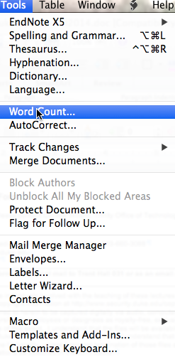

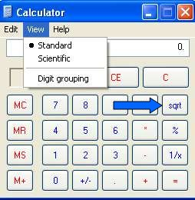
Examples of functions
Notes:
See the next slide. These are three examples of functions seen by students. Go over these quickly, understand from next slide why these pictures are here

Slide 20
Functions explained
In a calculator, sqrt: number in -> number out
What is domain, what is range?
In MSWord, word count: document -> number
Domain is word doc, range is integer
In browser, web: URL -> HTML formatted "page"
Domain is valid URL, range is HTML resources
In Python we see similar structure!

Slide 21
Demo
In Eclipse write a file with a function and run it
stuff.py
def sum(a, b):
return a+b
print sum(3,5)
print sum(1,4)

Slide 22
Python Functions
Answer these questions based on thinking, don't run any code
http://bit.ly/101f16-0906-3
Why do we need functions?
Manage complexity of large programs
Test and develop code independently
Reuse code in new contexts: create APIs!
Notes:
You don't need to understand the program, but we could run the code and that would help. But answer the questions without running the code!

Slide 23
Functions return values
Most functions return values
Sometimes used to make things simpler, but returning values is a good idea
def inch2centi(inches):
return 2.54*inches
xh = inch2centi(72)
def pluralize(word):
return word + "es"
pf = pluralize("fish")
Notes:
Simple examples, these will be in snarf-for-class examples – tinker with – cat we will need more powerful

Slide 24
Functions can print info
Some functions only print info
Note there is no return statement in the function
def helloPerson(name):
print "hello" + name
helloPerson("Susan")
helloPerson("Ademola")
Notes:
Simple examples, these will be in snarf-for-class examples – tinker with – cat we will need more powerful

Slide 25
APTs

Slide 26
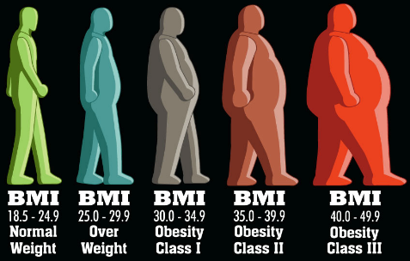
What is an APT? BMI APT
Automated/Algorithmic Problem Testing
Write one function, 2-30 lines, solve a problem
Tested automagically in Eclipse or the browser
Lots of test cases – test test test
Start simple, build toward more complex
What is a function? A function call?
What is a parameter? Argument?
How do you run/execute a program
Notes:
Google BMI and show the calculator on the web. Type in funny numbers weight 50 or weight 450

Slide 27
Demo Solving APT BMI
Write your code in Eclipse
Create python file
Name of file important – case matters
name of function important – cut and paste this
Write your code
Test a few examples in Eclipse
Run online on using APT Tester
Tests on lots of examples, Debug, fix
Get all GREEN
Submit on APT page
README form too

