Slide 1
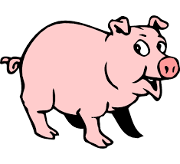
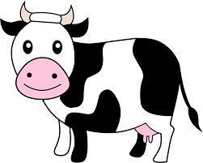
CompSci 101 Introduction to Computer Science
Sept 8, 2016
Prof. Rodger
(lecture by Barrett Ames)

Slide 2
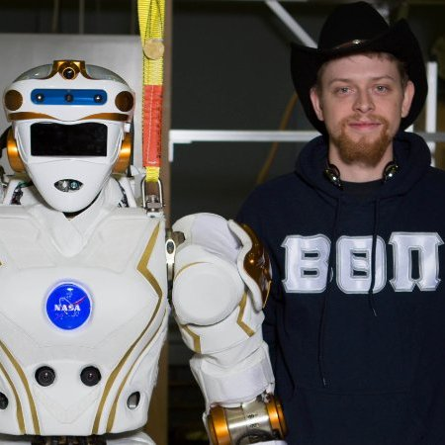
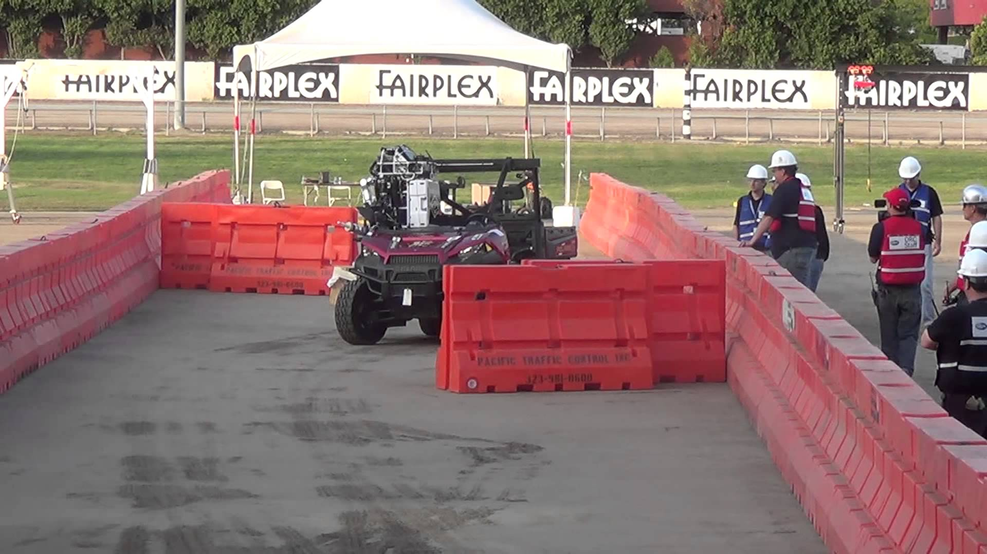
Whose this guy?

Slide 3
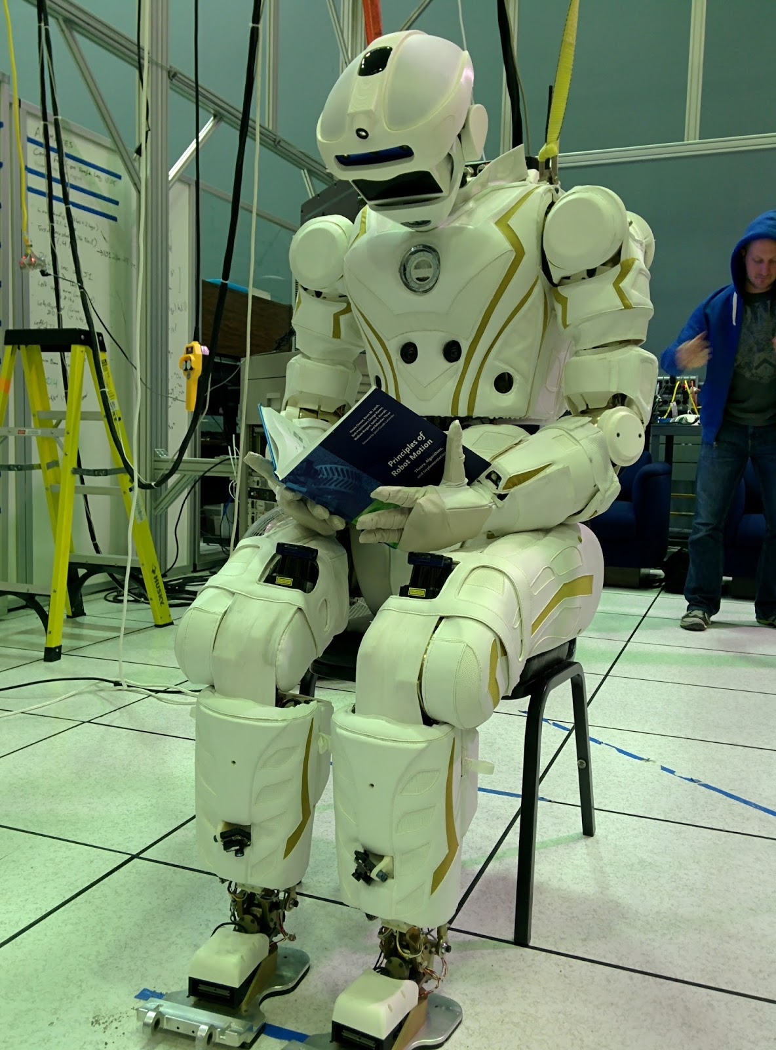
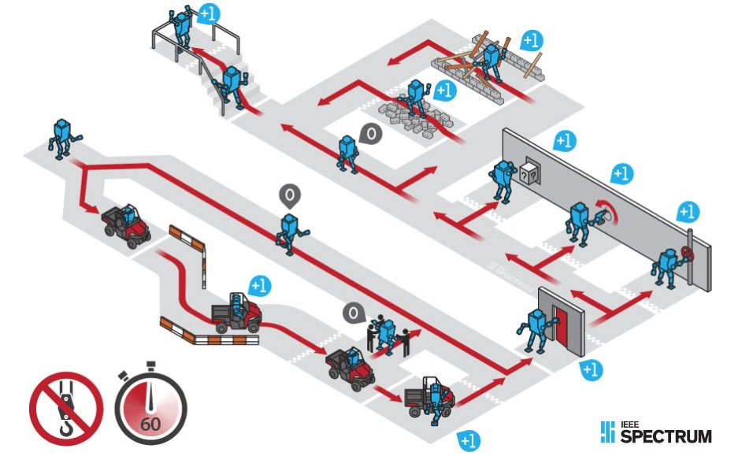
What do I do?

Slide 4
Announcements
Reading and RQ 4 due next time
Asgn 2 out, APT 1 is due Tuesday
Lab 2 this week
To add class or change sections – see:
www.cs.duke.edu/courses/compsci101/fall16
Today
more APT practice
functions, parameters
Names, types and values

Slide 5
Python Functions
Answer these questions based on thinking, don't run any code
http://bit.ly/101f16-0906-3
Why do we need functions?
Manage complexity of large programs
Test and develop code independently
Reuse code in new contexts: create APIs!
Notes:
You don't need to understand the program, but we could run the code and that would help. But answer the questions without running the code!

Slide 6
Functions return values
Most functions return values
Sometimes used to make things simpler, but returning values is a good idea
def inch2centi(inches):
return 2.54*inches
xh = inch2centi(72)
def pluralize(word):
return word + "es"
pf = pluralize("fish")
Notes:
Simple examples, these will be in snarf-for-class examples – tinker with – cat we will need more powerful

Slide 7
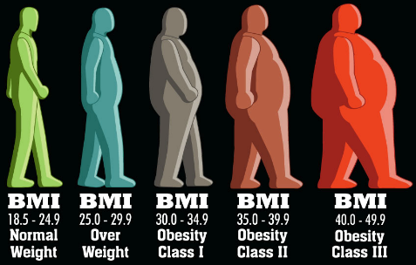
What is an APT? BMI APT
Automated/Algorithmic Problem Testing
Write one function, 2-30 lines, solve a problem
Tested automagically in Eclipse or the browser
Lots of test cases – test test test
Start simple, build toward more complex
What is a function? A function call?
What is a parameter? Argument?
How do you run/execute a program
Notes:
Google BMI and show the calculator on the web. Type in funny numbers weight 50 or weight 450

Slide 8
Demo Solving APT BMI
Write your code in Eclipse
Create python file
Name of file important – case matters
name of function important – cut and paste this
Write your code
Test a few examples in Eclipse
Run online on using APT Tester
Tests on lots of examples, Debug, fix
Get all GREEN – Green dance!
Submit on APT page
README form too

Slide 9
Function Detective
http://bit.ly/101sp16-0126-1

Slide 10
Results of Code Analysis
For details on plurals: http://bit.ly/1N49u6b
How did we call pluralize many times?
Loop. What is an alternative?
What does the 'if' statement do?
Selects a code block to execute (more next week)
If you have a question? Write and run code!
Notes:
Might have other things to note based on responses from class. Might want to run some calls of 'pluralize'. Can snarf it, add to list, try a few other things

Slide 11
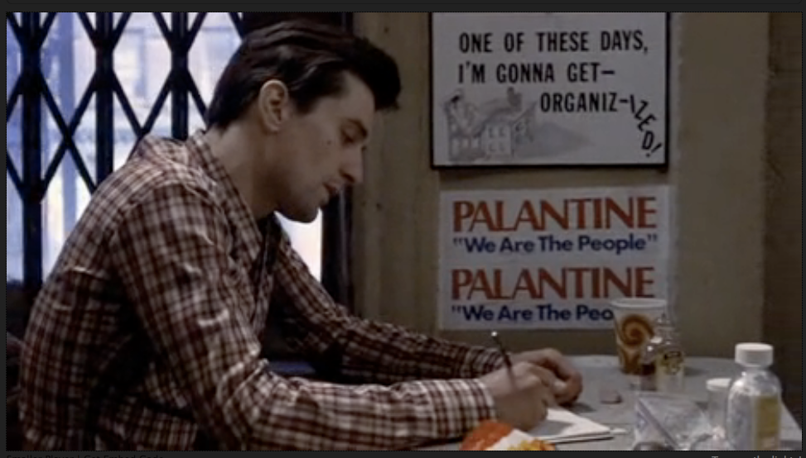
Organization matters
https://www.youtube.com/watch?v=1ve57l3c19g
Notes:
This is an all time favorite of mine. I think when Robert de Niro looks at Cybil Shepard in the clip it's clear that he's infatuated with her. It's a long time ago. We are still infatuated with teaching and coding and we hope they will be. We also want to be organizized with building programs.

Slide 12
APT organization, Code organization
You’ve written the BMI.py APT
Where is that module? How do you test it?
PyDev console, but then must import it
Adding print statements in BMI.py to test
Putting sentences together in order…
“Once upon a time…” “It was the best of times…” “Aujord’hui ma maman est morte”
Putting code together in order
Takes judgment and experience
Notes:
The second bullet is about famous 'first lines'. You don't need a good first line in a program. You need all the code to work together. Unlike a book where sentences can be skipped, you can't skip things in a program.. The 'judgment and experience' could lead to a famous quote "good judgment comes from experience, experience comes from bad judgment'

Slide 13
Python – Names and Types
Names vs abstractions
What is http://152.3.140.1
What is http://www.amazon.com
Types are important
What is foo.pdf, foo.mp4, foo.jpg, foo.wav
Do the file extensions guarantee file type?
Python – what types are these?
first = "Susan"
x = 6
y = 3.4
Notes:
First link is duke computer science – how would you know?
If I change the name of a file, I could change the extension, but then that file name is misleading…

Slide 14
Strings
Sequence of characters in quotes
"I" + 'Love' + '''Python'''
"I" 'Love' '''Python'''
'ILovePython'
String operators: concatenation (+), repeat(*)
Precedence?
"a" + "b" + "c" * 3
'abccc'
Precedence?
"a" + "b" "c" * 3
'abcbcbc'
Notes:
Don’t type these in, answers on next page
Read about strings for next time

Slide 15
Strings
Sequence of characters in quotes (same result)
"I" + 'Love' + '''Python'''
"I" 'Love' '''Python'''
'ILovePython'
String operators: concatenation (+), repeat(*)
Precedence?
"a" + "b" + "c" * 3
'abccc'
Precedence?
"a" + "b" "c" * 3
'abcbcbc'

Slide 16
Function
def functionName(parameters):
block of code
Parameters – place holder, will store value passed in
Arguments – values in the call, that you pass to the function to use as input
Notes:
Point out the parameters

Slide 17
Function – return or print?
Example function that returns a value
def sum(a, b):
return a+b
Example function that prints
def hw(name):
print "Hello " + name
Call Functions
print sum(4,7) sum(4,7)
answer = sum(4,7) print hw(“a”)
hw("Sue")
Notes:
Point out the parameters and arguments

Slide 18
Function – return or print?
Example function that returns a value
def sum(a, b):
return a+b
Example function that prints
def hw(name):
print "Hello " + name
Call Functions
print sum(4,7) sum(4,7)
answer = sum(4,7) print hw(“a”)
hw("Sue")
x
x
Notes:
Point out the parameters and arguments

Slide 19
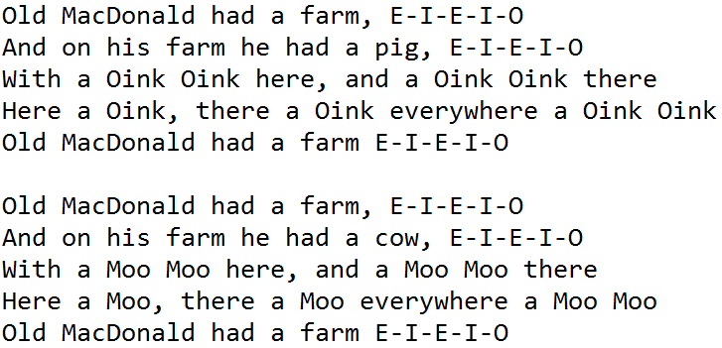
Old MacDonald Song
Write a Program to print this song

Slide 20
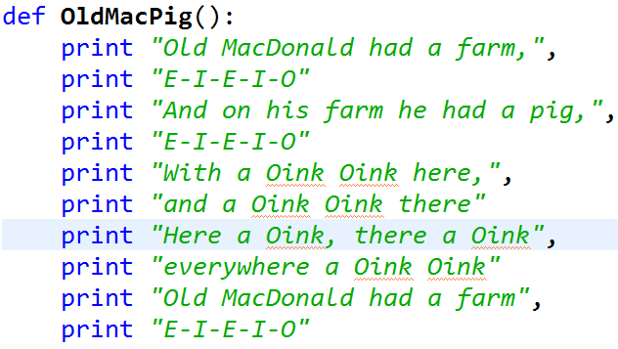
Function OldMacPig()

Slide 21
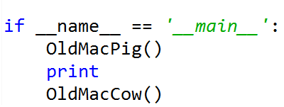
Rest of Code
Function OldMacCow
Replace “pig” with “cow”
Replace “Oink” with “Moo”
Code to start:

Slide 22
Discuss how to make code better bit.ly/101sp16-0126-1a
Describe in words how you can make the code better? More efficient?
Fewer lines of code?
Use more functions?
Discuss your changes.
What advantages do the changes you make have?

Slide 23
Demo – Old Mac improvements
What does the horse say?
What does the cow say?
What does the fox say?

Slide 24
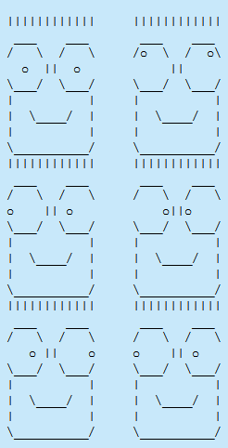
Assignment 2 out
Totem poles
printing heads
functions

Slide 25
Names, Types and Values
bit.ly/101sp16-0126-2

