Slide 1
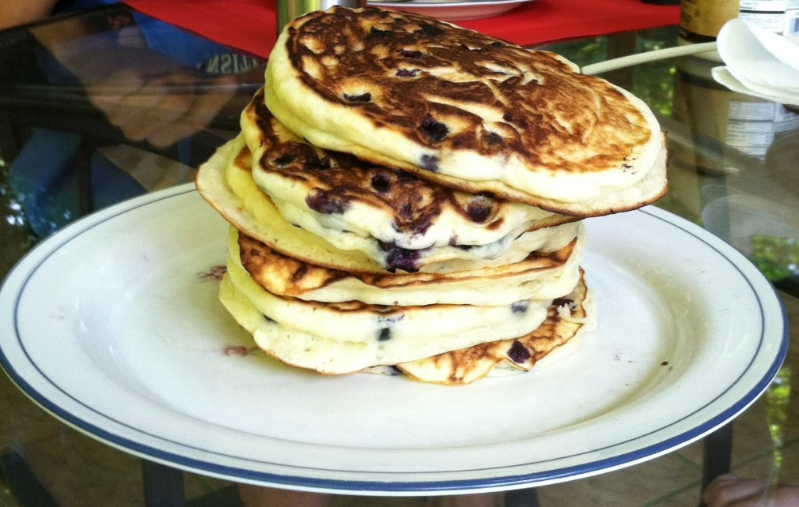
CompSci 101 Introduction to Computer Science
Sept 13, 2016
Prof. Rodger
Notes:
Blueberry pancakes, yum!
Bring Blank paper for this lecture!

Slide 2
Announcements
Reading and RQ5 due next time
Assignment 2 due Thursday
APT 1 is due today, APT 2 out today
Catch up Schedule on main web page
Today –
Solving problems – 7 Step process
Decisions - if, Boolean
Notes:
Last Thursday in January

Slide 3
How many ways can I run Python in this course?
Eclipse
Complete program
Interactive Console
APT
Online textbook
Beware Python 3 (‘/’ (2.7) vs ‘//’ (3) )
Python Tutor
Notes:
What is an APT, testing one method and it comes with free tests.
YOU WILL KNOW when an APT is correct!
You may not know for an assignment.
Have not seen python tutor yet, will see today

Slide 4
How to get Help in this class
Piazza
Consulting hours (Sunday-Thursday nights)
Office hours (Prof, TAs)
What happens if my laptop breaks and I can’t use my eclipse? Do I stop programming?
Clusters, Python Tutor, websubmit, borrow
Fill out form to request extension
Notes:
Love to help all 350 of my students learn python but that is tough!
That is why we have so many support

Slide 5
Submitting an APT – APT tab
Test – get it working
Submit – run it one time here and see the green
Finish – complete README for each APT
Check your grade – “check submissions” link

Slide 6
Submitting Assignment 2
Use Ambient/eclipse
Check if submitted with Submit History – files submitted should be listed!
Alternative submit – use websubmit – on assign tab
What time is it due? Thursday 11:59pm + 121 minutes
If you can’t submit on your computer, copy your file to another computer (Link?) and submit with websubmit on that computer

Slide 7
Completing and Turning in Lab
Lab is due Sunday night following lab
You should complete it (unless items marked optional)
If you miss lab you still need to do it and turn it in – max 3 of 4 points
Ok to miss a few labs, I’ll drop a few lab points at end of semester

Slide 8
Lab this week
Always read the reading for the week before lab
String splicing
Word = ”go duke”
print word[3:5] + word[0]
Making decisions – if
Lists – [”orange”, ”kiwi”, ”lemon” ]

Slide 9
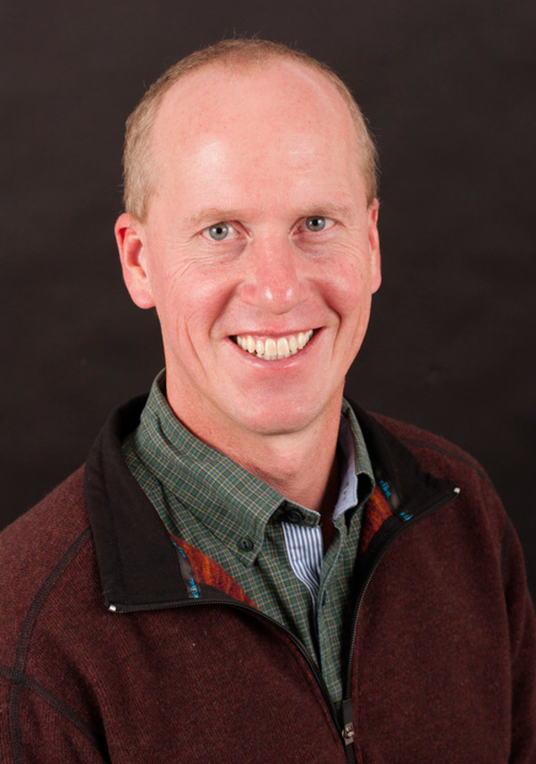
Why is this person so important to this course?
Notes:
Brad Miller took Python book from Elkner, Downey and Meyer and created the software for an online textbook that allows you to experiment with the python right in the book
Without him, no free book!

Slide 10
Why is this person so important to this course?
Have you donated yet?
Notes:
Brad Miller took Python book from Elkner, Downey and Meyer and created the software to allow you to experiment with the python right in the book
Without him, no free book!

Slide 11
Top 10 list for surviving in CompSci 101
10. Read the book and Ask questions
9. Eat lots of pizza
8. Learn how to spell Rodger
7. Understand what you turn in
6. Follow the 7 step process
Notes:
Learn seven step process today

Slide 12
Top 10 list (cont)
5. Check Piazza every day
4. Visit your prof in her office
3. Learn how to debug your programs
2. Seek help (one hour rule!)
1. Start programming assignments early
Notes:
Seek help (consulting hours, piazza, office hours)
Start early

Slide 13
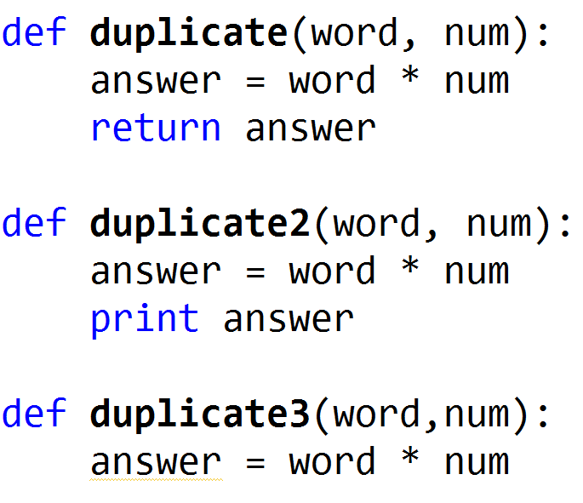
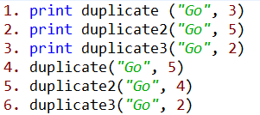
Review Functions
www.bit.ly/101f16-0913-1
Notes:
Show this in Python Tutor!

Slide 14
Use Python Tutor
Debug/trace your code
Doesn’t work with input files
Notes:
Trace through previous example with Python Tutor

Slide 15
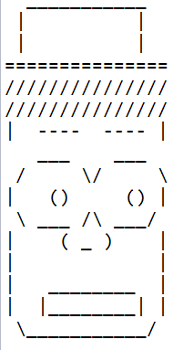
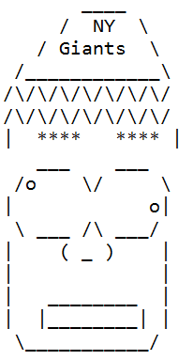
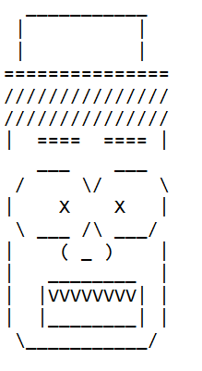
Assignment 2
Questions?
Demo
Notes:
Show Student Solution

Slide 16
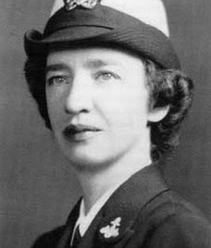
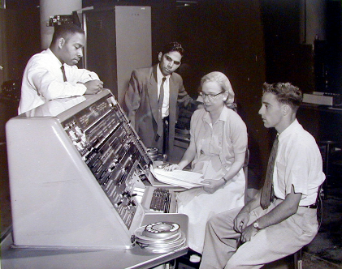
Grace Murray Hopper (1906-1992)
“third programmer on world's first large-scale digital computer”
US Navy: Admiral
“It's better to show that something can be done and apologize for not asking permission, than to try to persuade the powers that be at the beginning”
https://www.youtube.com/watch?v=1-vcErOPofQ
ACM Hopper award given for contributions before 35
2010: Craig Gentry: http://www.youtube.com/watch?v=qe-zmHoPW30
2011: Luis von Ahn
2013: Pedro Felzenszwab
2014: Sylvia Ratnasamy
2015: Brent Waters
Notes:
Play between start to 1:15, then nanosecond 4 to 5:30
Craig Gentry is Duke class of 1995, then Duke Law School, then Stanford PhD in computer science,
Second link is video about Craig’s work in cryptography.
Luis von Ahn is Duke class of 2000, then CMU PD.
See ACM website for details on others who are more recent winners

Slide 17
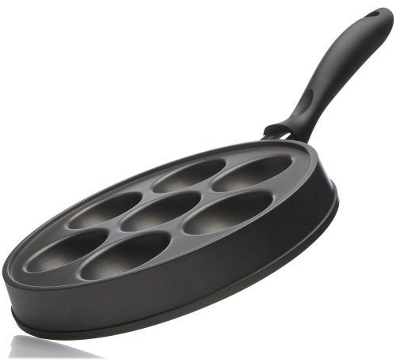
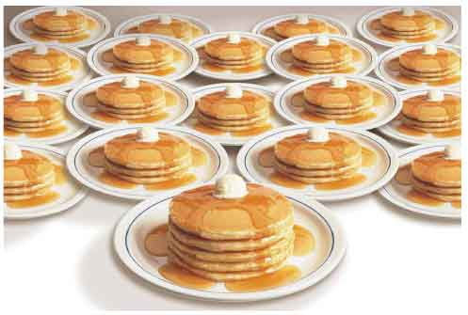
APT Pancake: http://bit.ly/pancakes101
How do you solve this problem?
First steps: are there simple cases that can be solved immediately?
What are these for the pancake problem?
Sometimes it helps to know if you are on track, should you use Python to check your paper and pencil work?
Get specific, solve for 5, not N
Fix one parameter, vary the other
Identify the cases and continue

Slide 18
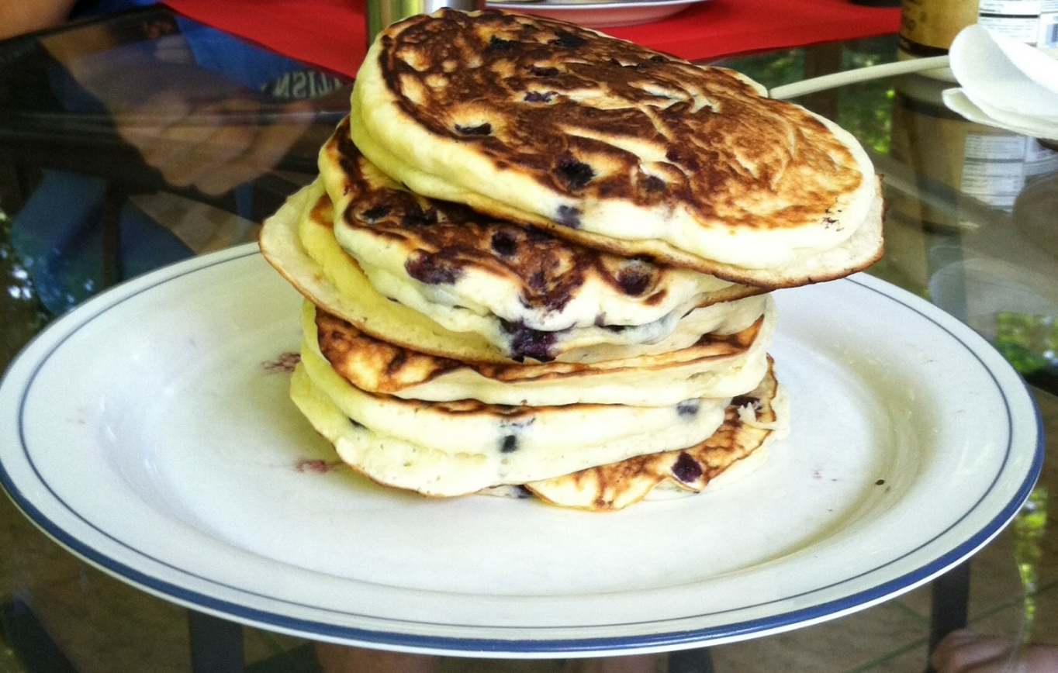
Solve an APT - Pancakes bit.ly/101f16-0913-2

Slide 19
Problem Solving to Code 7 Step Process
Work small examples by hand
Write down what you did in words (algorithm)
Find Patterns (generalize algorithm)
Work another example by hand (does your algorithm work? If not, go back to 2)
Translate to code
Test several cases
Debug failed test cases
Notes:
Now you have several APTs to solve. It is a huge step to go from problem statement to code!
Use the seven step process
Which step is writing code? It is not step one!!!!!!

Slide 20
Pancake Problem
Work through the 7 step process….
Notes:
This takes awhile to solve
Work the example by hand with pansize 4 pancakes – draw a picture. How do you calculate the answer. Try the example pansize 2, 3 pancakes. (see notes from last semester Jan 28 code – actually me working problem, then I did the code)
Write down algorithm

Slide 21
Three pancakes in a two-cake pan…
Number of cakes in the system
First 5 minutes
Number of cakes in the system
Second 5 minutes

Slide 22
Three pancakes in a two-cake pan…
Number of cakes in the system
Third 5 minutes
How many minutes to cook all three pancakes?

Slide 23
How to solve problems with different cases?
Keep score in a video game?
Different points for different tasks?
Translate a book from English to Spanish?
Different words, different rules
Identify proteins in strands of DNA?
Start codon: atg Stop Codon: tag
Different cases with Pancake APT?
In Python use: if, else ,elif

Slide 24
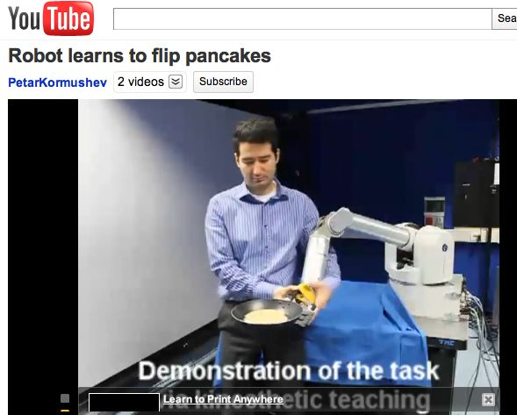
How to teach pancake Flipping
http://www.youtube.com/watch?v=W_gxLKSsSIE
Is this computer science? http://bit.ly/zykOrh
For longer, more complex robotic tasks
http://www.youtube.com/watch?v=4usoE981e7I

