Slide 1

CompSci 101
Introduction to Computer Science
Sept 15 , 2016
Prof. Rodger

Slide 2
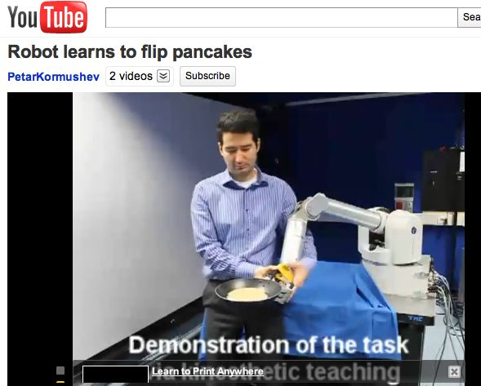
How to teach pancake Flipping
http://www.youtube.com/watch?v=W_gxLKSsSIE
  Is this computer science? http://bit.ly/zykOrh
  For longer, more complex robotic tasks
    http://www.youtube.com/watch?v=4usoE981e7I
Notes:
2cd link is to

Slide 3
Announcements
Reading and RQ6 due next time
Assignment 2 due today, Assignment 3 out
APT 2 due on Tuesday
APT Quiz 1 next Sunday 6pm-Tuesday 10pm
  You pick 2 hours to take it during that time
Today: MOS
  Problem solving: Strings, Lists
  Looping over things: characters, words
Notes:
Middle of September – Sept 15

Slide 4

Assignment 3
Turtles
  Creative
Earthquakes
  Data from last 30 days around the world
  Example - Find the largest earthquake

Slide 5
How to solve problems with different cases?
Keep score in a video game?
  Different points for different tasks?
Translate a book from English to Spanish?
  Different words, different rules
Identify proteins in strands of DNA?
  Start codon: atg Stop Codon: tag
Different cases with Pancake APT?
In Python use: if, else ,elif
Notes:
Last slide done in morning class last time.

Slide 6
LastNameFirst APT
http://www.cs.duke.edu/csed/pythonapt/lastnamefirst.html
Answer Questions here:
bit.ly/101f16-0915-1
Notes:
Come back to this a bit later.

Slide 7
More on Strings
Strings are indexed starting at 0
Example: ‘word’
Use [x] – to refer to a particular character in word
Use [x:y] to refer to a slice of the string starting at position x and up to but not including position y. Can leave out x or y.
w
o
r
d
0 1 2 3

Slide 8
Examples
phrase = "Duke Blue Devils"
print phrase[0]
print phrase[-3]
print phrase[1:3]
print phrase[5:10] + phrase[:4]
print (phrase[phrase.find('ev'):]).upper()
String fun
Crazy import
Notes:
antigravity

Slide 9
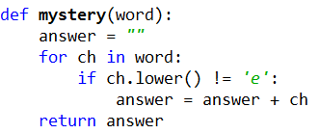
Loop over all characters in a String

Slide 10
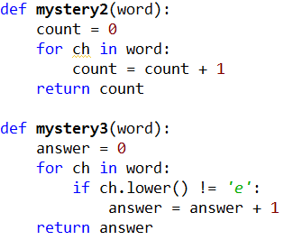
Loop over string
www.bit.ly/101f16-0915-2

Slide 11

Loop over all words in a list

Slide 12
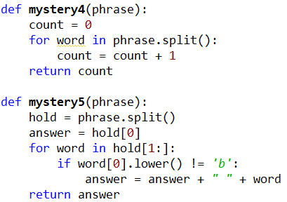
Loop over words
www.bit.ly/101f16-0915-3

Slide 13

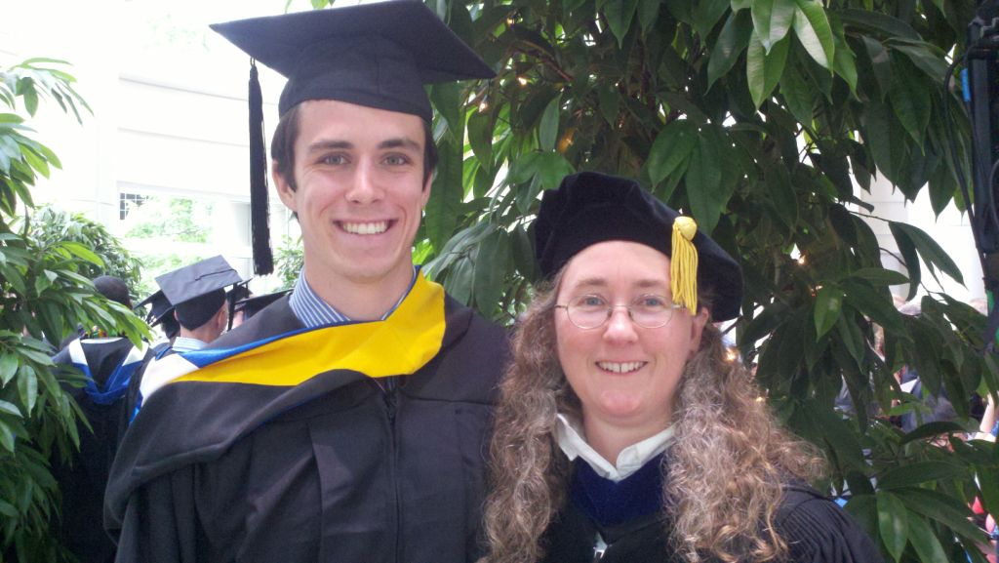
Computer Science Alum
Biology and CS
Undergraduate Research - JFLAP
Epic
Now in Med School at Vanderbilt
Notes:
Julian Genkins – he came to Duke premed. His fourth semester he took a computer science course and fell in loved it. He decided then to double major in CS and Biology. He did research with me on creating educational software. Then he took a gap year and worked at Epic for a year while he applied for med schools, and got a full scholarship to Vanderbilt.
With me just being in the hospital. It is pretty neat that Julian contributed to the EPIC medical software that Duke uses to manage my care while I am in the hospital.
He just wrote me sept 2014 and said he is on a student technology committee, focused on using technology in medical education. He is implementing new tools. “I cannot tell you how many times my experiences working on JFLAP have come in handy”

Slide 14
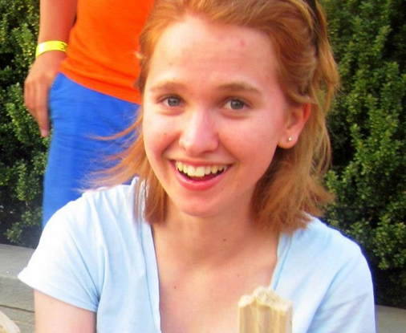

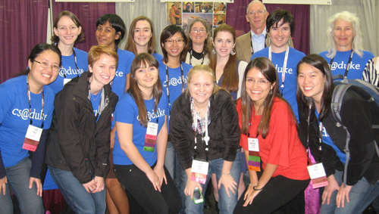
More Computer Science Duke Alums
Notes:
Becky DeNardis (UTA and worked at Google two summers, then got a full time job at google, valedictorian, unfortunately, she was killed by a drunk driver, some of you may have heard about her. She was incredibly passionate about computer science and passionate about helping people learn computer science). , Deborah Nelson (rightmost triplet) took CompSci 101 – she taught English in Turkey for a year, then went to graduate school in Human Computer Interaction, now is a User Experience Designer for Blackbaud

Slide 15
Back to LastNameFirst APT
http://www.cs.duke.edu/csed/pythonapt/lastnamefirst.html
Answer Questions here:
bit.ly/101f16-0915-4
Notes:
Come back to this a bit later.

Slide 16
Problem Solving to Code
7 Step Process
Work small examples by hand
Write down what you did in words (algorithm)
Find Patterns (generalize algorithm)
Work another example by hand (does your algorithm work? If not, go back to 2)
Translate to code
Test several cases
Debug failed test cases
Notes:
Now you have several APTs to solve. It is a huge step to go from problem statement to code!
Use the seven step process
Which step is writing code? It is not step one!!!!!!

Slide 17
Use 7 step process to solve LastName First

