Slide 1
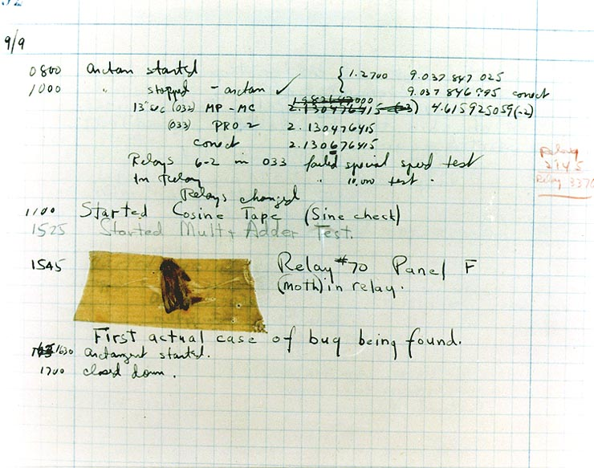
CompSci 101 Introduction to Computer Science
Sept 20, 2016
Prof. Rodger
Notes:
Turning things in

Slide 2
Announcements
Reading and RQ7 due next time
Assignment 3 due Thursday
APT 2 due today, APT 3 out
APT Quiz 1 – runs Sunday night-Tuesday night
Up for two days, you pick 3 hours to do it
Today
Designing programs to draw with turtles
Functions, if, strings, lists

Slide 3
Lab This week
Practice with lists and strings – splicing, etc
More on processing data from files
Do reading for Thursday before attending lab
Work on APT ScoreIt

Slide 4
Problem Solving to Code 7 Step Process
Work small example by hand
Write down what you did in words (algorithm)
Find Patterns (generalize algorithm)
Work another example by hand (does your algorithm work? If not, go back to 2)
Translate to code
Test several cases
Debug failed test cases
Notes:
Now you have several APTs to solve. It is a huge step to go from problem statement to code!
Use the seven step process
Which step is writing code? It is not step one!!!!!!

Slide 5
Removing ‘s’ at the end of words bit.ly/101f16-0920-1
def removePlurals(phrase):
answer = ""
alist = phrase.split()
for word in alist:
if word[-1] == "s":
answer = word[:-1] + " "
else:
answer = word + " "
return answer.strip()

Slide 6

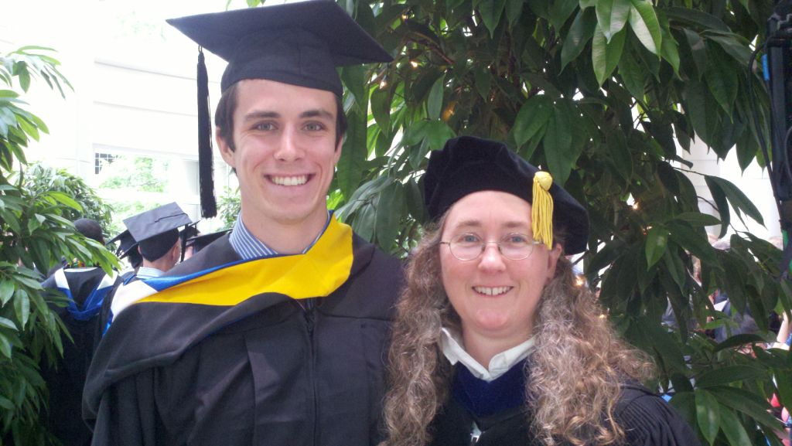
Computer Science Alum
Biology and CS
Undergraduate Research - JFLAP
Epic
Now in Med School at Vanderbilt
Notes:
Julian Genkins – he came to Duke premed. His fourth semester he took a computer science course and fell in loved it. He decided then to double major in CS and Biology. He did research with me on creating educational software. Then he took a gap year and worked at Epic for a year while he applied for med schools, and got a full scholarship to Vanderbilt.
With me just being in the hospital. It is pretty neat that Julian contributed to the EPIC medical software that Duke uses to manage my care while I am in the hospital.
He just wrote me sept 2014 and said he is on a student technology committee, focused on using technology in medical education. He is implementing new tools. “I cannot tell you how many times my experiences working on JFLAP have come in handy”

Slide 7
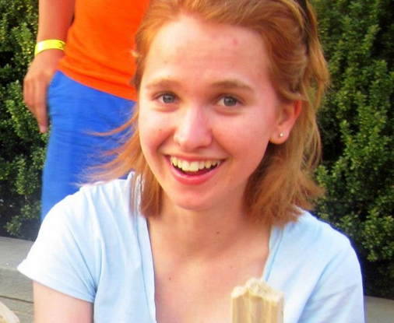

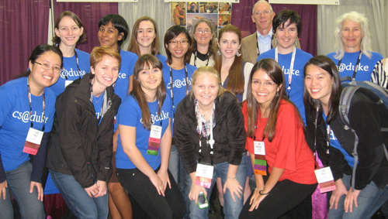
More Computer Science Duke Alums
Notes:
Becky DeNardis (UTA and worked at Google two summers, then got a full time job at google, valedictorian, unfortunately, she was killed by a drunk driver, some of you may have heard about her. She was incredibly passionate about computer science and passionate about helping people learn computer science). , Deborah Nelson (rightmost triplet) took CompSci 101 – she taught English in Turkey for a year, then went to graduate school in Human Computer Interaction, now is a User Experience Designer for Blackbaud

Slide 8
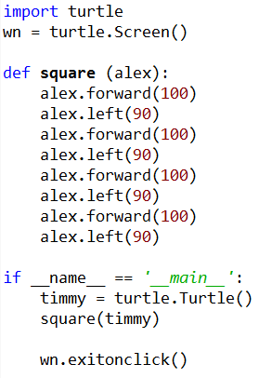
Turtles: bit.ly/101f16-0920-2
Run in eclipse
Make square with different sizes?
Make a rectangle?
Where is the repetition?
New commands:
up(), down(), position(), goto()

Slide 9

Assignment 3
Turtles
Creative
Earthquakes
Data from last 30 days around the world
Example - Find the largest earthquake

Slide 10
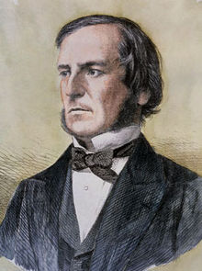
Python if statements and Booleans
In python we have if: else: elif:
Used to guard or select block of code
If guard is True then code block, else other
What type of expression used in if/elif tests?
==, <=, <, >, >=, !=, and, or, not, in
Value of expression must be either True or False
Type is bool - George Boole, Boolean,
Examples with if
String starts with vowel
(useful for APT Emphasize)
Notes:
George Boole was a mathematician who did foundational work in Boolean algebra and Boolean logic. Boolean logic laid the foundation for the information age. How computers work

Slide 11
Four versions of isVowel? bit.ly/101f16-0920-3
def isVowel(ch):
c = "aeiou".count(ch)
if c > 0:
return True
A
B
def isVowel(ch):
if ch =='e':
return True
if ch == 'a':
return True
if ch == 'i':
return True
if ch == 'o':
return True
if ch == 'u':
return True
return False
C
def isVowel(ch):
return "aeiou".count(ch) > 0
D
def isVowel(ch):
if ch in "aeiou":
return True
else:
return False
Notes:
Write helper function to solve problems, will make your life easier!
B doesn’t work, missing a False case. All others work

Slide 12
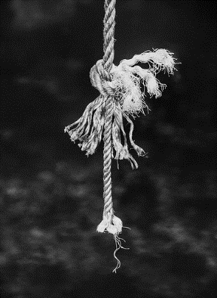
Anatomy of a Python String
String is a sequence of characters
Functions we can apply to sequences: len, slice [:], others
Methods applied to strings [specific to strings]
st.split(), st.startswith(), st.strip(), st.lower(), …
st.find(), st.count()
Strings are immutable sequences
Characters are actually length-one strings
Cannot change a string, can only create new one
What does upper do?
See resources for functions/methods on strings
Iterable: Can loop over it, Indexable: can slice it

Slide 13

Lynn Conway
See Wikipedia and lynnconway.com
Joined Xerox Parc in 1973
Revolutionized VLSI design with Carver Mead
Joined U. Michigan 1985
Professor and Dean, retired '98
NAE '89, IEEE Pioneer '09
Helped invent dynamic scheduling early '60s IBM
Transgender, fired in '68

Slide 14
Incremental + : numbers and strings
Wtht vwls cn y stll rd ths sntnc?
Create a no-vowel version of word
Examine each character, if it's not a vowel …
Pattern of building a string
def noVowels(word):
ret = ""
for ch in word:
if not isVowel(ch):
ret = ret + ch
return ret
Notes:
in the loop we are iterating over the characters in the word.
Ret is accumulating characters – building a new string

Slide 15
Counting vowels in a string
Accumulating a count in an int is similar to accumulating characters in a string
Alternative version of adding:
value += 1
def vowelCount(word):
value = 0
for ch in word:
if isVowel(ch):
value = value + 1
return value
Notes:
Notice the pattern again

Slide 16
What does this function do? bit.ly/101f16-0920-4
def mystery(s):
r = ""
for ch in s:
r = ch + r
return r
Notes:
Accumulating data in reverse order it was in before!

Slide 17
From high- to low-level Python
def mystery(s):
r = ""
for ch in s:
r = ch + r
return r
Create version on the right using disassembler
import dis
# mystery here dis.dis(mystery)
7 0 LOAD_CONST 1 ('')
3 STORE_FAST 1 (r)
8 6 SETUP_LOOP 24 (to 33)
9 LOAD_FAST 0 (s)
12 GET_ITER
>> 13 FOR_ITER 16 (to 32)
16 STORE_FAST 2 (ch)
9 19 LOAD_FAST 2 (ch)
22 LOAD_FAST 1 (r)
25 BINARY_ADD
26 STORE_FAST 1 (r)
29 JUMP_ABSOLUTE 13
>> 32 POP_BLOCK
10 >> 33 LOAD_FAST 1 (r)
36 RETURN_VALUE

Slide 18
Bug and Debug
software 'bug'
Start small
Easier to cope
Simplest input?
Judicious 'print'
Debugger too
Python tutor
Visualizes data
step through
Verify the approach being taken, test small, test frequently
How do you 'prove' your code works?
Notes:
Rarely do you use a large data file to test your program, how do you know it works?

Slide 19
Work on APT?

