Slide 1
CompSci 101 Introduction to Computer Science
September 22, 2016
Prof. Rodger
score = [10,8,10,9]

Slide 2
Announcements
Reading and RQ8 due next time
Assignment 3 due tonight
Assignment 4 out, due Sept 29
APT 3 is due on Tuesday
APT Quiz 1 take Sunday-Tuesday midnight
Friday – practice APT quiz available
Today - EOWF:
Solving problems with lists, ifs.
Notes:
End of Week Four

Slide 3
Getting help
Consider a peer tutor – one hour of one on one help a week.
Many take advantage of this
contact peer tutoring center
Are you getting too much help?
After solving APT
Can you solve again with a blank sheet of paper or blank file and no help?
Are you using 7 step process to solve?
Notes:
I will recruit more tutors if they do not have enough .
Bring form by and I will sign it.
This class is different than others, you may have never needed a tutor before.

Slide 4
Are you Learning How to Debug?
Print is your friend!
Create variables!
Isolate the problem
Comment out sections until you can isolate where the problem is
Python Tutor – trace
Doesn’t work with files but comment out file and create variable with sample input
Notes:
Works with APTS, you just need to call the function

Slide 5
Assignment 3 - Earthquakes
Write QuarryBlastQuakes – return the list of earthquakes that are something from a Quarry such as a Quarry Blast Quakes –
Description starts with “Quarry”
quakes is a list of earthquake strings in correct format
def QuarryBlastQuakes(quakes):

Slide 6
Assignment 3 - Earthquakes
Write QuarryBlastQuakes – return the list of earthquakes that are something from a Quarry such as a Quarry Blast Quakes –
Description starts with “Quarry”
quakes is a list of earthquake strings in correct format
def QuarryBlastQuakes(quakes):

Slide 7
Pattern to build and return new list
initialize newlist
for item in oldlist:
if item fits criteria
put item in newlist
return newlist

Slide 8
def quarryQuakes(quakes):
answer = []
for q in quakes:
pos = q.find(" : ")
rest = q[pos+3:]
if rest.startswith("Quarry"):
answer.append(q)
return answer

Slide 9
def quarryQuakes(quakes):
answer = []
for q in quakes:
pos = q.find(" : ")
rest = q[pos+3:]
if rest.startswith("Quarry"):
answer.append(q)
return answer

Slide 10
How do you use quarryQuakes?
In main:
print "Quarry quakes"
quarryQ = quarryQuakes(eqList)
printQuakes(quarryQ, -1)

Slide 11
How do you use quarryQuakes?
In main:
print "Quarry quakes"
quarryQ = quarryQuakes(eqList)
printQuakes(quarryQ, -1)

Slide 12
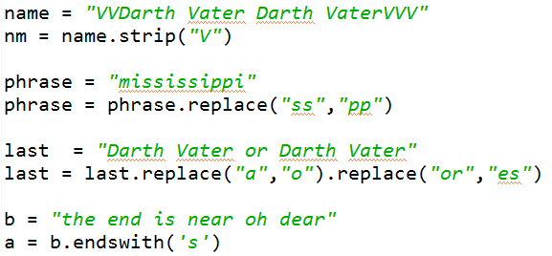
String Functions – What is output? bit.ly/101f16-0922-1

Slide 13
Making Decisions
Question?
True
if block
False

Slide 14
Making Decisions in Python
if condition1:
Block of code to do if condition is true
elif condition2:
Block of code to do if condition1 false, condition2 is true
else:
Block of code to do if other conditions false
Can have many elifs, leave out elif, leave out else

Slide 15
Making Decisions tools
Boolean values: True, False
Boolean operators: and, or, not
Relational operators: <, <=, >, >=
Equality operators: ==, !=
X | Y | X and Y | X or Y
True | True | True | True
True | False | False | True
False | True | False | True
False | False | False | False

Slide 16
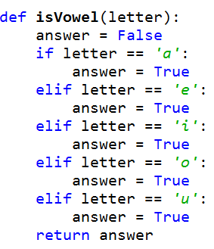
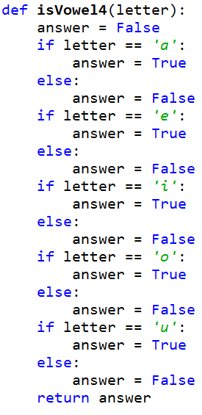
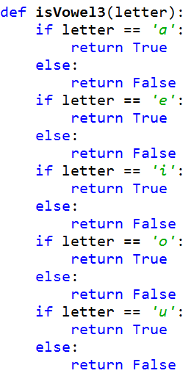
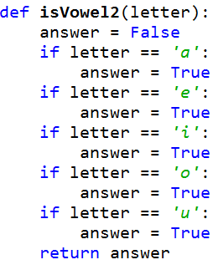
bit.ly/101f16-0922-2

Slide 17
Lists
A list is a collection of objects
scores = [99, 78, 91, 84]
allAboutMe = [“Mo”,25, “934-1234”]
club=[‘Mo’,‘Jo’,‘Po’, ‘Flo’, ‘Bo’]
Lists are mutable – use [num] to change a value
Lists are indexed starting at 0, or -1 from the end
Functions: max, min, len, sum
Slice lists [:]

Slide 18
List Examples
scores = [10, 8, 10, 9]
print scores
scores[2] = 5
print scores
print max(scores), len(scores),
print sum(scores)
print scores[1:]
print scores[1], scores[-1]
scores.append(4)
scores += [5]
print scores
Notes:
Show them also
Scores += 5

Slide 19
List before/after modification
0 1 2 3
score = [10,8,10,9]
10
8
9
10
0 1 2 3
score [2] = 5
10
8
9
5
10

Slide 20
Design pattern of accumulation for item in something
Summing to tally a count
value += 1
Building a new string by concatenating
str += ch
Building a new list by appending
lst.append(element)
OR
lst += [element]

Slide 21
Processing List Items
Process all the items in a list, one item at a time
Format: for variable in list:
process variable
Example:
sum = 0
nums = [6, 7, 3, 1, 2]
for value in nums:
sum = sum + value
print sum

Slide 22
Learn list functions
nums = [6, 7, 3, 1, 2]
print sum(nums)

Slide 23
Problem: Sum up even numbers in list of numbers
Could do it similar to two slides back
OR Build a list of the correct numbers, then sum
Notes:
You could do it the way two slides back, but you could also build

Slide 24
How to build list of evens and sum? bit.ly/101f16-0922-3
def sumUpEven(nums):
answer = question1
for item in nums:
if question2:
question3
return question4

Slide 25
Problem: What is length of longest string in list of strings?
Notes:
We develop this further in the next lecture

Slide 26
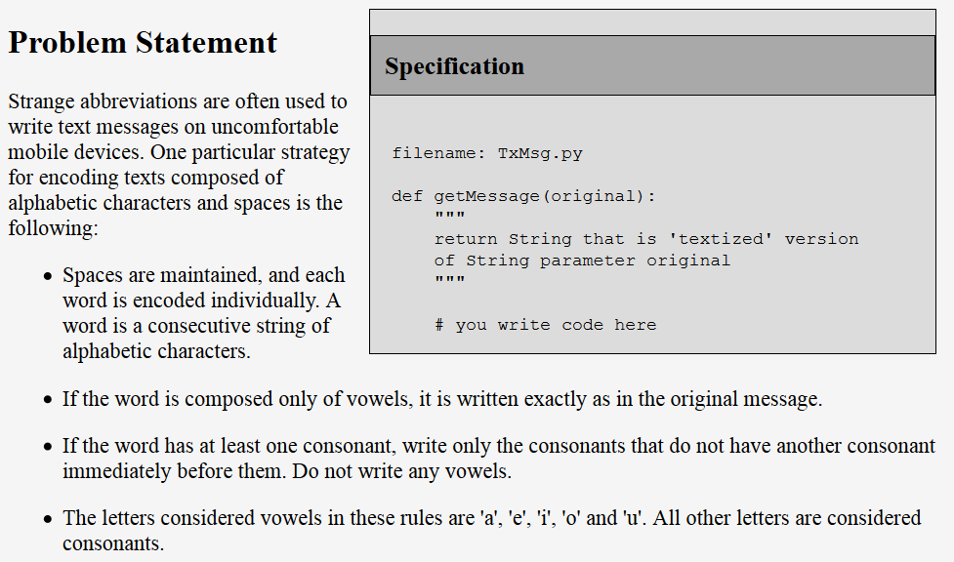
From APT 3 - TxMsg
http://www.cs.duke.edu/csed/pythonapt/txmsg.html

Slide 27
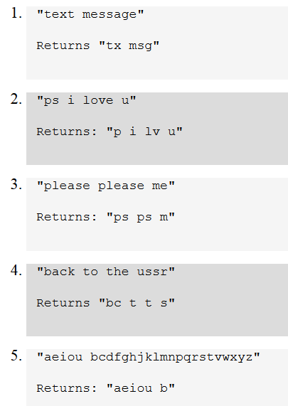
Examples
Do one by hand?
Explain to partner?
Identify Pythonic/programming challenges?

Slide 28
Debugging APTs: Going green
TxMsg APT: from ideas to code to green
What are the main parts of solving this problem?
Transform words in original string
Abstract that away at first
Finding words in original string
How do we do this?
def getMessage(original):
ret = ""
for word in :
ret = ret + " " + transform(word)
return ret #initial space?
original.split()
Notes:
Same idiom
Didn’t use join so you have an extra space,
Use join or strip, slide later also

Slide 29
Debugging APTs: Going green
TxMsg APT: from ideas to code to green
What are the main parts of solving this problem?
Transform words in original string
Abstract that away at first
Finding words in original string
How do we do this?
def getMessage(original):
ret = ""
for word in :
ret = ret + " " + transform(word)
return ret #initial space?
original.split()
Notes:
Same idiom
Didn’t use join so you have an extra space,
Use join or strip, slide later also

Slide 30
Why use helper function 'transform'?
Structure of code is easier to reason about
Harder to develop this way at the beginning
Similar to accumulate loop, build on what we know
We can debug pieces independently
What if transform returns "" for every string?
Can we test transform independently of getMessage?
Notes:
Make it look like something you know
Now solve txtmsg with code!!!!

Slide 31
Python via Problem Solving
In the loop for TxMsg we saw:
ret = ret + " " + transform(word)
- Why does this leave "extra" space at front?
- Eliminate with ret.strip()
Alternate: collect transform words in list, use join to return
Rather than construct string via accumulation and concatenation, construct list with append
Notes:
Use join here

