Slide 1
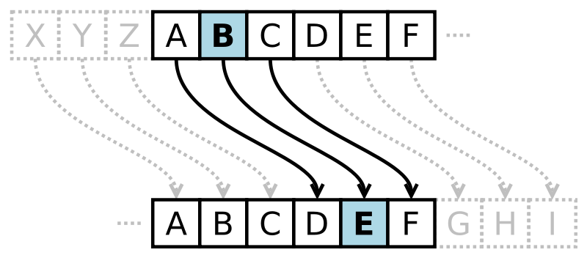
CompSci 101 Introduction to Computer Science
Sept. 27 , 2016
Prof. Rodger

Slide 2

Example – Software to Cheat (2015) http://www.bbc.com/news/business-34324772
If car.isDriving() or car.onRoad():
gofaster()
emit_more()
get_performance()
elif car.connectedToMonitor():
beclean()
register_as_wonderful()
else:
act_randomly()
engine_light_on()
Notes:
In 2015 VW was found to have written software in its cars to cheat on emissions testing whenever they were hooked up to a monitor, every time you hooked it up to a monitor – intentionally
Was in the news fall 2015

Slide 3
Announcements
No Reading or RQ until Oct 6
Assignment 4 due Thursday
APT 3 is due Today, no new APT out
APT Quiz 1
Exam 1 is Oct 4
Do practice Exam 1’s by Thursday
Will review next time
Today: problem solving with files
largest word in file, where is largest word

Slide 4
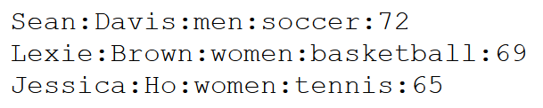
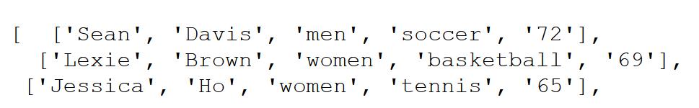
Lab this week….
Continue working with files, read file in once:
To this format:
Now ask many questions about the data…
Notes:
Read the file in once, now your file is in memory and can use the list of lists to ask lots of questions about it.
Sometimes the file is too big to read in but if it fits in memory read it all in and then work with it there.
First name, last name, gender, sport and height

Slide 5
Looping over and accumulating…
initialize
for variable in something:
ask question about variable?
accumulate
return answer
Loop over characters in strings, items in lists, lines in a file
Notes:
Given a problem – do need a loop or an if? If a loop, what do you want to loop over? Understand the accumulator pattern

Slide 6
Largest number in list bit.ly/101f16-0927-1
def biggest(numbers):
max = numbers[0]
for num in numbers:
if num > max:
max = num
return num
print biggest([8,3,9,1,5,7])
Returns 7? What is wrong?
Notes:
What is wrong?
Last line should be: return max

Slide 7
More on lists
range(5) is [0,1,2,3,4]
range(2,6) is [2, 3, 4, 5]
alist = [“a”, “b”, “d”, “c”]
for i in range(len(list)):
x = “ “.join(alist) # alist must be list of strings
y = list(“peach”)
Notes:
Range creates a list, use it with a for loop

Slide 8
Problem Solving
How do we count words in a file?
How do we find the length of the longest word?
wordsInFile.py
Notes:
Solve this one way, then have them answer questions on the next sheet

Slide 9
bit.ly/101f16-0927-2
Answer questions about computing the longest word in a file

Slide 10
More Problem Solving
How do we find the longest word?
How do we find where the longest word is?
Do we read a file into a list of words? A list of lines of words?

Slide 11
Reading from Files, Writing to Files
Programs generate data, store for access
Notes we take, notebooks we keep
Files we make our programs create and add to
File concepts for reading and writing
Call open with a path to file, how to open?
Choice of reading, writing, appending
Read or Write (depending on "r", "a", "w")
Close the file when done
Notes:
“a” – append to file
DON’t tell them on quiz - “w” – if already exists erases file and starts from scratch
Limit of how many files you can have open – so make sure you close the file – at scale matters

Slide 12
Reading from files: see Piglatin.py
Open file for reading
Read lines: for line in f:
Read file: st = f.read()
Both get strings, convert as needed
If fname not found?
Type of f?
Type of st?
def readFile(fname):
f = open(fname)
st = f.read()
f.close()
return st.split()
Notes:
First one reads from file line by line
f.read() – files as a string
Fname – program dies

Slide 13
Code in Piglatin.py
def writeFile(words, fname):
LINE_SIZE = 80
f = open(fname,"w")
wcount = 0
for word in words:
f.write(word)
wcount += len(word)
if wcount + 1 > LINE_SIZE:
f.write('\n')
wcount = 0
else:
f.write(' ')
f.close()
Notes:
Have any questions about any of this?

Slide 14
Questions: File writing and Transform
bit.ly/101f16-0927-3

Slide 15
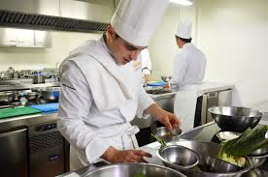

How to approach a 101 Assignment
Programming compared to Cooking
Follow a recipe to create {food or masterpiece}?
Understand the whole project before coding
Know at least a few steps before coding
Notes:
Chefs are also designing , you need to be able to
Biscuit recipe from grandmother
Coder vs programmer – want you to be creative

Slide 16
What do we learn from assignment?
We will snarf to get started
We will modify Piglatin.py
We will create CaesarCipher.py
We might want to use parts of Piglatin.py for CaesarCipher.py
Notes:
From the assignment page (READ)

Slide 17
What does Howto say about Piglatin.py
Lots of details on how to pigify a word
Ignore at first, make the structure of the program work
We have to write four functions
Details on function headers/prototypes given
Details on function functionality given
Types and values in main program
Work to understand the flow
Run the program, where do you start?
Notes:
What do you ignore at first

Slide 18
Making pigifyall work
Make sure you understand this
What do you need to do so this works?
What is header, signature, prototype: pigifyword
def pigifyall(st):
all = []
for word in st.split():
all.append(pigifyword(word))
return ' '.join(all)

Slide 19
Making pigifyword work
Once you know what pigifyword does, how do you implement it?
Review rules for piglatin
Review code for APT you hopefully did ☺
Don’t try to make every case work at once!
Start small and grow a working program.
How about first word is a vowel to begin …
Then add another case, …

Slide 20
If pigifyword is done … else …
Get to unpigifyall and unpigifyword
Which will be easy? Why?
Can you do one easy case in unpigifyword?
Why does it help to do one case at a time?
Builds confidence in reaching completion
Decreases time-to-completion: code works! Bugs easier to find.

Slide 21
In class Questions
bit.ly/101f16-0927-4

Slide 22
Cracking the Caesar Cipher
First create CaesarCipher.py
Where do you start?
What’s in the main program?
What’s copied from Pigify.py
What functions will you write first?
Where do you find this information?
What’s not clear about it?

Slide 23
Lots of details in making this work
How do you loop over characters in word?
Is there anything familiar here?
How do you know if a character is
Alphabetic?
Uppercase or lowercase?
A vowel or a consonant?
Once again: start simple, make something work, add functionality incrementally

Slide 24
How do you know encryption works?
Is this a chicken and egg question?
Could you write decrypt first?
Isn’t decrypting by eyeball decryption just encrypting 26 times?
14 Pljbqfjbp fq'p bxpv ql zlrkq colj 1-10, yrq klq xitxvp
15 Qmkcrgkcq gr'q cyqw rm amslr dpmk 1-10, zsr lmr yjuywq
16 Rnldshldr hs'r dzrx sn bntms eqnl 1-10, ats mns zkvzxr
17 Sometimes it's easy to count from 1-10, but not always
18 Tpnfujnft ju't fbtz up dpvou gspn 1-10, cvu opu bmxbzt
19 Uqogvkogu kv'u gcua vq eqwpv htqo 1-10, dwv pqv cnycau

Slide 25
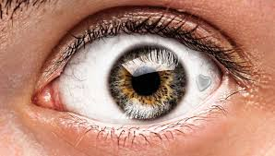
Can you call a function 26 times?
Encrypt using 26 shift keys and … eyeball!
Also write automatic decryption by determining which words are real words…
em = #encrypted message
for n in range(26):
sem = encrypt(em,n)
print n,sem
Notes:
If time back to apt txtmsg

Slide 26
What do you output for assignment 4?
Demonstrate with clear output that all parts of your program work.
See new statement in red on the bottom of the howto page.
Notes:
If time back to apt txtmsg

