Slide 1
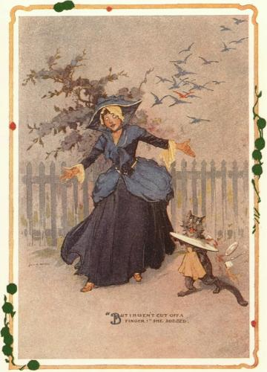
CompSci 101
Introduction to Computer Science
Sept 29, 2016
Prof. Rodger
“All your troubles are due to those ‘ifs’,”
declared the Wizard. If you were not a
Flutterbudget you wouldn’t worry.”
- The Emerald City of Oz by Frank Baum

Slide 2
Announcements
Test 1 is Tuesday!
  You must take the exam in your lecture section
  Accommodations for test 1? Must fill out form on website
See Regrades form on website
See all new Forms on website – main page
No labs next week
No consulting hours Tues-Thurs night
Exam 1 Review session – LSRC B101
  Sunday, 4:30-6pm

Slide 3
Exam logistics
Exam is in the regular classroom
Only need a pen or pencil
No scratch paper
Will give you a reference sheet of Python information with the test (see resources page)
Closed book, closed notes, closed neighbor
Covers lecture, lab and assigned reading, assgnmts, apts
Have put old quizzes back up as quiz review
  This is NOT for a grade, for studying only

Slide 4
The best way to study
Write code on paper!
Resources page has old tests and solutions
  Try writing code, then look at solutions
Rewrite an APT
Rewrite code we did in lecture
Rewrite code we did in lab

Slide 5
What we have not done
Test 1 from Fall 2014 on we have covered everything.
If looking at old exams, note we have not done the following:
  List comprehensions
  Code in square brackets such as
  y = [w for w in alist]
  There may be other things…. If it looks strange, it might be we haven’t done it….

Slide 6
Understand
What is the difference between:
  [ ] and ( )
  w = and w +=
  print value and assigning value to a variable
  print and return
  When do you print? When do you return?
  Does a function print or return?
if, for, range, strings, lists
  Understand format and how they work
Parameters vs arguments

Slide 7
Writing functions with formulae
bit.ly/101f16-0929-1

Slide 8
Writing functions with formulae
Using extra variables: can be really smart
  Helps in making each line simple
  Easy to correct if you've made a mistake
See triangleArea, what about other math symbols and formula?
  What do +, -, *, /, % do?
  What about math.sqrt or 5**0.5 or math.sin …

Slide 9
Accumulating in a loop
If you are going to return a string
  Initialization, return value, how to "build it"
If you are going to return an int (counter)
  Initialization, return value, how to "build it"
If you are going to return a list
  Initialization, return value, how to "build it"

Slide 10
Counting 'a's in a string, 'fox' in a list?
What Python functions/methods help
  If you forget, how can you recreate yourself?
  See exam Python reference sheet

Slide 11
Basic List/file Processing
bit.ly/101f16-0929-3
Notes:
Problem from Fall 2011

Slide 12
Review Old Exam Questions

