Slide 1
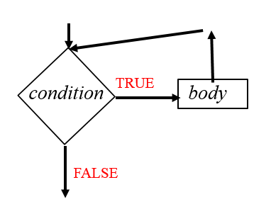
CompSci 101 Introduction to Computer Science
Oct 6, 2016
Prof. Rodger
Notes:
This lecture was 5 to 10 minutes short

Slide 2
Announcements
Reading and RQ due next time
APT 4 out today, due Oct 18
Do not discuss exam1 with anyone until it is handed back, likely after fall break
No Lab this week or next week
Today:
Loops – While, While True
Problem Solving

Slide 3

Developing an Algorithm
http://www.youtube.com/watch?v=AEBbsZK39es
$193, $540, $820, $700, $749. Are these reasonable? Why?
Notes:
This is the price is right game where you bid to try to guess the price of an item and you get several tries.
Play the video
Are these numbers reasonable? Poll the class

Slide 4
I'm thinking of a number …
You guess. I'll tell you high, low, or correct
Goal: guess quickly, minimal number of guesses
Number between 1 and 100…
Number between 1 and 1000…
Can you describe an algorithm, instructions, that would allow someone to use your instructions to play this game correctly. Start with 1 and 100, but ideally your instructions work with 1 and N
bit.ly/101f16-1006-1
Notes:
Ask for a volunteer
What is the best first guess? Second guess

Slide 5
Analyzing the binary search algorithm
Is the algorithm correct?
Try it, again, and again and …
Reason about it: logically, informally, …
How efficient is the algorithm?
How many guesses will it take (roughly, exactly)
Should we care about efficiency?
When do we really care about efficiency?
Examples?
Notes:
Algorithm correct? Can you try all possible data? Too much!
Why does google care about efficiency, and what does "efficient" mean? Searching billions of webpages in no time, making the user think it's no time, even when it is, e.g., auto-complete search query and scrolling google maps. Sometimes about algorithm and sometimes about user experience and making the web more efficient
Also efficiency of the user experience

Slide 6
Anderson
Applegate
Bethune
Brooks
Carter
Douglas
Edwards
Franklin
Griffin
Holhouser
Jefferson
Klatchy
Morgan
Munson
Narten
Oliver
Parker
Rivers
Roberts
Stevenson
Thomas
Wilson
Woodrow
Yarbrow
Find Narten
Notes:
The magenta/purple shows where Narten could be. After each guess, roughly in the middle, we eliminate half of the names from being the range
Of names in which Narten could be. So how many times can we cut the range in half?

Slide 7
Anderson
Applegate
Bethune
Brooks
Carter
Douglas
Edwards
Franklin
Griffin
Holhouser
Jefferson
Klatchy
Morgan
Munson
Narten
Oliver
Parker
Rivers
Roberts
Stevenson
Thomas
Wilson
Woodrow
Yarbrow
Find Narten
FOUND!
Notes:
The magenta/purple shows where Narten could be. After each guess, roughly in the middle, we eliminate half of the names from being the range
Of names in which Narten could be. So how many times can we cut the range in half?

Slide 8
Looking for a Needle in a Haystack
If a computer can examine 10 million names/numbers a second, suppose the list isn't sorted, or I say "yes/no", not "high/low"
How long to search a list of 10 million?
How long to search a list of a billion?
14 billion pixels in a 2 hour blu-ray movie
What about using binary search? How many guesses for 1000, 10⁶, 10^{9,} 10¹²
One of the things to remember: 2¹⁰ = 1024
Notes:
1 sec – 10 million
100 sec – billion – 2 min
14 billion pixels in 2 hour blu-ray movie
– days to render a movie
Faster
1000 – 10
10^6 – 20
10^9 – 30
10^12 - 40

Slide 9
Review - Searching for words
If we had a million words in alphabetical order, how many would we need to look at worst case to find a word?
If you are clever, cut the number of numbers to look
at in half, over and over again
Notes:
If you are clever, you only have to look at a few word!

Slide 10
Review - Searching for words
If we had a million words in alphabetical order, how many would we need to look at worst case to find a word?
20 words!
1,000,000
500,000
250,000
125,000
62,500
31,250
15,620
7812.5
3906
1953
976.56
488
244
122
61
30
15
7.5
3.75
1.875
If you are clever, cut the number of numbers to look
at in half, over and over again
Notes:
If you are clever, you only have to look at a few word!

Slide 11
Is number a Prime number? Bit.ly/101f16-1006-2
def isPrime(number):
if number<4:
return True
for n in range(4,number):
if number/n * n == number:
return False
return True
Notes:
Run this one

Slide 12
While loops
Repetition when you stop a loop based on a condition
while CONDITION:
BODY
As long as condition is true, keep executing loop.
Must have an update in the body to get closer to condition being false

Slide 13
Examples for while
Playing chess
while (game not over)
play game
(game must get closer to ending)
Finding the 100th prime

Slide 14
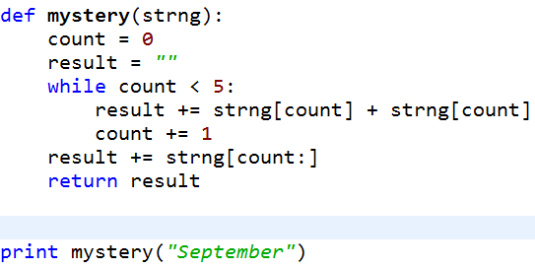
Mystery While example
bit.ly/101f16-1006-3
Notes:
Where is the update? What does this do?

Slide 15
Problem: Given a number, want the largest list of unique digits from 1 to x whose sum is less than or equal to the number
Given 5
Answer is 1 + 2 , list [1,2]
Given 6
Answer is 1+2+3, list [1,2,3]

Slide 16
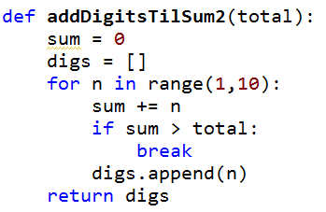
bit.ly/101f16-1006-4

Slide 17
Looping with while – not sure when to stop
Playing chess
Determining the 100th prime number
Another way – while True
Must have ways to break out of infinite loop
Must have update – gets closer to ending

Slide 18
while condition vs while True
while condition: while True:
body body
continue if condition:
break
continue
While condition is true - must update
- must get closer to making condition false
- use break to exit

Slide 19
While True
initialize
while True:
if something:
break
if something2:
update
update
Continue or return

Slide 20
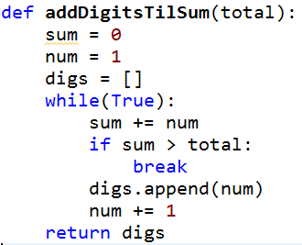
Revisit addDigitsTilSum bit.ly/101f16-1006-5

Slide 21
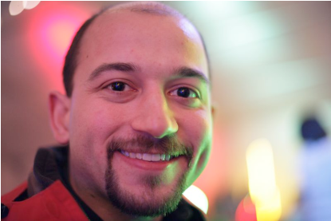
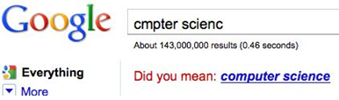
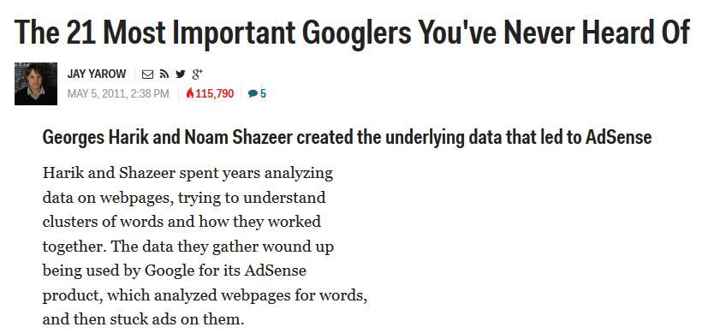
Computer Science Duke Alum
Notes:
Noam Shazeer (works at google, sat in the front row in B101 in CompSci 101!)

Slide 22
condition body
TRUE
FALSE

