Slide 1
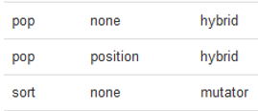
CompSci 101 Introduction to Computer Science
Oct 13, 2016
Prof. Rodger

Slide 2
Announcements
Reading and RQ 11 due next time
APT 4 is due on Tuesday
Today:
A different way to process elements
List comprehension
Coming – more ways to process data
Exam 1 back
Rodger extra office hours today 3-5:30pm

Slide 3
Giving Back Exam 1… on Gradescope
Solutions posted – regrades til Oct 21.
Ask for regrade on gradescope
Try working problem you missed first
Then look at solution
Once you think you understand
Get blank sheet of paper – try again
Understand all solutions

Slide 4
Exam 1 scores
90
89 89 89 89 89 89 89 89 89 89 89 89 89 89 89
88 88 88 88 88 88 88 88 88 88 88 88 88 88 88 88 88 88 88 88
87 87 87 87 87 87 87 87 87 87 87 87 87 87 87
86 86 86 86 86 86 86 86 86 86 86 86 86 86 86 86 86 86
85 85 85 85 85 85 85 85 85 85 85 85 85 85 85 85 85 85 85 85 85 85 85
84 84 84 84 84 84 84 84 84 84 84 84 84 84 84 84
83 83 83 83 83 83 83 83 83 83 83 83 83 83 83 83 83 83 83
82 82 82 82 82 82 82 82 82 82 82 82 82 82 82 82 82 82 82 82 82
81 81 81 81 81 81 81 81 81 81 81 81 81 81 81 81
80 80 80 80 80 80 80 80 80 80 80 80 80 80 80 80 80 80 80 80 80
79 79 79 79 79 79 79 79 79
78 78 78 78 78 78 78
77 77 77 77 77 77 77 77
76 76 76 76 76 76 76 76 76 76
75 75 75 75 75 75 75 75 75
74 74 74 74
73 73 73 73 73 73 73
72 72 72 72 72
71 71 71 71 71 71 71 71
70 70 70
69 69 69 69
68 68 68 68 68 68 68
67 67 67 67 67 67 67 67
66 66 66
65 65 65 65
64 64 64 64 64
63 63 63
62 62
61 61 61 61 61
60 60 60 60 60 60
59 59
58 58 58 58
57
56 56 56 56
54 54
53 53
51 51
50
49
48
47
46
45 45 45
43
42
41 41
40
39 39 39
38
36
35
34
31
29
28
25
22

Slide 5
Exam 1 scores
90
89 89 89 89 89 89 89 89 89 89 89 89 89 89 89
88 88 88 88 88 88 88 88 88 88 88 88 88 88 88 88 88 88 88 88
87 87 87 87 87 87 87 87 87 87 87 87 87 87 87
86 86 86 86 86 86 86 86 86 86 86 86 86 86 86 86 86 86
85 85 85 85 85 85 85 85 85 85 85 85 85 85 85 85 85 85 85 85 85 85 85
84 84 84 84 84 84 84 84 84 84 84 84 84 84 84 84
83 83 83 83 83 83 83 83 83 83 83 83 83 83 83 83 83 83 83
82 82 82 82 82 82 82 82 82 82 82 82 82 82 82 82 82 82 82 82 82
81 81 81 81 81 81 81 81 81 81 81 81 81 81 81 81
80 80 80 80 80 80 80 80 80 80 80 80 80 80 80 80 80 80 80 80 80
79 79 79 79 79 79 79 79 79
78 78 78 78 78 78 78
77 77 77 77 77 77 77 77
76 76 76 76 76 76 76 76 76 76
75 75 75 75 75 75 75 75 75
74 74 74 74
73 73 73 73 73 73 73
72 72 72 72 72
71 71 71 71 71 71 71 71
70 70 70
69 69 69 69
68 68 68 68 68 68 68
67 67 67 67 67 67 67 67
66 66 66
65 65 65 65
64 64 64 64 64
63 63 63
62 62
61 61 61 61 61
60 60 60 60 60 60
59 59
58 58 58 58
} Wow
} Yes
57
56 56 56 56
54 54
53 53
51 51
50
49
48
47
46
45 45 45
43
42
41 41
40
39 39 39
38
36
35
34
31
29
28
25
22
} ok
Get a tutor -
Understand when you get help

Slide 6


Slide 7
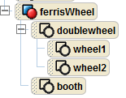
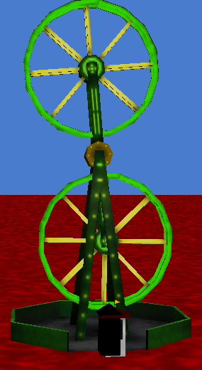
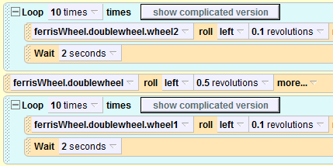
Alice programming language alice.org, Alice version 2.4
Notes:
See folder AliceDemos/TheFair/ for Alice Worlds

Slide 8
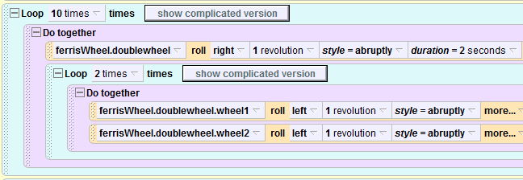
Nested Loop

Slide 9
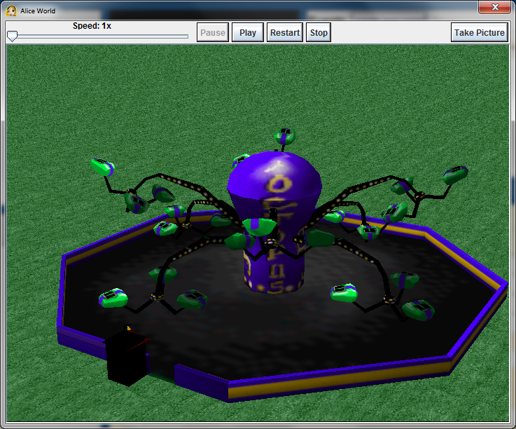
Fair Ride – Octopus

Slide 10
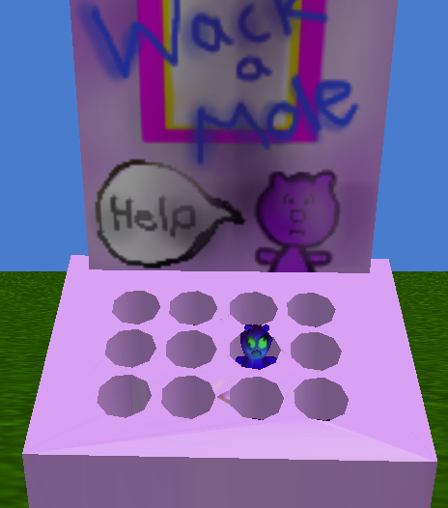
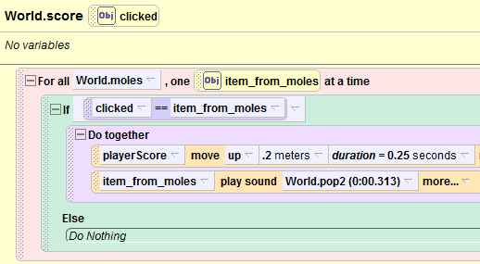

Wac-A-Mole
Notes:
How is wac a mole implemented? A list of moles, go through and check if what you clicked on is in the list

Slide 11
Problem: Find the first duplicate adjacent words in a phrase
“Did I make make a mistake in in this?”
Convert to list
Answer is 2, (start counting at 0)
Notes:
make make

Slide 12
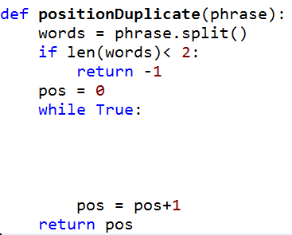
Bit.ly/101f16-1013-A

Slide 13
APTs solved in a similar way
NameGroup
Pikachu

Slide 14
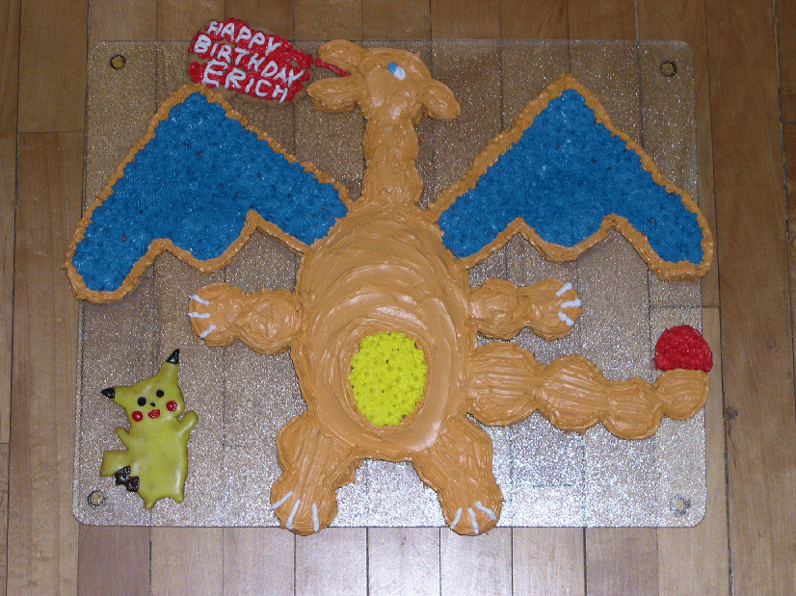
APTs solved in a similar way
NameGroup
Pikachu

Slide 15
Creating a list
Given a list of numbers, create a second list of every number squared.
nums = [8, 3, 5, 4, 1]
sqnums = []
for v in nums:
sqnums.append(v*v)
print sqnums
[64, 9, 25, 16, 1]
Notes:
Talk about append. It modifies the list. Note there is not a return value.
Also note that it is a function that is applied to the list – notice the dot
Nameoflist.function
We have functions

Slide 16
More on List operations
Previous page
nameOfList “dot” function (parameter)
sqnums.append(v*v)
See list operations on next page
Mutator vs hybrid vs return
Mutator changes the list (no return value)
Hybrid changes list and returns value
Return – returns value, no change to list

Slide 17
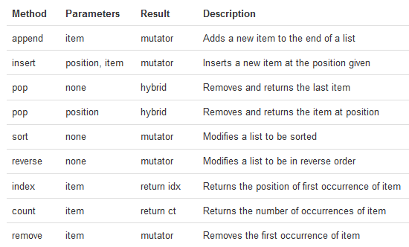
List operations from book

Slide 18
Problem
Remove all negative numbers from list
[4, -2, 5, 6, -3] → [4, 5, 6]
Two ways
1) return a new list with all negative numbers removed
2) Modify a list to remove negative numbers

Slide 19
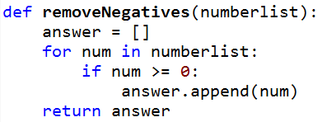
www.bit.ly/101f16-1013-2
somenums = [3, -1, 8, -5, -2, 6, 7]
nonegs = removeNegatives(somenums)

Slide 20
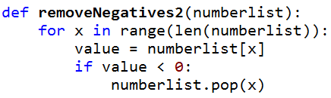
www.bit.ly/101f16-1013-3
somenums = [3, -1, 8, -5, -2, 6, 7]
removeNegatives2(somenums)

Slide 21
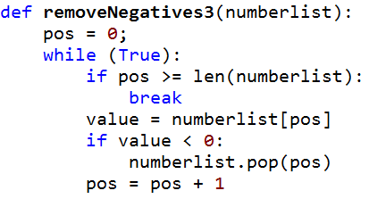
www.bit.ly/101f16-1013-4
somenums = [3, -1, 8, -5, -2, 6, 7]
removeNegatives3(somenums)

