Slide 1

CompSci 101
Introduction to Computer Science
Oct 18, 2016
Prof. Rodger

Slide 2
Announcements
Reading and RQ due next time
Assignment 5 out today
APT 4 due today, APT 5 out
Lab 6 this week
  Read APT Anagramfree and Assignment 5 before going to lab!
Today:
  Focus on problem solving with sets, list comprehensions

Slide 3

Richard Stallman
MacArthur Fellowship (Genious grant)
ACM Grace Murray Hopper award
Started GNU – Free Software Foundation (1983)
  GNU Compiler Collection
  GNU Emacs
a
Notes:
Lived in his office at MIT until 1998
Came to Duke in 1997 – brought three people with him including a film maker

Slide 4
Solving problems –
APT MorseLikeCode
Compare find vs index
  find with string – returns -1 when not found
  index with list – CRASHES if not there!
  You can’t say: pos = alist.index(“…”)
  Instead: if “…” in alist:
  pos = alist.index(“…”)
How to get started?
Notes:
What do you do instead? If “…” in alist, then set pos
Started? Consider writing a function helper

Slide 5
List Comprehension
Take advantage of patterns, make a new list based on per element calculations of another list
Format:
[<expression with variable> for <variable> in <old list>]
Example:
nums = [8, 3, 5, 4, 1]
sqnums = [v*v for v in nums]

Slide 6
These result in the same list!
nums = [8, 3, 5, 4, 1]
sqnums = []
for v in nums:
sqnums.append(v*v)
sqnums = [v*v for v in nums]
1)
2)
Notes:
Short cut!

Slide 7
Examples of List Comprehensions bit.ly/101f16-1018-1
nums = [4, 3, 8]
[v for v in nums]
[2 for v in nums]
sum([v*2 for v in nums])
[v+5 for v in nums][1]

Slide 8
Creating a list with just the even numbers
nums = [8, 3, 5, 4, 1]
evennums = []
for v in nums:
if v % 2 == 0:
evennums.append(v)
print evennums
[8, 4]

Slide 9
List Comprehension with Filtering
Create list and use “if” to filter out elements to the list
Format:
[<expression with variable> for <variable> in <old list> if <filter with variable> ]
Example: nums = [8, 3, 5, 4, 1]
evennums =
[v for v in nums if v%2==0]
Notes:
Same thing as before

Slide 10
More on List Comprehensions www.bit.ly/101f16-1018-2
names = [“Bo”, “Moe”, “Mary”, “Aaron”, “Joe”]
What is the list for the following:
1) [w for w in names if w.endswith(“e”)]
2) [w for w in names if w.lower()[0] > ‘c’]
3) [j+1 for j in range(20) if (j%3) == 0]
4) [i*2 for i in [j+1 for j in range(20)
if (j%3) == 0] if i*i > 19]

Slide 11
More on List Comprehensions bit.ly/101sp16-1018-3
Problem: Given a list of strings, return the longest string. If there are more than one of that length, return the first such one.
[‘kiwi’, ‘plum’, ‘orange’, ‘lemon’, ‘banana’]
Write a list comprehension for this problem
Notes:
Answer below
[w for w in words if len(w) == max([len(x) for x in words])][0]

Slide 12
Python Sets
Set – unordered collection of distinct items
  Unordered – can look at them one at a time, but cannot count on any order
  Distinct - one copy of each
Operations on sets:
  Modify: add, clear, remove
  Create a new set: difference(-), intersection(&), union (|), symmetric_difference(^)
  Boolean: issubset <=, issuperset >=
Can convert list to set, set to list
  Great to get rid of duplicates in a list

Slide 13
List vs Set
List
  Ordered, 3rd item, can have duplicates
  Example: [ 4, 6, 2, 4, 5, 2, 4]
Set
  No duplicates, no ordering
  Example:
Both
  Add, remove elements
  Iterate over all elements
6
2
5
4
Notes:
With a list you can tell the ith item, they are ordered. You can have duplicates.
Can add elements to both, you can iterate over all elements in both

Slide 14
Summary (from wikibooks)
set1 = set() # A new empty set
set1.add("cat") # Add a single member
set1.update(["dog", "mouse"]) # Add several members
set1.remove("cat“) # Remove a member - error if not there
print set1
for item in set1: # Iteration or “for each element”
print item
print "Item count:", len(set1) # Length, size, item count
isempty = len(set1) == 0 # Test for emptiness
set1 = set(["cat", "dog"]) # Initialize set from a list
set3 = set1 & set2 # Intersection
set4 = set1 | set2 # Union
set5 = set1 - set3 # Set difference
set6 = set1 ^ set2 # Symmetric difference (elements in either set but not both)
issubset = set1 <= set2 # Subset test
issuperset = set1 >= set2 # Superset test
set7 = set1.copy() # A shallow copy (copies the set, not the elements)
set8.clear() # Clear, empty, erase

Slide 15
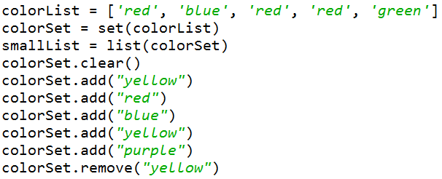
Creating and changing a set

Slide 16
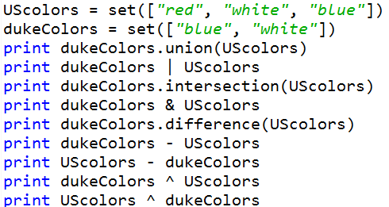
Set Operations

Slide 17
Set Examples bit.ly/101f16-1018-4
poloClub = set(['Mary', 'Laura', 'Dell'])
rugbyClub = set(['Fred', 'Sue', 'Mary'])
Questions:
print [w for w in poloClub.intersection(rugbyClub)]
print poloClub.intersection(rugbyClub)
print [w for w in poloClub.union(rugbyClub)]
print poloClub.union(rugbyClub)

Slide 18
Set Examples (cont)
lista = ['apple', 'pear', 'fig', 'orange', 'strawberry']
listb = ['pear', 'lemon', 'grapefruit', 'orange']
listc = [x for x in lista if x in listb]
listd = list(set(lista)|set(listb))

Slide 19
Assignment 5 - Hangman
Guess a word given the number of letters.
  Guess a letter
  see if it is in the word and where.
Demo
Will start in lab

Slide 20
APT AnagramFree
words = ["creation","sentence","reaction","sneak","star","rats","snake"]
Returns: 4
“star” “rats” → both have letters: a r t s
“snake” “sneak”
“creation” “reaction”
“sentence”

Slide 21
Problem
Given two books:
  How many words in each book?
  How many unique words in each book?
  What words that start with “r” are in one book and not the other book?

Slide 22
Process Exam Scores bit.ly/101f16-1018-5
Calculate
  total number of scores
  Average score
  Median score
Print a visualization of the grades
Get snarf file

