Slide 1
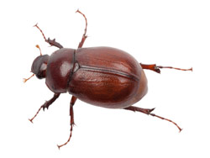
CompSci 101 Introduction to Computer Science
Oct 20, 2016
Prof. Rodger
Lecture by Barrett Ames

Slide 2
Announcements
Reading and RQ due next time
Assignment 5 due in one week
APT 5 due Tuesday
Today:
Debugging
APT SandwichBar

Slide 3
Process Exam Scores bit.ly/101f16-1018-5
Calculate
total number of scores
Average score
Median score
Print a visualization of the grades
Get snarf file

Slide 4
Problem 1: Set Examples bit.ly/101f16-1020-1
s = set(lista)
t = set(listb)
problem1 = (s-t) | (t-s)
print problem1
problem2 = (s|t) - (s&t)
print problem2
problem3 = (s|t|(s&t))
print problem3
lista = ['apple', 'pear', 'fig', 'orange', 'strawberry']
listb = ['pear', 'lemon', 'grapefruit', 'orange']
Notes:
Review sets

Slide 5
Debugging Problems
Today the focus is on debugging.
There are several problems. Trace by hand to see if you can figure out if they are correct or not, or what to do to correct them.
Enter your answers on the google form

Slide 6
Debug 1 – Does it work? bit.ly/101f16-1020-2
The function sizes has a parameter named words that is a list of strings. This function returns a list of the sizes of each string. For example, sizes(['This', 'is', 'a', 'test']) should return the list
[4, 2, 1, 4]
def sizes(words):
nums = [ ]
for w in words:
nums = len(w)
return nums

Slide 7
Debug 2 – Does it work? Bit.ly/101f16-1020-3
The function buildword has a parameter words that is a list of strings. This function returns a string that is made up of the first character from each word in the list. For example, buildword(['This', 'is', 'a', 'test']) returns 'Tiat'
def buildword(words):
answer = ''
for w in words:
answer += w[:1]
return answer

Slide 8
Debug 3 – Does it work? Bit.ly/101f16-1020-4
The function middle has a parameter names that is a list of strings, which each string is in the format "firstname:middlename:lastname". This function returns a list of strings of the middlenames.
def middle(names):
middlelist = []
for name in names: name.split(":") middlelist.append(name[1]) return middlelist

Slide 9
Debug 4 – Does it work? Bit.ly/101f16-1020-5
The function removeOs has one string parameter named names. This function returns a string equal to names but with all the lowercase o's removed.
def removeOs(word):
position = word.find("o")
while position != -1:
word = word[:position] + word[position+1:]
return word

Slide 10
Problem 5 – Does it work? Bit.ly/101f16-1020-6
The function uniqueDigits has one int parameter number. This function returns the number of unique digits in number. If the number is 456655, then it returns 3.
def uniqueDigits(number)
digits = [ ]
while number > 0:
digits.append(number % 10)
number = number / 10
return len(digits)

Slide 11
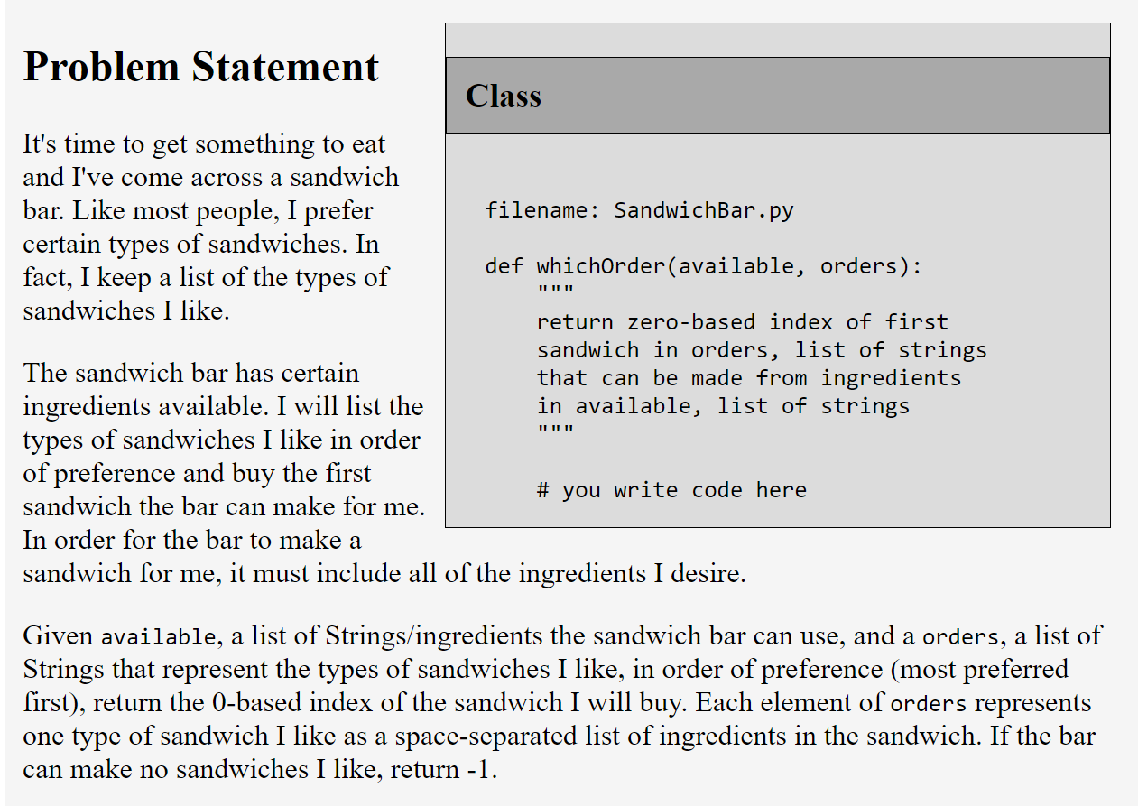
APT SandwichBar

Slide 12
APT SandwichBar
Example:
[ "cheese", "cheese", "cheese", "tomato" ]
[ "ham ham ham", "water", "pork", "bread", "cheese tomato cheese", "beef" ]
Returns: 4
Notes:
Solve APT Sandwichbar with feedback from them, use sets

