Slide 1

CompSci 101
Introduction to Computer Science
Oct. 25 , 2016
Prof. Rodger
Notes:
Too many slides on image part – condense
See slides for next lecture where I redid one of these slides

Slide 2
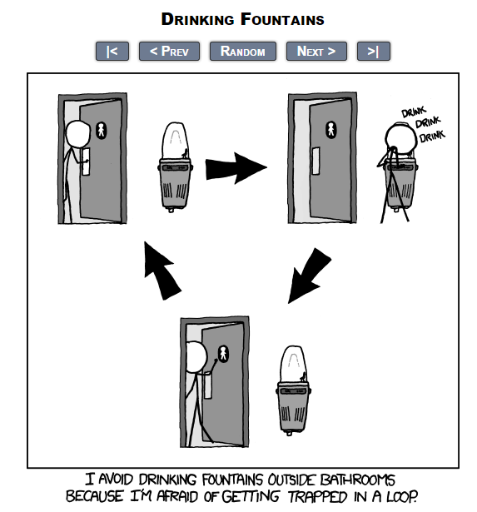
fromxkcd

Slide 3
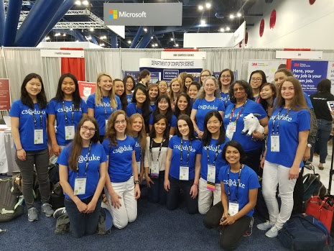
Grace Hopper Celebration of Women in Computing Conference

Slide 4
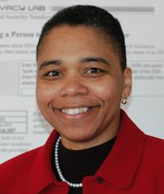
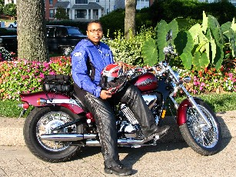
Latanya Sweeney
Chief Technologist at FTC. I am a computer scientist with a long history of weaving technology and policy together to remove stakeholder barriers to technology adoption. My focus is on "computational policy" and I term myself a "computer (cross) policy" scientist. I have enjoyed success at creating technology that weaves with policy to resolve real-world technology-privacy clashes.
http://latanyasweeney.org/
Identify 87% of US population using (dob,zip,gender). Director of Harvard Data Privacy Lab, instrumental in HIPAA because of de-identification work
Notes:
Keynote Speaker at GHC 2016

Slide 5
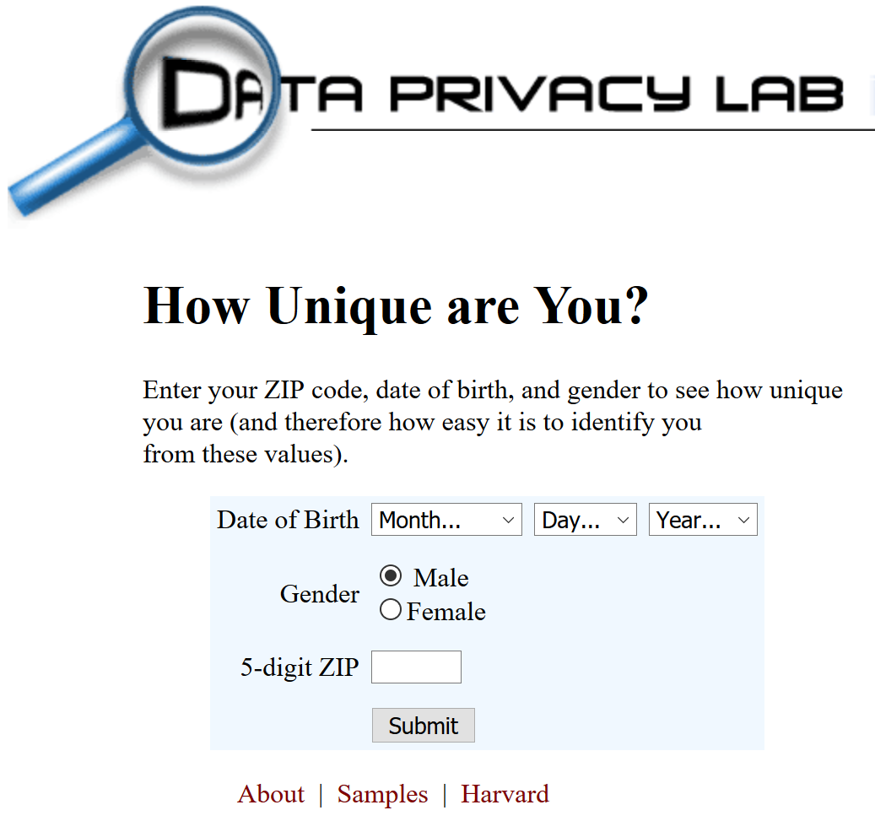
aboutmyinfo.org
Entered my data
Easily identifiable by birth date (about 1)
Lots with my birth year (about 273)
Lots of people in my age range (of four years) – (1365)
Notes:
One of her sites

Slide 6
aboutmyinfo.org
Entered my data
Easily identifiable by birth date (about 1)
Lots with my birth year (about 273)
Lots of people in my age range (of four years) – (1,365)
Notes:
One of her sites

Slide 7
Announcements
Reading and RQ14 due next time
Assignment 5 due Thursday
APT 5 due today, APT 6 out
This week:
  Nested loops, tuples, images and more with sets

Slide 8
Problem: Given list of words, find word with most vowels
Example:
  Given [‘dog’, ‘cat’, ‘gerbil’, ‘elephant’]
  ‘elephant’ has 3 vowels, the most
To solve – nested loops:
  Loop over words in list
    For each word: Loop over characters in word

Slide 9
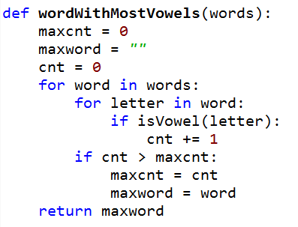
Bit.ly/101f16-1025-1
a
Notes:
Point out nested loops
Doesn’t work, what is wrong?

Slide 10
Problem 2 – Given two lists of names, print a list of pairs of names in which the two names are the same length
A = [‘mo’,’ted’,’bill’]
B = [‘billie’, ‘jes’, ‘bo’]
To solve
  for name in A:
  for name in B: Check length
  print pair
mo, bo
ted jes

Slide 11
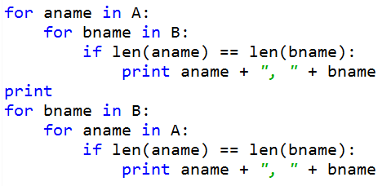
bitly/101f16-1025-2
a

Slide 12
Tuples
Like a list, but cannot change them
  Define them with “,”
  (5, 7, 8) or 5, 7, 8
Use most list operations on them
  they are a type of list
  But immutable
Examples
Notes:
Could use an activity on tuples?

Slide 13
Example
print z
z[0][1] = 12
print z
z[0].append(4)
print z
z[0].remove(5)
z[0].remove(12)
z[0].remove(4)
print z
x = (4, 6, 8)
y = 9, 5, 6
print x
print y
print x[1]
print y[1]
y[0] = 2
z = ([5,6], [7,8])
Notes:
These are for the console only
Also v,w = 8, 3

Slide 14
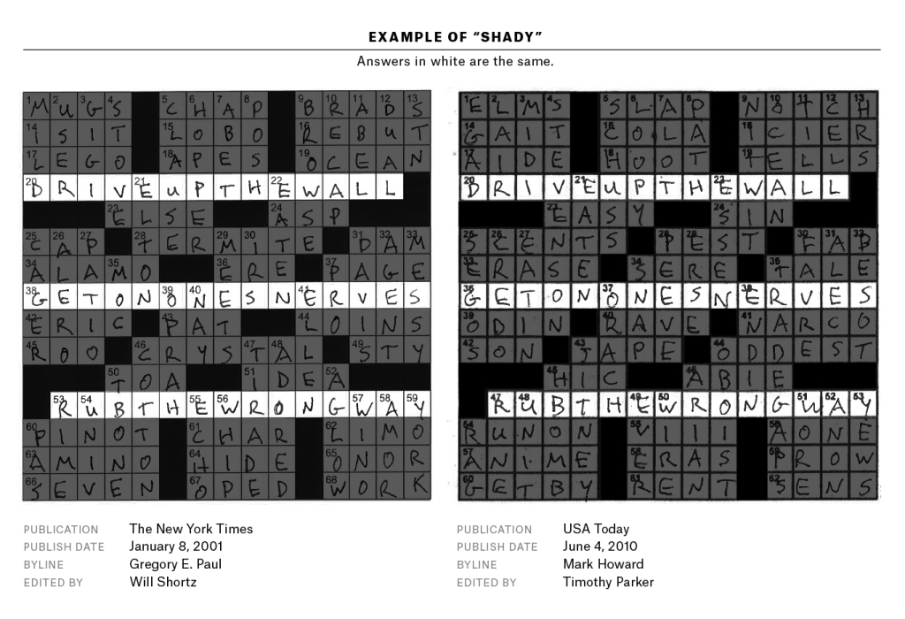
Crossword Plagiarism bit.ly/crossword-0308 - from fivethirtyeight.com
Notes:
March 4, 2016
Database of tens of thousands of puzzles and someone wrote a program to compare puzzles and create a similarity score

Slide 15
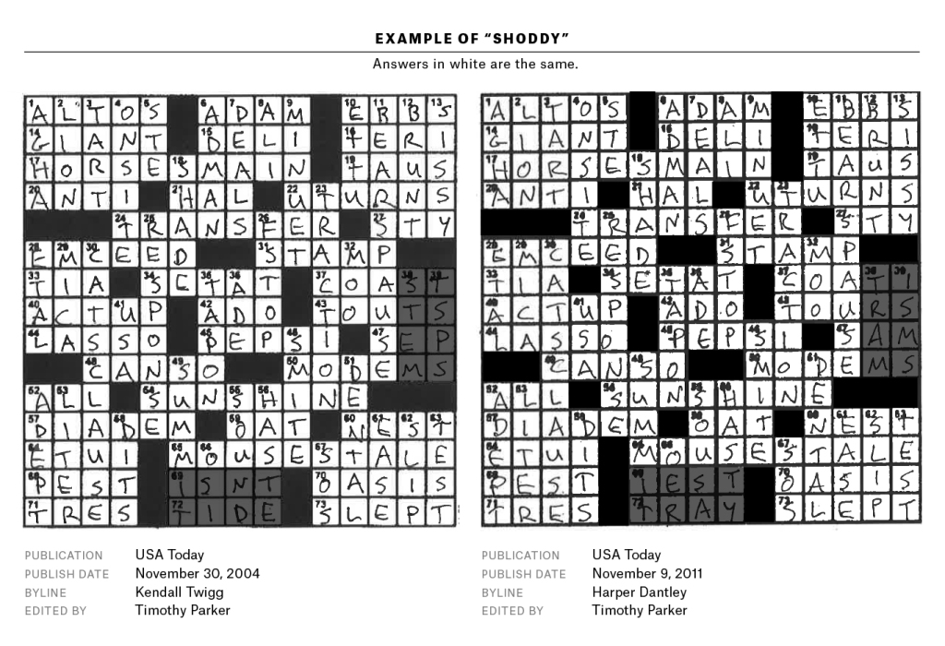
Crossword Plagiarism

Slide 16
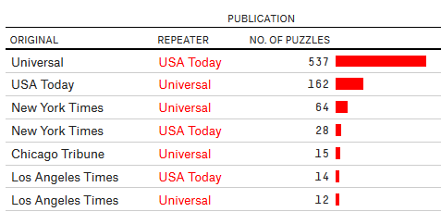
Puzzles with at least 25% similarity to previous puzzle since May 2003
Notes:
Since May 19 2003

Slide 17
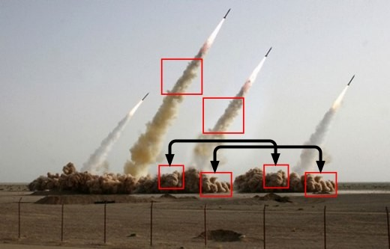
Image Processing
What's real, what's Photoshopped
  http://bit.ly/1Kj0Kn6 from 2008
  Learn more at http://bit.ly/1Psi0hG, we'll do very basic stuff in class and lab, next assignment too!
Notes:
Now we'll use image processing as an area of research and practice to illustrate python concepts; tuples in detail, generators in passing
Iranian government in 2008 to show off their new missiles, One must have failed because the second from the right is clearly photoshopped into the picture.

Slide 18
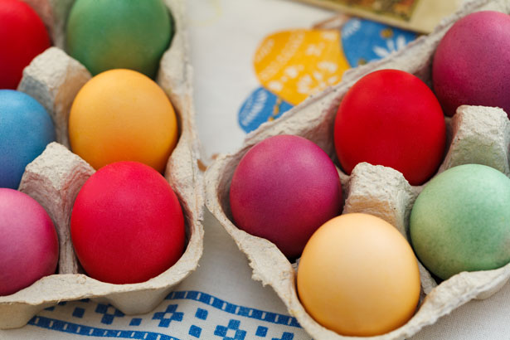
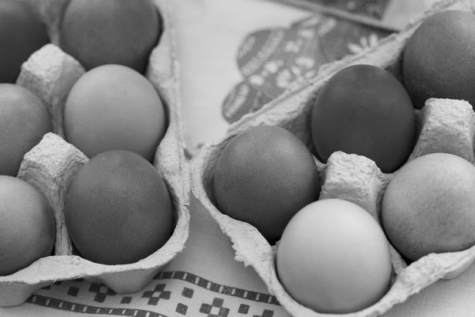
Example: convert color to gray scale
Process each pixel
Convert to gray
Notes:
We'll see this example and go over it in detail in class today

Slide 19

Example: convert blue to green
Process each pixel
Convert blue ones to green
Is this like red-eye removal?
Notes:
We'll see this example on Thursday, but it's almost doable today with time

Slide 20
Need new concepts and Image library
Red, Green, Blue color model
  Triples of (R,G,B) are processed as Python tuples.
  Let's study tuples!
Images can be very big, what's 4K display?
  4,096 x 2,160 = 8,847,360 pixels, 8Mb at least
  Creating huge lists takes up memory
  Sometimes only need one pixel at-a-time
  Let's study generators!
Notes:
Show colorpicker –
Introducing tuples and generators --- two Python concepts in the context of doing image processing This page describes the ideas in general, motivating understanding python concepts in the context of image processing

Slide 21
Need new concepts and Image library
Red, Green, Blue color model
  Additive model, each pixel specified by (r,g,b) triple, values of each between 0-255
  https://en.wikipedia.org/wiki/RGB_color_model
  White is (255,255,255) and Black is (0,0,0)
Images stored as sequence of (r,g,b) tuples, typically with more data/information too
  256 values, represented as 8 bits, 2⁸ = 256
  32 bits per pixel (with alpha channel)
  In Python we can largely ignore these details!
Notes:
Some details on (RGB). Highlight 2^8 is 256 values that are in range 0..255.
8 bits for each of r g and b, 8 bits for alpha
Alpha represents the opacity of the object

Slide 22
Image library: Two ways to get pixels
Each pixel is a tuple in both models
  Like a list, indexable, but immutable
  pix = (255,0,0)
    What is pix?, pix[0]? What is pix[5]?
Invert a pixel: by subscript or named tuple
  Access by assignment to variables!
npx = (255-pix[0],255-pix[1],255-pix[2])
(r,g,b) = pix
npx = (255-r,255-g,255-b)
Notes:
Use python console to show tuples
Try to do this pix = (0,1,2)
pix[0] = 255 XXXXXXX, immutable

Slide 23
Let's look at GrayScale.py
Key features we see
  Import Image library, use API by example
  Image.open creates an image object
Image functions for Image object im
  im.show(),displays image on screen
  im.save("xy"), saves with filename
  im.copy(), returns image that's a copy
  im.load(),[x,y] indexable pixel collection
  im.getdata(),iterable pixel collection
Let's look at two ways to process pixels!
Notes:
Look at GrayScale.py, run it, highlight the lines in each function and explain what they do. How to modify the code there to invert an image? That is, 255-x for x each of r,g,b. DO this for grayit2, lead class through discussion about copying fucntion, and making invert fucntion called in list comprehension
API – Application program interface

Slide 24
Image Library: open, modify, save
Image.open can open most image files
  .png, .jpg, .gif, and more
  Returns an image object, so store in variable of type Image instance
  Get pixels with im.getdata()or im.load()
Image.new can create a new image, specify color model "RGB" and size of image
  Add pixels with im.putdata()
These belong to Image package
Notes:
New image is blank ,you need to call putdata with a list of pixels to fill the image

Slide 25
im.getdata(), accessing pixels
Returns something like a list
  Use: for pix in im.getdata():
  Generates pixels on-the-fly, can't slice or index unless you use list(im.getdata())
  Structure is called a Python generator!
  Saves on storing all pixels in memory if only accessed one-at-a-time
See usage in GrayScale.py, note how used in list comprehension, like a list!
Notes:
Do example in console with x = [2*n for n in range(10000)] and y = (2*n for n in range(10000))
Print them, do sum, do len on x and y and loop over them
Maybe a bitly form on this topic?

Slide 26
Alternate : Still Tuples and Pixels
The im.getdata() function returns list-like iterable
  Can use in list comprehension, see code
  Use .putdata() to store again in image
pixels = [makeGray(pix) for pix in im.getdata()]
def makeGray(pixel):
r,g,b = pixel
gray = (r+g+b)/3
return (gray,gray,gray)

Slide 27
Making Tuples and Generators
Overuse and abuse of parentheses
  To create a tuple, use parentheses
  To create a generator use parentheses as though creating a list comprehension!
See this in PyDev console
for pix in im.getdata():
(r,g,b) = pix
npx = (255-r,255-g,255-b)
[2*n for n in range(10000)]
(2*n for n in range(10000))
Notes:
Show tuples and generators in pydev console, using len(x) for each and seeing it fail on generator, and using loopover each and see that succeed.
Y = (2*n for n in range(10000))
Z = [w for w in y]
Zz = [v for v in y] - doesn’t work, elements already generated

Slide 28
Questions about Image Code
bit.ly/101f16-1025-3

Slide 29
im.load(), accessing pixels
Returns something that can be indexed [x,y]
  Only useful for accessing pixels by x,y coords
Object returned by im.load() is …
  Use pix[x,y] to read and write pixel values
Note: this is NOT a generator
pix = im.load()
tup = pix[0,0]
pix[1,1] = (255,255,0)
Notes:
Alternate way to access elements, will need for steganography or for greenscreen, this is for completeness in these slides, may not get here and that's ok

Slide 30
Lab 7
You’ll create new images
  Invert
  Solarize
  Darken
  Brighten
  etc

Slide 31

NC State Fair
Experience it!

