Slide 1
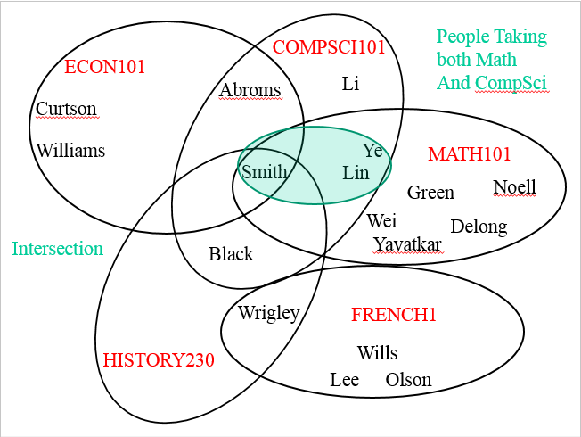
CompSci 101 Introduction to Computer Science
Oct. 27, 2016
Prof. Rodger

Slide 2
Announcements
Next Reading and RQ due Nov 1
Assignment 5 due today
Next Assignment out next week
APT 6 due Tues
Today:
Review nested loops, tuple generators
Focus on problem solving with sets

Slide 3
Review from last time: generator im.getdata(), accessing pixels
Returns something like a list
Use: for pix in im.getdata():
Generates pixels on-the-fly, can't slice or index unless you use list(im.getdata())
Structure is called a Python generator!
Saves on storing all pixels in memory if only accessed one-at-a-time
Notes:
Did this example (see next slide) last time console with x = [2*n for n in range(10000)] and y = (2*n for n in range(10000))
Print them, do sum, do len on x and y and loop over them
Maybe a bitly form on this topic?

Slide 4
Review from last time Making Tuples and Generators
Overuse and abuse of parentheses
To create a tuple, use parentheses
To create a generator use parentheses as though creating a list comprehension!
See this in PyDev console
for pix in im.getdata():
(r,g,b) = pix
npx = (255-r,255-g,255-b)
[2*n for n in range(10000)]
(2*n for n in range(10000))
Notes:
Show tuples and generators in pydev console, using len(x) for each and seeing it fail on generator, and using loopover each and see that succeed. See file on examples

Slide 5





Set Operations from pictures bit.ly/101f16-1027-1
Question: Which operation does the red represent?
A)
D)
C)
B)
E)
Notes:
Answers below
http://en.wikipedia.org/wiki/File:Venn0111.svg
Symmetric Difference B) intersection C) everything not in either set D) Union e) Difference

Slide 6
Problems – snarf setExample.py
Given a list of strings that have the name of a course (one word), followed by last names (one word each) of people in the course:
Find total number of people taking any course
Find number of people taking just one course
["econ101 Abroms Curtson Williams Smith”,
"history230 Black Wrigley Smith”, … ]
Process data – create lists of strings of names for each course
Notes:
Do we need the course names to answer these questions? No. We need to keep the students in a course together to represent a course, but we don’t need the names of the courses to answer these questions.

Slide 7
Data for example
[“compsci101 Smith Ye Li Lin Abroms Black“,
“math101 Green Wei Lin Williams DeLong Noell Ye Smith”,
“econ101 Abroms Curtson Williams Smith”,
“french1 Wills Wrigley Olson Lee”,
"history230 Black Wrigley Smith” ]
TO easier format to work with:
[ [ ‘Smith’, ‘Ye’, ‘Li’, ‘Lin’, ‘Abroms’, ‘Black’],
[‘Green’, ‘Wei’, ‘Lin’, ‘Williams’, ‘DeLong’, ‘Noell’, ‘Ye’, ‘Smith’], [‘Abroms’, ‘Curtson’, ‘Williams’, ‘Smith’], …. ]

Slide 8
COMPSCI101
Set Picture of
Data
ECON101
Abroms
Li
Curtson
Williams
Ye
MATH101
Smith
Lin
Green
Noell
Wei
Delong
Yavatkar
Black
Wrigley
FRENCH1
HISTORY230
Wills
Lee
Olson
Notes:
Visual way to look at this example. Look at Smith – in four courses.
Wrigley in two courses

Slide 9
COMPSCI101
People in
CompSci 101
ECON101
Abroms
Li
Curtson
Williams
Ye
MATH101
Smith
Lin
Green
Noell
Wei
Delong
Yavatkar
Black
Wrigley
FRENCH1
HISTORY230
Wills
Lee
Olson

Slide 10
People Taking
both Math
And CompSci
COMPSCI101
ECON101
Abroms
Li
Curtson
Williams
Ye
MATH101
Smith
Lin
Green
Noell
Wei
Delong
Intersection
Yavatkar
Black
Wrigley
FRENCH1
HISTORY230
Wills
Lee
Olson
Notes:
Intersection is the green

Slide 11
Part 1 – processList bit.ly/101f16-1027-2
Given a list of strings that have the name of a course (one word), followed by last names of people in the course:
Convert list into lists of strings of names for each course
["econ101 Abroms Curtson Williams Smith",
"history230 Black Wrigley Smith", … ]
[ [‘Abroms’, ‘Curtson’, ‘Williams’, ‘Smith’], [‘Black’, ‘Wrigley’, ‘Smith’, …] ]

Slide 12
Part 2 – peopleTakingCourses bit.ly/101f16-1027-3
Given a list of lists of names, each list represents the people in one course:
Find total number of people taking any course
peopleTakingCourses should return unique list of names
Small Example
[[‘Abroms’, ‘Curtson’, ‘Williams’, ‘Smith’], [‘Black’, ‘Wrigley’, ‘Smith’]]
Answer is 6 unique names

Slide 13
COMPSCI101
People taking
Courses - Union
ECON101
Abroms
Li
Curtson
Williams
Ye
MATH101
Smith
Lin
Green
Noell
Wei
Delong
Yavatkar
Black
Total
Number
Is
17
unique names
Wrigley
FRENCH1
HISTORY230
Wills
Lee
Olson

Slide 14
Next, find the number of people taking just one course

Slide 15
COMPSCI101
Union all sets
But French1
ECON101
Abroms
Li
Curtson
Williams
Ye
MATH101
Smith
Lin
Green
Noell
Wei
Delong
Yavatkar
Black
Wrigley
FRENCH1
HISTORY230
Wills
Lee
Olson
Notes:
Discuss, wouldn’t it help if you had the union of all sets but the one

Slide 16
To solve this problem
First let’s write a helper function

Slide 17
Part 3 – unionAllSetsButMe bit.ly/101f16-1027-4
Given example, a list of sets of strings, and the index of one of the sets, return the union of all the sets but that one
example = [set(["a", "b", "c"]), set(["b", "c", "d", "g"]), set(["e", "d", "a"])]
unionAllSetsButMe(example,1) is
set(["a", "b", "c", "e", "d" ])

Slide 18
Part 4 – peopleTakingOnlyOneCourse bit.ly/101f16-1027-5
Given a list of lists of strings of names representing people from courses
Find number of people taking just one course
[[‘Abroms’, ‘Curtson’, ‘Williams’, ‘Smith’], [‘Black’, ‘Wrigley’, ‘Smith’, ‘Abroms’]]
4
Notes:
If this was just our data, we have 4 people taking just one course – either econ101 or history230

Slide 19
COMPSCI101
People taking
Only one course
ECON101
Abroms
Li
Curtson
Williams
Ye
MATH101
Smith
Lin
Green
Noell
Wei
Delong
Yavatkar
Black
Wrigley
FRENCH1
HISTORY230
Wills
Lee
Olson

Slide 20
APT - UniqueZoo
How do you solve this problem?
How is it similar to the problem we just solved

Slide 21
Example Data for UniqueZoo
["zebra bear fox elephant","bear crocodile fox",
"rhino elephant crocodile kangaroo", "elephant bear"]
zebra
fox
bear
crocodile
elephant
rhino
kangaroo

Slide 22
UniqueZoo – two zoos have unique animals
zebra
fox
bear
crocodile
elephant
rhino
kangaroo

