Slide 1
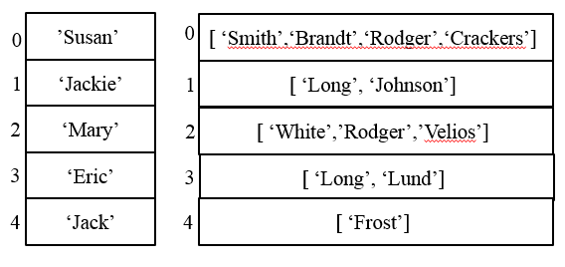
CompSci 101 Introduction to Computer Science
Nov 1, 2016
Prof. Rodger

Slide 2
Announcements
Reading and RQ due next time
APT 6 due today, APT 7 out
Do more APTs to catch up….
APT QUIZ 2 – Nov. 6-8
Next Assignment out Thursday
Lab this week!
Today:
Processing data – how to organize it?
enumerate

Slide 3
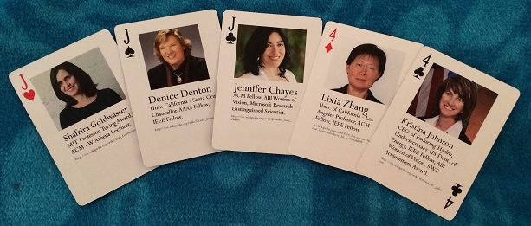
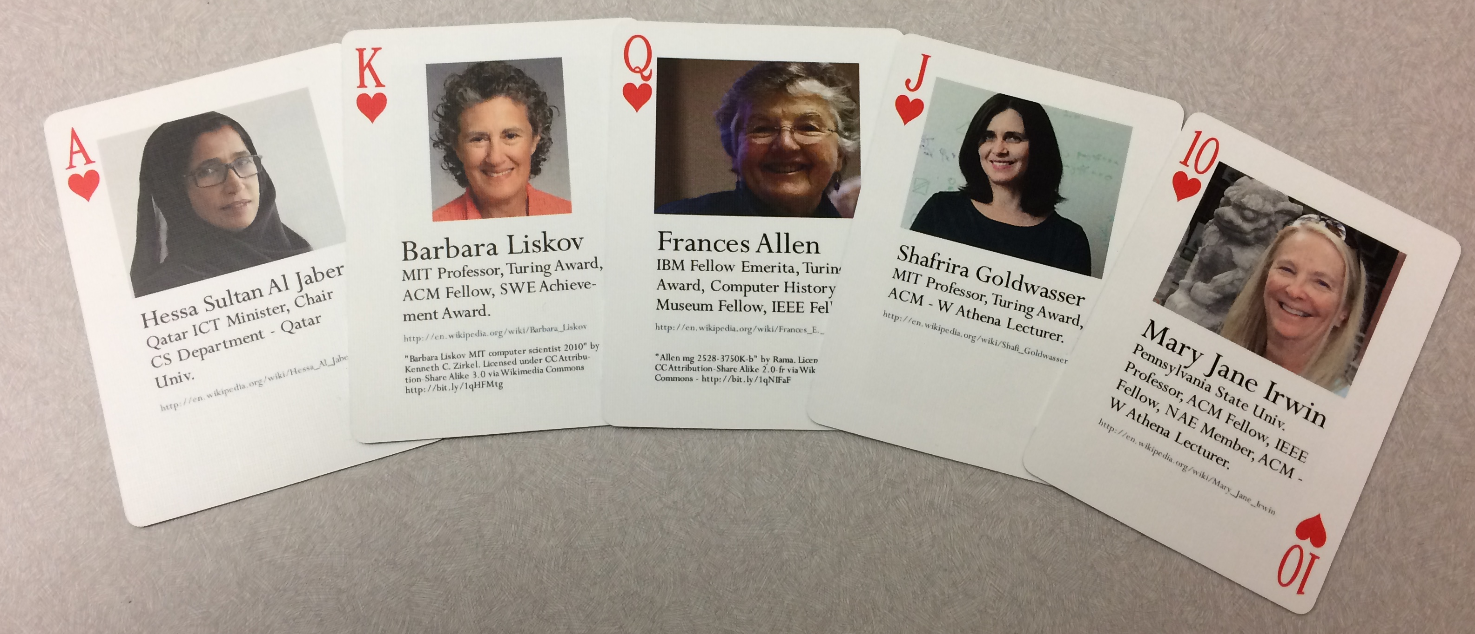
Lab this week! - Odds with poker!
Notes:
Deck of playing cards I made of 54 notable women in computing!
Full House – three jacks and 2 fours – what are the odds?
Flush

Slide 4
ACM Programming Contest
Need volunteers to help on Saturday Nov 5 from 11:20am to 6pm. (includes food)
Contest
Team of three, one computer, 6-8 problems, 5 hours
Problems “APT-like”
See Piazza post for how to sign up

Slide 5
Registration time…
What CS courses can you take next?
CompSci 201
CompSci 230
CompSci 230 is prereq for CompSci 330
CompSci 201 is prereq for many electives

Slide 6
When Halloween and Computer Science COLLIDE!

Slide 7
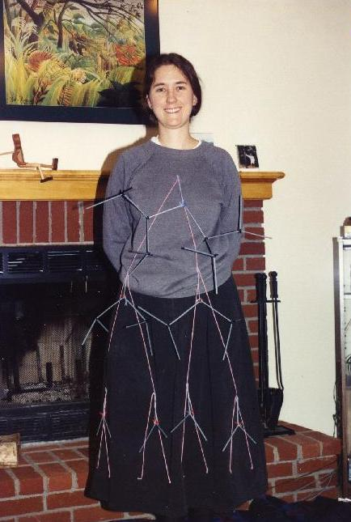
CS Concepts Coming Alive
What data structure is this?
Notes:
This is me in my Halloween costume back in 1989, teaching the algorithms course. Anyone know what I am?
I am a 2D-range tree data structure

Slide 8
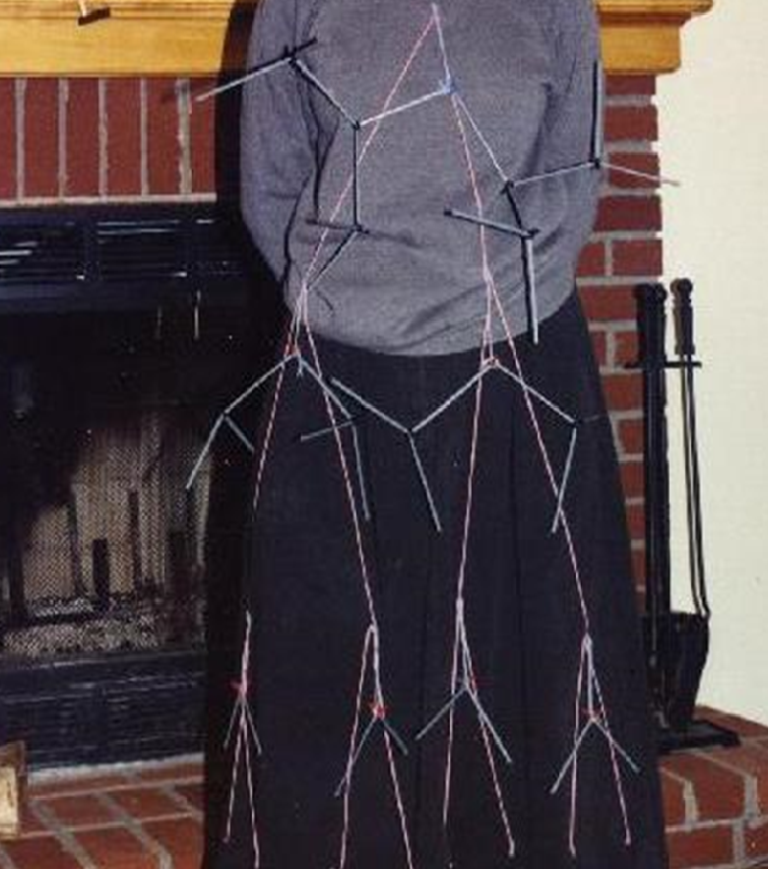
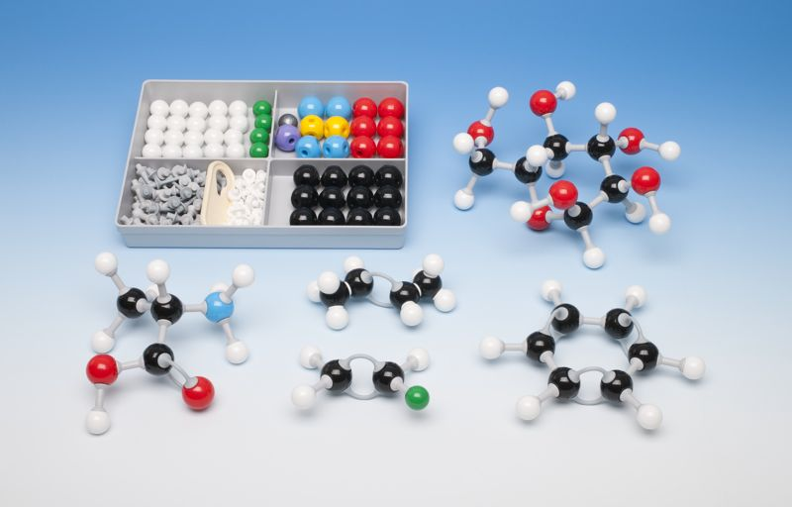
YARN, in the shape of a binary tree
Subtrees made with molecule kit
What is it?

Slide 9
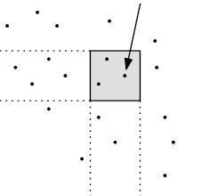
2D-range tree
Search in x-y plane
Main tree organized by x-values
Subtree organized by y values
y-range
x-range

Slide 10
Binary Search tree of points in the plane – sorted by X-value
Each subtree organized by y-value
Search each subtree by y-value
In the x-range

Slide 11
Problem: Longest Name
Given a list of names (one word only) and a letter (assume names start with capital letter, and letter is capital)
names = [‘Helen’, ‘Bob’, ‘Bart’, ‘Hugh’]
Find the longest name that starts with that letter
Notes:
Mention Examples

Slide 12
Code for longest name
def longestName(alist, letter):
longest = ''
for name in alist:
if letter == name[0] and
len(name) > len(longest):
longest = name
return longest
How do you modify to find the location (position) of the longest name?

Slide 13
Problem: Find the position of the longest name that starts with that letter bitly/101f16-1101-1
Notes:
Go over code solutions

Slide 14
Enumerate
An iterator, generates a sequence
Generates tuples of (index, item)
Used with for loop to get both index and item
for (index,item) in enumerate(somelist):
You get both at the same time!

Slide 15
Solve previous problem with enumerate

Slide 16
Problem: Popular Name
Given a list of names, determine the most popular first name and print that name with all of its last names.
Input: Names are always two words, names are in a file. If multiple names are on the same line they are separated by a “:”
Output: Most popular first name, followed by a “:”, followed by corresponding last names separated by a blank

Slide 17
Example Input File with 5 lines
Susan Smith:Jackie Long:Mary White
Susan Brandt
Jackie Johnson:Susan Rodger:Mary Rodger
Eric Long:Susan Crackers:Mary Velios
Jack Frost:Eric Lund
Corresponding Output
Susan: Smith Brandt Rodger Crackers

Slide 18
What do you need to solve this problem? bit.ly/101f16-1101-2

Slide 19
How might one organize the data to solve this problem?
How many different ways to solve this problem?

Slide 20
One way to solve
Create a list of unique first names
Create a list of lists of last names that are associated with each first name

Slide 21
Example – two lists
Unique
First names
Corresponding Last names
’Susan’’
0
[ ‘Smith’,‘Brandt’,‘Rodger’,‘Crackers’]’
0
1
‘Jackie’
1
[ ‘Long’, ‘Johnson’]’
2
‘Mary’
[ ‘White’,’Rodger’,’Velios’]’
2
3
‘Eric’
3
[ ‘Long’, ‘Lund’]’
4
‘Jack’
4
[ ‘Frost’]’

Slide 22
Example – two lists
Unique
First names
Corresponding Last names
’Susan’’
0
[ ‘Smith’,‘Brandt’,‘Rodger’,‘Crackers’]’
0
1
‘Jackie’
1
[ ‘Long’, ‘Johnson’]’
2
‘Mary’
[ ‘White’,’Rodger’,’Velios’]’
2
3
‘Eric’
3
[ ‘Long’, ‘Lund’]’
4
‘Jack’
4
[ ‘Frost’]’
Jackie in position 1
Jackie’s last names in position 1

Slide 23
Now can we solve the problem?
Compute those two lists that are associated with each other
List of unique first names
List of corresponding last names
Compute the max list of last names
Now easy to print the answer.
See popular.py

Slide 24
Look at the code for popular.py www.bit.ly/101f16-1101-3
Which datafile is read in?
What format is namelist in?
Write the code for uniqueFirstNames

Slide 25
Write the code: www.bit.ly/101f16-1101-4
allLastNames
correspondingLastNames
printFirstWithLasts

Slide 26
Finish
maxnum = max([len(item) for item in lastNames])
print maxnum
lastIndex = [index for (index, v) in enumerate(lastNames) if len(v) == maxnum]
print "first name with most last names is:"
Notes:
What is the last line of code?

Slide 27
Another way – list of lists
First word in each list is a first name
The rest are last names.
[ ‘Susan’, ‘Smith’,‘Brandt’,‘Rodger’,‘Crackers’]’
0
1
[‘Jackie’, ‘Long’, ‘Johnson’]’
2
[‘Mary’, ‘White’,’Rodger’,’Velios’]’
3
[ ‘Eric’, ‘Long’, ‘Lund’]’
4
[ ‘Jack’, ‘Frost’]’
Notes:
Another way to do it. What would change? How you process the data?
Can you find the max size list still? yes

Slide 28
Expanding the Problem
Suppose we want to read from multiple data files
names1.txt, names2.txt, names3.txt
See processFiles in popular.py

