Slide 1
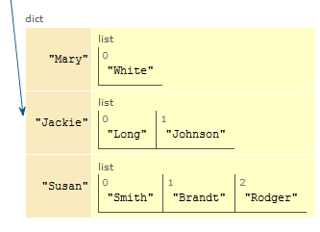
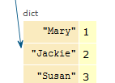
CompSci 101
Introduction to Computer Science
Nov. 3, 2016
Prof. Rodger

Slide 2
Announcements
No Reading or RQ until after exam
Assignment 6 out today
APT 7 due Tues
APT Quiz 2 – Sunday - Tuesday
  Pick 3 hours to take it
Today:
  Finish from last time
  Dictionaries – a way to organize data for fast lookup

Slide 3
LAST TIME:
Problem: Popular Name
Given a list of names, determine the most popular first name and print that name with all of its last names.
Input: Names are always two words, names are in a file. If multiple names are on the same line they are separated by a “:”
Output: Most popular first name, followed by a “:”, followed by corresponding last names separated by a blank

Slide 4
Example Input File with 5 lines
Susan Smith:Jackie Long:Mary White
Susan Brandt
Jackie Johnson:Susan Rodger:Mary Rodger
Eric Long:Susan Crackers:Mary Velios
Jack Frost:Eric Lund
Corresponding Output
Susan: Smith Brandt Rodger Crackers

Slide 5
Example – two lists
firstNames
lastNames
’Susan’’
0
[ ‘Smith’,‘Brandt’,‘Rodger’,‘Crackers’]’
0
1
‘Jackie’
1
[ ‘Long’, ‘Johnson’]’
2
‘Mary’
[ ‘White’,’Rodger’,’Velios’]’
2
3
‘Eric’
3
[ ‘Long’, ‘Lund’]’
4
‘Jack’
4
[ ‘Frost’]’

Slide 6
Now can we solve the problem?
Compute those two lists that are associated with each other
  List of unique first names
  List of corresponding last names
Compute the max list of last names
Now easy to print the answer.
See popular.py

Slide 7
This function generates the list of lists
of corresponding last names
def correspondingLastNames(data, firstNames):
lastNames = [ ]
for name in firstNames: lastNames.append(allLastNames(data,name))
return lastNames

Slide 8
Answer questions about bit.ly/101f16-1103-1
Printing first names with corresponding last names
Reading data from files

Slide 9
Finish
maxnum = max([len(item) for item in lastNames])
print maxnum
lastIndex = [index for (index, v) in enumerate(lastNames) if len(v) == maxnum]
print "first name with most last names is:"
Notes:
What is the last line of code?

Slide 10
Expanding the Problem
Suppose we want to read from multiple data files
names1.txt, names2.txt, names3.txt
See processFiles in popular.py

Slide 11
Another way – list of lists
First word in each list is a first name
The rest are last names.
[ ‘Susan’, ‘Smith’,‘Brandt’,‘Rodger’,‘Crackers’]’
0
1
[‘Jackie’, ‘Long’, ‘Johnson’]’
2
[‘Mary’, ‘White’,’Rodger’,’Velios’]’
3
[ ‘Eric’, ‘Long’, ‘Lund’]’
4
[ ‘Jack’, ‘Frost’]’
Notes:
Another way to do it. What would change? How you process the data?
Can you find the max size list still? yes

Slide 12

ACM Turing Award Winners 2015
Notes:
The ability for two parties to communicate privately over a secure channel is fundamental for billions of people around the world. On a daily basis, individuals establish secure online connections with banks, e-commerce sites, email servers and the cloud. Diffie and Hellman’s groundbreaking 1976 paper, “New Directions in Cryptography,” introduced the ideas of public-key cryptography and digital signatures, which are the foundation for most regularly-used security protocols on the Internet today. The Diffie-Hellman Protocol protects daily Internet communications and trillions of dollars in financial transactions.
We have studied cryptography at a simpler level, with Caesar Cipher and saw that it is breakable easily with a computer, they have worked on more sophisticated algorithms to make secure techniques that are much more difficult to break. We don’t want people breaking into our bank accounts.

Slide 13
Dictionaries/Maps
Dictionaries/maps are another way of organizing data
Keys and Values
  Each key maps to a value
  Some keys can map to the same value
  Can change the value a key maps to

Slide 14
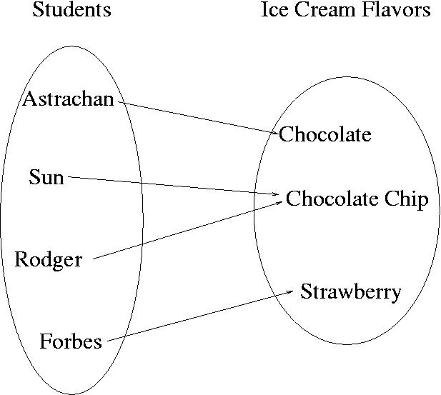
Example
Each student could be mapped to their favorite ice cream flavor
Notes:
How is this different then

Slide 15
How is dictionary different than a list?
List – have to search for name first
Dictionary – each key maps to a value
getting name (or key) is automatic! Fast!
Keys
Values
Notes:
In a list if we wanted to know the ice cream flavor for Rodger, we would have to search for Rodger and then could get it. If we use a dictionary, we don’t have to search for Rodger, the dictionary knows where the name is and thus can return what it is matched to quickly.
In 101 we are just focused on using a dictionary. In 201, you learn how dictionaries are implemented.

Slide 16
Implementing a Dictionary/Map
Keys map to values
Create Empty dictionary
  somemap = {}
Put in a key and its value
  somemap[“Forbes”] = “Strawberry”
Get a value for a dictionary
  value = somemap[“Forbes”]
  OR value = somemap.get(“Forbes”, “default”)
Change a value for a dictionary
  somemap[“Forbes’] = “Chocolate”
Notes:
Default – returns default value if there is no value

Slide 17
More on using a Dictionary/Map
Get all the keys (as a list)
  listKeys = somemap.keys()
Get all the values (as a list)
  listValues = somemap.values()
Other methods
  clear – empty dictionary
  items – return (key,value) pairs
  iteritems – return (key,value) pairs more efficiently, iterator – must use with for
  update – update with another dictionary

Slide 18
Change Astrachan’s value somemap[“Astrachan”] = Coffee Mocha

Slide 19
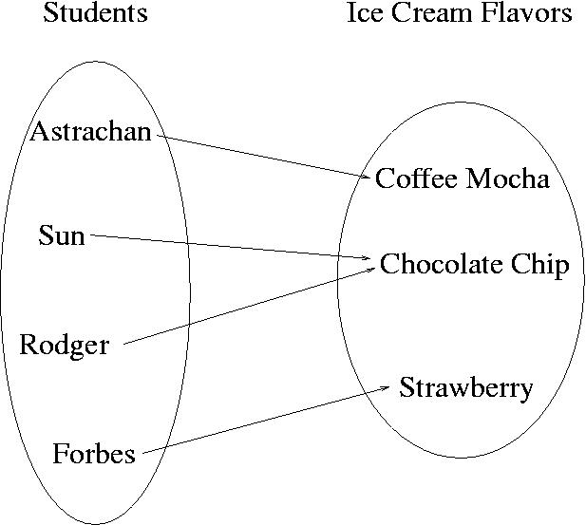
Change Astrachan’s value somemap[“Astrachan”] = Coffee Mocha

Slide 20
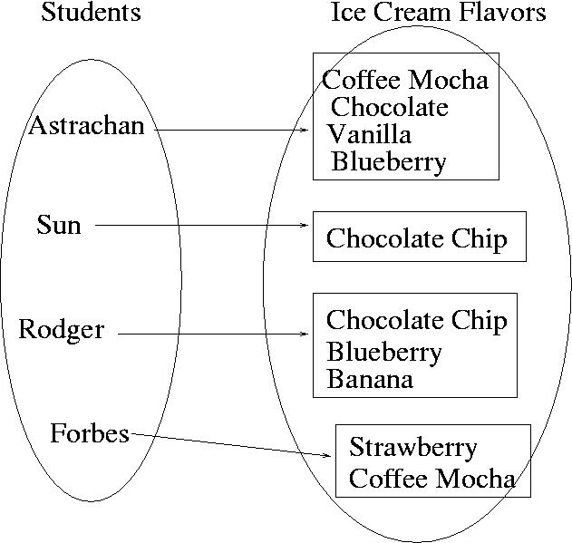
Value could be a set or list

Slide 21
Back to Popular Name Problem:
Given a list of names, determine the most popular first name and print that name with all of its last names.
Input: Names are always two words, names are in a file. If multiple names are on the same line they are separated by a “:”
Output: Most popular first name, followed by a “:”, followed by corresponding last names separated by a blank

Slide 22
Example Input File with 5 lines
Susan Smith:Jackie Long:Mary White
Susan Brandt
Jackie Johnson:Susan Rodger:Mary Rodger
Eric Long:Susan Crackers:Mary Velios
Jack Frost:Eric Lund
Corresponding Output
Susan: Smith Brandt Rodger Crackers

Slide 23
Use a dictionary/map www.bit.ly/101f16-1103-2
Map first names to count of corresponding last names
def mapNameToNumberLastNames(data):
Use a dictionary/map
popularMap.py

Slide 24
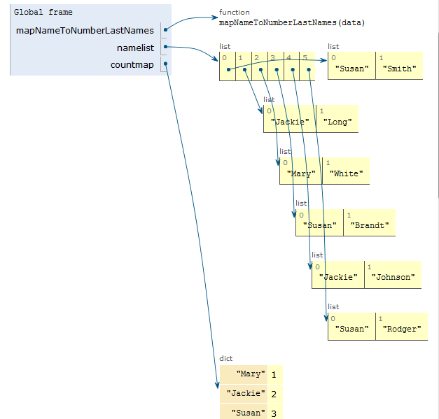
Trace example with Python Tutor see popularMapSolnSmall.py

Slide 25
Use a dictionary/map www.bit.ly/101f16-1103-3
Map first name to list of corresponding last names
def mapNameToLastNames(data):

Slide 26
Trace through example with Python Tutor
See the small example popularMapSolnSmall.py

Slide 27
Use a dictionary/map www.bit.ly/101f16-1103-4
Map first name to set of corresponding last names
def mapNameToSetLastNames(data):

Slide 28
Compare
Using two parallel lists?
Using one dictionary/map
Which dictionary is most useful to solve the most popular name problem?

